Slide 1
II STRUCTURE THEORY
II.5 (Wed Feb 08) Initial Sets and Performances, Performance Cells and Hierarchies

Slide 2
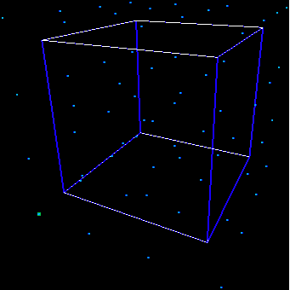
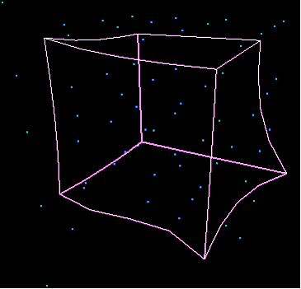
Performance fields for onset time, pitch, and loudness
℘_{EH L}
H
?
h
(E,H,L)
(e,h,l) = ℘_{EH L}(E,H,L)
L
l
E
e
performance field
diagonal field

Slide 3
Reconsider the one-dimensional case, Tempo
[sec.]
E₁-E₀ = T(E). (e₁- e₀)
e₁
T(E) = 1/slope
e₁- e₀
1
e₀ = e(E₀)
linear approximation around E₀
[♩]
E₀
E₁

Slide 4
X
℘
x =℘(x)
X₀
F
x₀
performance field Z, value at X = Z(X)
X₀ ∈ I = initial set
curve ∫_{X0}Z of flow through X₀
∫_{X0}Z hits X at „time“ t:
X = ∫_{X0}Z(t)
Δ = (1,1,…,1)
= Const.
x₀ = ℘_{I}(X₀)
initial performance
x = ℘(X) = x₀ + t.Δ

Slide 5
A performance cell C is a 5-tuple as follows:
frame F = cube ⊆ Parameterspace P_{EHL...,} for set of symbolic parameters E, H, L,...
a performance field Z, defined on F
an initial set I in frame F
a finite set of score events K ⊆ F, le symbolic kernel, such that each flow curve ∫_{X}Z through X ∈ K meets I
an initial performance ℘_{I}:I → P_{ehl...,} of corresponding physical parameters
℘_{I}
F
K
I
Z

Slide 6
Performance as a shifter sign (like I, here, now).
It is important to understand the deep meaning of initial performance. We have known performance as a transitional process from mental to physical reality. This is a transition from the score to the acoustical realization, to be archived on sound media such as a CD. Following the valid doctrine—as preconized by Paul Valéry and Theodor W. Adorno—the performance is an integral part of the work of art, and this means that, in the sense of communication theory of art as described by Jean Molino, performance is part of the semiosis of the work, its meaning is not complete except when it is performed.

Slide 7
Performance as a shifter sign (like I, here, now).
Put it the other way round: The mental score conveys a part but not the whole content, and only via performance can we complete the work’s semiosis. Performance englobes a kind of usage of the mental score sign by a performer. More specifically, those signs whose content are not only instantiated but substantially depend on the user are the well-known shifters. Performance of a mental score is such a shift from lexicality to full-fledged meaning, since the pure score is essentially less than the work of art. In other words, performance is a shifter characteristic of the score semantics.
Production of full-fledged meaning is only possible by means of performance, and this adds a semantic aspect to the sign which is a non-trivial function of the performer(s).

Slide 8
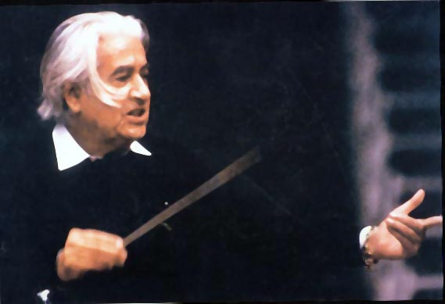
Sergiu Celibidache

Slide 9
To model piano performance, one works with
the basis parameters E, H, L,
and corresponding fields T(E), S(H), I(L)
duration parameter D (pianola)
The cellular piano hierarchy is the following diagram, where arrows mean that the target cell is independent of the other parameters in the start cell, like EH → E for tempo, etc.
∂T × S
∂T×I×S
∂T
source
∂T × I
T × S
T
T × I × S
T × I
S
I × S
I
fundament
Notes:
Here is a classical example of the piano performance hierarchy

Slide 10
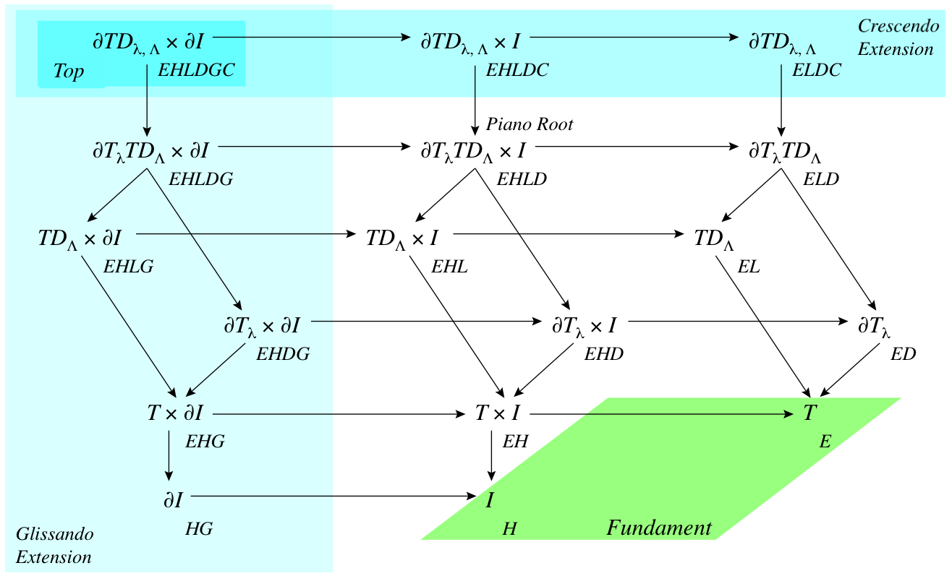
To model violin performance, one works with
the basis parameters E, H,
and corresponding fields T(E), S(H) (= I(H) here!!)
duration parameter D,
glissando parameter G,
crescendo parameter C
Cellular violin hierarchy:
Notes:
Here is a classical example of the piano performance hierarchy

