Slide 1
III EXPRESSIVE THEORY
III.2 (Mo Feb 13) Emotional Expression II

Slide 2
Emotional Expression:
Manfred Clynes
Jörg Langner-Reinhard Kopiez
Anders Friberg
Alf Gabrielsson

Slide 3
Susan Langer (referred to by Alf Gabrieslsson):
Langer (1942): - Music represents the dynamic form of emotional life, not specific emotions.
- Music is a tonal analogue to emotive life, music is (...) formulation and representation of emotions, moods, mental tensions and resolutions. (Reference to a similar statement by Richard Wagner)
- Because the forms of human feeling are much more congruent with musical forms than with the forms of language, music can reveal the nature of feelings with a detail and truth that language cannot approach.
- forms of growth and attenuation, flowing and stowing, conflict and resolution, speed, arrest, terrific excitement, calm, or subtle activation and dreamy lapses, patterns of motion and rest, or tension and release, of agreement and disagreement, preparation, fulfillment, excitation, sudden change, etc.

Slide 4
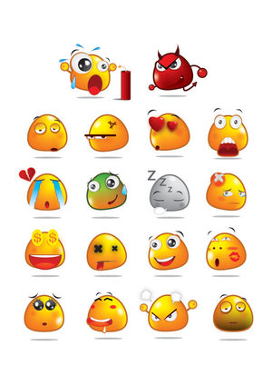
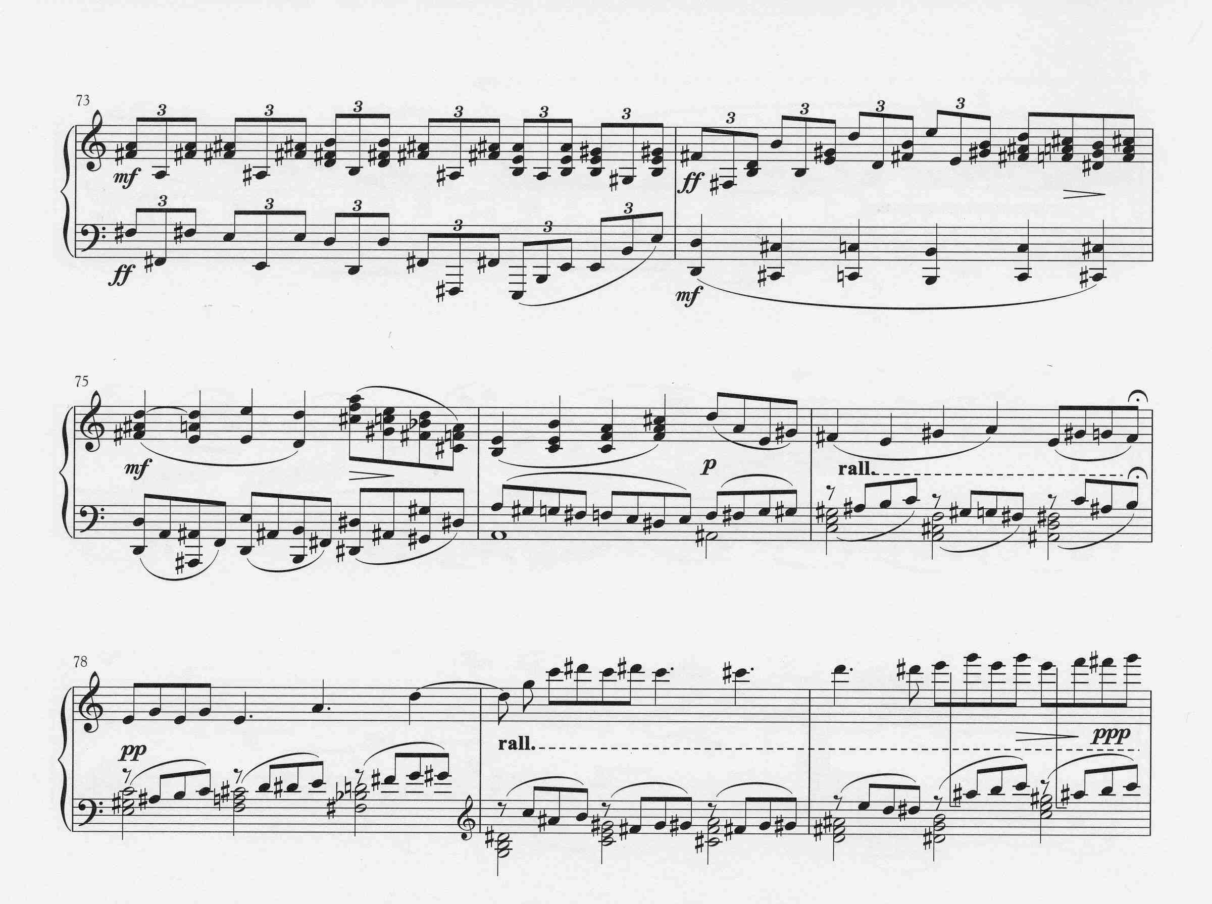
Alf Gabrielsson:
Gabrielsson (1995):
- There is an isomorphism between the structure of music and the structure of feelings.
- We may also generally notice the fact that we bahave/move differently in different moods, as reflected in expressions like „to jump for joy“, „sink in despair“, „tremble for fear“, etc.
- In summary, we may consider emotion, motion, and music as being isomorphic.

Slide 5
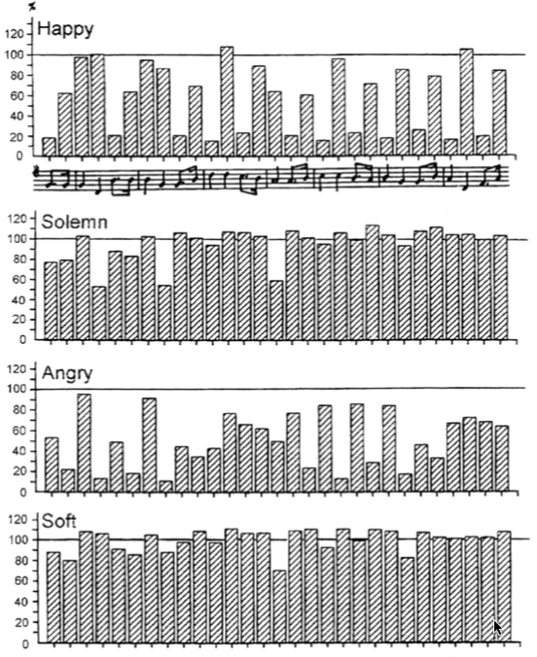
„Oh, my darling Clementine“
Articulation
(>100 = legato, <100 = staccato)
(A. Gabrielsson 1995)
Serious and solemn music is slow, low pitched, and avoids irregular rhythms and dissonant harmonies.
Sad music is likewise slow and low pitched and further apt to be in minor mode and to contain dissonance.
Calm music is slow and soft and apt to contain little dissonance.
Happy music is fast, high pitched and in major mode and contains little dissonance.
Exciting music is fast and loud and apt to contain dissonance.

Slide 6
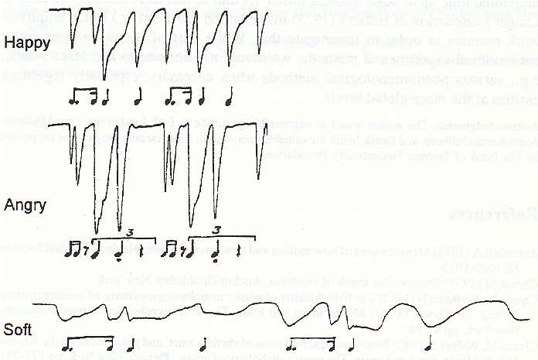
„Oh, my darling Clementine“ (A. Gabrielsson 1995)
Pressure patterns of a sentograph preformance
Happy
Angry
Soft

Slide 7
13 tones
72 tones
1 592 645 620 686 ~ 1.59 ×10¹²
number stars in galaxy = 100 000 000 000 ~ 1.00 ×10¹¹
2 230 741 522 540 743 033 415 296 821 609 381 912 ~ 2.23 ×10³⁶

Slide 8
x^144 + x^143 + 5x^142 + 26x^141 + 216x^140 + 2 024x^139 + 27 806x^138 + 417 209x^137 +6 345 735x^136 + 90 590 713x^135 +
1 190 322 956x^134 + 14 303 835 837x^133 +157 430 569 051x^132 + 1 592 645 620 686x^131 + 14 873 235 105 552x^130 +
128 762 751 824 308x^129 + 1 037 532 923 086 353x^128 + 7 809 413 514 931 644x^127 +55 089 365 597 956 206x^126 +
365 290 003 947 963 446x^125 +2 282 919 558 918 081 919x^124 + 13 479 601 808 118798 229x^123 +75 361 590 622 423 713 249x^122 +
399 738 890 367 674230 448x^121 +2 015 334 387 723 540 077 262x^120 + 9 673 558 570 858 327 142 094x^119 +
44 275 002 111 552 677 715 575x^118 + 193 497 799 414 541 699 555 587x^117 +808 543 433 959 017 353 438 195x^116 +
3 234 171 338 137 153 259 094292x^115 +12 397 650 890 304 440 505 241198x^114 + 45 591 347 244 850 943 472027 532x^113 +
160 994 412 344 908 368 725 437 163x^112 + 546 405 205 018 625 434 948486 100x^111 +1 783 852 127 215 514 388 216 575 524x^110 +
5 606 392 061 138 587 678 507 139 578x^109 +16 974 908 597 922 176 404 758662 419x^108 +49 548 380 452 249 950 392 015617 673x^107 +
139 517 805 378 058 810 895 892 716 876x^106 +379 202 235 047 824 659 955 968 634 895x^105 +995 405 857 334 028 240 446 249 995 969x^104 +
2 524 931 913 311 378 421 460 541 875 013x^103 +6 192 094 899 403 308 142 319 324 646 830x^102 +
14 688 225 057 065 816 000 841247 153 422x^101 +33 716 152 882 551 682 431 054950 635 828x^100 +
74 924 784 036 765 597 482 162224 697 378x^99 +161 251 165 409 134 463 248 992 354 275 261x^98 +
336 225 833 888 858 733 322 982 932 904 265x^97 +679 456 372 086 288 422 448 712 466 252 503x^96 +
1 331 179 830 182 151 403 666 404 596 530 852x^95 +2 529 241 676 111 626 447 928 668 220 456 264x^94 +
4 661 739 558 127 027 290 220 867 616 981 880x^93 +8 337 341 899 567 786 249 391 103 289 453 916x^92 +
14 472 367 067 576 451 752 984797 361 008 304x^91 +24 388 618 572 337 747 341 932969 998 362 288x^90 +
39 908 648 567 034 355 259 311114 115 744 392x^89 +63 426 245 036 529 210 051 949169 850 308 102x^88 +
97 921 220 397 909 924 969 018620 386 852 352x^87 +146 881 830 585 458 073 270 850 321 720 445 928x^86 +
214 098 939 483 879 341 610 433 150 629 060 274x^85 +303 306 830 919 747 863 651 620 555 026 700 930x^84 +
417 668 422 888 061 171 460 770 548 484 103 836x^83 +559 136 759 653 084 522 330 064 385 877 590 780x^82 +
727 765 306 194 069 123 565 702 210 626 823 392x^81 +921 077 965 629 957 077 012 552 741 715 036 692x^80 +
1 133 634 419 214 796 834 928 853 170 296 724314x^79 +1 356 926 047 220 511 677 349 073 201 120 481570x^78 +
1 579 704 950 475 555 411 914 967 237 903 930342x^77 +1 788 783 546 844 376 088 722 000 995 922 467990x^76 +
1 970 254 341 437 213 013 502 048 964 983 877090x^75 +2 110 986 794 386 177 596 749 436 553 816 924660x^74 +
2 200 183 419 494 435 885 449 671 402 432 366956x^73 +2 230 741 522 540 743 033 415 296 821 609 381912x^72 +
….
…
...+ 2024.x⁵ + 216.x⁴ + 26.x³ + 5.x² + x + 1 = cycle index polynomial
2 230 741 522 540 743 033 415 296 821 609 381 912 ~ 2.23 × 10³⁶

Slide 9
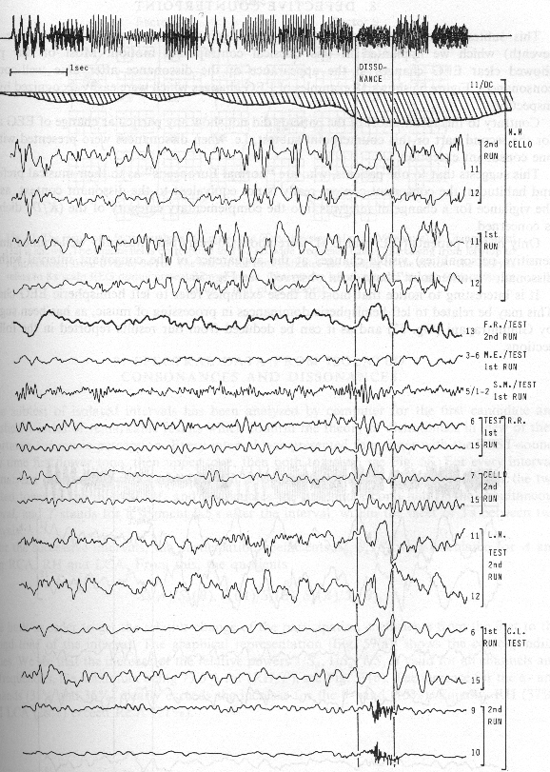
Disso nance

Slide 10
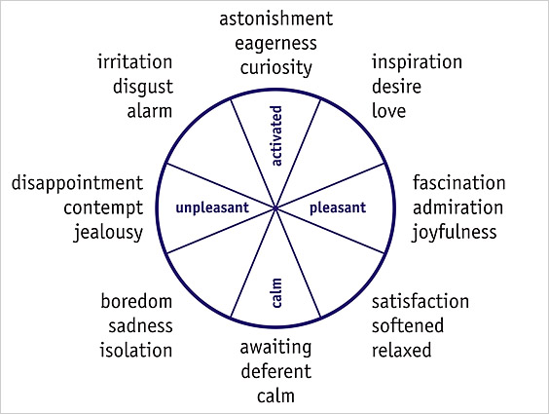
event
power
δ
θ
α
β
frequency
50 Hz
4
8
14
40
β
circumplex model
V(event) = (S/S_{θ}, S/S_{α}, S/S_{β})
= vigilance vector
V(event)
θ
α

Slide 11
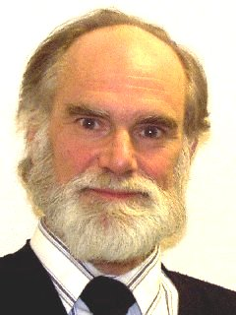
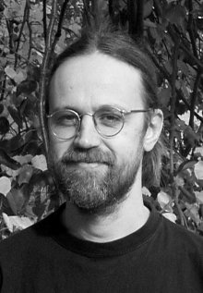
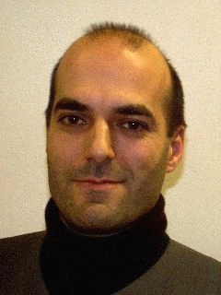
Emotional Expression:
Manfred Clynes
Jörg Langner-Reinhard Kopiez
Anders Friberg
Alf Gabrielsson
Johan Sundberg
Roberto Bresin

Slide 12
Facts on expressed emotions (not induced emotions):
Emotional expression can be reliably communicated from performer to listener
Up to 80-90% of the listeners‘ answers can be predicted using models based on musical features
Despite different semantic sets, the four emotions sadness, happiness, anger, and love/tenderness (including synonyms) seem to be the ones that are especially easy to differentiate, describe and model

Slide 13
Performance features:
Timing - Tempo, tempo variation, duration contrast
Dynamics: overall level, crescendo/decrescendo, accents
Articulation: overall (staccato/legato), variability
Timbre: Spectral richness, onset velocity
Score features:
Melody: range (small/large), direction (up/down)
Harmony (consonant/complex-dissonant)
Tonality (chromatic-atonal/key-oriented)
Rhythm (regular-smooth/firm/flowing-fluent/irregular-rough)
Timbre (harmonic richness)

Slide 14
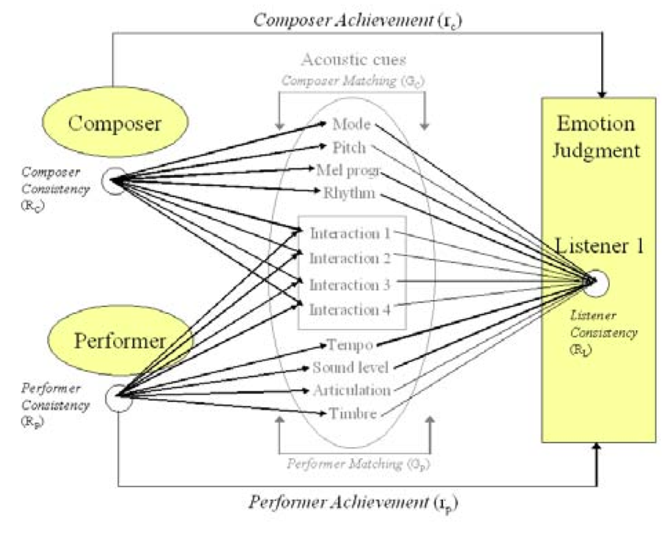
Analysis: Juslin‘s lense model: multiple regression analysis (MRA) for statistical analysis of matching of features

Slide 15
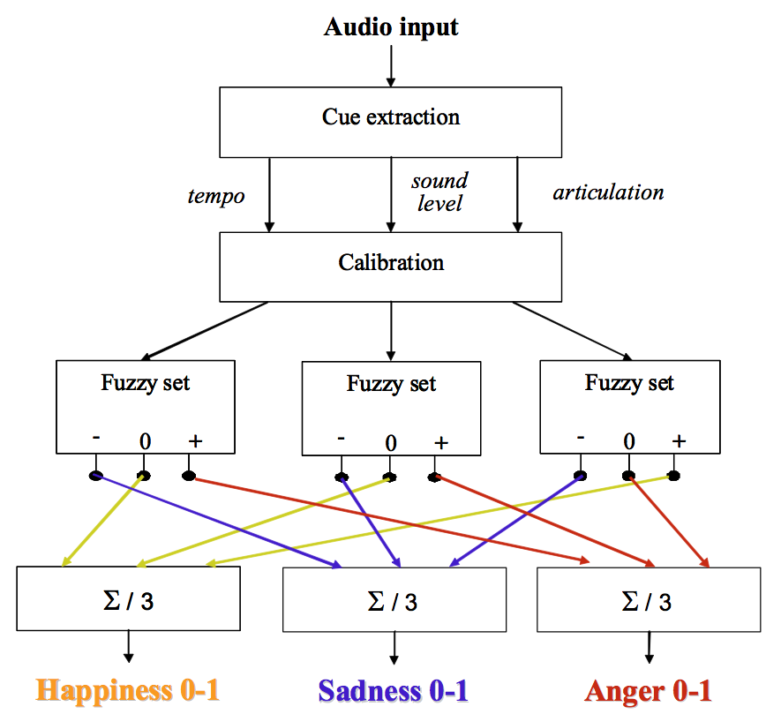
Analysis: Friberg‘s fuzzy mapper of emotional expression in music

Slide 16
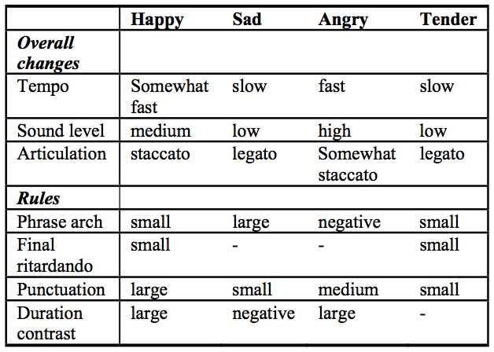
Synthesis: Friberg‘s, Bresin‘s and Sundberg‘s qualitative value model for emotional expression in synthesizing musical performance

