Slide 1
III EXPRESSIVE THEORY
III.1 (Fr Feb 10) Emotional Expression I

Slide 2
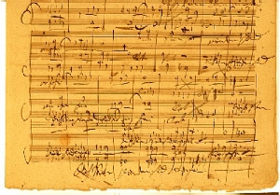
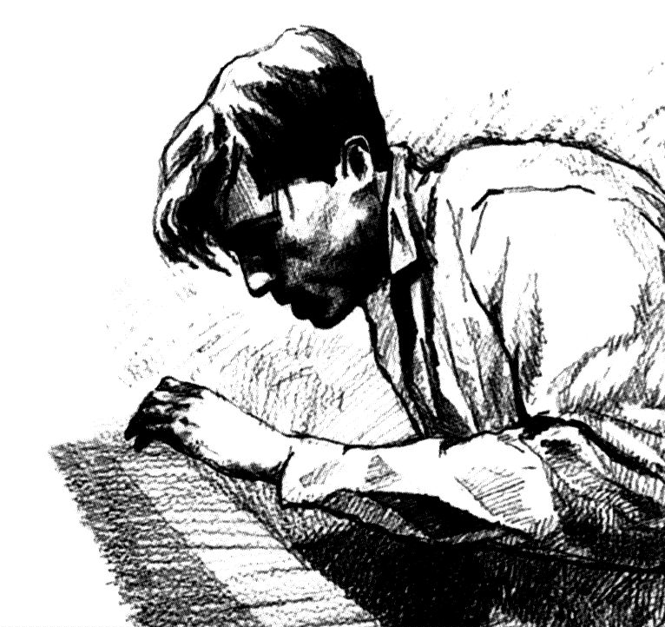
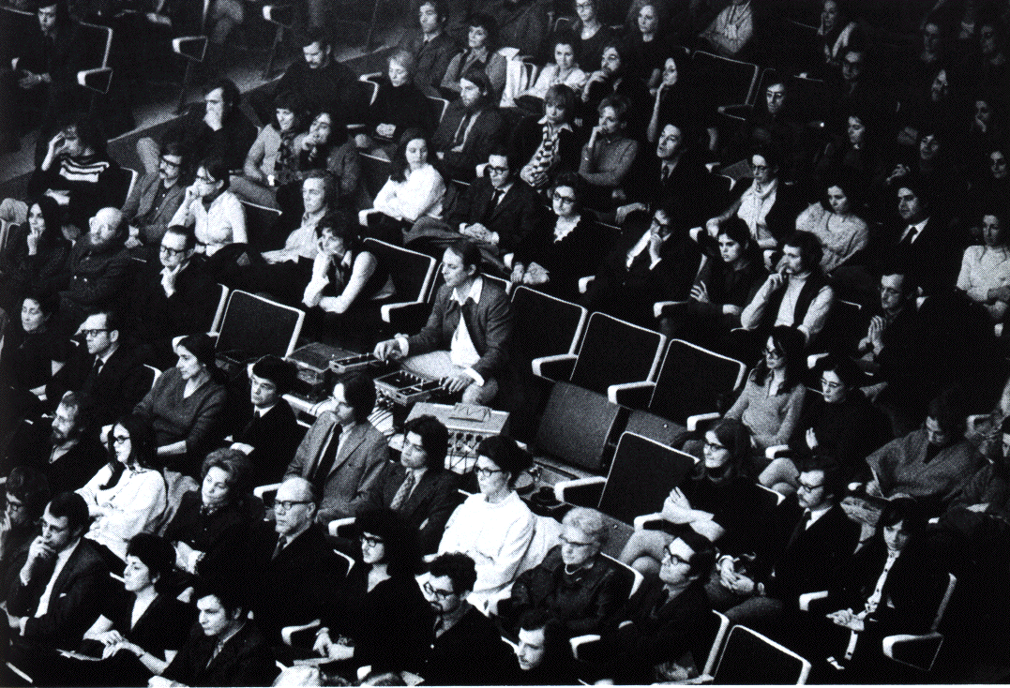
Rhetoric Expressivity „HOW?“
Poiesis
Neutral Niveau
Aesthesis
CSI
℘
Expression
physical
psychological
symbolic
HOW?
Signification
tions, feelings,
of musical
entity and/or
drama
e-motions as dynamic entities,
not results
sssnd
ertwd generators
werwer gestures
sdfasdf
asdfasdf
fafafaf
sound
sound generators
body movement, Fourier gestures
tions, feelings,
wewewe/or
xxx
wert
tions, feelings,
of musical
entity and/or
afafaf
asdadsfadsf
adsf
ad
Content
Realities
Realities
Realities
harmonic values
motivic work
gestures of
modulation
wewewewe
wewewewewe
wretwret
??????
!!!!
afafafaf
Embodiment
Embodiment
Embodiment

Slide 3
Examples of CSI-defined contents in realities/embodiment:
CSI
emotional
emotions, feelings,
soul state of musical
entity and/or the audience
drama
e-motions as dynamic entities,
not results
psychological
gestural
sound
sound generators
body movement, Fourier gestures
physical
analytical
harmonic values
motivic work
gestures of
harmonic modulation
symbolic/mental
facts
processes
gestures

Slide 4
There are several approaches to the total spectrum of rationales:
Neil McAgnus Todd generic performance procedure vs. listening procedure.
The GERM model by Friberg, Bresin, and Juslin It means Generative rules ~ analytical Emotional expression ~ emotional Random variables ~ gestural (motor imprecision) Motion principles ~ gestural The system is to be implemented in Friberg's Director Musices software.

Slide 5
Emotional Expression:
Manfred Clynes
Jörg Langner-Reinhard Kopiez
Anders Friberg
Alf Gabrielsson

Slide 6
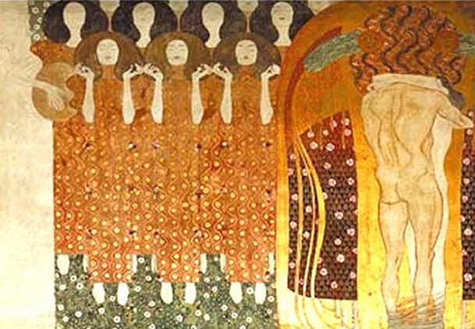
John A. Sloboda & Patrik N. Juslin
(Music and Emotion, Oxford U P 2001, p.71) Psychology is concerned with the explanation of human behaviour. Behaviour includes overt action as well as ‚inner‘ behaviour, such as thought, emotion, and other reportable mental states. It can include behaviour of which the agent is not fully or even partly aware, such as the dilation of the pubils of the eye.
A psychological approach to music and emotion therefore seeks an explanation of how and why we experience emotional reactions to music, and how and why we experience music as expressive of emotion.
Gustav Klimt: Beethoven fries

Slide 7
Definition of Emotion
characteristics | examples
self-report | feelings, verbal descriptions, checklists, rating scales, etc.
expressive behavior | facial expressions, gestures, vocalization, etc.
physiological measures | blood pressure, skin conductance, muscle tension, EKG, EEG, etc.
qualia!

Slide 8
Categories of Emotions (R.S. Lazarus et al.)
Emotion | Juncture of plan | Core relational theme
Happiness | Subgoals being achieved | Making reasonable progress towards a goal
Anger | Active plan frustrated | A demeaning offense against me and mine
Sadness | Failure of major plan or loss of active goal | Having experienced an irrevocable loss
Fear | Self perseveration goal threatened or goal conflict | Facing an immediate, concrete, or overwhelming physical danger
Disgust | Gustatory goal violated | Taking in or being close to an indigestible object or idea (metaphorically speaking)

Slide 9
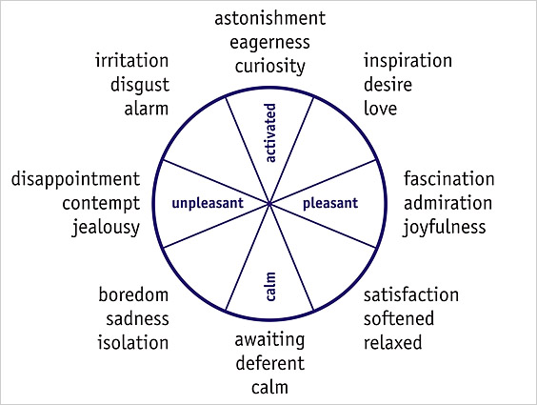
Two Dimensions of Emotions
(J.A. Russell et al. „circumplex model“)
activation
pleasantness

Slide 10
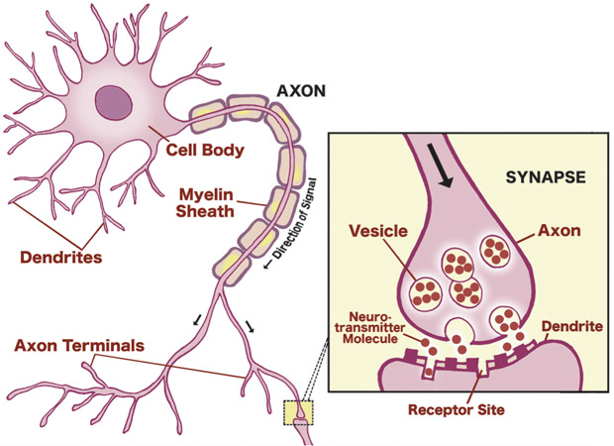
A Neurotransmitter Model?
Have essentially 9 neurotransmitter types:
1. acetylcholine motor control, learning, memory, sleep, dream
2. epinephrine energy
3. norepinephrine arousal, vigilance
4. serotonine impulses, dream
5. dopamine reward, motivation, motor control
6. gaba inhibit action potential
7. glutamate enhance action potential, learning, memory
8. endorphine reward, pain reduction
9. substance p pain perception, mood

Slide 11
acetylcholine motor control, learning, memory, sleep, dream
glutamate
enhance action potential, learning, memory
memory
substance p
pain perception
dopamine
motivation
pain
gaba
pleasure
endorphines
pain reduction
serotonine
impulses, dream
energy
epinephrine energy
norepinephrine
arousal, vigilance

Slide 12
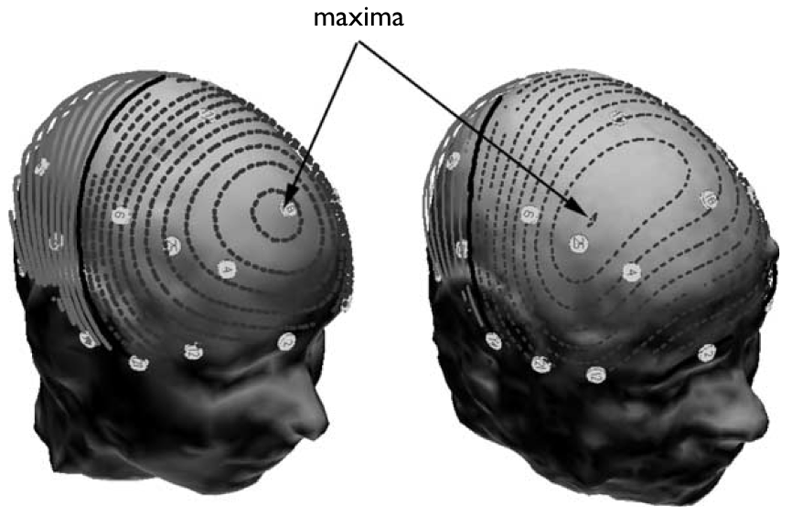
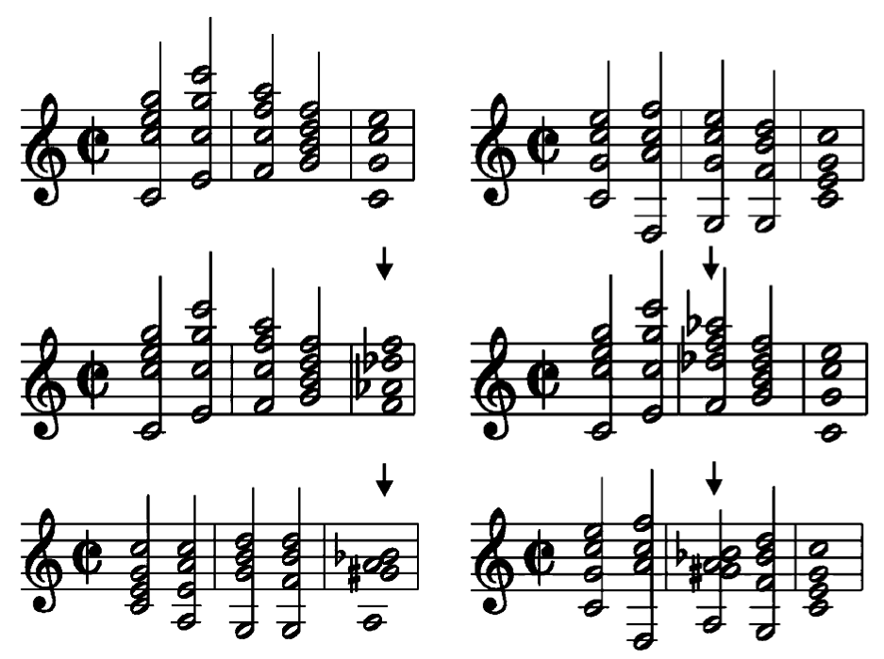
Stefan Koelsch et al. (Leipzig 2003): Electric Brain Responses Reveal Gender Differences in Music Processing
Event Related brain Potentials (ERP)
M.M. ♩ = 100
maxima
neapolitan
cluster
corpus callosum
music laypersons
5-9 age, girls and boys

Slide 13
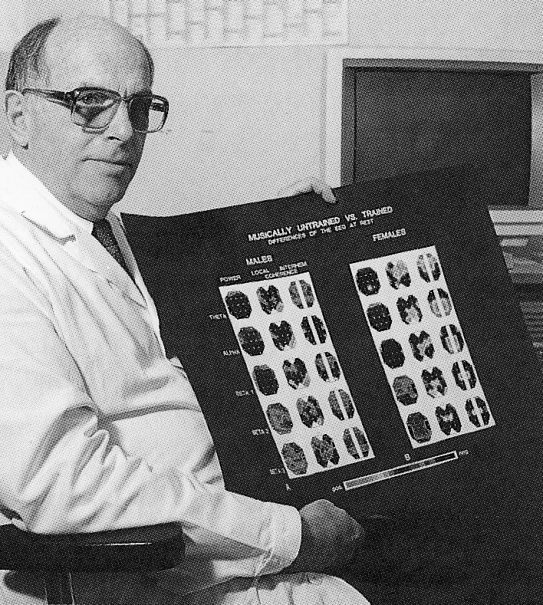
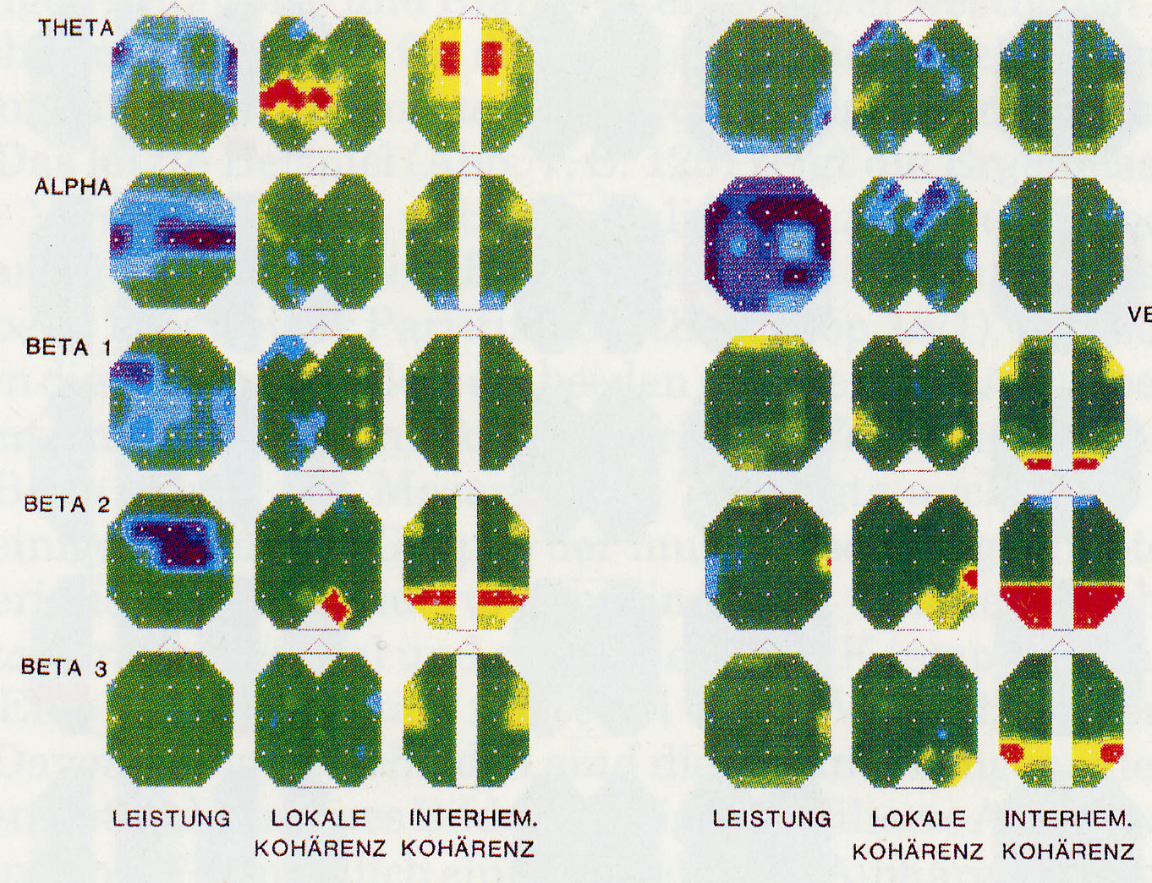
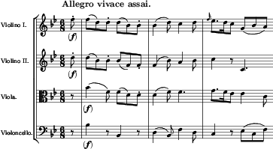
Hellmuth Petsche et al. (Vienna 1986-1998): EEG and Thinking
24 #
28 #
4 - 7.5
8 - 12.5
13 - 18
18.5 - 24
W. A. Mozart:
Jagdquartett
KV 458,
1st mov.
24.5 - 31.5
persons with music education

Slide 14
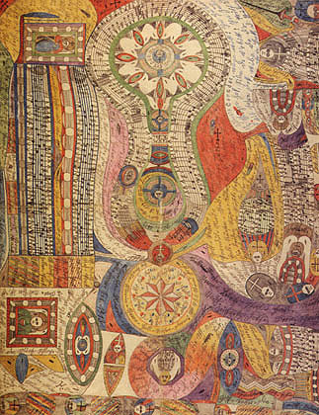
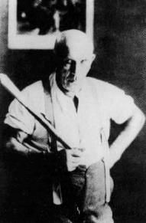
Adolf Wölfli

Slide 15
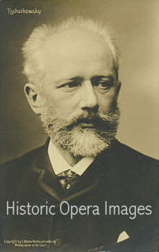
Peter Tschaikowsky (1840-1893)
pathétique

Slide 16
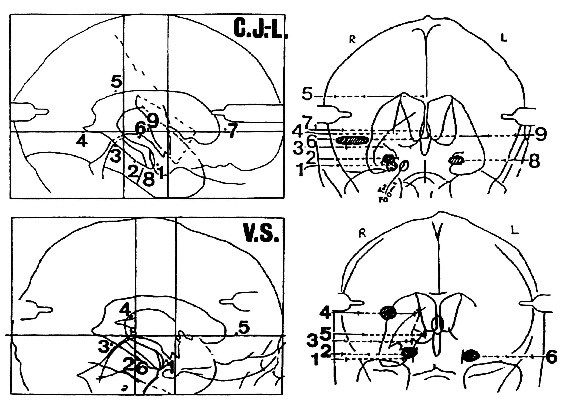
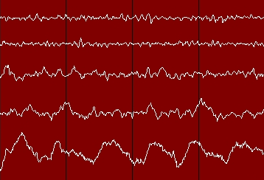

Slide 17
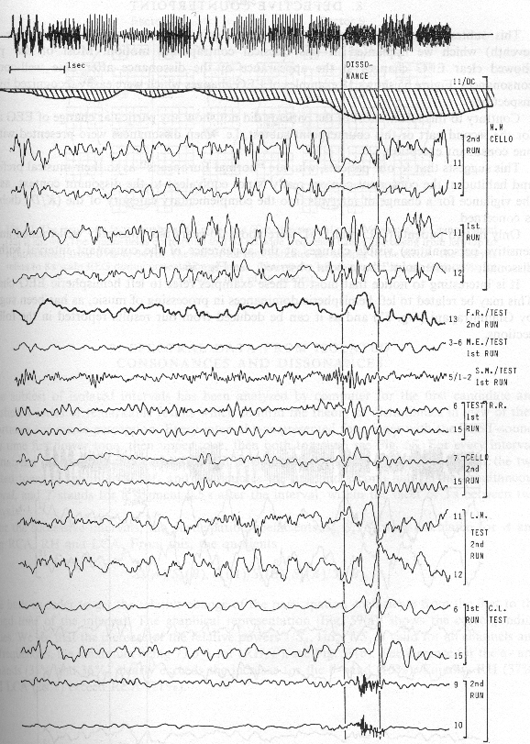
Disso nance

Slide 18
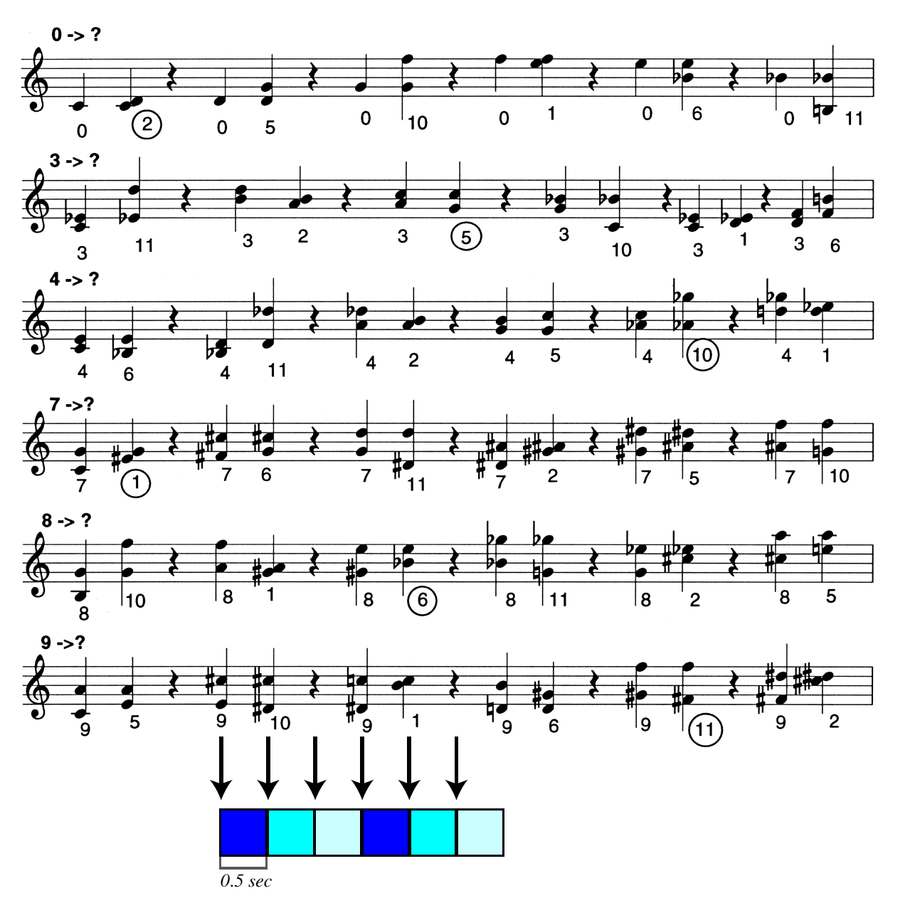
D = 5K+2
0 <-> 2
3 <-> 5
4 <-> 10
7 <-> 1
8 <-> 6
9 <-> 11

Slide 19
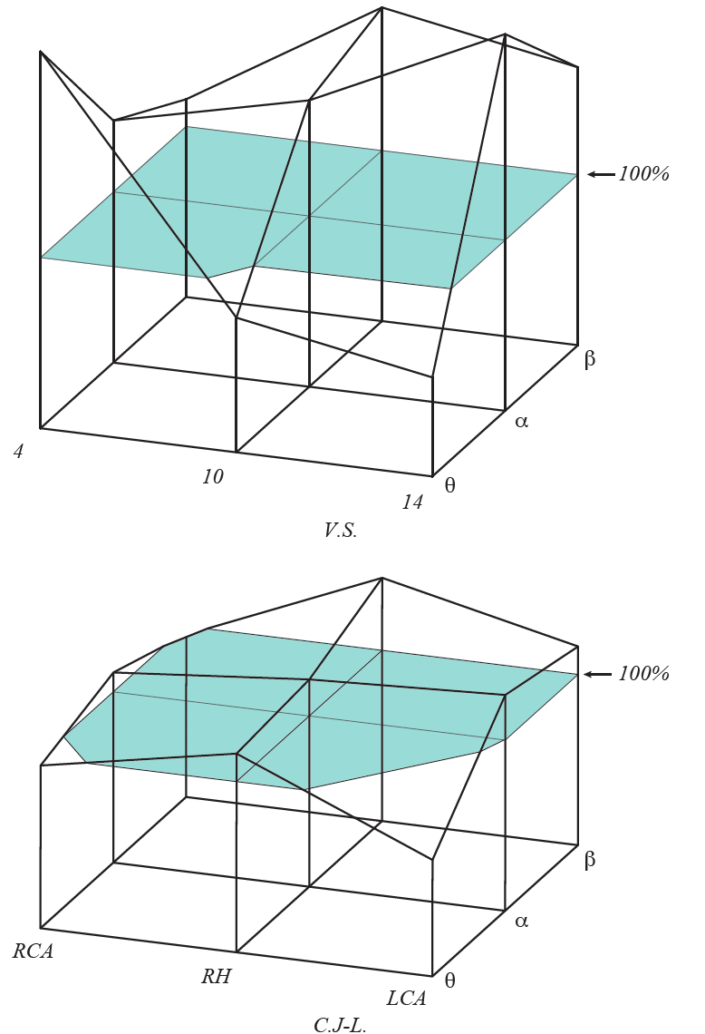

Slide 20
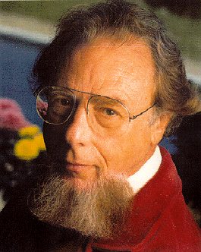
Emotional Expression:
Manfred Clynes
Jörg Langner-Reinhard Kopiez
Anders Friberg
Alf Gabrielsson
In Western culture we have devised a singular means of killing music—writing it down in a score. It then has to be resuscitated or resurrected in performance. The performer has to supply all the nuances, the microstructure that was not and could not be notated by the composer, in order to bring the music to life. Therein lies his art.

Slide 21
In the early 1980, the Australian pianist and music theorist Manfred Clynes developed a theory of emotional semantics in music.
He stresses „microstructure“, which means those performance deformations, mainly in agogics and dynamics.
The shapes of this expressive forms are referred to as essentic forms, which Clynes argues are biologically programmed in our nervous system.
So the emotional meaning of music refers to an activation of essentic forms.
They are transcultural by definition, which explains the universal function of music.

Slide 22
The most elementary form of microstructure is a four-note performance curve built from tempo and dynamics. Every composer has his/her own pulse (Mozart, Beethoven, Schubert, etc.).
There is also a pulse within each note (for instruments where that works), essentially given via envelope functions.
There are different levels of pulses intra-note, measure, phrase etc.

Slide 23
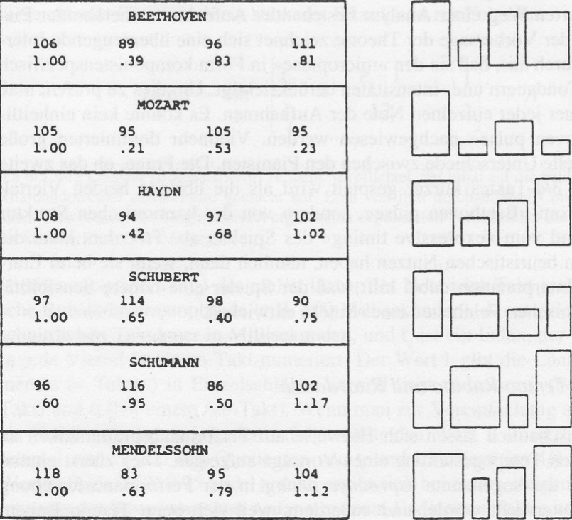
Composer‘s Pulses 4 Pulse
—> gestures, see below!
BEETHOVEN
Duration ——— Loudness———
MOZART
Duration ——— Loudness———
HAYDN
Duration ——— Loudness———
SCHUBERT
Duration ——— Loudness———
SCHUMANN
Duration ——— Loudness———
MENDELSSOHN
Duration ——— Loudness———

Slide 24
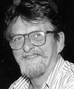
Clynes also constructed a patented machine, the sentograph, also used by composer Tamas Ungvary for playing music.
Clynes associated with certain types of essentic micropulses categories of emotions.
This is a precursor of the Friberg approach to associate emotions with musical parameter settings, see below.
The phylogenetic origin of essentics makes musical meaning qua emotions a super-individual experience: It is the generic anger etc. that is being expressed/perceived, not the individual one.
Tamas Ungvary

Slide 25
Emotional Expression:
Manfred Clynes
Jörg Langner-Reinhard Kopiez
Anders Friberg
Alf Gabrielsson
Kopiez Langner

Slide 26
Jörg Langer and Reinhard Kopiez have invented the TOS (=Theory of Oscillating Systems).
It postulates a neuronal cognitive mechanism in humans that correlates to a set of 120 sinoidal oscillators from 8 to 0.008 Hz distributed in logarithmic steps.
A corresponding Fourier-like analysis (never revealed by the authors...) is applied to the dynamical curve of a recorded music file.
Expressivity is correlated to the neuronal oscillator system and „production and perception of expressiveness in music are essentially the same.“
This is a warmed up version of Clynes' essentics. No experimental verification of the existence of TOS in human brain is published, much as Clynes' neuronal theory.

Slide 27
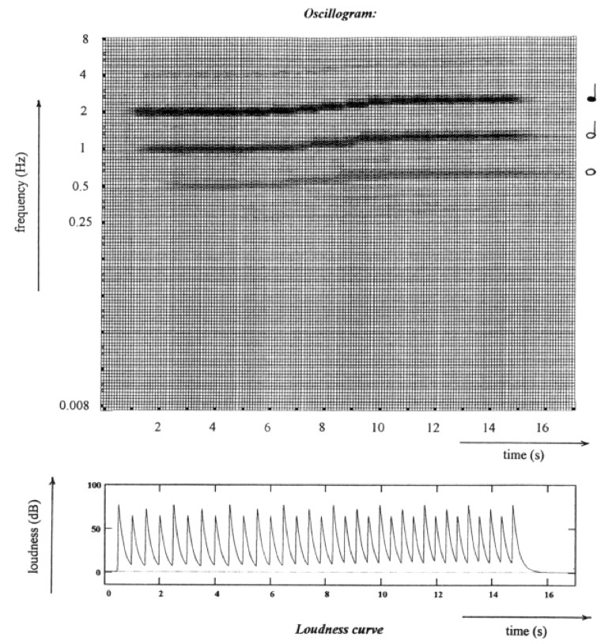
Oscillogram (above) and loudness curve (below) belonging to quarter notes played in a 4/4-time
signature by a drum computer with an additional accelerando at the end.
This accelerando leads to a parallel upward movement of the dark bands in the oscillogram, which means that the activation changes to higher oscillator frequencies.

