Slide 1
I INTRODUCTION
I.4 (Mo Sept 12) Oniontology: Examples

Slide 2
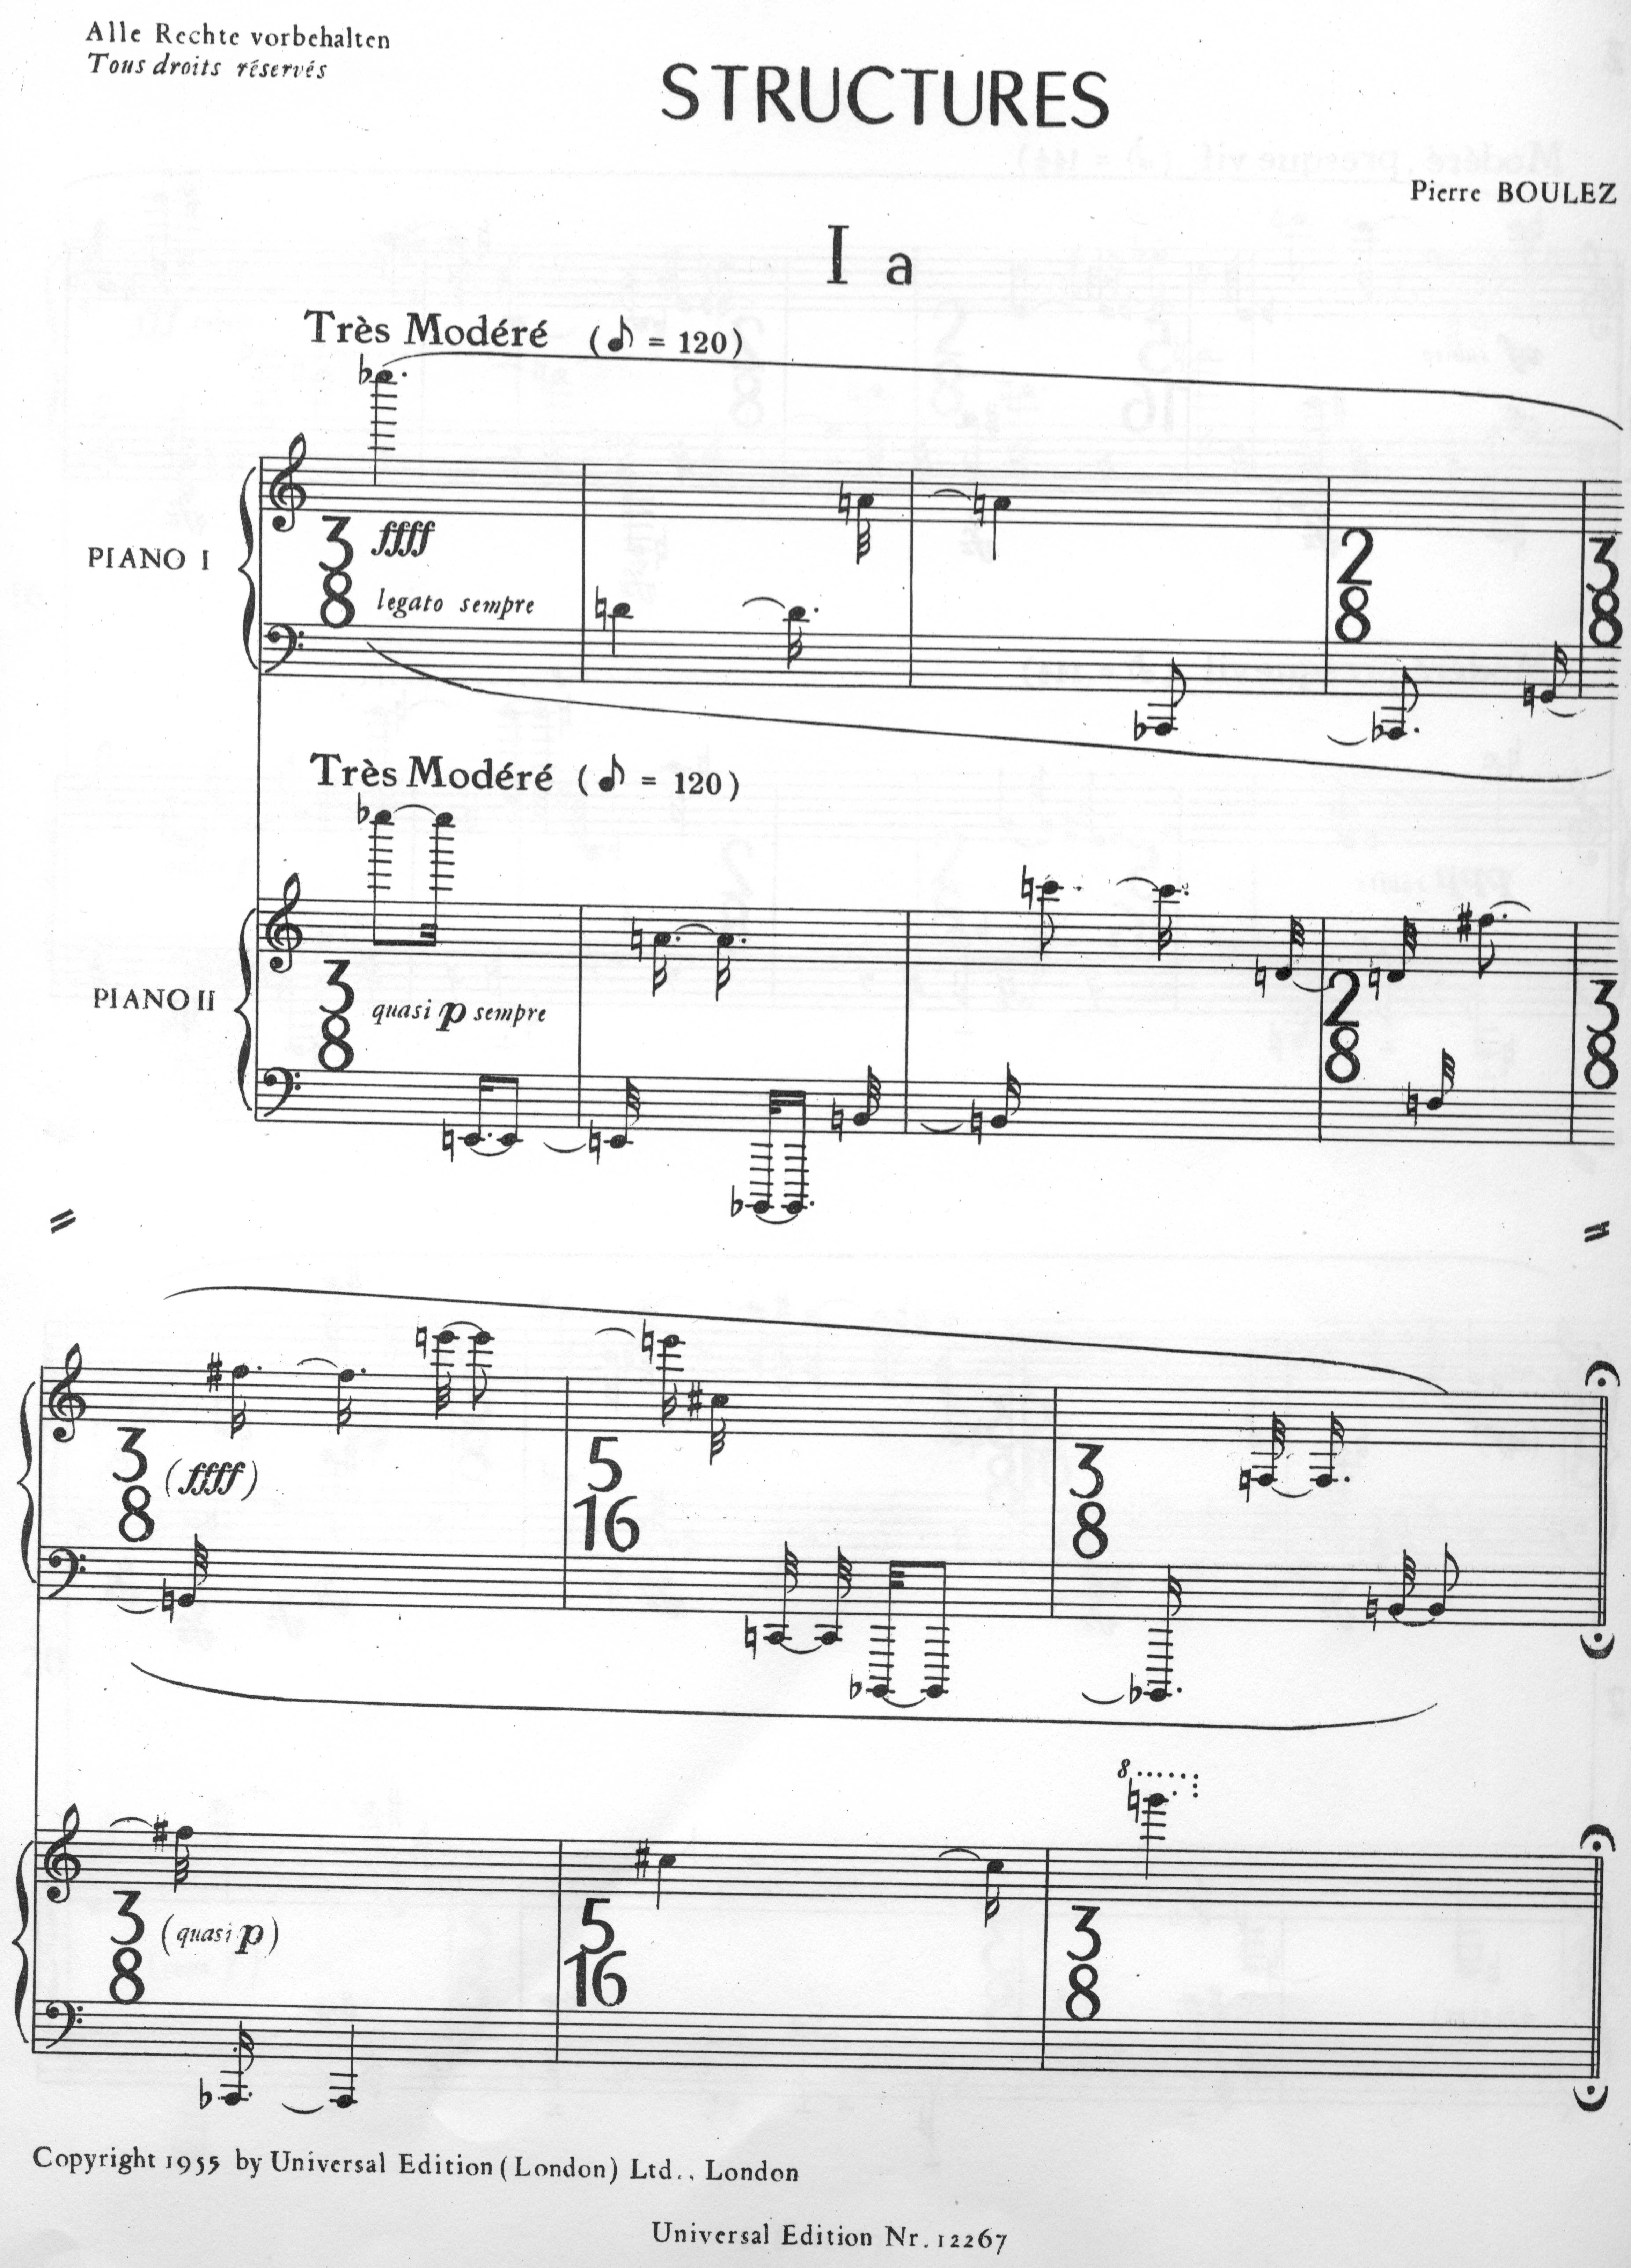
Pierre Boulez structures Ia (1952)
CD wergo 1965
(3:36)
Alfons & Aloys Kontarsky
thread („Faden“)
Composition is a system of threads!

Slide 3
Boulez: Messiaen‘s series from modes et valeurs d‘intensité
11
10
9
8
7
6
5
pitch class
4
3
2
1
0
sequence number
1
2
3
4
5
6
7
8
9
10
11
12

Slide 4
Series for durations
1/32
12/32
1/32 + 2/32 +... 12/32 = 78/32 = total duration of one thread

Slide 5
Series for loudness

Slide 6
The series of attacks

Slide 7
Ligeti‘s critical comments:
He compares the result to the flashing neon lights of a big city, which, although being driven by precise machines, generate an overall effect of statistical sound swarms. He concludes that with this radical elimination of expressivity, still present in Webern's compositions, the composition finds it beauty in the opening of pure structures. And Boulez---we follow Ligeti's wording---in such a nearly obsessive-compulsive neurosis, strains himself at the leash and will only be freed by his colored sensual cat world of ``Marteau''.
Ligeti attributes to these constructions the qualification of combinatorial fetishism.
Ligeti‘s matrix Q of Permutations of the row

Slide 8
Ligeti‘s pictures for the loudness paths
a (Part A)
c (Part B)
a
c
a: Ÿ¹¹ → Ÿ¹¹⊗ Ÿ¹¹

Slide 9
Ligeti‘s pictures for the attack paths

Slide 10
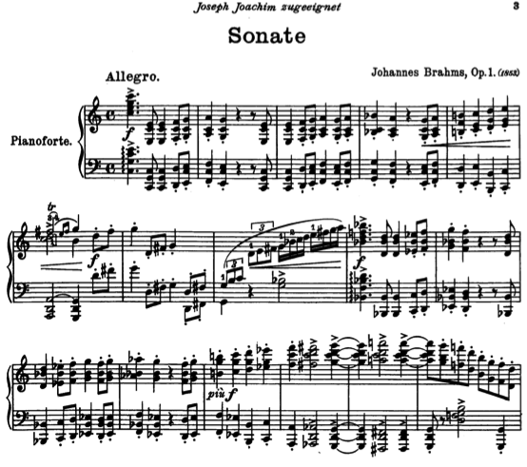
Paper on a Metrical Analysis of Brahms's Sonata op. 1, First Movement, by Computer Software

Slide 11
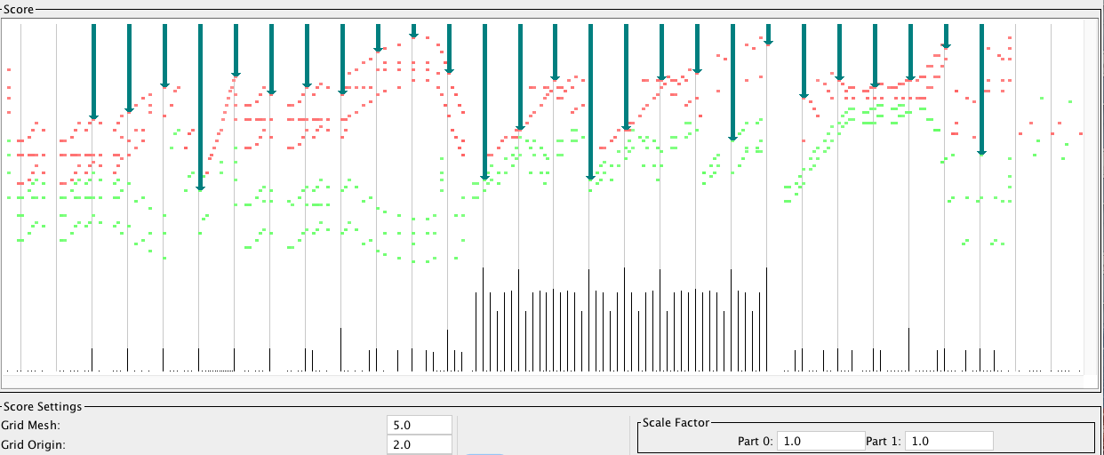
Visual Representation of Analysis:
Strong 5/4 metrical weights.

Slide 12
Comments by one of the paper's reviewers:
The authors claim to have uncovered a mysterious force of metric organization at play in Brahms's sonata
(and by extension, it is suggested, in his other early works as well).
The algorithm found it.
But you cannot hear it (even with supreme effort),
you cannot see it (in the score), and, one presumes,
Brahms himself was unaware of it.

