Slide 1
I INTRODUCTION
I.3 (F Sept 09) Oniontology: Examples

Slide 2
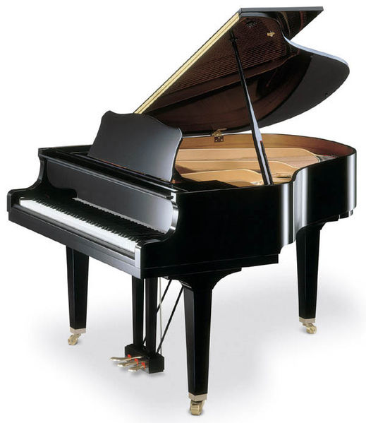
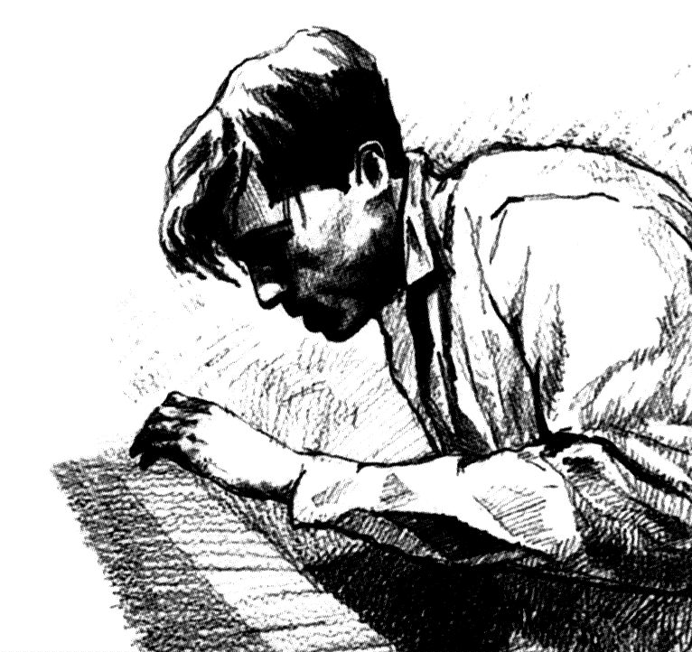
The Ontology of Music
expression
signification
content
signs
physical
psychological
symbolic
realities
communication
poiesis neutral level aesthesis

Slide 3
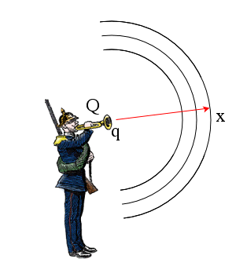
Realities: Physical

Slide 4
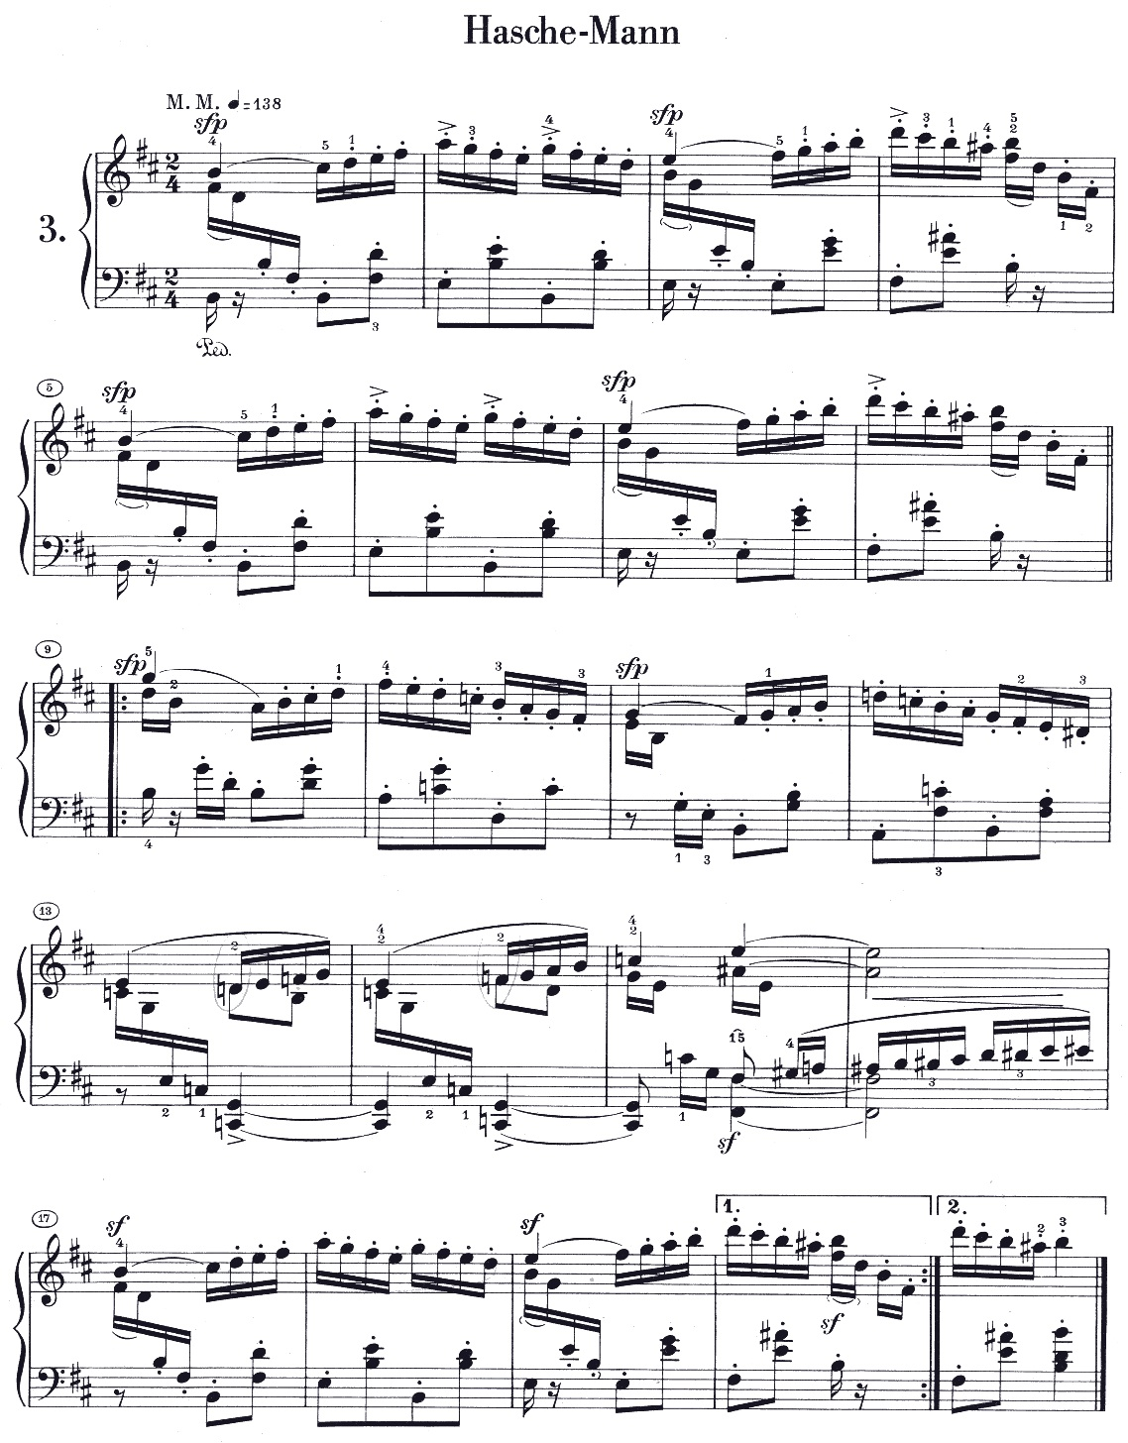
Realities: Symbolic
hounted

Slide 5
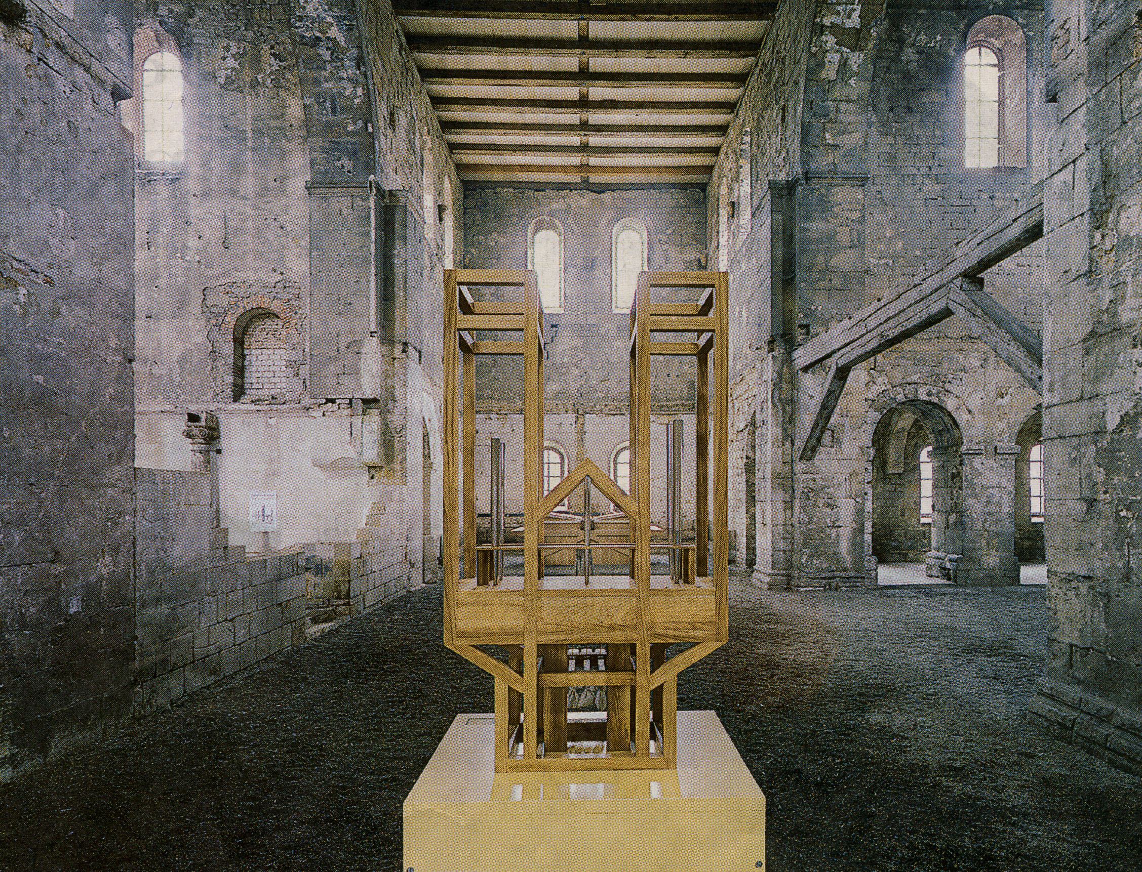
Realities: Symbolic
John Cage: ASLSP

Slide 6
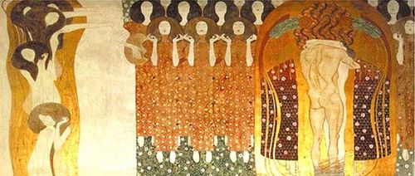
Realities: Psychological
Gustav Klimt: Beethoven Frieze

Slide 7
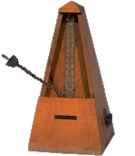
Symbolic
Physical
℘
Psychic
Elton John
Candle in the Wind

Slide 8
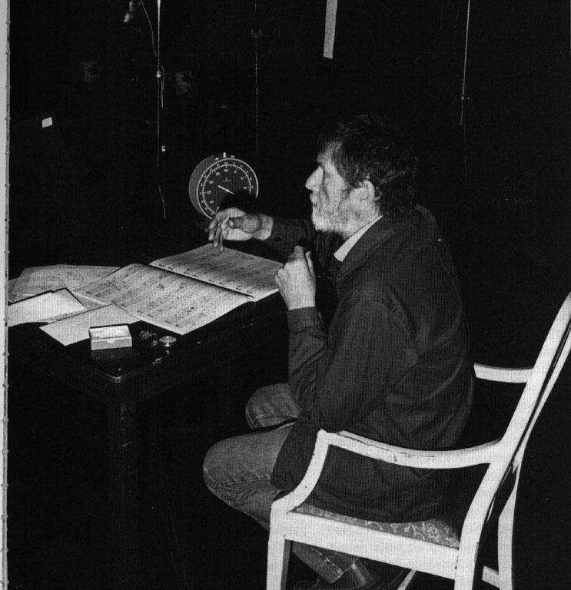
Communication: Poiseis
Arnold Schoenberg/John Cage

Slide 9
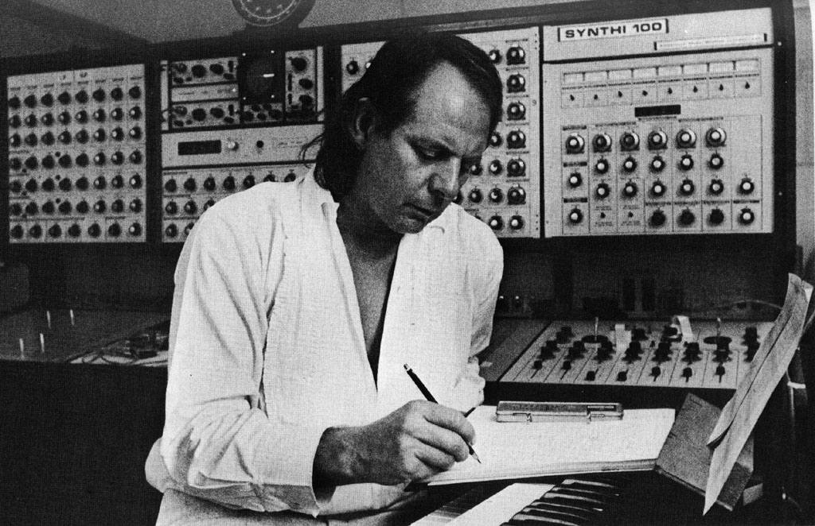
Communication: Poiseis
Stockhausen

Slide 10
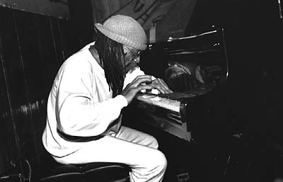
Communication: Poiseis
Cecil Taylor/Peter Broetzmann

Slide 11
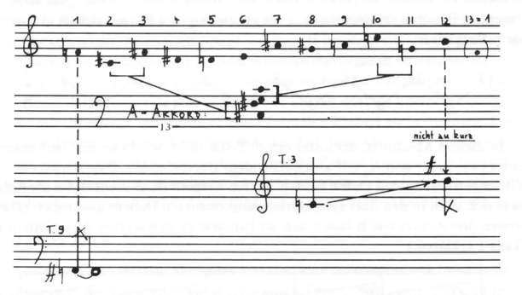
Communication: Poiseis
Karlheinz Stockhausen Klavierstück IX

Slide 12
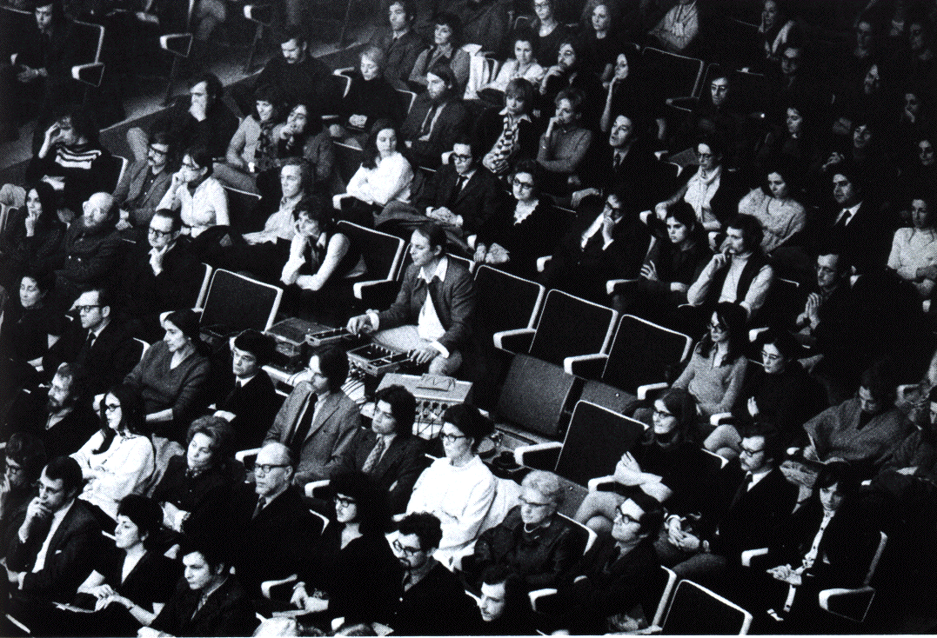
Communication: Aesthesis
with Stockhausen

Slide 13
Communication: Aesthesis
Performance/Interpretation

Slide 14
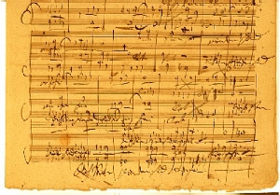
Communication
Poiesis
Neutral Niveau
Aesthesis
Jean Molino, Paul Valéry, Nicolas Ruwet, Jean-Jacques Nattiez

Slide 15
Semiotics
Sign
Expression
Signification
Content
!
„Firework“
aliquid
pro
aliquo

Slide 16
Semiotics
Expression
„score surface“
Signification
harmonic analysis
Content
tonal modulation G _{maj} → E-flat _{maj}
Sign

Slide 17
Communication
Poiesis
Neutral Niveau
Aesthesis
Physical
Symbolic
Psychic
Content
Realities
Signification
Expression
Sign

Slide 18
Embodiment
Teak Leaves at the Temples

Slide 19
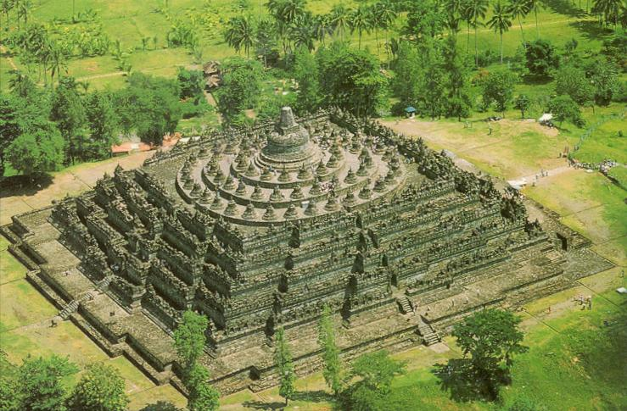
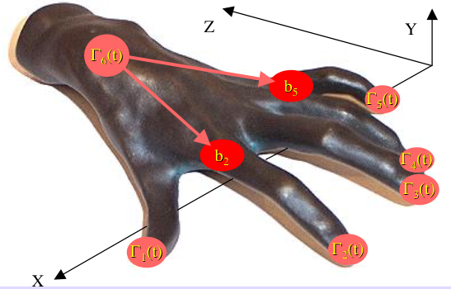
The Oniontology of Music
realities
communication
Facts
signs
Processes
Gestures

Slide 20
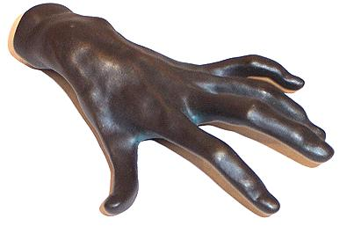
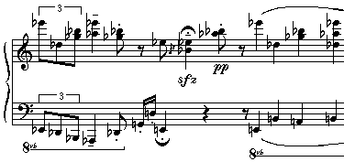
Embodiment
Gesture
to make
MIDI
Process
to refer to
Facts
to be the case

Slide 21
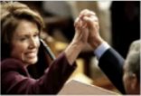
Embodiment
Gesture
Process
Facts

Slide 22
Embodiment
Gesture
disembodiment & schematization
Process
evaluation & dissection
Facts

Slide 23
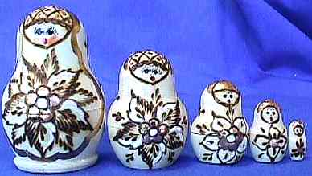
Louis Hjelmslev‘s Babuschka-Principle
Sign systems are boxed systems,
having components, which
are composed of sign subsystems,
which are again composed of
sign subsystems, etc.

Slide 24
Expression
Signification
Content
„Firework“
Connotation
Expression
Signification
Content
„Firework“
Firework

Slide 25
Poiesis:
Interpreter
Neutral Niveau:
Recording (e.g. CD)
Aesthesis:
Listener

Slide 26
Renate Wieland & Jürgen Uhde: Forschendes Üben
Die Klangberührung ist das Ziel der zusammenfassenden Geste, der Anschlag ist sozusagen die Geste in der Geste.
The sound contact is the target of the embracing gesture, the touch is so to speak the gesture within the gesture.
pitch
tip space
onset
position

Slide 27
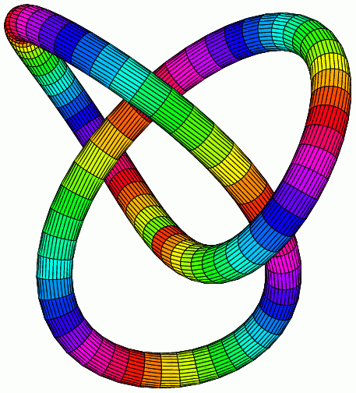
Hypergestures!
„loop of loops “
knot
loop

Slide 28
Expressive performance has these two directions:
Communication ~ HOW
Poiesis
Neutral Niveau
Aesthesis
Expression
Semiotics ~ WHY
Signification
Content

Slide 29
Semiotic Expressivity „WHY?“
If adequate shaping of performance works, it has to deal with the semiotic anatomy of the message.
Let us consider the message as built from the complex poietic communication unit that is defined by CSI = Composer —> Score —> Interpreter.
CSI

Slide 30
Semiotic Expressivity „WHY?“
This anatomy is centered around the score's sign expressions and points to a variety of contents specified by embodiment and realities.
CSI
Expression
Signification
Content
Realities
Embodiment

Slide 31
Examples of CSI-defined contents in realities/embodiment:
CSI
emotions, feelings,
soul state of musical
entity and/or the audience
drama
e-motions as dynamic entities,
not results
psychological
sound
sound generators
body movement, Fourier gestures
physical
harmonic values
motivic work
gestures of
harmonic modulation
symbolic/mental
facts
processes
gestures

Slide 32
Rhetoric Expressivity „HOW?“
Poiesis
Neutral Niveau
Aesthesis
CSI
℘
Expression
physical
psychological
symbolic
HOW?
Signification
tions, feelings,
of musical
entity and/or
drama
e-motions as dynamic entities,
not results
sssnd
ertwd generators
werwer gestures
sdfasdf
asdfasdf
fafafaf
sound
sound generators
body movement, Fourier gestures
tions, feelings,
wewewe/or
xxx
wert
tions, feelings,
of musical
entity and/or
afafaf
asdadsfadsf
adsf
ad
Content
Realities
Realities
Realities
harmonic values
motivic work
gestures of
modulation
wewewewe
wewewewewe
wretwret
??????
!!!!
afafafaf
Embodiment
Embodiment
Embodiment

