Slide 1
II Acoustic Reality
II.3 (W Sept 14) Fourier

Slide 2
Sound anatomy
Classical Joseph Fourier (partials/overtones) ~ 1800
Frequency Modulation (FM) John Chowning ~ 1970
Wavelets (Jean Morlet et al.) ~ 1984
Physical Modeling (Claude Cadoz et al.) ~ 1989

Slide 3
Sound anatomy
Classical Joseph Fourier (partials/overtones) ~ 1800
Frequency Modulation (FM) John Chowning ~ 1970
Wavelets (Jean Morlet et al.) ~ 1984
Physical Modeling (Claude Cadoz et al.) ~ 1989

Slide 4
Sound anatomy
A sound „laaaa“
time
envelope
wave

Slide 5
Sound anatomy
envelope H
+
=
wave w
shift and squeeze
w. H
amplitude A
support
duration d
onset e

Slide 6
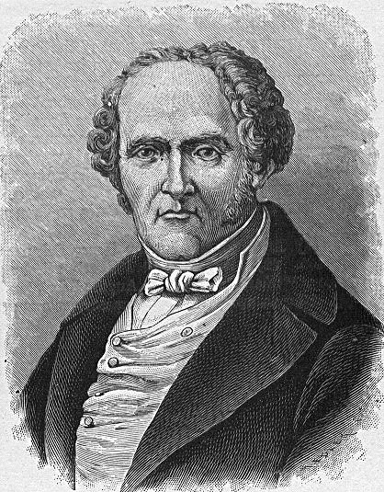
Sound anatomy
Classical Joseph Fourier (partials/overtones) ~ 1800
every periodic function!!!
2nd partial
= 2nd overtone
amplitude length of arrow
wave w
w(t) = A₀ + A₁ sin(2π.ft+Ph₁) + A₂ sin(2π.2ft+Ph₂) + A₃ sin(2π.3ft+Ph₃) +...
fundamental = 1st partial
= 1st overtone
phase (angle)
w(t) = A₀ + ∑_{n≥1} A_{n} sin(2π.nft+Ph_{n})
Simplicity of sinusoidal waves?

Slide 7
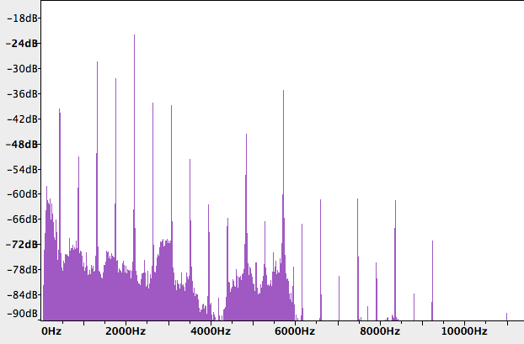
Sound anatomy
Amplitude spectrum
w(t) = A_{c} + A₁ sin(2π.ft+Ph₁) + A₂ sin(2π.2ft+Ph₂) + A₃ sin(2π.3ft+Ph₃) +...

Slide 8
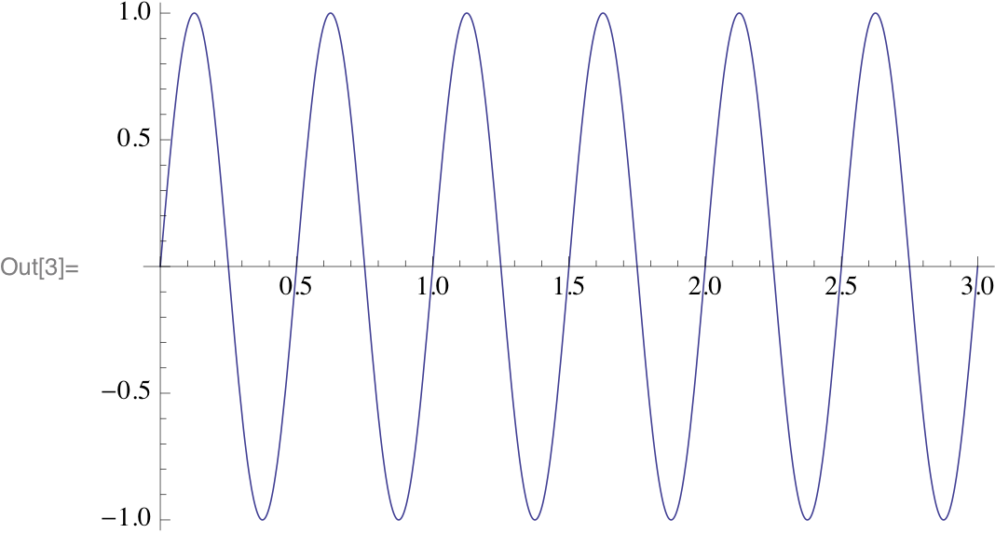
w(t) = A₀ + A₁ sin(2π.ft+Ph₁) + A₂ sin(2π.2ft+P₂) + A₃ sin(2π.3ft+Ph₃) +A₄ sin(2π.4ft+Ph₄)
SPIN.nb

Slide 9
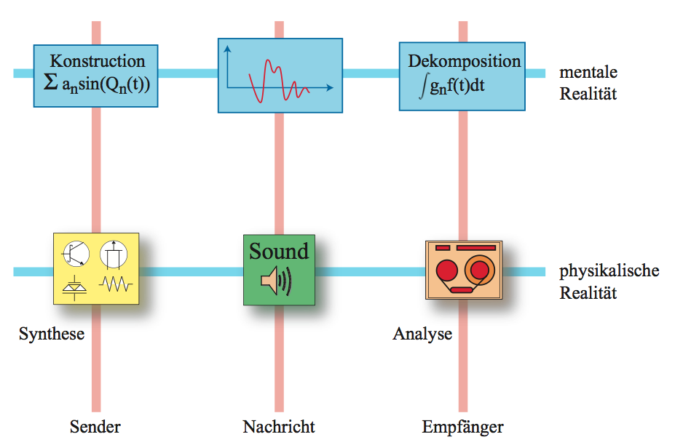
Sound anatomy: remarks on Fourier and realities
construction
decomposition
mental
reality
physical
reality
synthesis
analysis
sender
message
receiver

Slide 10
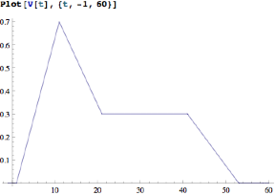
Sound anatomy
Some explicit examples calculated via Mathematica SW
SawFourier.nb
peak
ADSR
envelope
model
Sustain
onset
+Attack
+ decay
+ sustain
+ Release
onset
onset
+Attack
onset
+Attack
+ decay
+ sustain
onset
+attack
+Decay

Slide 11
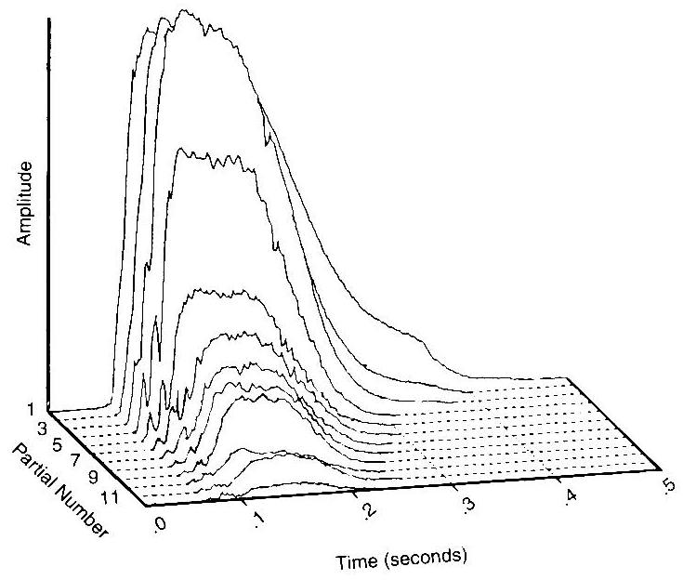
Sound anatomy
Chronospectrum of a trumpet

