Slide 1
III Digital Audio
III.1 (Fr Sept 30) Audio Encoding

Slide 2
General Scheme of Audio Encoding
semiotics
analog digital
expression
signification
content
physical reality
poiesis
neutral niveau
aesthesis
communication

Slide 3
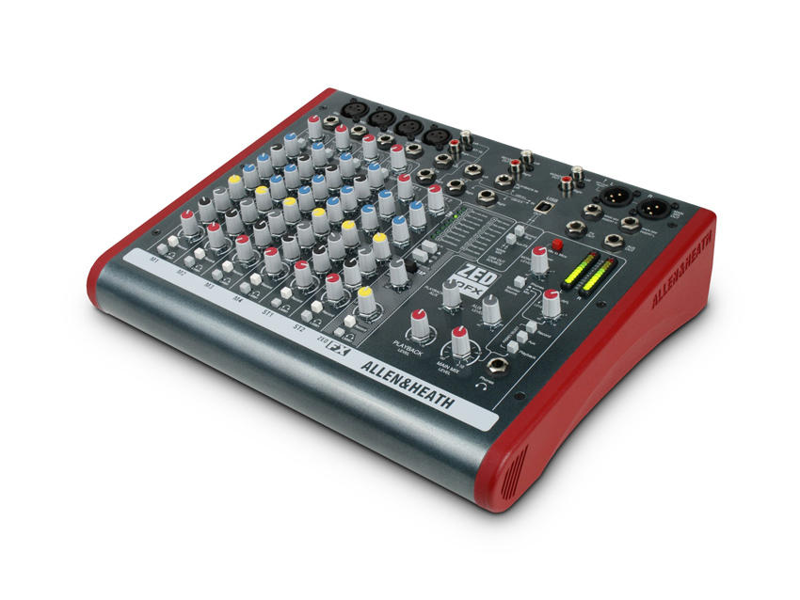
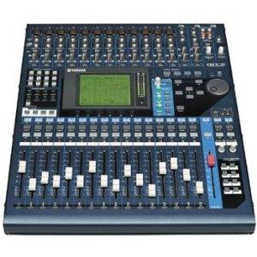
analog digital encoding
mixer
analog
mixer
analog
voltage
analog
voltage
analog
mics
loudspeakers
mixer
digital

Slide 4
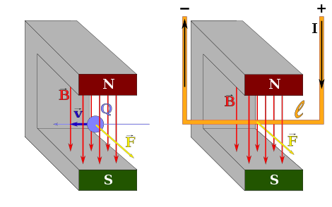
microphone types
moving coil dynamic
ribbon = thin corrugated metal
condenser = dynamic capacitor
Lorentz force on electrical charges

Slide 5
microphone polar patterns
omnidirectional bidirectional cardioid hypercardioid

Slide 6
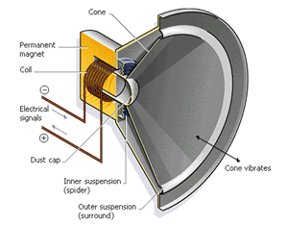
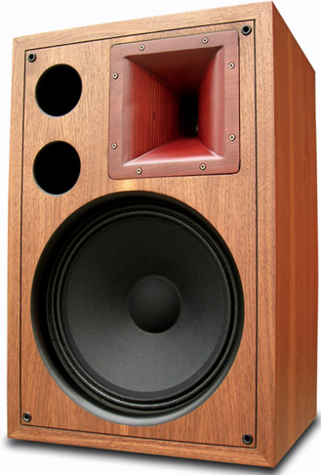
loudspeaker anatomy
Cone
Permanent magnet
Coil
Electrical signals
tweeter (high)
Dust cap
Cone vibrates
Inner supension (spider)
midrange
Outer supension (surround)
(sub)woofer (low)

Slide 7
analog
mechanical: LP
magnetic: Analog Tape
encoding of sound
optical: CD = Compact Disk
digital
magnetic: DAT = Digital Audio Tape
HD = Hard Drive
electric: (semiconductor-based)
volatile, e.g. RAM (Random Access Memory)
semi-volatile, e.g. Memory Sticks
non-volatile, e.g. ROM (Read Only Memory)
0100001010100100010001010

Slide 8
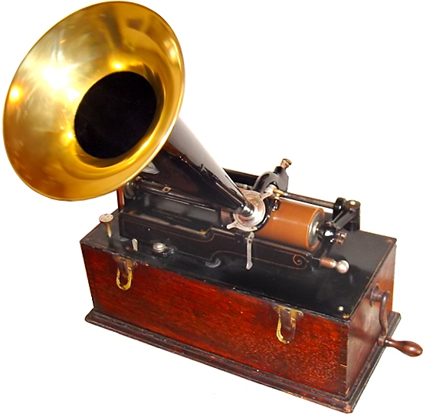
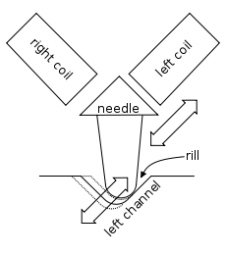
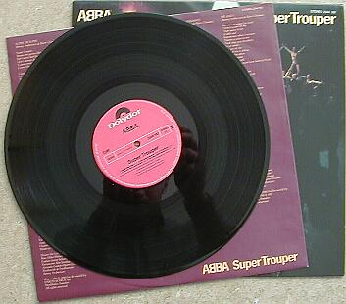
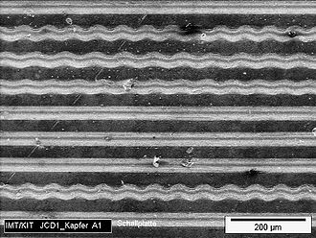
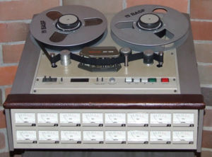
1877 Thomas Alva Edison’s phonograph vertical print on tin foil
mechanical: LP
1888 Emil Berliner’s horizontal printing
1931 RCA vinyl (PVC) 331/3 RPM, 30 cm ∅
analog
Alan Blumlein 1930
1935 AEG, BASF/3M (!!)
9.5 cm/sec, amplitude ~ magnetization ← The Tascam 85 16B analog tape recorder 16 tracks of audio on 1 inch (2.54 cm) tape.
VHS analog video by JVC 1976
magnetic: Analog Tape

Slide 9
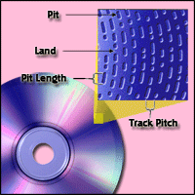
optical: CD = Compact Disk
Commercial since 1982 by Philips & Sony
Herbert von Karajan recorded Richard Strauss’s Alpensinfonie 120 mm diameter, 80 min audio ~ 700 MB
By 2007 200 ×10⁹ CDs sold!
track width ~1μm
digital
Polycarbonate
0100001010100100010001010
land
pit
laser reading 0001110110100111001010000111110000111.....

Slide 10
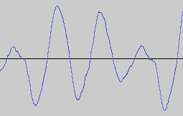
1. amplitude quantization
1Bit 0 or 1
4 Bit 0000, 0001, ... 1111 = 16 values 0,1,2,3....15
binary representation of numbers:
1011 means (sign!!)
1 × 2³ + 0 × 2² + 1 × 2¹ + 1 × 2⁰ = 8 + 2 + 1 = 11
CD has 16 Bit amplitude quantization:
16 entries: 101.....1 = 1 × 2¹⁵ + 0 × 2¹⁴ + 1 × 2¹³ + ...1 × 2⁰
0,1,..., 65‘535 = 2¹⁶ values
2. time quantization
CD of one hour and stereo has total of
2 channels × 60 minutes × 60 seconds × 44‘100 samples × 16 amplitude Bits = 635 MByte (1 Byte = 8 Bits)
CD has 44‘100 samples per second
?

Slide 11
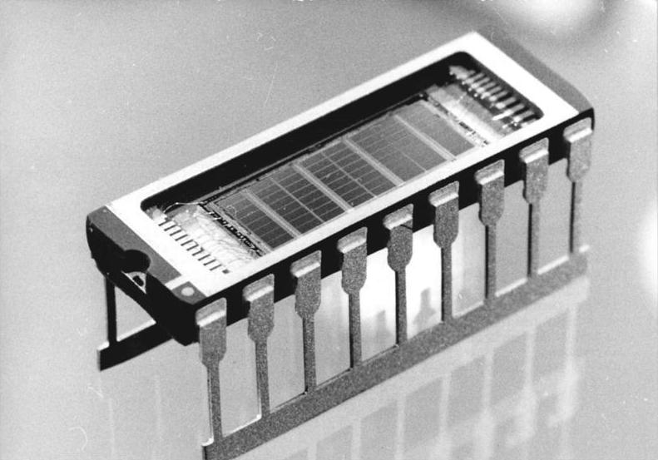
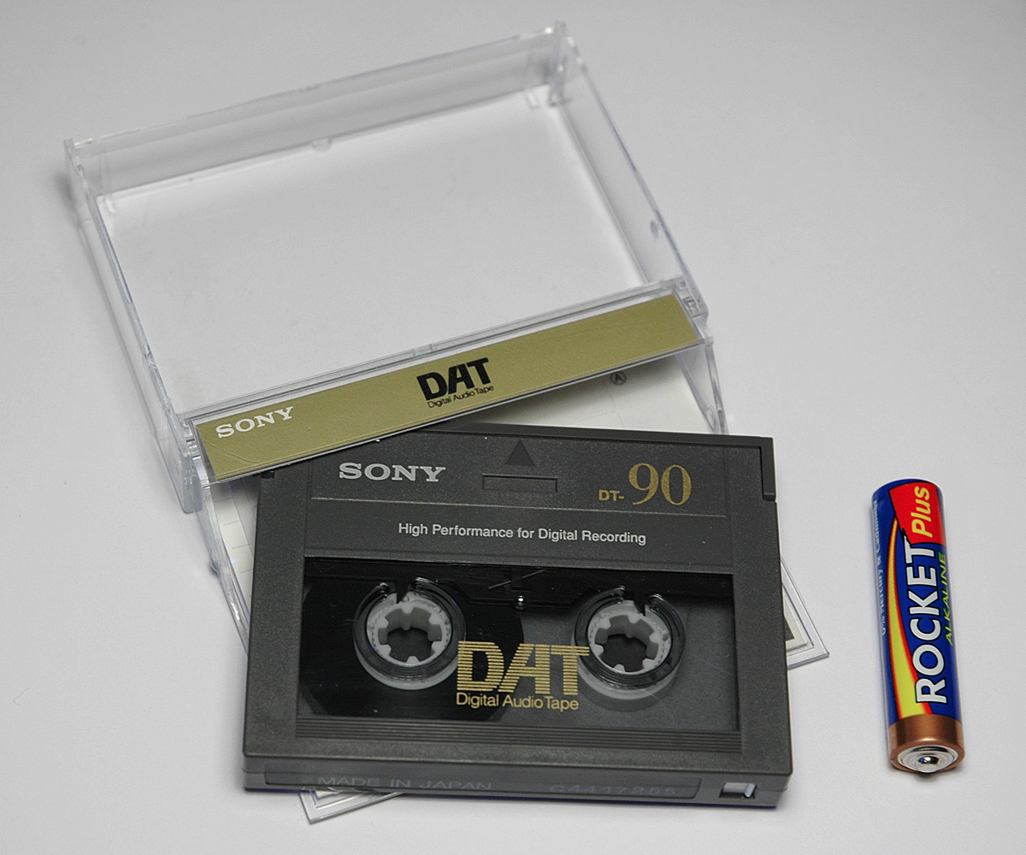
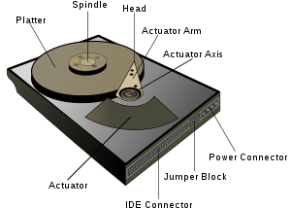
electric: (semiconductor-based)
volatile, e.g. RAM (Random Access Memory)
semi-volatile, e.g. Memory Sticks
non-volatile, e.g. ROM (Read Only Memory)
magnetic: DAT = Digital Audio Tape1983
99 kHz sample rate & 24 Bit resolution
magnetic:
HD = Hard Drive, non-volatile
Invented 1956 by IBM
digital
5000 RPM
“Ring” writing element
0100001010100100010001010
longitudinal recording (standard)
air cushion 10 nm
hair = 50 μm

