Slide 1
III.2 Semiotic Anatomy
III.2.2 (Tue Oct 04)
Hjelmslev‘s Babushka Puppets

Slide 4
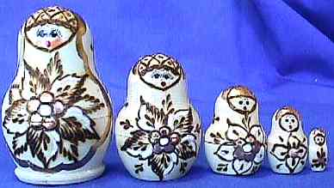
Louis Hjelmslev‘s Babushka-Principle
Sign systems are boxed systems,
having components, which
are composed of sign subsystems,
which are again composed of
sign subsystems, etc.

Slide 5
Hjelmslev‘s Babushka-Principle
Expression
Signification
Content
Connotation
Motivation
Meta System
Expression
Signification
Content
Expression
Signification
Content
Expression
Signification
Content

Slide 6
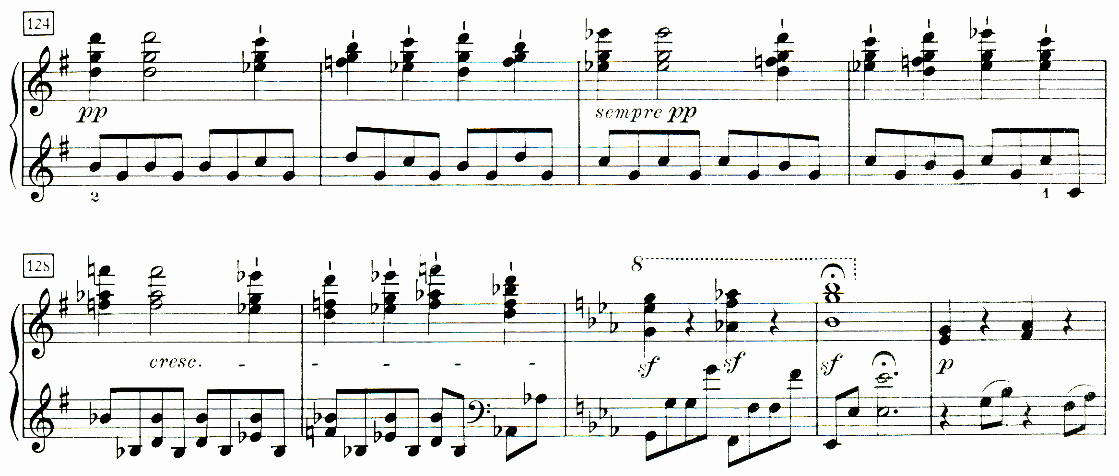
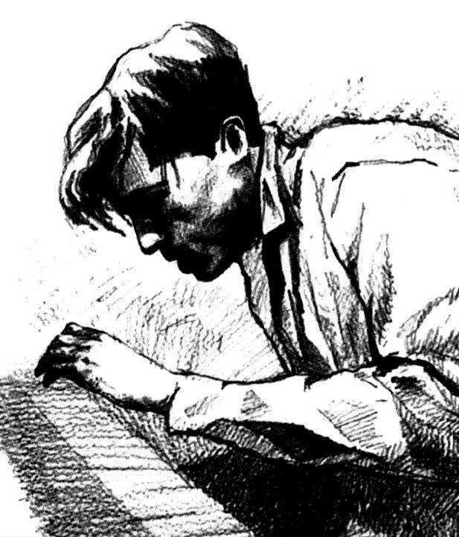

Score Text
Read
Conceived Score
Connotation
Conceived Score
Analytical Form
Analysis
Connotation
Analytical Form
Shaping
Performance
Connotation
Performance
Makes in Brain
Emotions

Slide 7
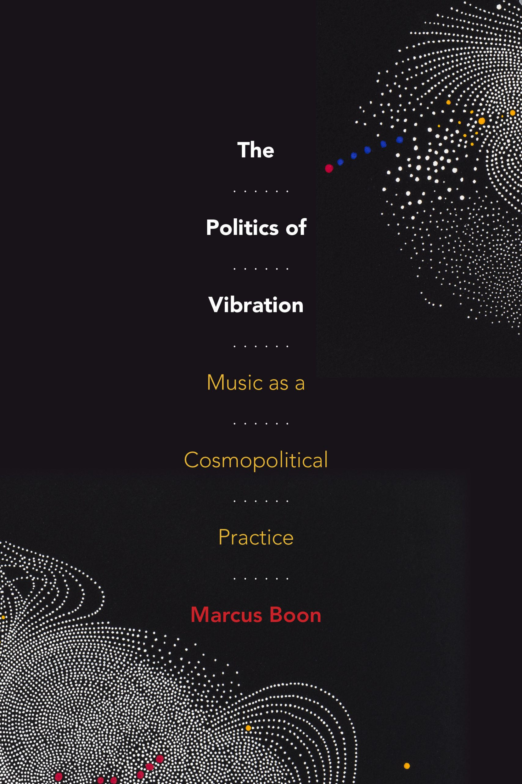
Duke UP, August 2022

