Slide 1
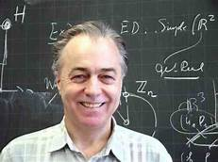
Universal Concept Frameworks and Music Theory
Prof. Dr. Guerino Mazzola
University of Minnesota, School of Music
www.encyclospace.org
concepts.pptx
mazzola@umn.edu

Slide 2
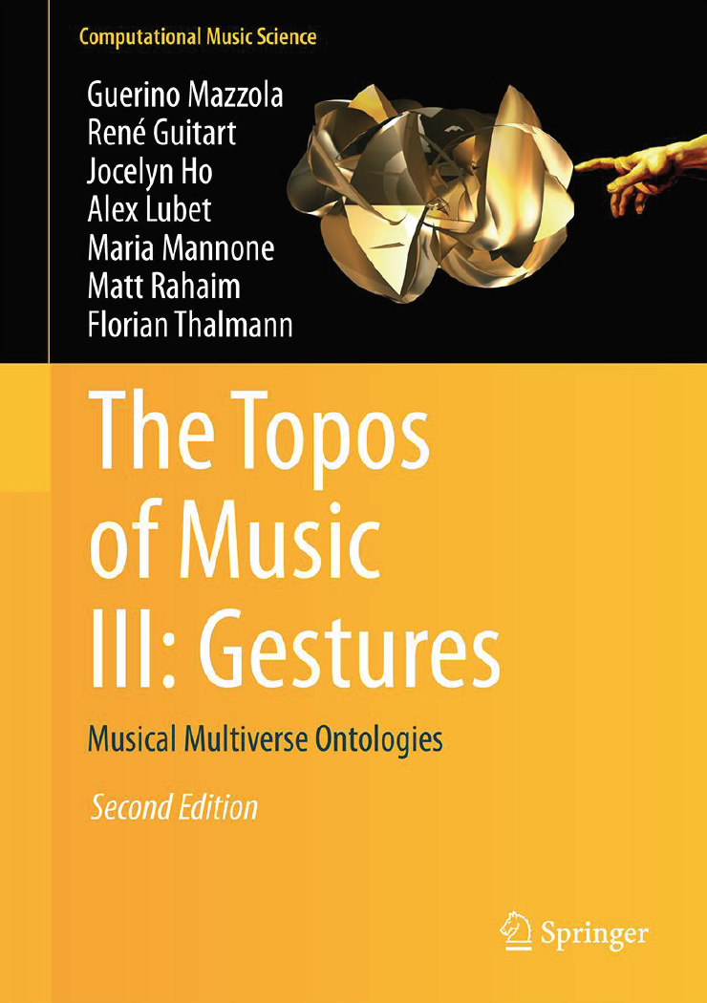
Reference:
The Topos of Music
Springer, 2nd edition 2017, 1700 pp.

Slide 3
Table of Contents
General Principles of Concept Architectures
The Formalism of Denotators and Forms
Simple Forms
Compound Forms
Implementation on the Rubato Software
The IRCAM crisis
Gestures
General Addresses
Hyergestures and Hypercompositions
The Escher Theorems
Music Theory for Compositions and Gestures

Slide 4
Table of Contents
General Principles of Concept Architectures
The Formalism of Denotators and Forms
Simple Forms
Compound Forms
Implementation on the Rubato Software
The IRCAM crisis
Gestures
General Addresses
Hyergestures and Hypercompositions
The Escher Theorems
Music Theory for Compositions and Gestures

Slide 5
Jean le Rond D‘Alembert
1751
Denis Diderot
Sylvain Auroux: La sémiotique des encyclopédistes (1979)
Three encyclopedic caracteristics of general validity:
unité (unity) grammar of synthetic discourse philosophy
intégralité (completeness) all facts dictionary
discours (discourse) encyclopedic ordering representation
euchar
hostiae

Slide 6
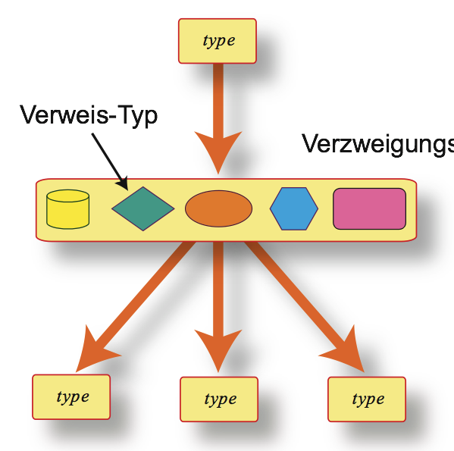
ramification type ~ completeness
reference ~ unity
linear ordering ~ discourse

Slide 7
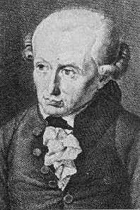
(Kritik der reinen Vernunft, B 324) Man kann einen jeden Begriff, einen jeden Titel, darunter viele Erkenntnisse gehören, einen logischen Ort nennen. You may call any concept, any title (topic) comprising multiple knowledge, a logical site.
Immanuel Kant
concepts are points in concept spaces

Slide 8
Table of Contents
General Principles of Concept Architectures
The Formalism of Denotators and Forms
Simple Forms
Compound Forms
Implementation on the Rubato Software
The IRCAM crisis
Gestures
General Addresses
Hyergestures and Hypercompositions
The Escher Theorems
Music Theory for Compositions and Gestures

Slide 9
<denotator_name><form_name>(coordinates)
denotator
form
D₁
<form_name><type>(coordinator)
F₁
D_{s-1}
F_{n}
D_{s}

Slide 10
Simple Forms = Elementary Spaces

Slide 11
Table of Contents
General Principles of Concept Architectures
The Formalism of Denotators and Forms
Simple Forms
Compound Forms
Implementation on the Rubato Software
The IRCAM crisis
Gestures
General Addresses
Hyergestures and Hypercompositions
The Escher Theorems
Music Theory for Compositions and Gestures

Slide 12
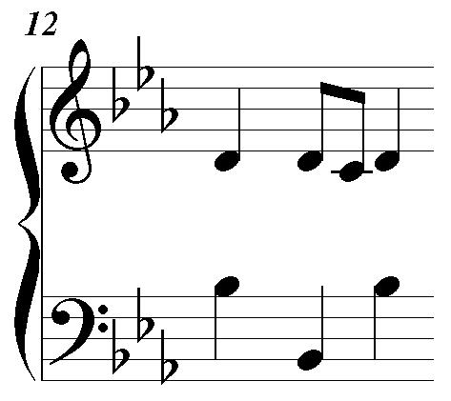
Simple
<form_name><type>(coordinator)
A = integers Ÿ = {...-2,-1,0,1,2,3,...}
example:
‘Pitch’
Simple
<denotator_name><form_name>(coordinates)
integer number
from Ÿ
example:
b-flat ~ 58
example:
‘thisPitch’

Slide 13
<form_name><type>(coordinator)
A module M over a ring R (e.g., a real vector space)
Simple
Examples:
M = —³ space for space music description
M = –³ pitch space o.log(2) + f.log(3) + t.log(5)
M = Ÿ₁₂, Ÿ₃, Ÿ₄ for pitch classes
M = Ÿ ×Ÿ₃₆₅ × Ÿ₂₄ × Ÿ₆₀ × Ÿ₆₀ × Ÿ₂₈ (y:d:h:m:s:fr) for time
M = ¬, Polynomials R[X] etc. for sound, analysis, etc.
<PitchClass><Simple>(Ÿ₁₂)

Slide 14
Table of Contents
General Principles of Concept Architectures
The Formalism of Denotators and Forms
Simple Forms
Compound Forms
Implementation on the Rubato Software
The IRCAM crisis
Gestures
General Addresses
Hyergestures and Hypercompositions
The Escher Theorems
Music Theory for Compositions and Gestures

Slide 15
Compound Forms = Recursive Spaces

Slide 16
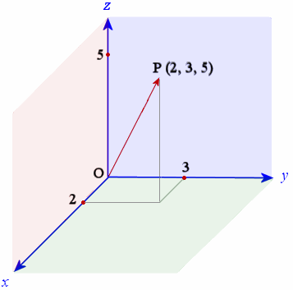
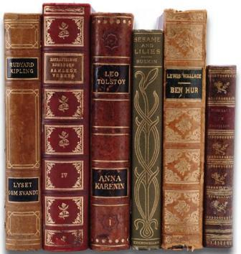
spaces/forms
exist three compound space types:
product/limit
union/colimit
collections/powersets

Slide 17
<form_name><type>(coordinator)
sequence F₁, F₂,... F_{n} of n forms
example:
‘Note’
Limit
<denotator_name><form_name>(coordinates)
n denotators from F₁, F₂,... F_{n}
example (n=2):
(‘myOnset’,’thisPitch’)
example:
‘myNote’

Slide 18
<form_name><type>(coordinator)
F₁
extend to diagram of
n forms + functions
F_{n}
F_{i}
example:
‘Interval’
Limit
K-nets (networks!)
<denotator_name><form_name>(coordinates)
n denotators, plus arrow conditions
example:
(‘note₁’,’on’,’note₂’)
Note Onset Note
example:
‘myInterval’

Slide 19
3
7
∈
T⁴
∈
Ÿ₁₂
Ÿ₁₂
T⁵.-1
T¹¹.-1
Ÿ₁₂
Ÿ₁₂
∈
T²
∈
2
4
Ÿ₁₂
Ÿ₁₂
T⁴
limit
T⁵.-1
T¹¹.-1
Ÿ₁₂
T²
Ÿ₁₂

Slide 20
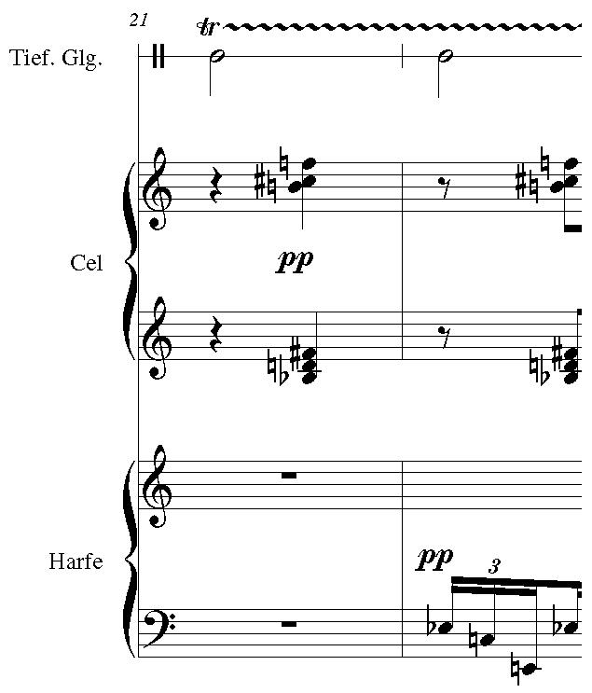
<form_name><type>(coordinator)
sequence F₁, F₂,... F_{n} of n forms
example:
‘Orchestra’
Colimit
<denotator_name><form_name>(coordinates)
one denotator for i-th form F_{i}
example:
Select a note from celesta
example:
‘mySelection’

Slide 21
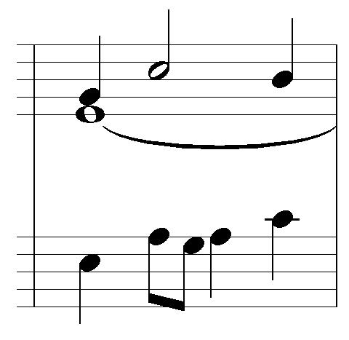
Power 1
<form_name><type>(coordinator)
one form F
Example:
‘Motif’
Powerset
<denotator_name><form_name>(coordinates)
A set of
denotators
of form F
example:
{n₁,n₂,n₃,n₄,n₅}
example:
‘thisMotif’
F = Note

Slide 22
FM-Synthesis

Slide 23
FM-Synthesis
FM-Object
Node
Support
Modulator
Amplitude
Frequency
Phase
FM-Object
—
—
—

Slide 24
FM-Synthesis
FM-Object
Node
Support
FM-Object
Amplitude
Frequency
Phase
—
—
—

Slide 25
Table of Contents
General Principles of Concept Architectures
The Formalism of Denotators and Forms
Simple Forms
Compound Forms
Implementation on the Rubato Software
The IRCAM crisis
Gestures
General Addresses
Hyergestures and Hypercompositions
The Escher Theorems
Music Theory for Compositions and Gestures

Slide 26
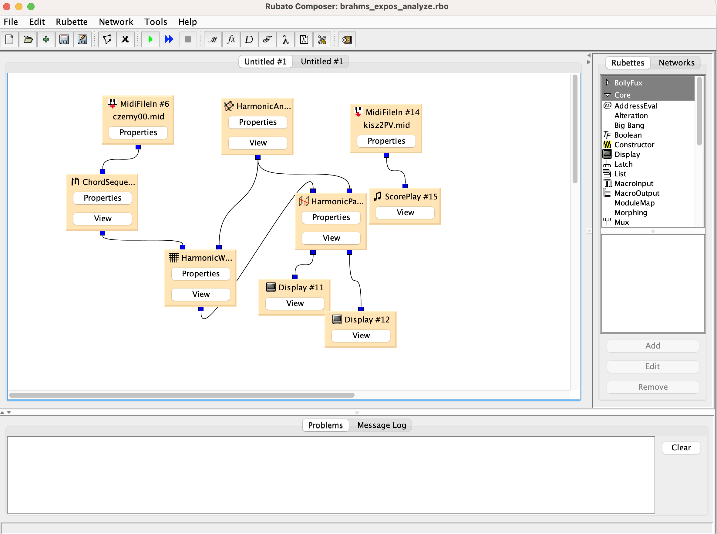
Guerino Mazzola/Gérard Milmeister: Rubato Composer

Slide 27
Table of Contents
General Principles of Concept Architectures
The Formalism of Denotators and Forms
Simple Forms
Compound Forms
Implementation on the Rubato Software
The IRCAM crisis
Gestures
General Addresses
Hyergestures and Hypercompositions
The Escher Theorems
Music Theory for Compositions and Gestures

Slide 28
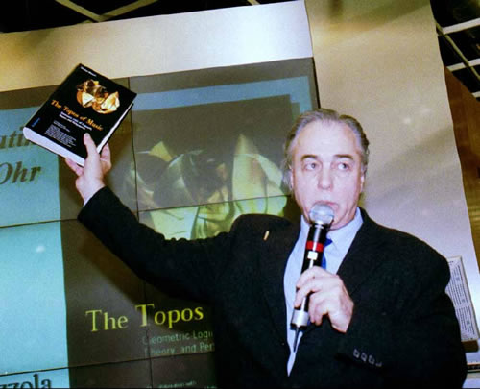
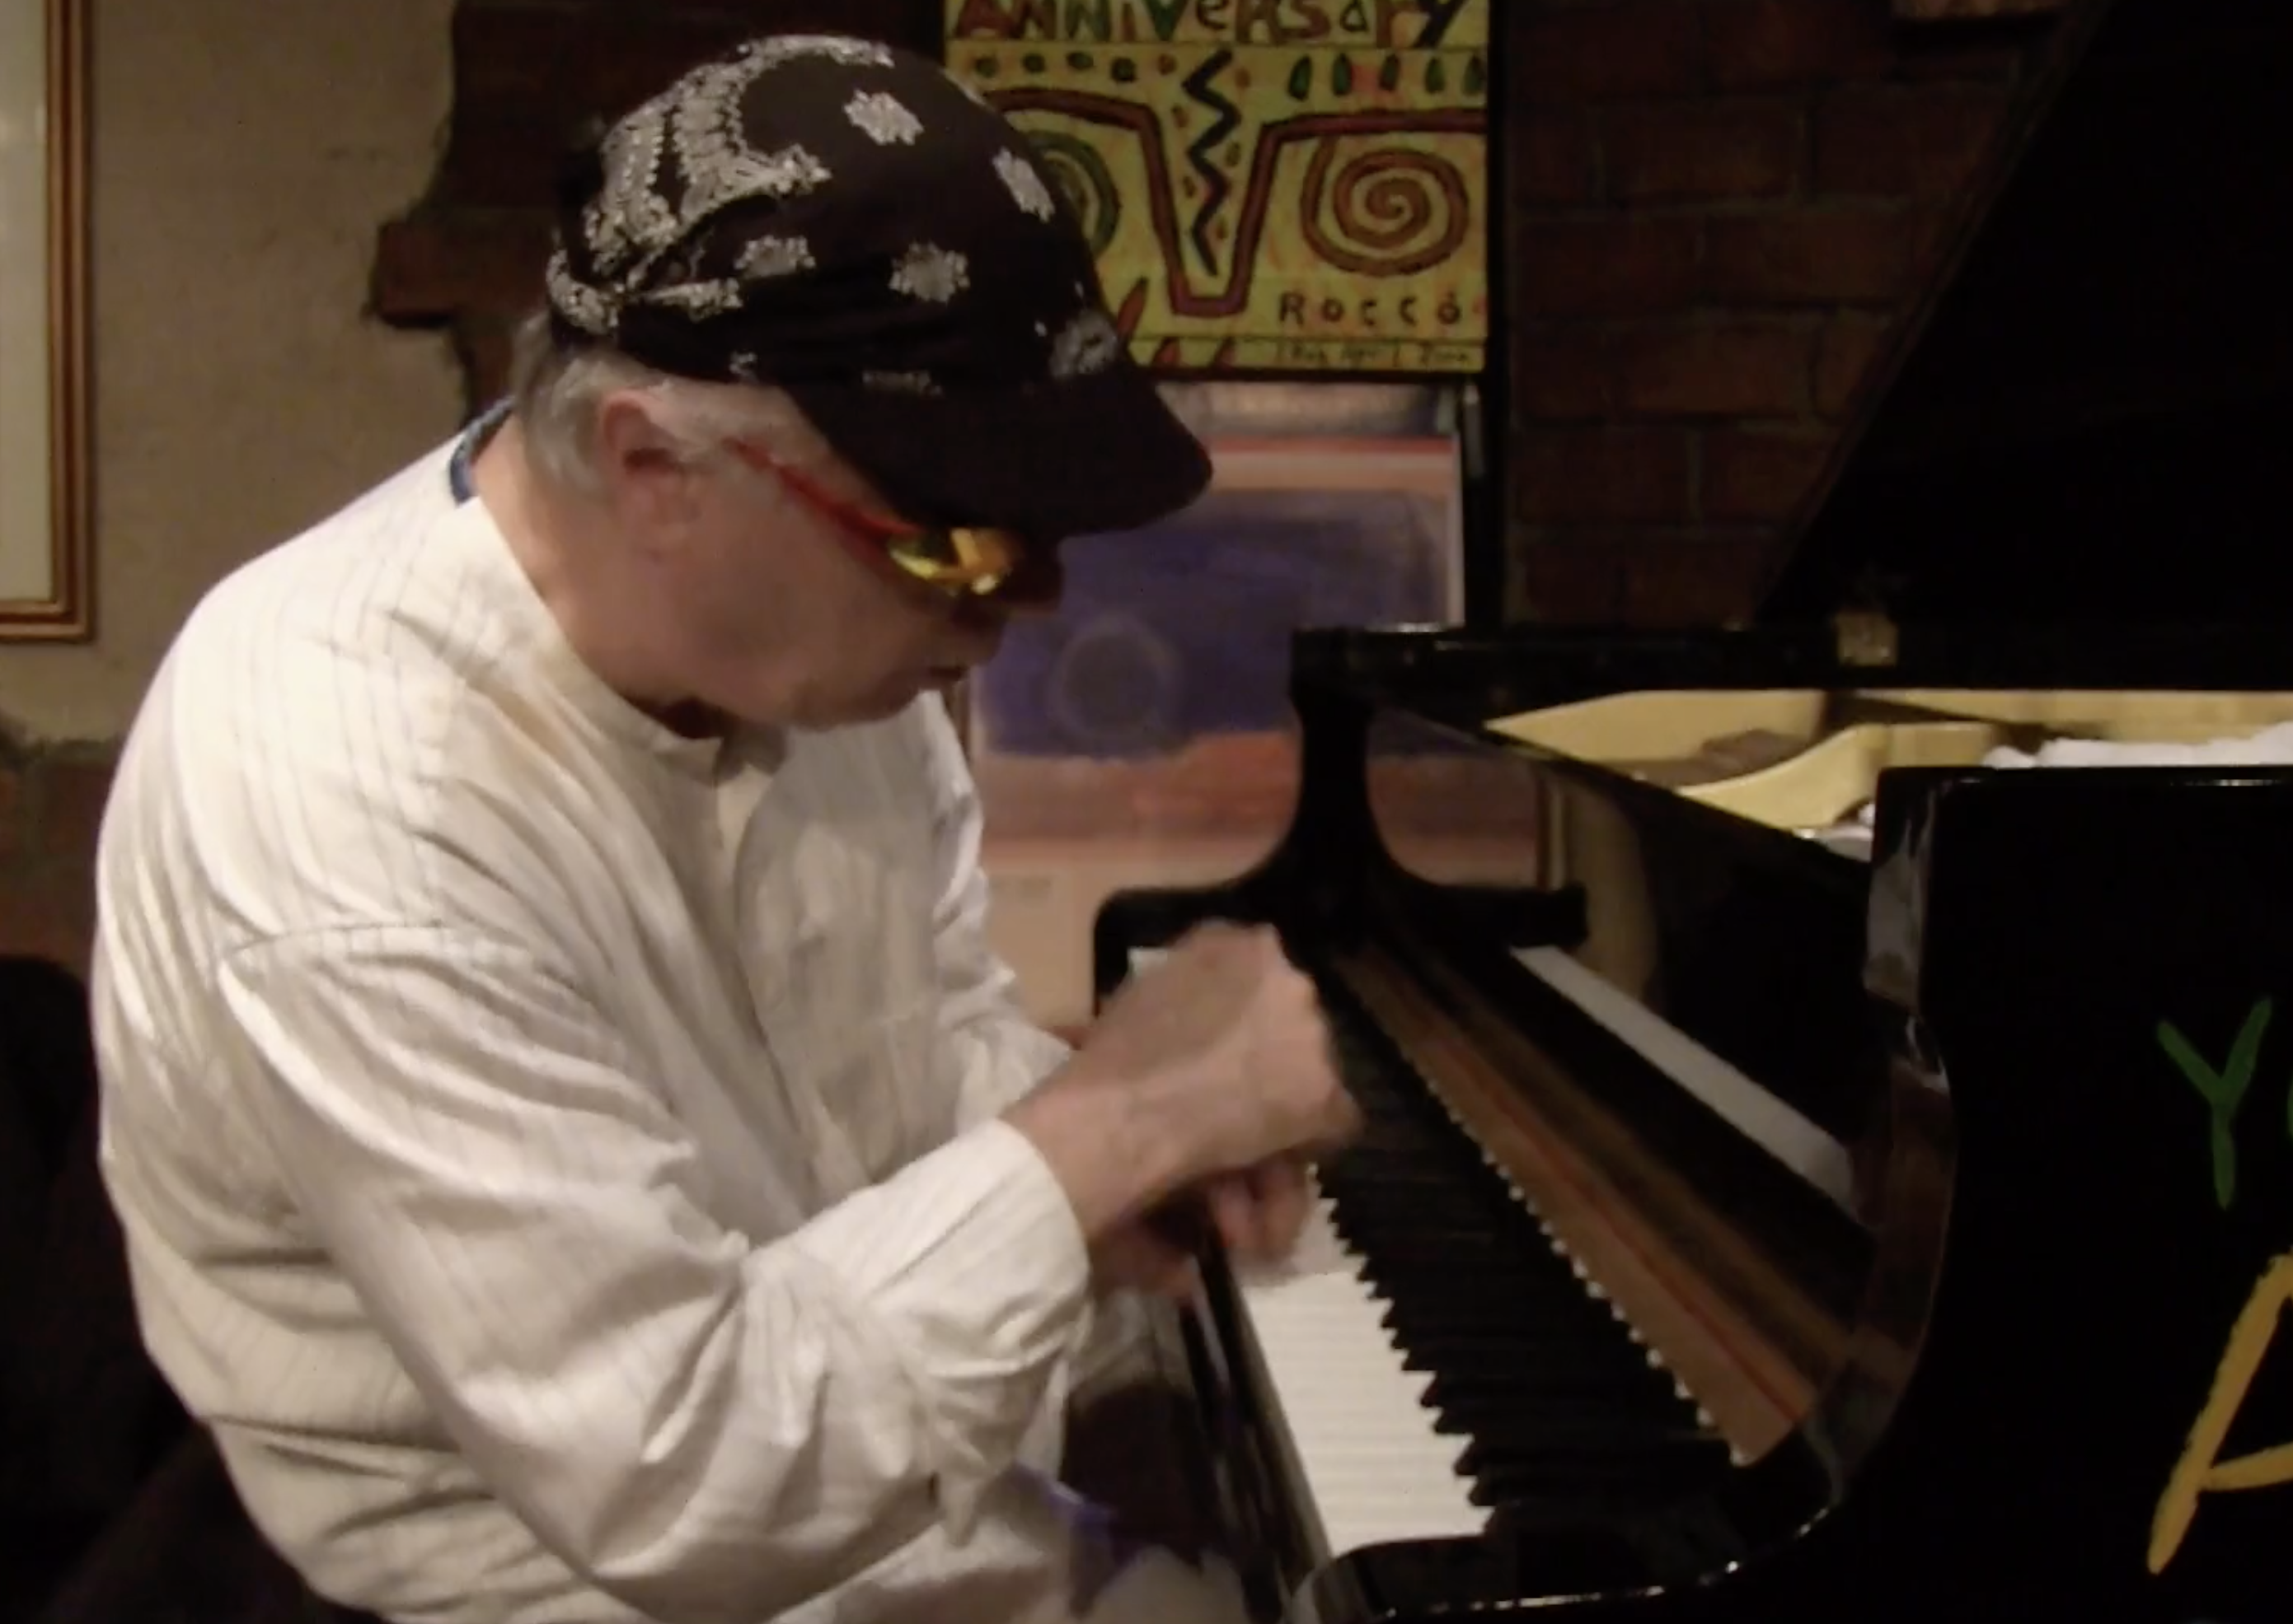
The IRCAM Crisis
Talk in May 2002
Book „The Topos of Music“ finished
My Gestural Approach to Piano Improvisation in the movie
„Imaginary Time“ at Airegin Jazz Club 2014

Slide 29
Table of Contents
General Principles of Concept Architectures
The Formalism of Denotators and Forms
Simple Forms
Compound Forms
Implementation on the Rubato Software
The IRCAM crisis
Gestures
General Addresses
Hyergestures and Hypercompositions
The Escher Theorems
Music Theory for Compositions and Gestures

Slide 30
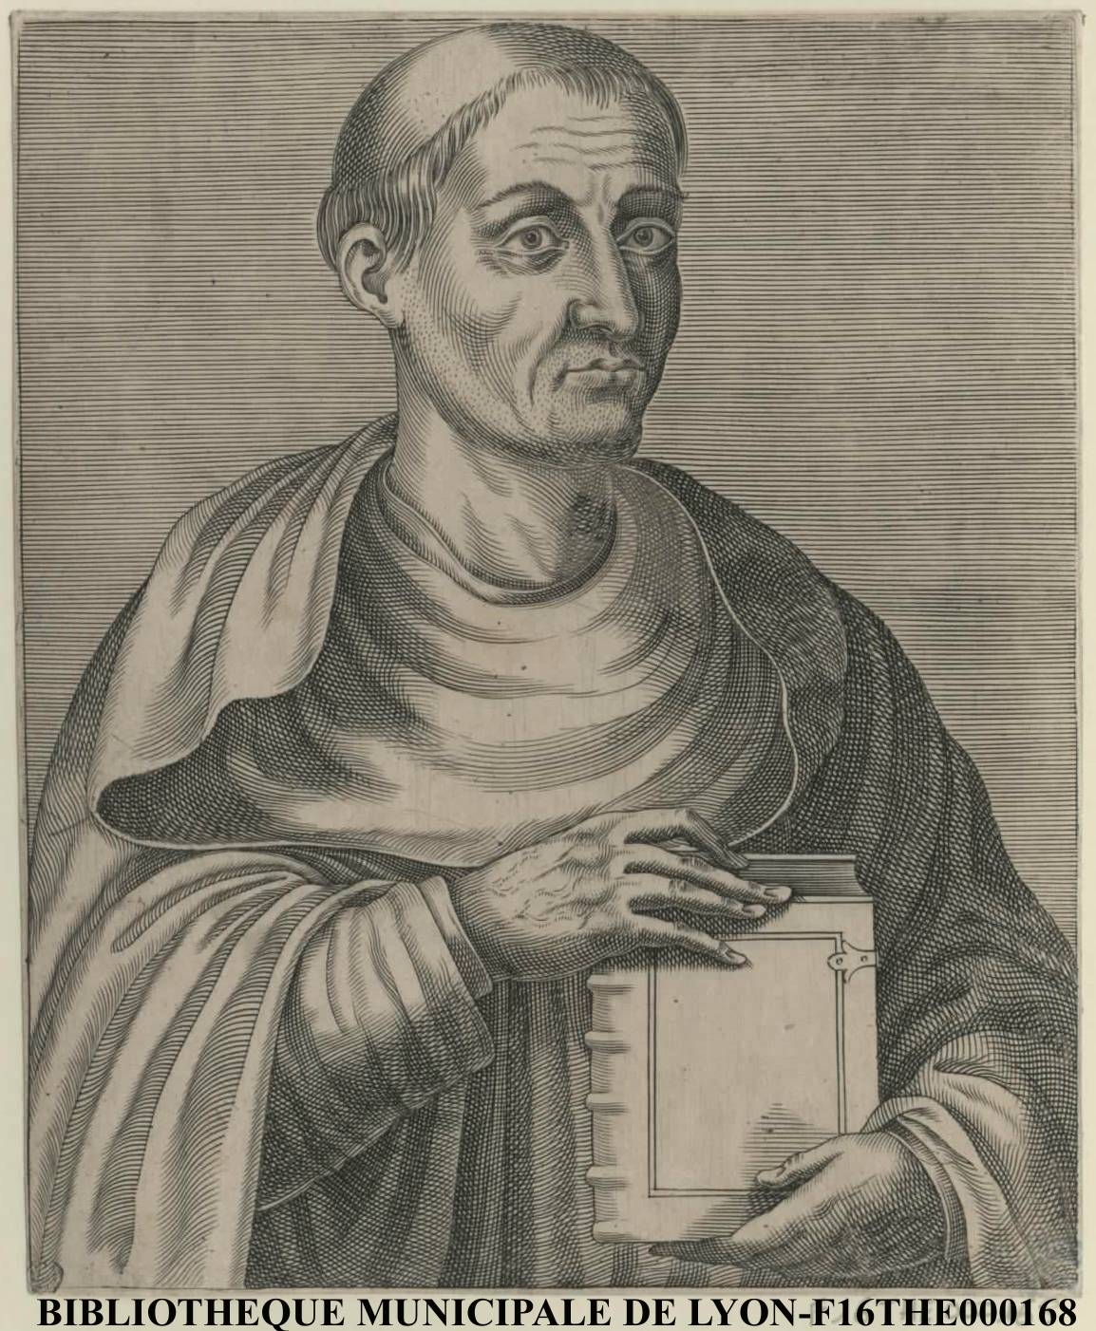
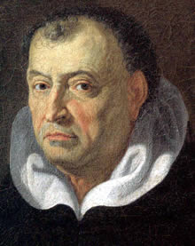
Origins of gesture philosophy:
Hugues de Saint-Victor gives a most adequate definition:
“Gestus est motus et figuratio membrorum corporis, ad omnem agendi et habendi modum.” (Gesture is the movement and figuration of the body’s limbs with an aim, but also according to the measure and modality proper to the achievement of all action and attitude.)
Hugues de Saint-Victor
(1097-1141)
Tommaso Campanella : (Philosophia Rationalis 1637-38, Paris, Du Bray):
“...omnes propositiones per singulares tamquam ad digitum exponuntur.” (...pointing with your finger is the only certitude)
Tommaso Campanella
(1565-1639)

Slide 31
→
Gesture = digraph morphism g: Γ → (= Γ-addressed point) in spatial digraph X (= digraph of continuous curves I → X, I = [0,1])
of topological space X
X
→
body
skeleton
pitch
g
X
Γ
time
position

Slide 32
Table of Contents
General Principles of Concept Architectures
The Formalism of Denotators and Forms
Simple Forms
Compound Forms
Implementation on the Rubato Software
The IRCAM crisis
Gestures
General Addresses
Hyergestures and Hypercompositions
The Escher Theorems
Music Theory for Compositions and Gestures

Slide 33
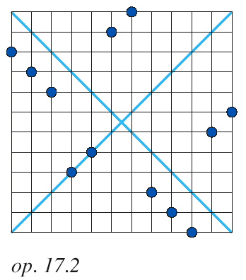
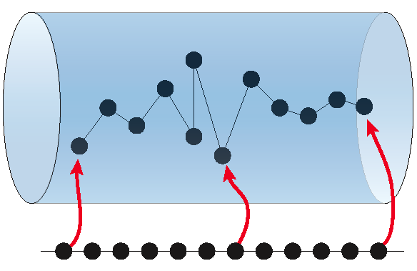
Dodecaphonic Series
Ÿ₁₂
S
e₁
e₁₂
A = Ÿ¹¹ = {e₁, e₂,... e₁₂},
F = PitchClass:.Simple(Ÿ₁₂)
S: Ÿ¹¹ → Ÿ₁₂
e_{i} ~> S_{i}
S = (S₁, S₂, ... S₁₂)

Slide 34
Generalize!
Ÿ¹¹ ~ {e₁, e₂,... e₁₂} ~ {1, 2,...12}
S: Ÿ¹¹ → ParameterSpace (e.g. ParameterSpace = PitchClass, Duration,...)
S = (S₁, S₂, ... S₁₂)
i ~> S_{i} i = 1, 2, 3,... 12

Slide 35
„address“ B
f ∘ g
address change g
f
space F
„address“ A
A@F
Notes:
Look differnetly at spaces! Take points as being affine homomorphisms from the zero space A=0. Here is the generic notation and visualization: Apoint is an A-parametrized set of points in F.

Slide 36
Hierarchy of forms for gestures:
So for gestures, we have the same compound form types: limit, colimit, and powerset.
But the simple gestural forms are all defined for spatial digraphs X of topological spaces X.
Limit Colimit Powerset compound forms
Simple Gesture simple gestural forms
→
Simple Composition Simple module forms

Slide 37
Table of Contents
General Principles of Concept Architectures
The Formalism of Denotators and Forms
Simple Forms
Compound Forms
Implementation on the Rubato Software
The IRCAM crisis
Gestures
General Addresses
Hyergestures and Hypercompositions
The Escher Theorems
Music Theory for Compositions and Gestures

Slide 38
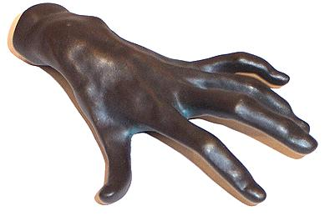
Space of gestures with skeleton Γ and body in X is a topological space.
Notation: Γ@X
→
gestures of gestures of....
= hypergestures!
pitch
tip space
realistic forms?
p
Γ
time
position

Slide 39
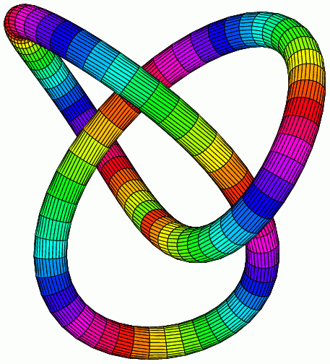
→
Γ @X = topological space of gestures of directed graph Γ in a topological space X
Hypergestures!
„loop of loops “
knot
circle

Slide 40
hypergesture
time
space
space
Space-time X

Slide 41
Look at fanfare of Beethoven‘s op. 106 to understand rhythm!
1/8
1/8

Slide 42
repetition of halting gesture
halting of repetition gesture
halting gesture
repetition gesture

Slide 43
Some hyper-denotators for compositions and gestures:
hyper-denotators for compositions - c ∈ ℤ^{d} @ ℤ¹¹ @ ℤ₁₂ = Hom(ℤ^{d} , Hom(ℤ¹¹, ℤ₁₂), a d+1-sequence of 12-tone rows (address = ℤ^{d} ), e.g., Boulez‘s Structures pour deux pianos: ℤ³ @ ℤ¹¹ @ ℤ₁₂, four series.
hypergestures - performance hypergestures: p ∈↑@ℝ^{EHLD} - performance deformation q ∈↑@↑@ℝ^{EHLD}
here, ↑@ℝ^{EHLD} is a topological space, so we may continue!

Slide 44
Performance fields are gestures!
morphism of gestures!
H
h
L
l
performance field
E
diagonal field
e
skeleton of an integral curve!

Slide 45
Table of Contents
General Principles of Concept Architectures
The Formalism of Denotators and Forms
Simple Forms
Compound Forms
Implementation on the Rubato Software
The IRCAM crisis
Gestures
General Addresses
Hyergestures and Hypercompositions
The Escher Theorems
Music Theory for Compositions and Gestures

Slide 46
Escher categories???
Diamond conjecture
The Escher Theorem:
Let p be a permutation of numbers 1,2,...n.
hyper-denotators for compositions - for a sequence of modules M₁, M₂,... M_{n}, M we have a isomorphism
M₁@M₂ @... M_{n} @ M ≌ M_{p1}@M_{p2} @... M_{pn} @ M
hypergestures - for a sequence of digraphs Δ₁, Δ₂,... Δ_{n}, and space X we have a isomorphism
Δ₁@Δ₂ @... Δ_{n} @ X ≌ Δ_{p1}@Δ_{p2} @... Δ_{pn} @ X
Example: counterpoint!
→
→
→
→
→
→

Slide 47
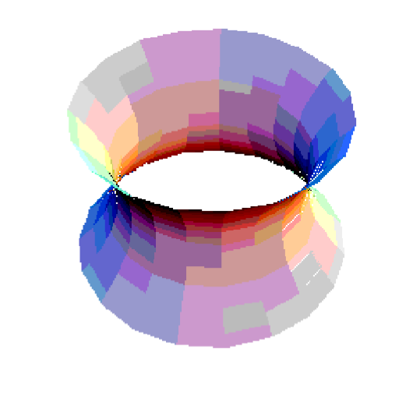

Slide 48
Table of Contents
General Principles of Concept Architectures
The Formalism of Denotators and Forms
Simple Forms
Compound Forms
Implementation on the Rubato Software
The IRCAM crisis
Gestures
General Addresses
Hyergestures and Hypercompositions
The Escher Theorems
Music Theory for Compositions and Gestures

Slide 49
Tonal Modulation Theory
There is a model over the category Mod of modules, using symmetries between local compositions.
There is now also a model over the category Digraph, using gestural morphisms.
Both models yield the same results (pivotal chords in Schoenberg‘s conceptualization from his harmony book, 1911).

Slide 50
Harmonic band of major scale C⁽³⁾
II
VI
V
IV
I
VII
III

Slide 51
A
e^{t}
e^{t}.A
S⁽³⁾
T⁽³⁾
e^{t}
k
k
modulation S⁽³⁾ → T⁽³⁾ = „cadence + symmetry “

Slide 53
[X,Y]-integral curves are force fields for gestures of modulation theory
VII_{C}
VII_{F}

Slide 54
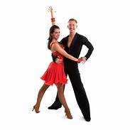
Global Gestures
body 2
gesture
body 1
gesture
shared
subgesture

Slide 55
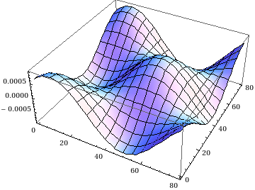
There is a good counterpoint model over the category Mod, but it is an open question, whether there is a corresponding model over the category Digraph.
The general problem is to search for general correspondences of models and theorems in these two conceptual architectures.
Conceptually, we may at least state that the generalization from local compositions to global compositions works also for the construction of global gestures.
But the existing classification of global compositions is not yet paralleled by a classification of global gestures.
The latter is mathematically difficult, because it would include as a special case the classification of closed gestures, which corresponds to the inexistent classification of knots.
The knot type of gestures appears in the description of conductors’ gestures.

