Slide 1
V THREE COLLABORATIVE PILLARS
V.2 (Tue March 26) Gesture Theory (2)

Slide 2
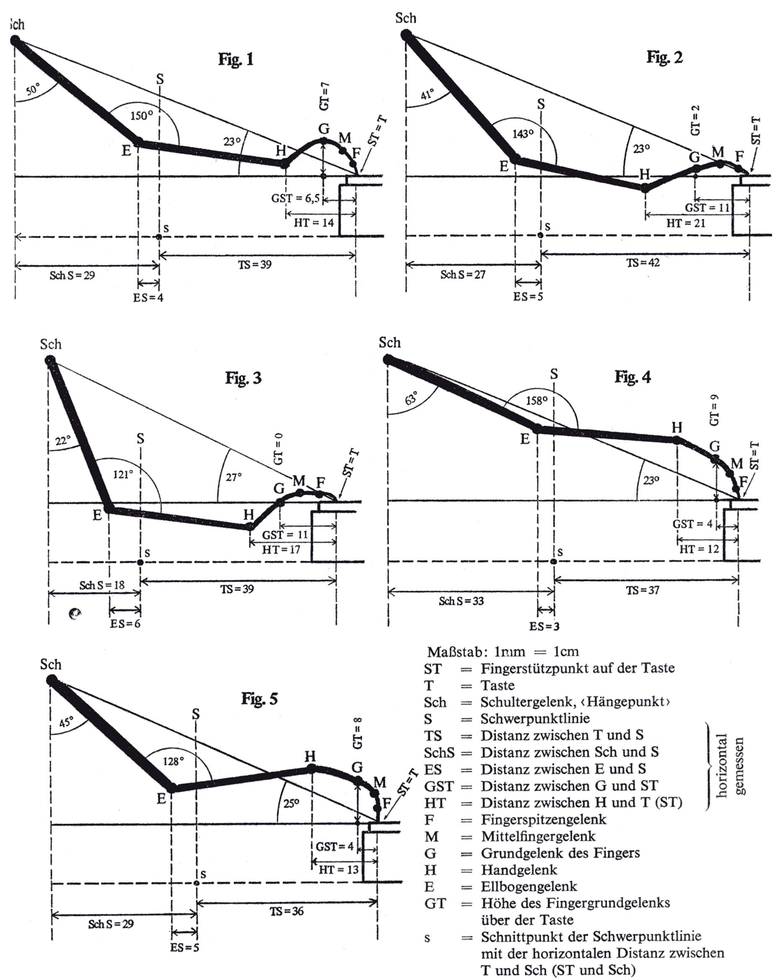
Ceslaw Marek:
Lehre des
Klavierspiels
Atlantis-Verlag
Zürich 1972/77

Slide 4
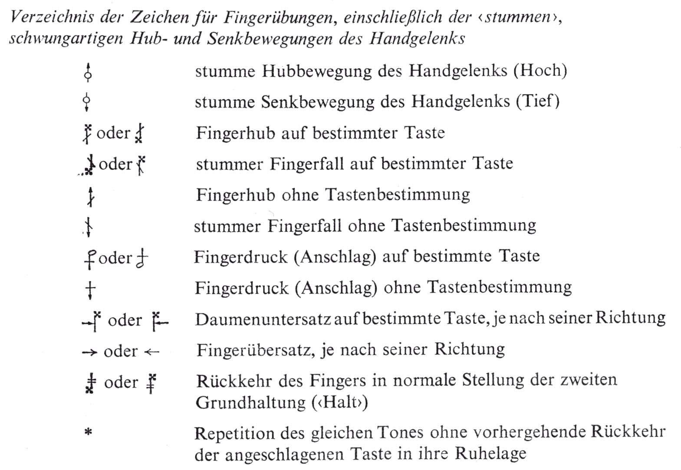
Folie 2

Slide 5
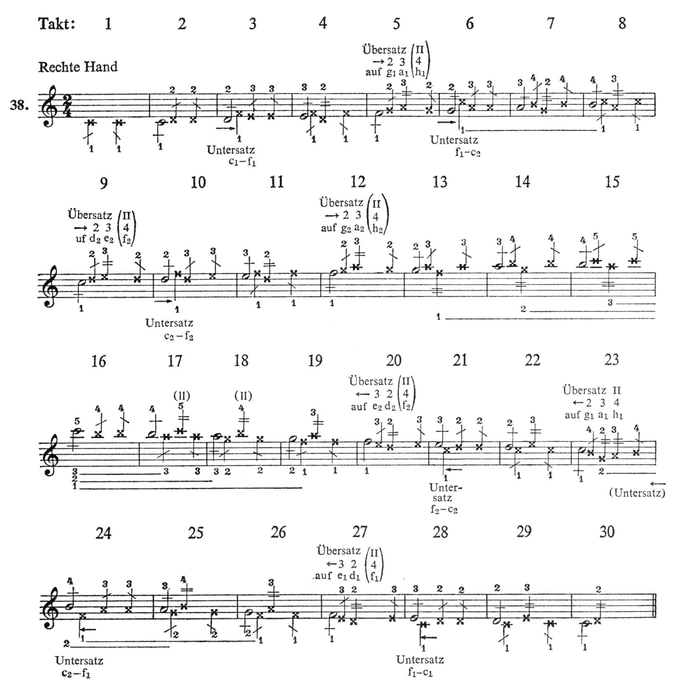
playing C major scale
Folie 2

Slide 6
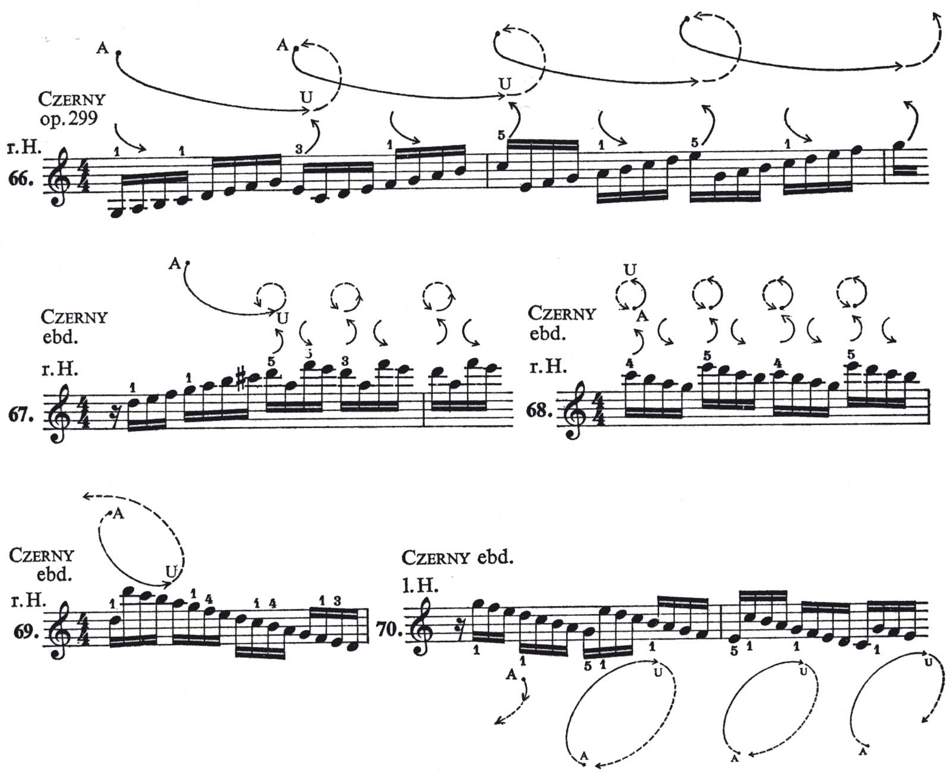
Folie 2

Slide 7
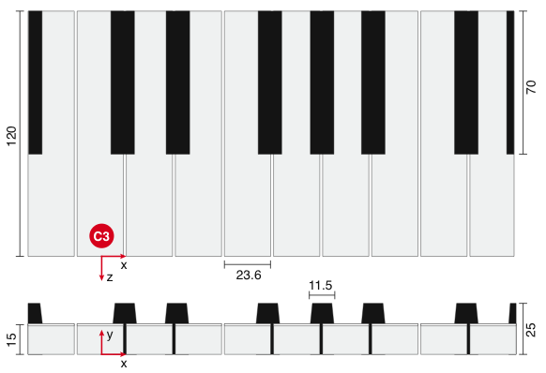
C3
DIN8996

Slide 8
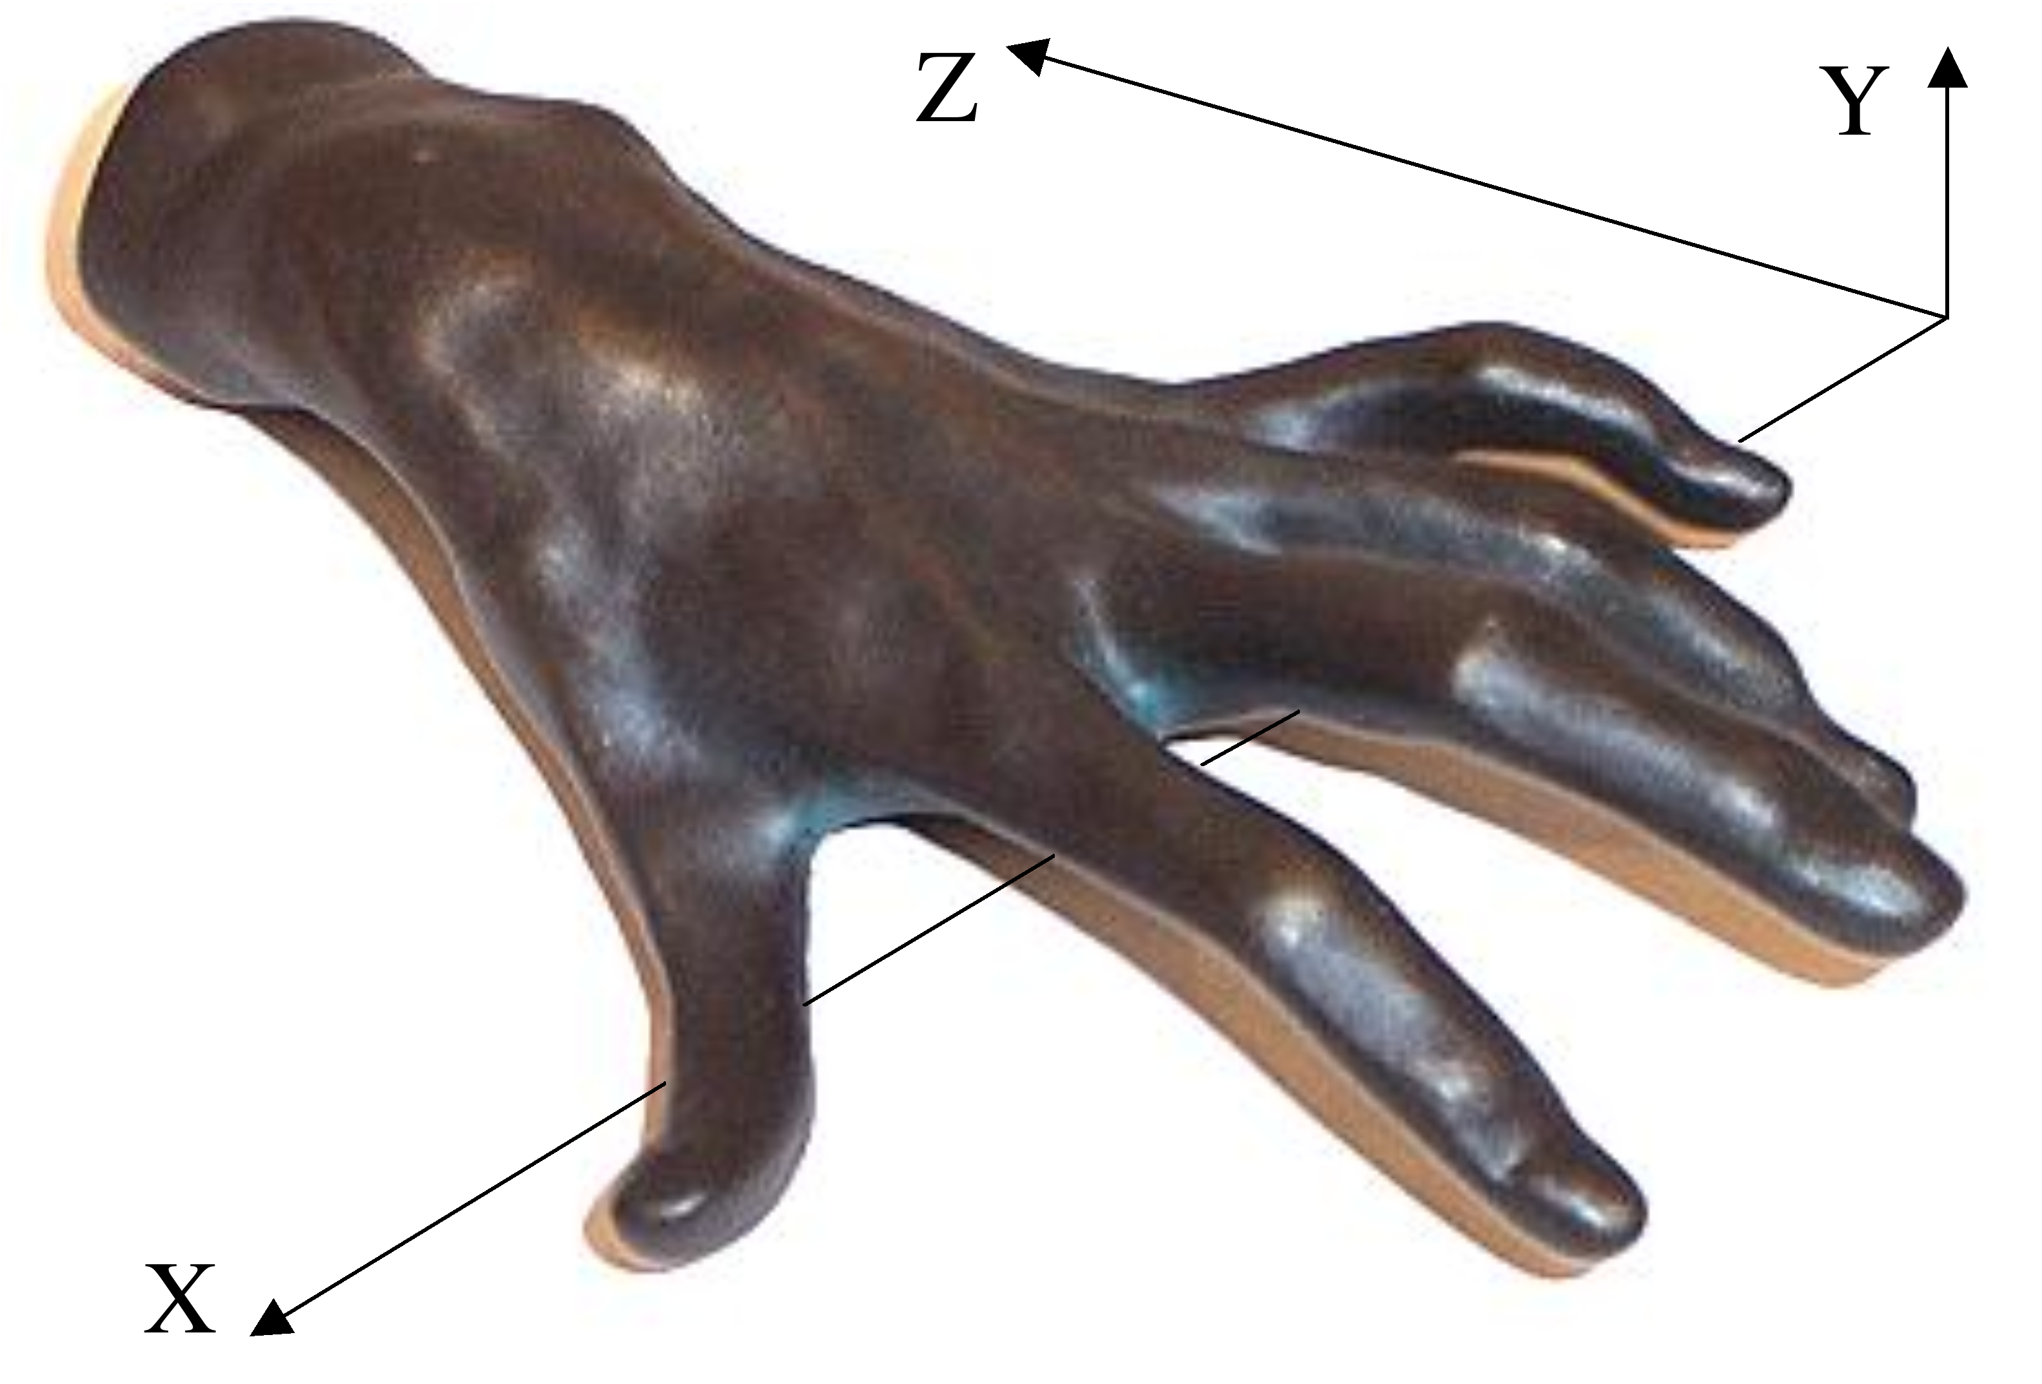
One hand ⇒ 6 gestural curves in space-time (x,y,z;e) of piano
j = 1, 2, ... 5: tips of fingers
j = 6: the carpus
e = time
y
z
γ
γ
(t
)
6
(t
)
6
γ
γ
(t
)
5
(t
)
5
γ
γ
(t
)
4
(t
)
4
γ
γ
(t
)
3
(t
)
3
γ
γ
γ
γ
(t
)
(t
)
(t
)
x
(t
)
2
1
2
1

Slide 9
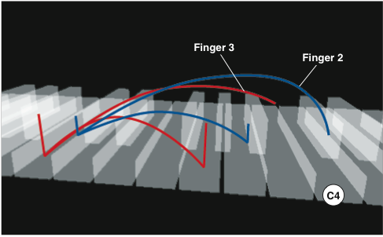
Graphics of sequence of gestural curves
finger 3
finger 2
C4

Slide 10
Gestural interpretation of Carl Czerny‘s op. 500

Slide 11
Stefan Müller
Notes:
More precisely, performance is a transformation P from the symbolic reality of the score to the physical reality of sounds (a quarter note is not determined in its physical duration, only the metronome yields the relation between symbolic reality and physical reality).
The mathematical analysis of tempo and pitch transformations shows that the performance transformation P can be described by a performance vector field, as shown to the left in the symbolic parameter space.
Essentially, performance is calculated via integration of such performance vector fields, much as the time is calculated via integration of the tempo curve.
In this language, performance operators are built in order to produce new performance fields from the old ones inherited from the relative mothers.

Slide 12
pitch
tip space
onset
position

Slide 13
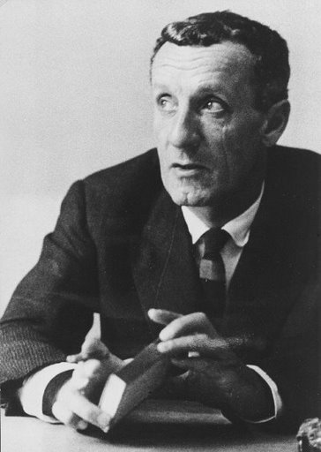
Cognitive Science and Philosophy of Language
Maurice Merleau-Ponty:
Phenomenology of Perception (1945) “The word and speech must somehow cease to be a way of designating things or thoughts, and become the presence of that thought in the phenomenal world,
and, moreover, not its clothing but its token or its body.”

Slide 14
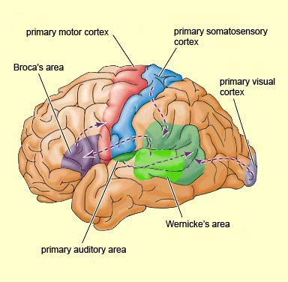
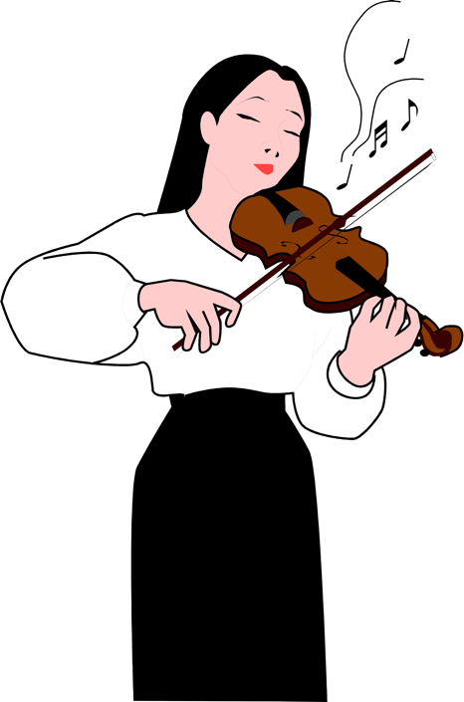
Speech and Music Gestures
primary motor cortex
primary somatosensory cortex
Broca‘s area
primary visual cortex
Wernicke‘s area
primary auditory area

Slide 15
Hugues de Saint-Victor (French theologist XIIth Century):
Gestus est motus et figuratio membrorum corporis, ad omnem agendi et habendi modum.
Gesture is the movement and figuration of the body‘s limbs proper to the achievement of all action and attitude.
body
skeleton
pitch
g
X
Γ
time
position

Slide 16
Renate Wieland & Jürgen Uhde: Forschendes Üben
Die Klangberührung ist das Ziel der zusammenfassenden Geste, der Anschlag ist sozusagen die Geste in der Geste.
The sound contact is the target of the embracing gesture, the touch is so to speak the gesture within the gesture.
pitch
gestures of gestures of....
= hypergestures!
tip space
realistic forms?
p
Γ
time
position

Slide 17
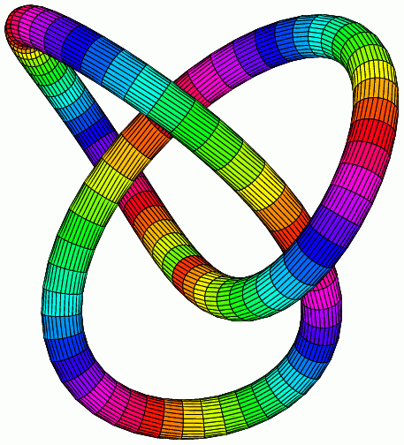
→
Γ @X = topological space of gestures of directed graph Γ in a topological space X
Hypergestures!
„loop of loops “
knot
circle

Slide 18
ET-dance gesture
time
space
space

Slide 19
g
E
h
hypergesture impossible!

Slide 20
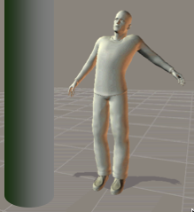
e
z
y
x

Slide 21
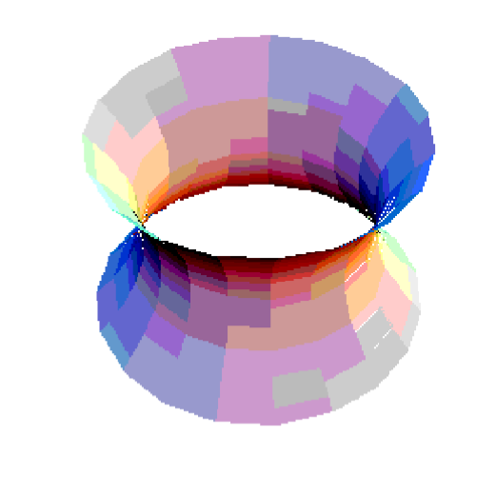

Slide 22
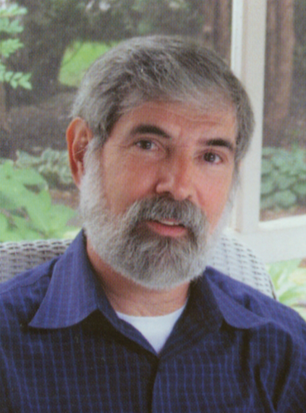
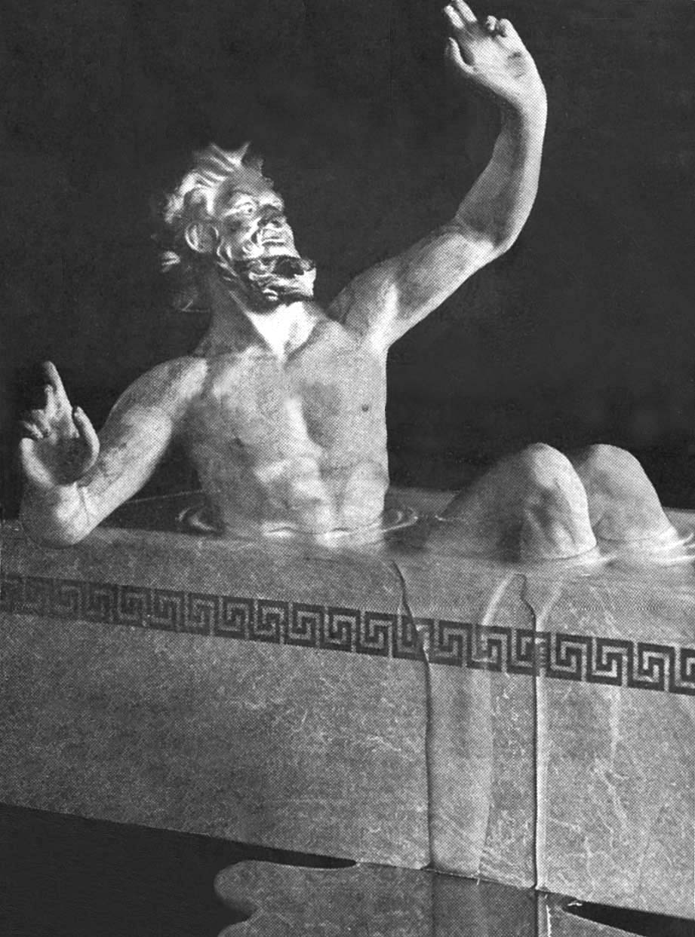
Musical Poetology
Michael Cherlin („Schoenberg‘s Musical Imagination“ 2007)
Metaleptic Schoenberg: Trope of metaphor of a metaphor ~ hypergesture.
Search for a language for the musical drama, which is neither emotional program nor structural formalism but a thinking in music...
eureka!
He's a couch potato

Slide 23
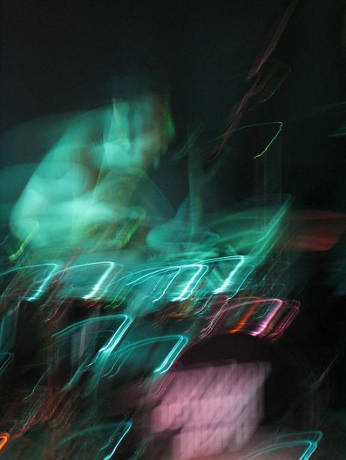
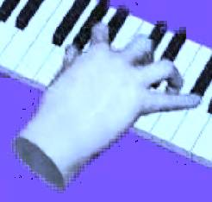
Problem: The discrete and the continuous... (Hatten et al.) Have often discrete sequence of events, gestures etc. in space-time. Connection?

Slide 24
Lynn A. Cooper and Roger N. Shepard (U Pittsburg/U Stanford 1978): 3DMR = Three dimensional mental rotation
Hypergestures!
We perform mental rotations, i.e. gestural curves between the shapes

Slide 25
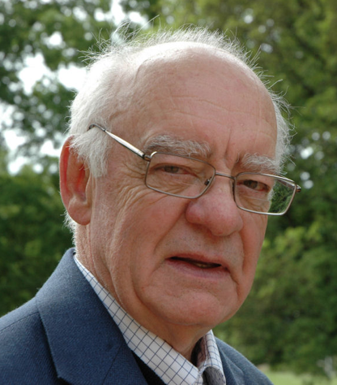
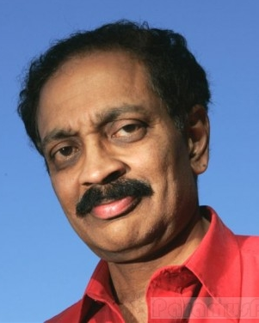
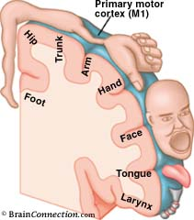
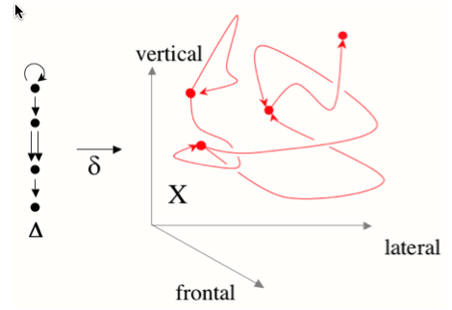
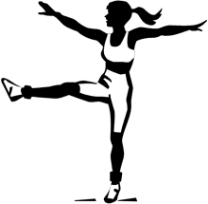
Mirror-Neurons in anthropology and cognitive science:
Anthropolgist Merlin W. Donald: cultural human evolution via gestural memesis.
Neurologist Vilayanur S. Ramachandran: Mirror neuron „resonance“ plays in psychology the role of DNA copying in molecular biology.
?
Body & Environment
Homunculus
Gestures
Cognition
LANGUAGE
Perhaps one should proceed in the other direction: First the simplest transformations of thoughts to gestures, then the difficult ones.
mirror neurons
LOGIC
(A & B) ⇒ C
MATHEMATICS
X² + 2X-3 = 0

