Slide 1
V THREE COLLABORATIVE PILLARS
V.1 (Thu March 21) Gesture Theory

Slide 2
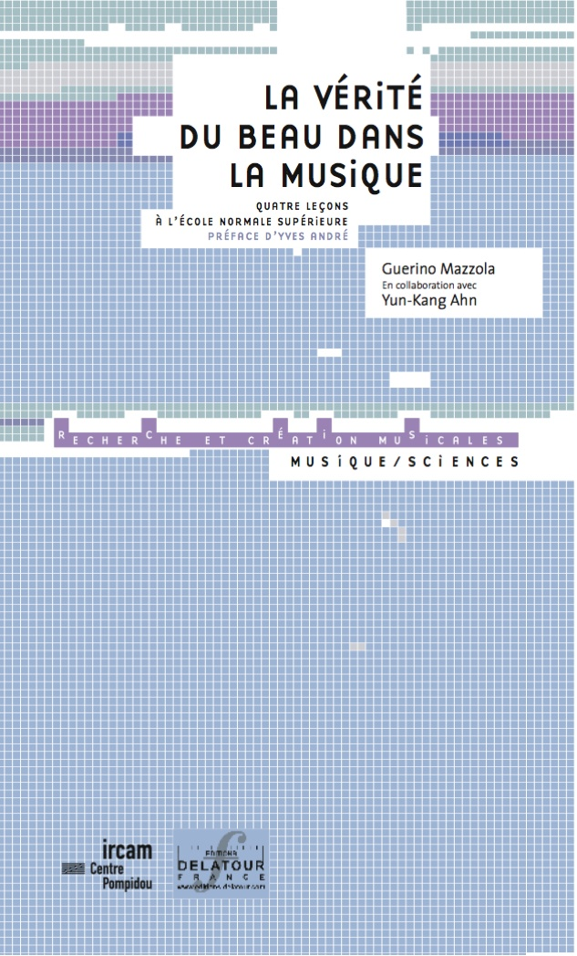
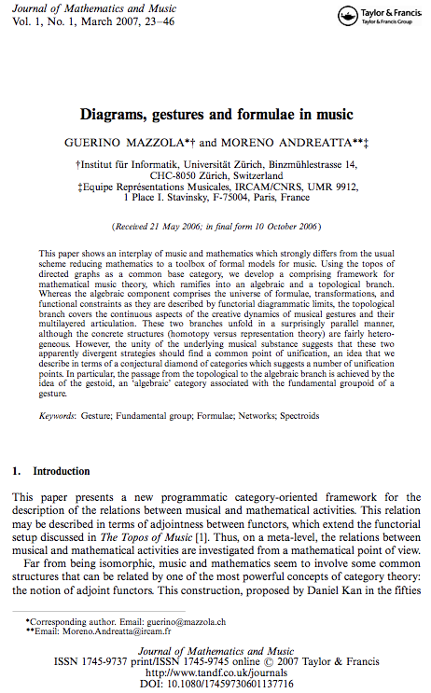
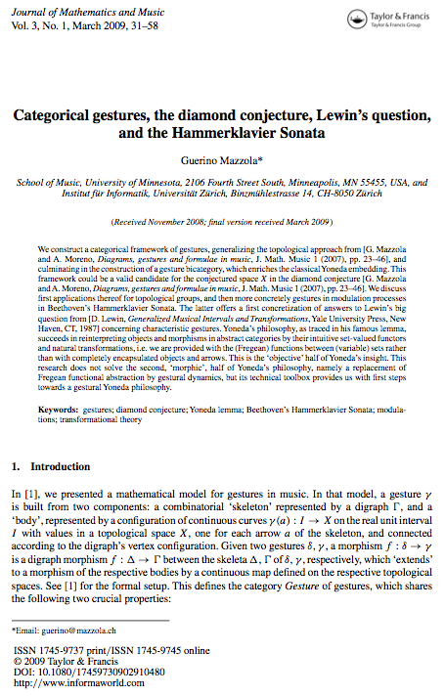

Slide 3
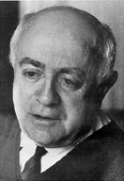
Gestures in Performance Theory
Theodor W. Adorno („Zu einer Theorie der musikalischen Reproduktion“ 1946):
Danach wäre die Aufgabe des Interpreten, Noten so zu betrachen, bis sie dem insistenten Blick in Originalmanuskripte sich verwandeln; nicht aber als Bilder der Seelenregung des Autors — sie sind auch dies, aber nur akzidentiell — sondern als die seismographischen Kurven, die der Körper der Musik selber in seinen gestischen Erschütterungen hinterlassen hat.
Correspondingly the task of the interpreter would be to consider the notes until they are transformed into original manuscripts under the insistent eye of the observer; however not as images of the author‘s emotion—they are also such, but only accidentally—but as the seismographic curves, which the body has left to the music in its gestural vibrations.

Slide 4
Neumes

Slide 5
Gestures in Performance Theory
(Jürgen Uhde &) Renate Wieland („Forschendes Üben“ 2002):
Affekte waren ursprünglich ja Handlungen, bezogen auf ein Objekt draussen, im Prozess der Verinnerlichung haben sie sich von ihrem Gegenstand gelöst, aber immer noch sind sie bestimmt von den Koordinaten des Raumes. (...) Es gibt mithin etwas wie gestische (Raum-)Koordinaten.
Originally affects were actions, related to an exterior object, along the process of interiorization they were detached from their object, but they are still determined by the coordinates of space. (...) There is therefore something like gestural (space) coordinates.

Slide 6
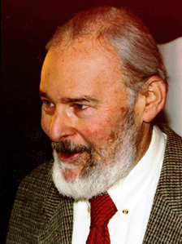
Musical Transformational Theory
David Lewin („Generalized Musical Intervals and Transformations“ 1987):
If I am at s and wish to get to t, what characteristic gesture should I perform in order to arrive there?
This attitude is by and large the attitude of someone inside the music, as idealized dancer and/or singer. No external observer (analyst, listener) is needed.
Compare Gould and Horowitz for LvB op. 57!

Slide 7
mathematics of Lewin‘s transformational theory
S
T
?
K
P
Diagrams are only the „skeletons“ of gestures, the „flesh“ is missing.
Q

Slide 8
algebra compactifies gestures to symbolic formulas
rotation
matrix equation
a₁₁x+a₁₂y+a₁₃z = a
a₂₁x+a₂₂y+a₂₃z = b
a₃₁x+a₃₂y+a₃₃z = c
a₁₁ a₁₂ a₁₃
a₂₁ a₂₂ a₂₃
a₃₁ a₃₂ a₃₃
x
y
z
a
b
c
=

Slide 9
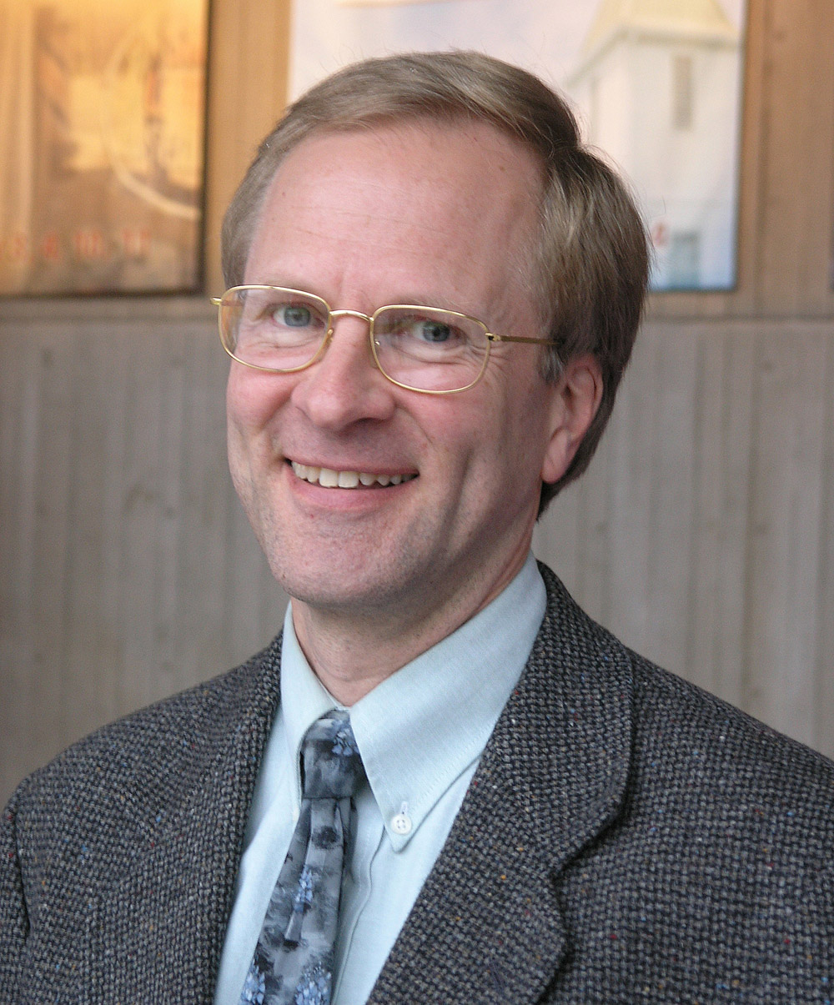
Music Theory
Robert S. Hatten („Interpreting Musical Gestures, Topics, and Tropes“ 2004, p.113)
Given the importance of gesture to interpretation, why do we not have a comprehensive theory of gesture in music?
p.109: Gesture is most generally defined as communicative (whether intended or not), expressive, energetic shaping through time (including characteristic features of musicality such as beat, rhythm, timing of exchanges, contour, intensity), regardless of medium (channel) or sensory-motor source (intermodal or cross-modal).
At a higher, more symbolic cognitive level, the representation of gesture may be considered amodal, in that it is not restricted to any particular modality.

Slide 10
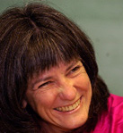
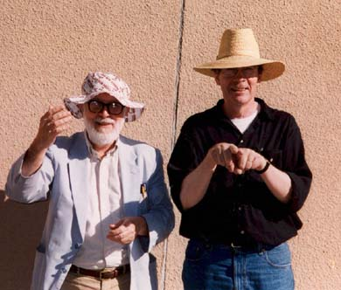
Psychological Gesture Theory
Presemiotic gestures: Susan Goldin-Meadow Hearing gesture: How our hands help us think. Cambridge, MA.: Harvard UP, 2003 Advances in mathematical reasoning are very likely to come first in gesture—and they do. Do new ideas always come first in gesture, regardless of domain?
Gestural semiotics (gestures are signs in semiotic systems): Adam Kendon, David McNeill

Slide 11
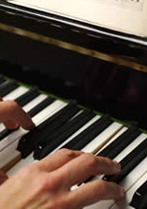
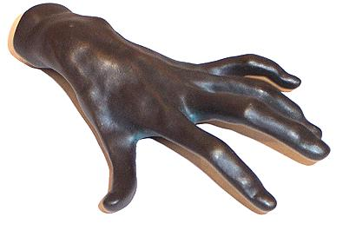
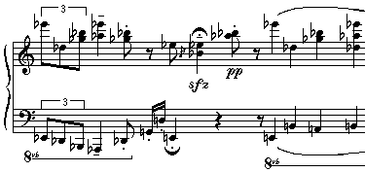
gestures
sound events
pitch
h
instrumentalize
time
e
position
l
instrumental- interface
thaw
℘
Instruments/ playing action
Musical sound
freeze
score
Musical theory/ notation
Tellef Kvifte: Instruments and the electronic Age.
Solum forlag, Oslo, 1988
analysis
Notes:
More precisely, performance is a transformation P from the symbolic reality of the score to the physical reality of sounds (a quarter note is not determined in its physical duration, only the metronome yields the relation between symbolic reality and physical reality).
The mathematical analysis of tempo and pitch transformations shows that the performance transformation P can be described by a performance vector field, as shown to the left in the symbolic parameter space.
Essentially, performance is calculated via integration of such performance vector fields, much as the time is calculated via integration of the tempo curve.
In this language, performance operators are built in order to produce new performance fields from the old ones inherited from the relative mothers.

Slide 12
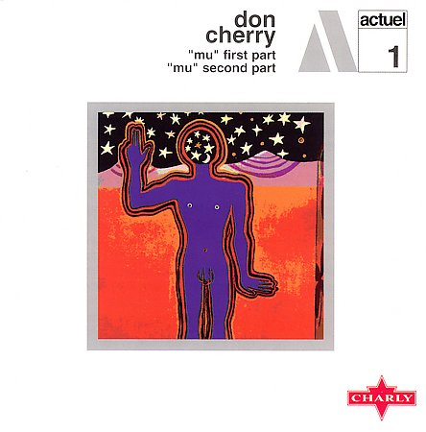
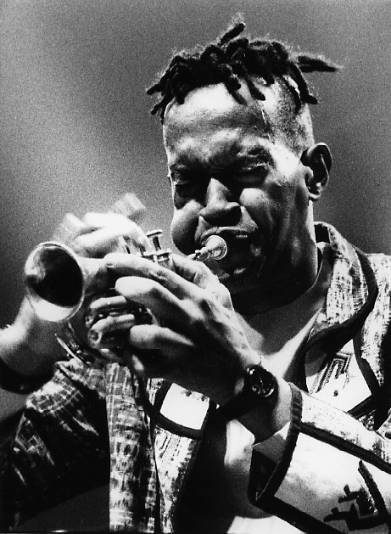
Don Cherry vocals, pocket trumpet, flute, piano, percussion, bells Ed Blackwell drums, percussion, bells
producd by Jean Karakos and Jean Luc Young recorded August 22, 1969 (at?)
Brilliant Action 8:44 Amejelo 7:29 Total Vibration 9:28 Sun Of The East 7:54 Terrestrial Beings 4:35 Mysticism Of My Sound 3:53 Dollar Brand/ 2:43 Spontaneous Composing/ Exert, Man On The Moon Bamboo Night 7:00 Teo-Teo Can 6:04 Smiling Faces, Going Places 4:42 Psycho Drama 2:23 Theme: Albert Heath/ 4:01 Theme: Dollar Brand/ Babyrest, Time For...
„Throwing gestures to each other“

Slide 13
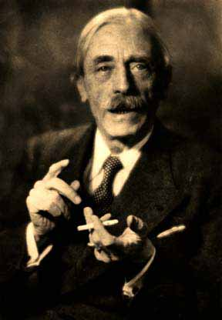
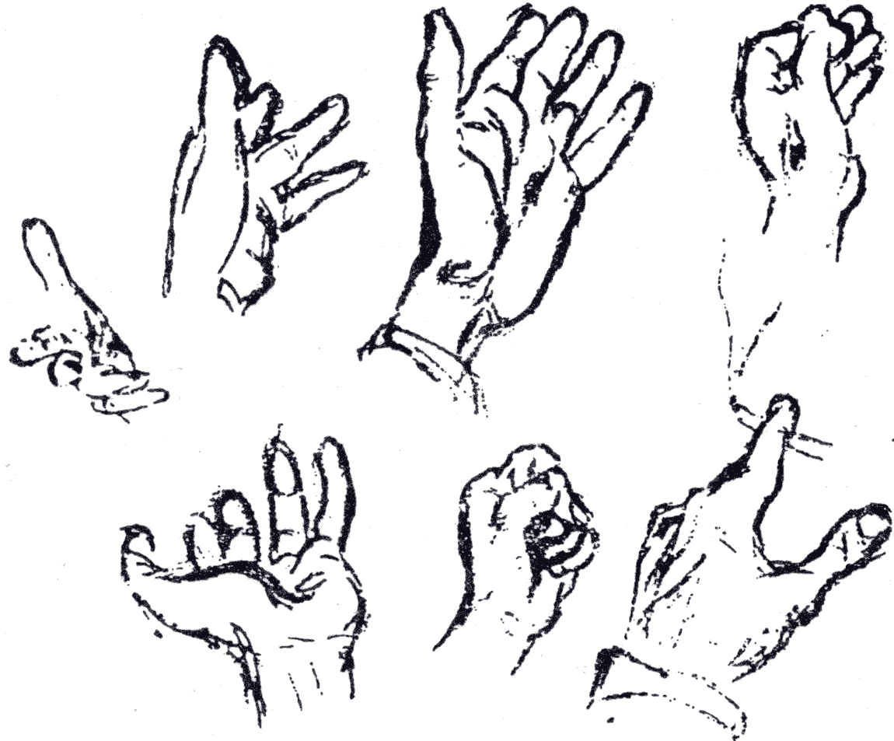
DANS CES MURS VOUÉS AUX MERVEILLES
J’ACCUEILLE ET GARDE LES OUVRAGES
DE LA MAIN PRODIGIEUSE DE L’ARTISTE
ÉGALE ET RIVALE DE SA PENSÉE
L’UNE N’EST RIEN SANS L’AUTRE
(Paul Valéry, Palais Chaillot)
Paul Valéry
IN THESE WALLS DEVOTED TO THE MARVELS
I REVCEIVE AND KEEP THE WORKS
OF THE ARTIST'S PRODIGIOUS HAND
EQUAL AND RIVAL OF HIS THOUGHT
ONE IS NOTHING WITHOUT THE OTHER.

Slide 14
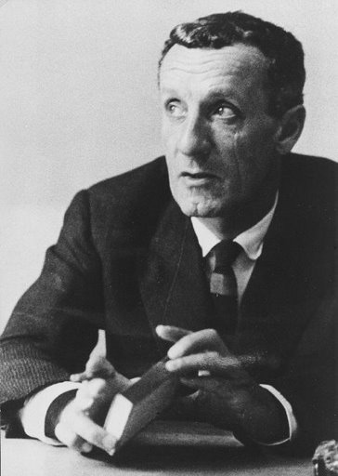
Philosophy of Language
Maurice Merleau-Ponty:
Phenomenology of Perception (1945) “The word and speech must somehow cease to be a way of designating things or thoughts, and become the presence of that thought in the phenomenal world,
and, moreover, not its clothing but its token or its body.”

Slide 15
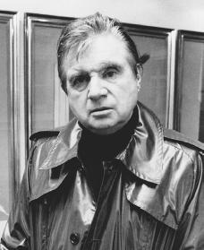
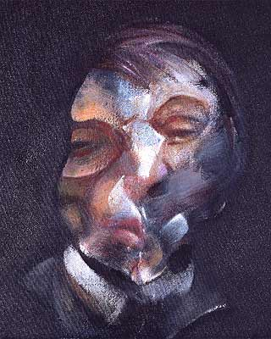
Francis Bacon
The marks are made, and you survey the thing like you would a sort of graph. And you see within this graph the possibilities of all types of fact being planted..
In the way I work I don’t in fact know very often what the paint will do, and it does any things which are very much better than I could make it do.
What has never yet been analyzed is why this particular way of painting is more poignant than illustration. I suppose because it has a life completely of its own.
So the artist may be able to open up or rather, should I say, unlock the valves of feeling.
David Sylvester: Interview with Francis Bacon: The Brutality of Fact. Thames and Hudson, New York 1975
Gilles Deleuze (1925 - 1995):
Francis Bacon. La logique de la sensation.
Editions de la Différence, Paris 1981 „graph“ → „diagramme“/“geste“

Slide 16
Jean Cavaillès (1903 - 1944): Comprendre est attraper le geste et pouvoir continuer.
Understanding is catching the gesture and being capable of continuing.
Charles Alunni (1951 -): Ce n‘est pas la règle qui gouverne l‘action diagrammatique, mais l‘action qui fait émerger la règle.
It is not the rule that governs the diagrammatic action, but the action that causes the rule to emerge.

Slide 17
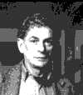
Gilles Châtelet (1944 - 1999), Figuring Space (better: The Stake of the Mobile - Les enjeux du mobile, Seuil, Paris 1993) pp 9/10:
A diagram can immobilize a gesture, put it to rest long before it hides itself within a sign, and this is why the contemporary geometers or cosmologists love diagrams and their power of preemptive evocation.
The gesture is not substantial: it gains amplitude by determining itself. Its sovereignity is equal to its penetration and that is why we refer to the gesture‘s ‚accuracy‘: the precision of the strike is proof of the reverberation of its skill. The gesture inaugurates a family of gestures, wheres the rule only enunciates ‚instructions‘, a protocol for decomposing the action into endless repeatable acts. The gesture possesses a historical exemplariness: if one can speak of an accumulation of knowledge over the course of successive generations, one should speak of gestures inaugurating dynasties of problems;
...

Slide 18
the gesture is not a simple spatial displacement: it decides, deliberates and suggests a new modality of ‚moving oneself‘. Hugues de Saint-Victor defined the gesture as ‚the motion and figuration of the members of the body according to the measure and modalities of all action and attitude‘. The gesture refers to a disciplined distribution of mobility before any transfer takes place: one is infused with the gesture before knowing it;
the gesture is elastic, it can crough on itself, leap beyond itself and reverberate, whereas the function gives only the form of the transit from one external term to another external term, whereas the act exhausts itself in its result. The gesture is therefore involved with the implicit pole of the relation;
the gesture envelops before grasping and sketches its unfoldinig long before denoting or exemplifying: already domesticated gestures are the ones that serve as references;
a gesture awakes other gestures: it is able to store up all the allusions‘s provocative virtualities, without debasing it into abbreviation.

Slide 19
one could even say that the radical thought experiment is an experiment where Nature and the Understanding switch places. Galileo sometimes puts himself in Nature‘s place, which, in its simplicity, could not have chosen to ‚move at an inconceivable speed an immense number of very large bodies, to produce a result for which the moderate movement of a single body turning around its own centre would suffice‘. Einstein was in the habit of saying that it was necessary to put oneself in God‘s place to understand Nature. There is nothing surprising therefore in these teleportations where Einstein takes himself for a photon and positions himself on the horizon of velocities (...), in these immersions where Archimedes, in his bathtub, imagines that his body is nothing but a gourd of water. Thus, to understand the photon, it is necessary to become a photon and, to understand floating, it is necessary to turn oneself into a wineskin! The thought experiment taken to its conclusion is a diagrammatic experiment in which it becomes clear that a diagram is for itself its own experiment. The gestures that it captures and particularly those that it arouses are no longer directed towards things, but take their place in a line of diagrams, within a technical development; (...)
one could even say that the radical thought experiment is an experiment where Music and the Understanding switch places. Boulez sometimes puts himself in Music‘s place, which, in its simplicity, could not have chosen to ‚move at an inconceivable tempo an immense number of very large sounds, to produce a result for which the moderate movement of a single sound turning around its own centre would suffice‘. Bach was in the habit of saying that it was necessary to put oneself in God‘s place to understand Music. There is nothing surprising therefore in these teleportations where Boulez takes himself for a sound and positions himself on the horizon of tempi (...), in these immersions where Beethoven, in his piano, imagines that his body is nothing but a envelope of waves. Thus, to understand the sound, it is necessary to become a sound and, to understand waves, it is necessary to turn oneself into a vibration! The thought experiment taken to its conclusion is a diagrammatic experiment in which it becomes clear that a diagram is for itself its own experiment. The gestures that it captures and particularly those that it arouses are no longer directed towards things, but take their place in a line of diagrams, within a technical development; (...)
make thought experiment with this text
Gilles Châtelet (1944 - 1999)

Slide 20
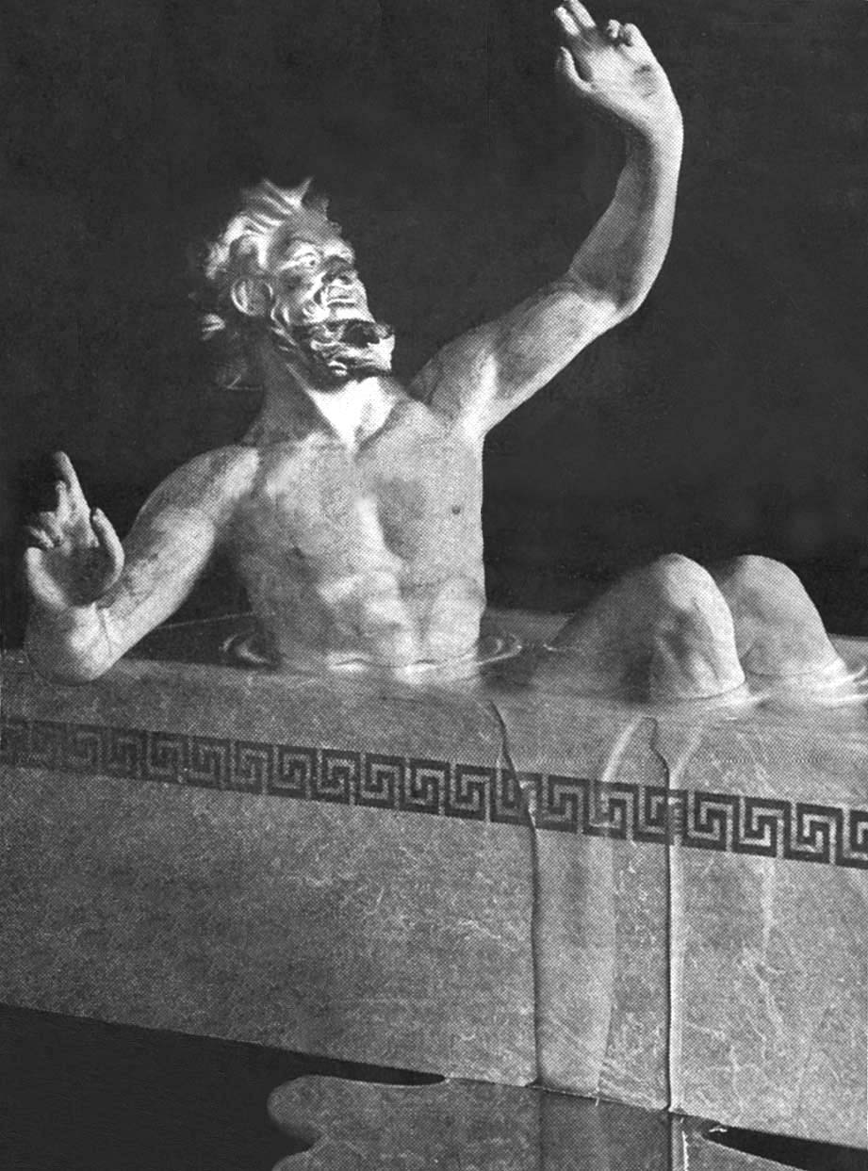

Slide 21
Cecil Taylor p, dance, voc William Parker b Andre Martinez ds, pc (For me personally this is the worst session we ever had) Tony Oxley ds
VHS, Mystic Fire Video Produced by Sheldon Rochlin and Maxine Harris New York City 1991
Poles 10:20 The Silence of Trees 30:50 For (1st Part) 7:10
CECIL
TAYLOR

