Slide 1
IV THREE COLLABORATIVE PILLARS
IV.1 (Tue Feb 27) Ornette Coleman: Free Jazz

Slide 2
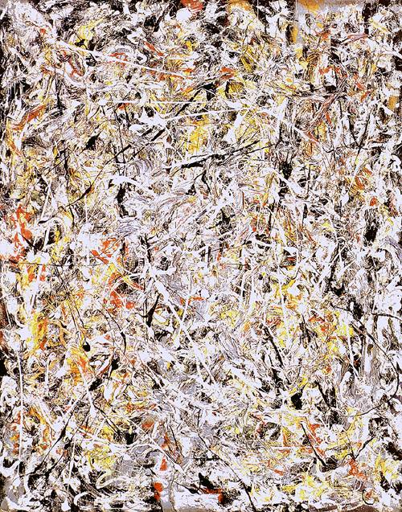
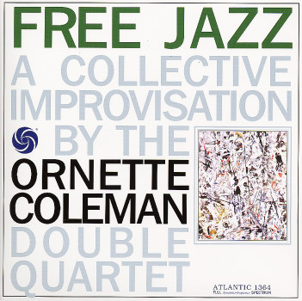
left channel:
Ornette Coleman as Don Cherry pocket tp Scott LaFaro b Billy Higgins d
right channel:
Eric Dolphy bass cl Freddie Hubbard tp Charlie Haden b Ed Blackwell d
recorded at the A & R Studios New York City 21 December, 1960
Free Jazz 37:04
John Tynan (Down Beat): „Collective improv? Nonsense. The only collectivity consists in that these eight nihilists have shown up at the same time in the same studio with the same objective: to distroy the music to which they owe their existence.“
Jackson Pollock: White Light

Slide 3
Ornette Coleman (liner notes):
Coleman has said that one of the basic ideas of his music is to encourage the improvisor to be freer, and not to obey pre-conceived chord-pattern according to set ideas of „proper“ harmony and tonality: „ Let‘s play the music and not the background.“
„The most important thing was for us to play together, all at the same time, without getting in each other‘s way, and also to have enough room for each player to ad lib alone—and to follow this idea for the duration of the album. When the soloist played something that suggested a musical idea and direction to me, I played that behind him in my style. He continued his own way in his solo, of course.“
Ornette‘s comment on hearing their interplay played back later was, „You can hear the others continue to build together so beautifully that the freedom even becomes impersonal.“
structure
gesture
collaboratory
Cavaillès: Understanding is catching the gesture and being able of continuing.
flow (distributed identity)

Slide 4
0:00 „harmonic unision“/ Dolphy
5:13 „harmonic unision“ /Hubbard
9:45 „harmonic unision“ /Coleman
19:36 „harmonic unision“/Cherry (+ Hubbard + Coleman) from 23:00 Cherry alone
25:22 „harmonic unision“/Haden
29:52 „harmonic unision“/LaFaro
33:48 „harmonic unision“/Blackwell
35:19 „harmonic unision“/Higgins
36:33 „harmonic unision“
hounted

Slide 5
Closed Spaces — Open Spaces
Closed Spaces
populate given spaces such as
tonalities/cadences/modulation
consonances/dissonances
32 song/ blues scheme
sonata scheme...global forms
conductor‘s baton
a-1, a-2, a-1, 2, 3, 4...
etc.
Open Spaces
transcend given spaces (Sirone: „one octave higher“) via
variation of spaces (e.g. scale/chord types: ToM lists, example: chromatic chord {c, c#, d} with 6 (!) 6 third ext., 25 ext. with 7 thirds)

Slide 6
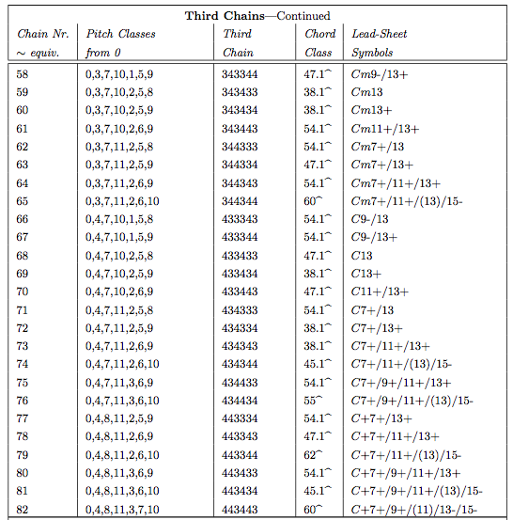
ToM L.2, p.1177

Slide 7
Closed Spaces — Open Spaces
Closed Spaces
populate given spaces such as
tonalities/cadences/modulation
consonances/dissonances
32 song/ blues scheme
sonata scheme...global forms
conductor‘s baton
a-1, a-2, a-1, 2, 3, 4...
etc.
Open Spaces
transcend given spaces (Sirone: „one octave higher“) via
variation of spaces (e.g. scale/chord types: ToM lists, example: chromatic chord {c, c#, d} with 6 (!) 6 third ext., 25 ext. with 7 thirds)
extending spaces (Folia #3: beginning)
negation of the space limits (Monk: C/D)
negation of instrumental limits (Taylor, Coleman)
suspending structures/rules (Evans: dialog)
creating empty spaces (Liquid Bridges #2: 4:22-6:00)
etc.
Collaborative principle for open space creation/negotiation:
Be constantly aware of the musicians‘ positions in those spaces in order to enable them to unfold with a maximal relief and collaborative presence.

Slide 8
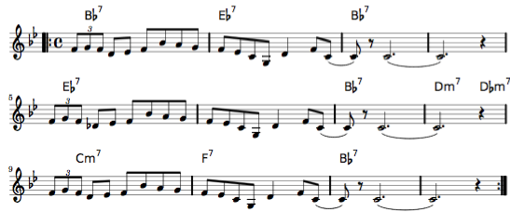
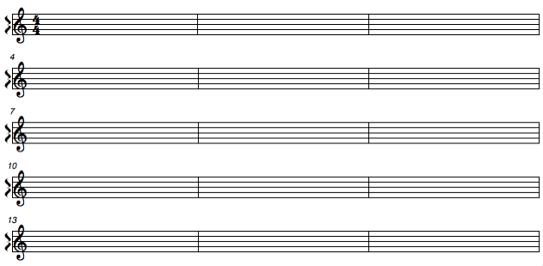
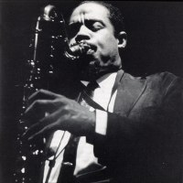
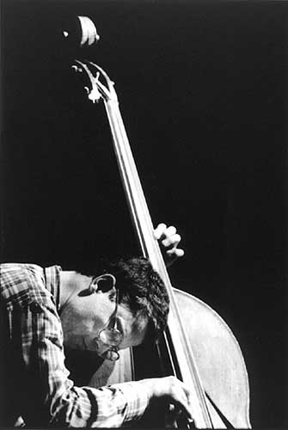
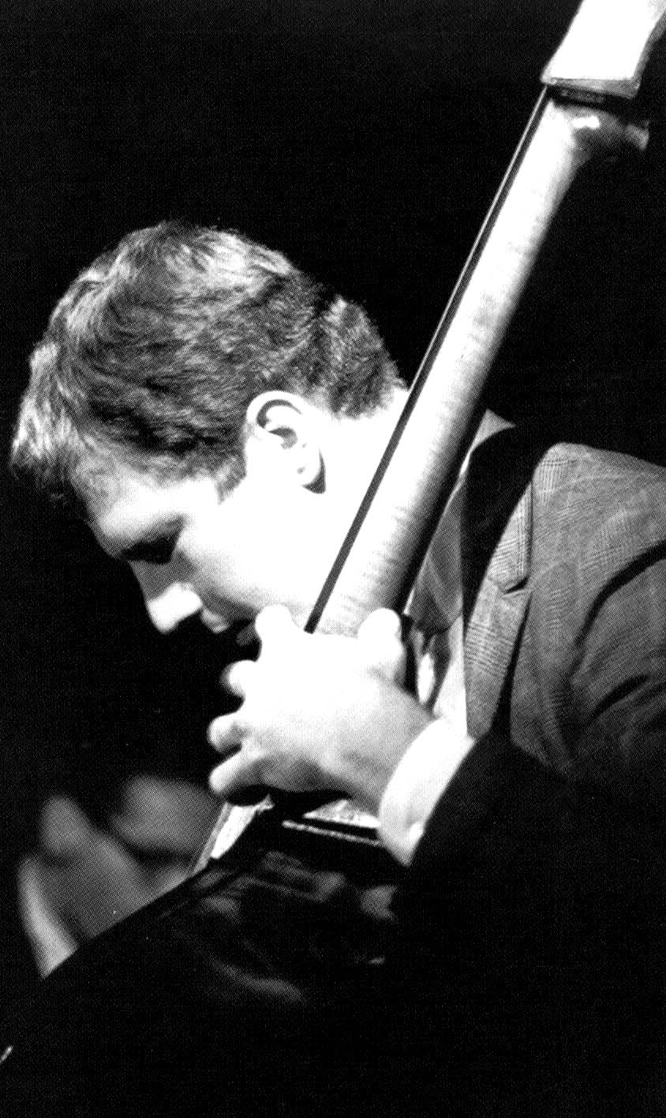
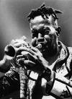
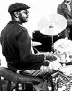
facts
structures
traces of gestures
processes
gestures

Slide 9
Ornette‘s Melodic Spaces
1) harmonic „homelands“ ~ major/minor tonality X Riemann‘s functions R_{X}: {chords} → {T,D,S,t,d,s}
2) group of smaller „homes“
X
modulation
Y
modulation
modulation
Z
3) maze of „hotels“, small (modal) reference structures
4) Ornette has abandoned the tonal and harmonic homelands and hotels in favor of small melodic „units“ gesturally related by associative chains (harmelodics)

Slide 10
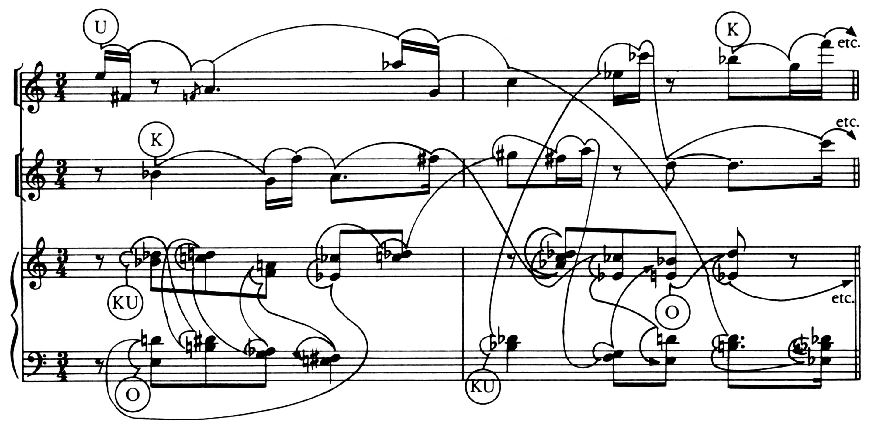
Ornette Coleman — Arnold Schoenberg
contrapuntal symmetries
motivic deformations
(Reti motif theory)
?
I
R
R
IR
O
O
IR

