Slide 1
II GETTING OFF GROUND
II.2 (Tue Feb 06) Jazz in transition Cecil Taylor „The Complete Candid Records/Air take 28“ Bill Evans‘s „Autumn Leaves“

Slide 2
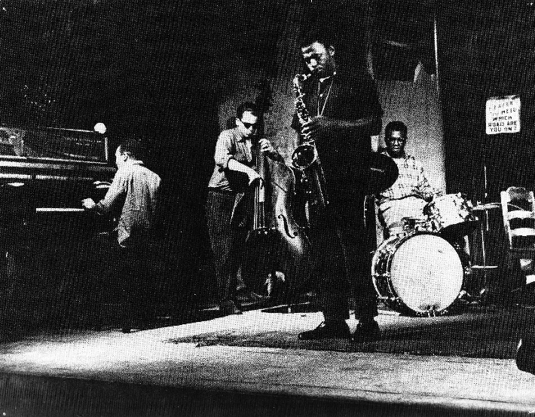
The Complete Candid Recordings of Cecil Taylor and Buell Neidlinger
Archie Shepp ts
Cecil Taylor p
Buell Neidlinger b
Dennis Charles ds
Air/take 28 8:45
October 13, 1960
produced by Nat Hentoff Candid Records
at Nola‘s Penthouse Sound Studio NYC
The drum intro leads this time to a statement of the theme, fortissimo alterating with piano, staccato altering with legato. A succint A.S. quotes Escamillo‘s aria from Carmen. C.T. flourishes as the bass and drums flag momentarily, Cecil sizing on these lapses to create microsyncopations otherwise unavailable from a more regular pulse. The piano playing in the four-bar exchanges with the drums show the results of the pianist‘s percussion studies. A the end of this take we hear Cecil say, „all right...one more...one more for me.“

Slide 3
Flow, Gesture, and Spaces, pp.13/14:
According to Nat Hentoff’s liner notes, he had met Taylor and became familiar with his innovative ideas about the dimensions of time while being a student of the New England Conservatory in 1951. During a singular seven-week gig at New York’s Five Spot in 1957, Taylor was already so advanced that musicians hearing him left disturbed, and Taylor was forced to work day jobs as short-order cook or dishwasher. He then had to practice alone and create a virtual audience. Later, he stressed the importance of communicating with oneself, but it must have been during these hard times that he invented and developed that attitude: “I have to believe I’m communicating to somebody, I have to keep contact going.” This attitude however was essential, as Hentoff adds Taylor’s conclusion: “Obviously, music saved my life.”
Out of this historically precious collection, we want to consider take 28, the second of three consecutive takes of Taylor’s composition “Air.” This take captures and showcases the imminent dissolution of four-bar-oriented time frames. After a 20-second metrically disciplined drum intro, Taylor’s one-minute solo intro breaks all bar-oriented metrical regularities, presenting bursts of rhythmical taaah-taah-ta-ta-ta units alternating with lyrical, nonmetrical time shards. Taylor’s innovative approach to time and composition struck the traditional landscape of jazz with the power and impetuosity of a meteor. It is followed by the full group’s traditional play, having Shepp quoting Escamillo’s aria from Carmen, Neidlinger walking, and Charles keeping the four-four timing. Taylor is inserting himself in a charmingly traditional comping style.

Slide 4
At minute 3:16, Taylor follows Shepp’s solo with a then already intriguing technique of extremely fast melodic threads, here and there interrupted by those dissonant chord clusters, which later were developed to the famous two-handed high-speed sequences of typically 10 hits per second. Although these garlands fit in the bar frame defined by Charles, one senses the deep contradiction between the tayloresque gestures and the rigid time frames of the jazz tradition.
Taylor is contained by his group’s traditional approach as a dancer would be contained by chains in a tiny prison. At minute 6:02 the dialog between the piano and drums initiates a musical call-and-response sequence where the musicians trade four-bar units. This sequence is highly musical, but nevertheless leaves one with the impression that implicit in Taylor’s responses is the sentiment “Look, this is how I would answer you if I were one of your species.” In turn, the answers of Charles are somehow funny transfigurations of Taylor’s far-ahead shapes back into the dominant drum language of metrically subdivided, but still entirely framed sets of gestures. The piece soon fades out, one hears Taylor saying “all right... one more for me” at the end of the piece (minute 8:30). He would have needed not one more piece, but other time sculptors: the drummers Sunny Murray or Andrew Cyrille. We will return later to the subject of overhauling the shaping of time and bar structure.

Slide 5
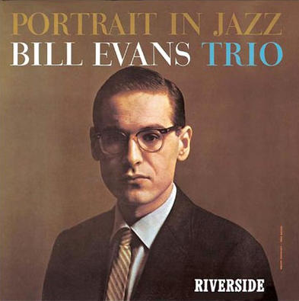
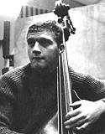
Bill Evans p
Scott LaFaro b
Paul Motian ds
Joseph Kosma‘s
Autumn Leaves 5:59
Riverside Dec 28 1959, NYC
1929-1980

Slide 6
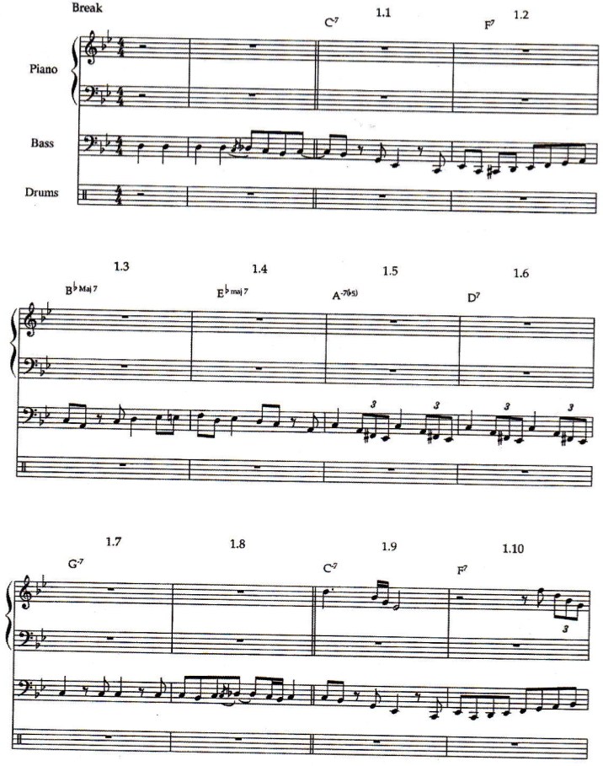
Robert Hodson:
Interaction, Improvisation, and Interplay in Jazz Routledge NY 2007

Slide 7
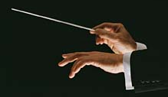
topological deformation of motives →
similar shapes →
gestural utterances
Rudolph Reti, Chantal Buteau: math. theory of motives

Slide 8
Bill Evans (line notes):
„I‘m hoping the trio will grow in the direction of simultaneous improvisation rather than just one guy blowing followed by another guy blowing. If the bass player, for example, hears an idea that he wants to answer, why should he just keep playing a background?“
Processes of motivic and gestural
imitation,
transformation,
contrast, and
resonance
45‘‘
str110%
ptch 2.5

Slide 9
contrast 1
imitation 1
imitation 2 (b-flat/g)
resonance 1 (d/e-flat)
imitation 3
imitation 4
contrast 2
imitation 5 (of ds!)
imitation 6

Slide 10
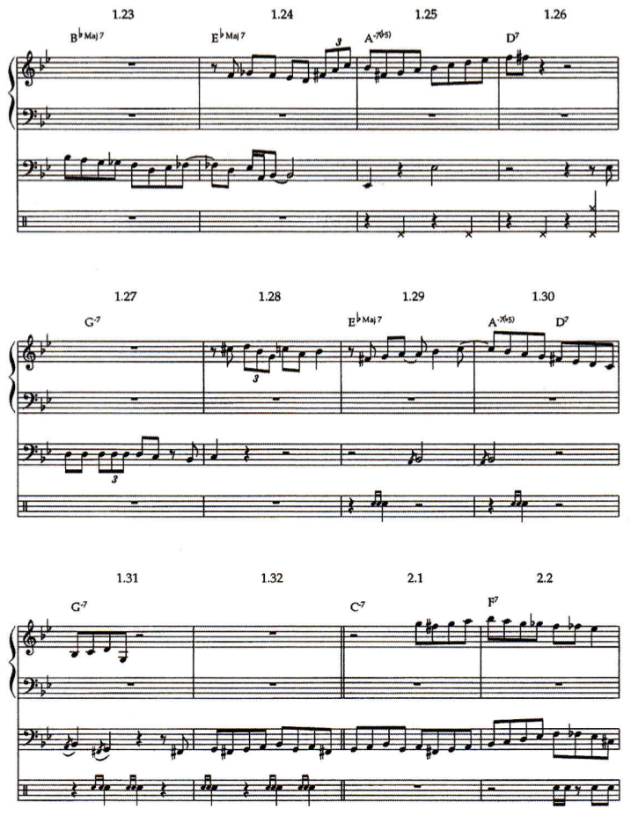
imitation 7
imitation 8
resonance 2
resonance 3

Slide 11
Robert Hodson:
Interaction, Improvisation, and Interplay in Jazz Routledge NY 2007

Slide 12
contrast 1
imitation 1
imitation 2 (b-flat/g)
resonance 1 (d/e-flat)
imitation 3
imitation 4
contrast 2
imitation 5 (of ds!)
imitation 6

Slide 13
imitation 7
imitation 8
resonance 2
resonance 3

Slide 14
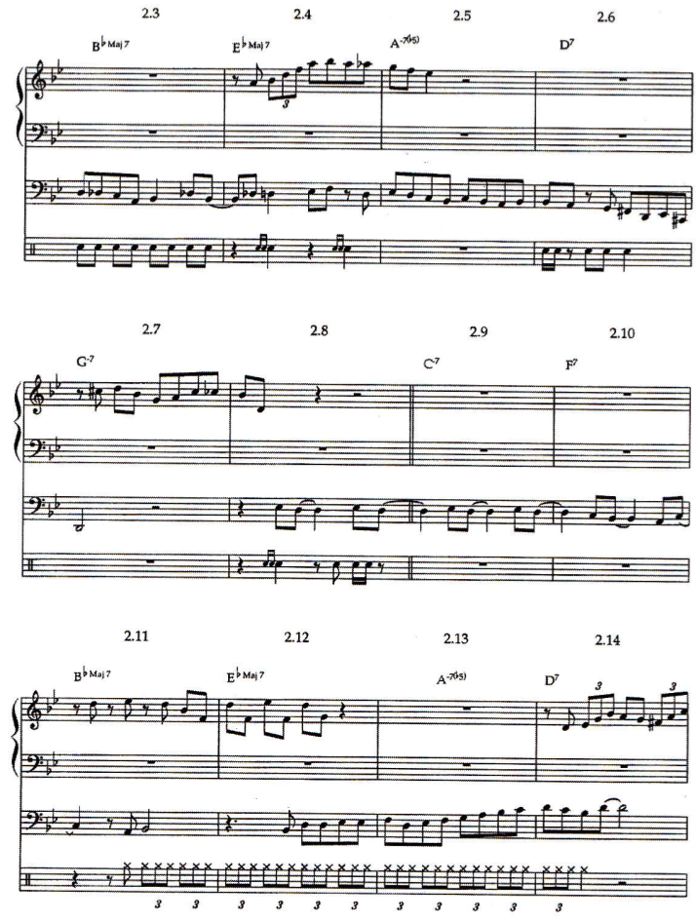

Slide 15
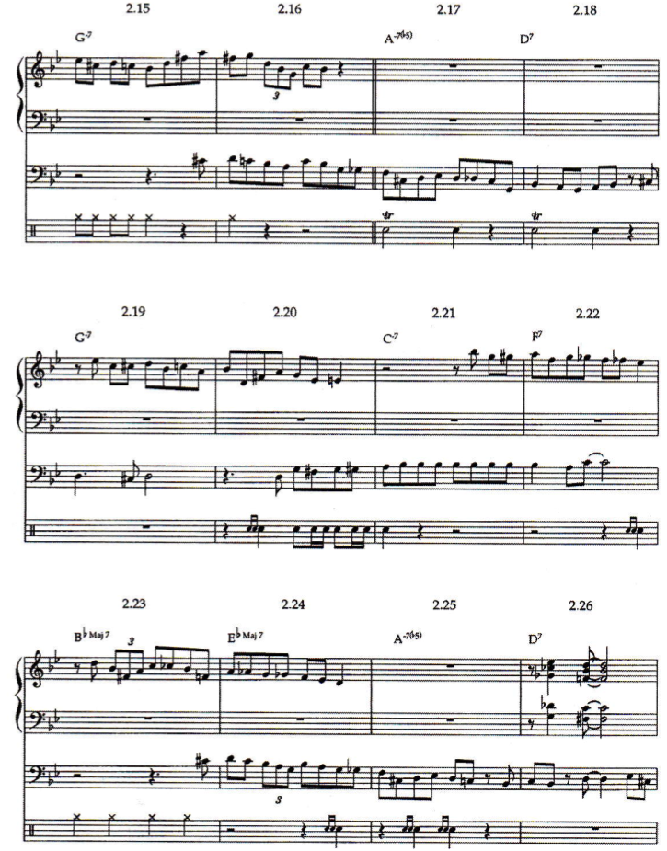

Slide 16
