Slide 1
II GETTING OFF GROUND
II.1 (Tue Jan 30)
Jazz in transition
John Coltrane‘s „Giant Steps“
John Coltrane‘s „A Love Supreme“
Archie Shepp „Life at the Donaueschingen Music Festival“ 1967

Slide 2
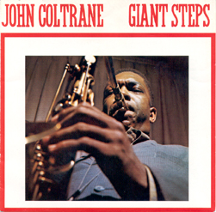
John Coltrane’s Giant (Symmetric) Steps
1959 composition, in the synonymous LP, released 1960
Tommy Flanagan and Cedar Walton struggled with the fast changes.
original recording & visuals by Michal Levy
McCoy Tyner

Slide 3
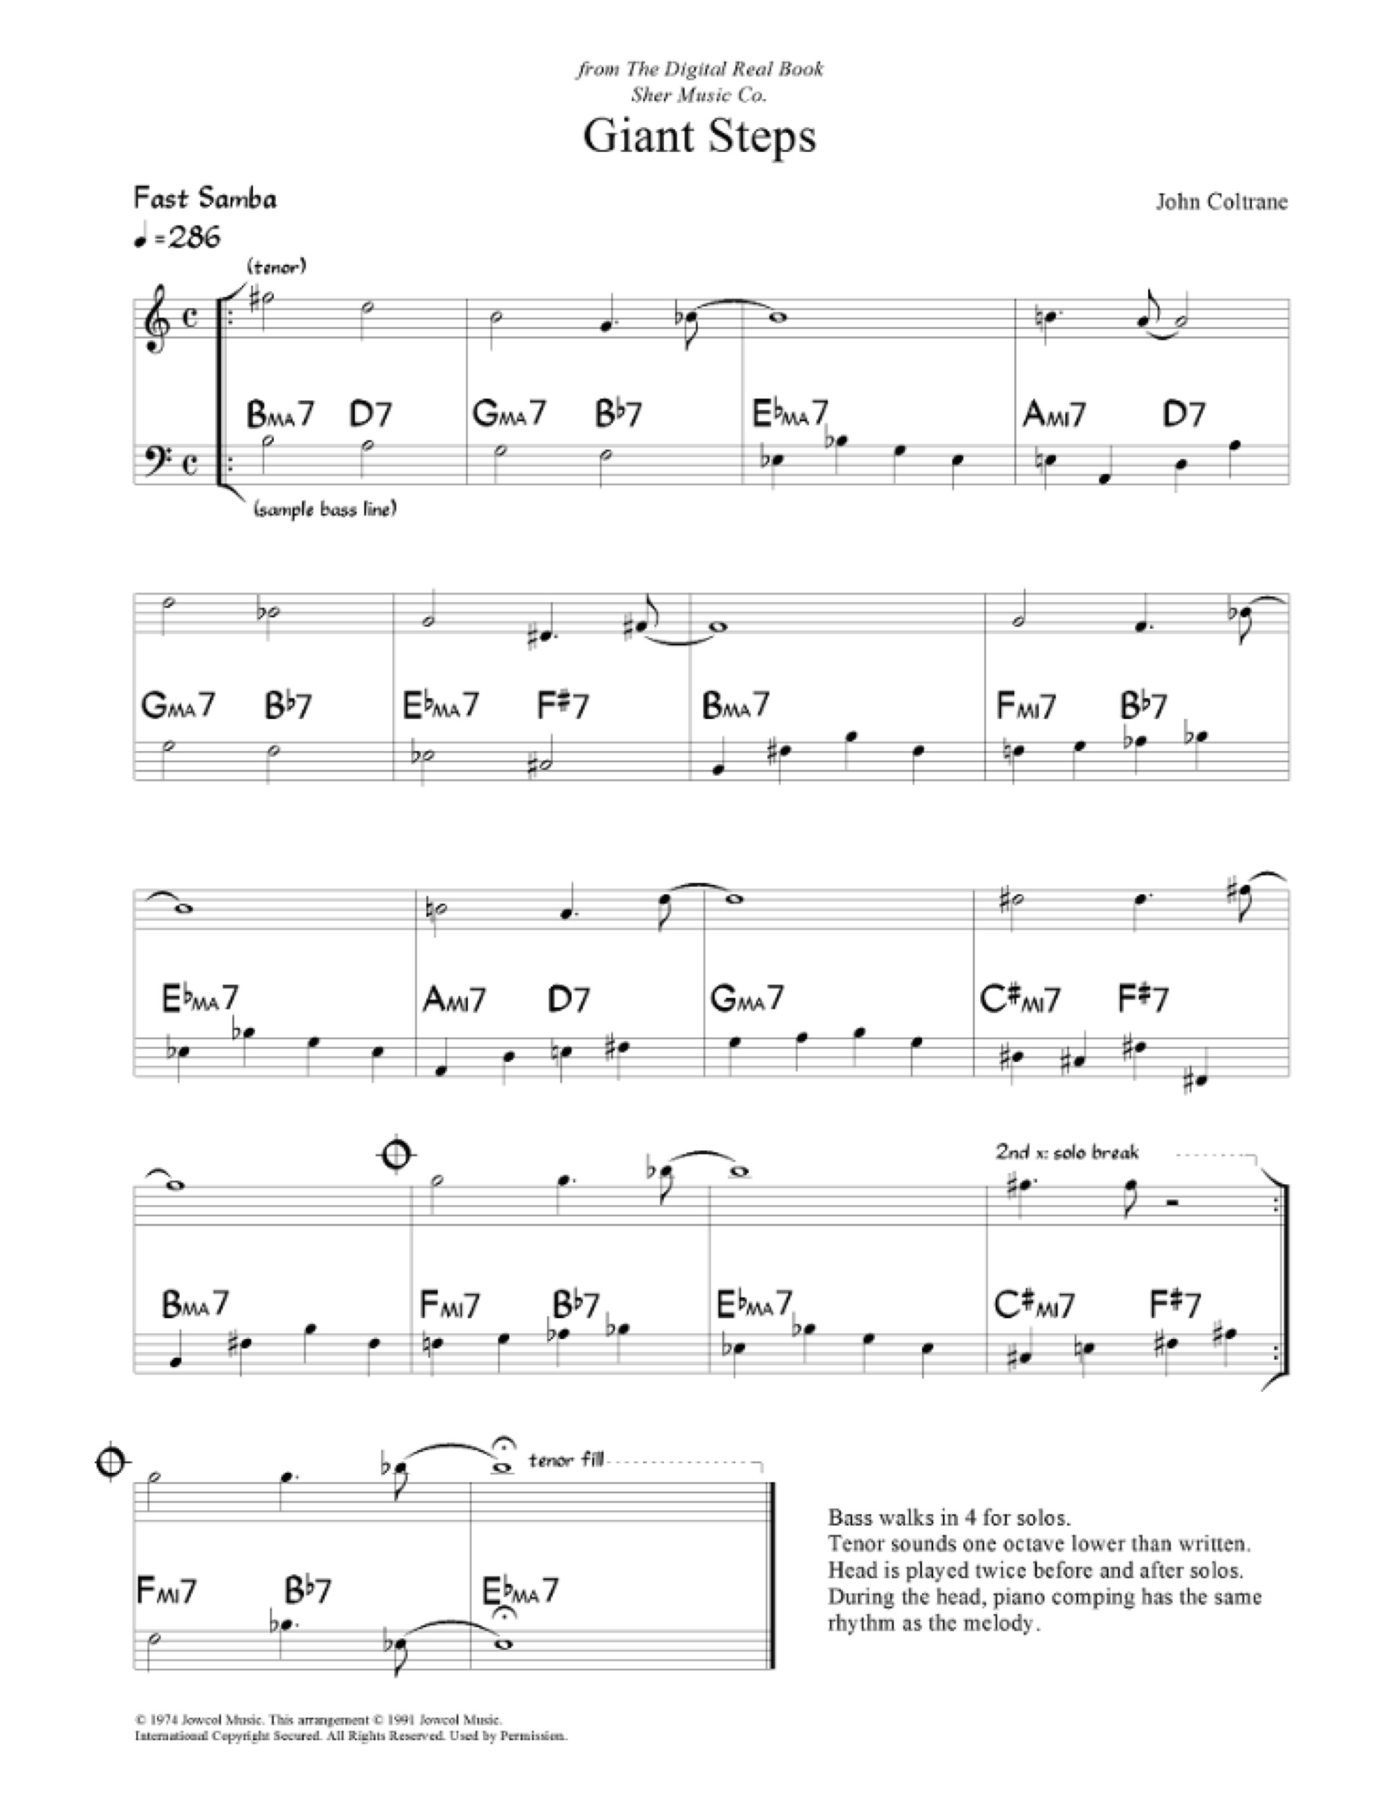

Slide 4
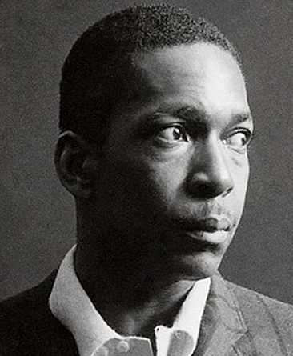
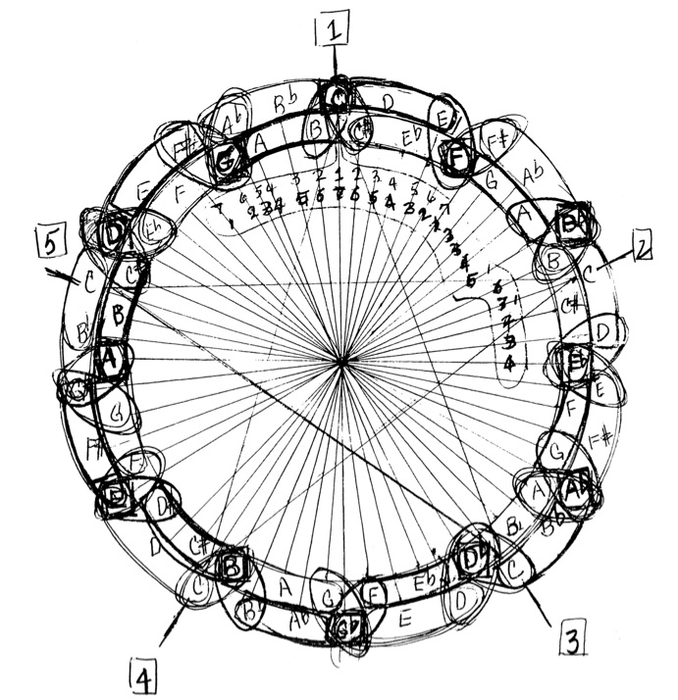
Coltrane was working on mathematical structures,
such as inversions, transpositions, etc.
Here is his famous circular graphics
he gave to saxophonist Yusef Lateef 1960

Slide 5
Symmetries for Major Seventh Chords
Inversion at C (= I_{C})
Transposition by 1
C^{maj7}
C#^{maj7}
c
c
b
c#
e
g#
g
f

Slide 6
Symmetries for Minor Seventh Chords
Inversion at C (= I_{C})
Transposition by 2
Cmin⁷
Dmin⁷
c
c
b♭
d
a
e♭
g
f

Slide 7
Symmetry I_{D} of C-major Scale
c
I_{D}
d
a
e
g
f

Slide 8
Two Big I_{D}-symmetric Harmonic Regions
Nine chords around Am⁷ in m.4
Eleven chords around Am⁷ in m.10
(We merge 7 and maj7 chords for I_{D})

Slide 9
Nine chords around Am⁷ in m.4
List of I_{D} symmetries of the chords:
D^{maj7} ~ E♭^{maj7}
G^{maj7} ~ B♭^{maj7}
Am⁷ ~ Am⁷ (fixpoint)
m.1 2 3 4 5 6
I_{D}
I_{D}
I_{D}
harmonic
inversion
I_{D}
G^{maj7}
retrograde
B♭^{maj7}

Slide 10
Eleven chords around Am⁷ in m.10
List of I_{D} symmetries of the chords:
B^{maj7} ~ F#^{maj7}
G^{maj7} ~ B♭^{maj7}
D^{maj7} ~ E♭^{maj7}
Am⁷ ~ Am⁷ (fixpoint!)
Fm⁷ ~ C#m⁷
m.6 7 8 9 10 11 12 13
I_{D}
I_{D}
I_{D}
harmonic
inversion
I_{D}
F#^{maj7}
retrograde
B^{maj7}

Slide 11
The first and last chords are I_{D}-symmetric:
I_{D}: B^{maj7} ~ F#^{maj7} ~ F#⁷
arpeggio
arpeggio
The initial melody is an arpeggio of G^{maj7}
and the first note F# is symmetric to the last B♭
The melody on m. 5 is an arpeggio of E♭^{maj7} and the second note B♭ is symmetric to the last F#
I_{D}
I_{D}

Slide 12
B^{maj7}
F#^{maj7}
C#m⁷
G#
E♭^{maj7}
B♭^{maj7}
Fm⁷
C
G^{maj7}
D^{maj7}
Am⁷
E
v
v
v
v
v
v
3rd Messiaen Scale
v
v
v
v
v
v

Slide 13
3rd Messiaen Scale
I_{D}
C
G#
E

Slide 14
3rd Messiaen Scale
F
C
G
F
C
G
A#
D
A#
D
D#
A
D#
A
G#
E
G#
E
C#
B
C#
F#
F#
B

Slide 15
Fourth Relation
I_{D} Symmetry
Am⁷
v
v
D^{maj7}
v
v
v
G^{maj7}
v
v
v
E♭^{maj7}
v
v
v
v
B♭^{maj7}
v
v
v
v
Fm⁷
v
v
C#m⁷
v
v
F#^{maj7}
v
v
v
B^{maj7}
v
v
v
v

Slide 16
v
v
v
v
v
v
v
v
v
v
v
v
v
v
v
v
v

Slide 17
the speed
D^{maj7}
G^{maj7}
1x
E♭^{maj7}
End
B♭^{maj7}
D^{maj7}
D^{maj7}
G^{maj7}
2x
E♭^{maj7}
G^{maj7}
1x
E♭^{maj7}
B♭^{maj7}
B♭^{maj7}
rall.
accel.
F#^{maj7}
F#^{maj7}
Start
B^{maj7}
B^{maj7}
the blues
F#^{maj7}
B^{maj7}

Slide 18
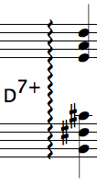
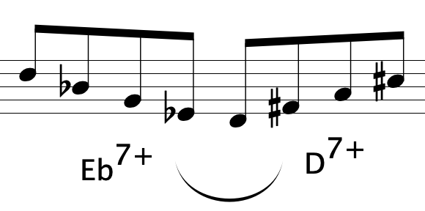
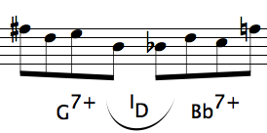
f#
b
c#
e
Am⁷
v
a
D-maj in
fifth circle
D^{maj7}
v
v
G^{maj7}
v
v
d
E♭^{maj7}
v
v
g
B♭^{maj7}
v
v
Am⁷
b
f#
e
D^{maj7}
a
G-maj in
fifth circle
G^{maj7}
E♭^{maj7}
d
B♭^{maj7}
g
c

Slide 19
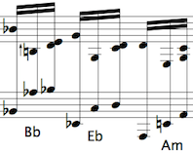
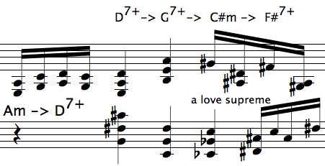
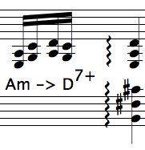
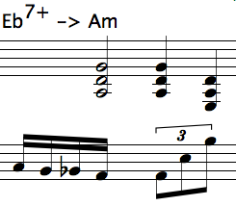
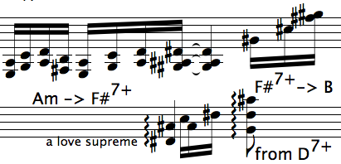
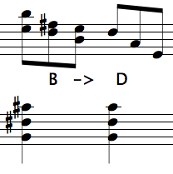
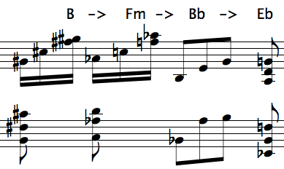
rall.
the blues!
Am⁷
Am⁷
Am⁷
Am⁷
restart
D^{maj7}
D^{maj7}
D^{maj7}
D^{maj7}
G^{maj7}
G^{maj7}
G^{maj7}
end
G^{maj7}
E♭^{maj7}
E♭^{maj7}
E♭^{maj7}
E♭^{maj7}
B♭^{maj7}
B♭^{maj7}
B♭^{maj7}
B♭^{maj7}
Fm⁷
Fm⁷
rall.
the blues!
C#m⁷
C#m⁷
F#^{maj7}
F#^{maj7}
F#^{maj7}
B^{maj7}
B^{maj7}
B^{maj7}
B^{maj7}

Slide 20
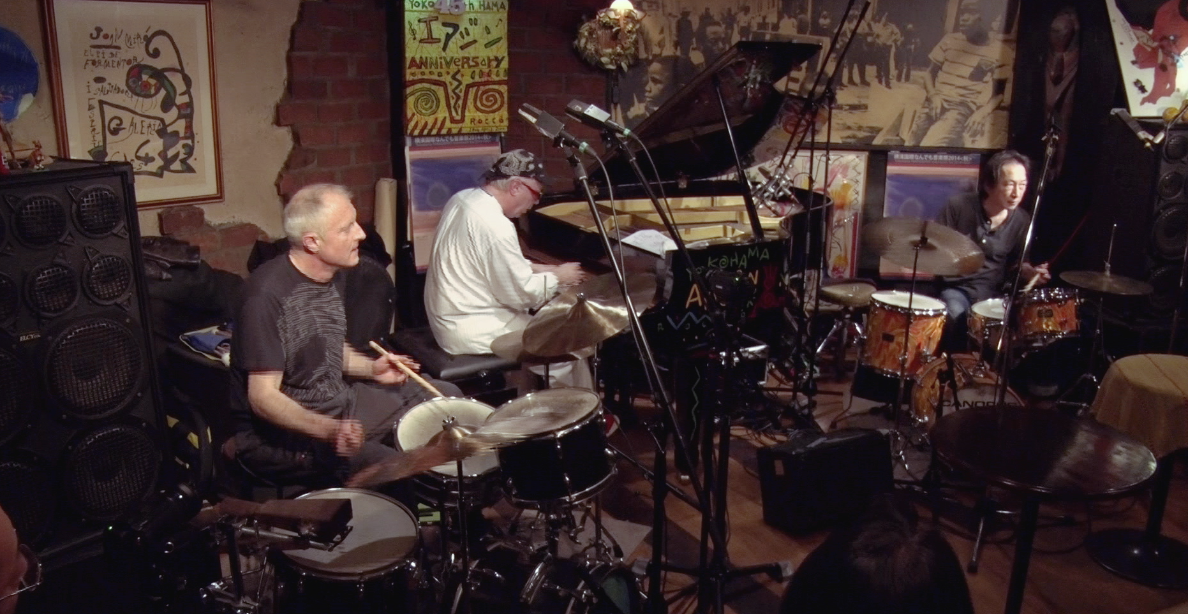
Guerino Mazzola p
Heinz Geisser perc
Shiro Onuma perc
Imaginay Time
Video on VIMEO
Giant‘s Steps 00:36 Dec 26 2014, Airegin Jazz Club, Yokohama

Slide 21
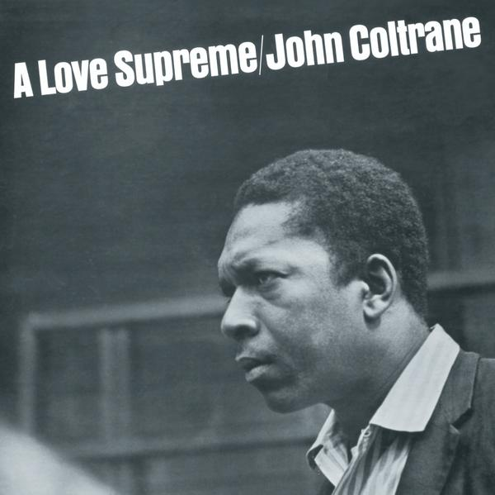
John Coltrane ts
McCoy Tyner p
Jimmy Garrison b
Elvin Jones ds
Acknowledgment 7:43
Resolution 7:18
Pursuance 10:43
Psalm 7:03
Impulse Dec 9 1964
Lewis Porter: J C‘s A Love Supreme: Jazz Improvisation and Composition J. Am. Mus. Soc. Vol.38/3 1985

Slide 22
Acknowledgment 7:43 prelude, free form, with song ending F minor
Resolution 7:18 increasing tension standard E♭ minor 24 measures = 3 x 8 measures
Pursuance 10:43 fastest section, drum intro B♭ minor 12 measures blues scheme
Psalm 7:03 postlude, free poetical form, bass intro C minor
C min.
?
B♭ min.
11
0
1
10
2
E♭ min.
9
3
8
4
7
6
5
F min.

Slide 23
two modes
11
0
1
10
2
9
3
8
4
7
5
6
Pentatonic in A♭

Slide 24
3 → 5
5
counterpoint theory: d = 5 . k + 2 5 = 5 . 3 + 2
11
0
1
10
2
9
3
8
4
7
5
6
3

Slide 25
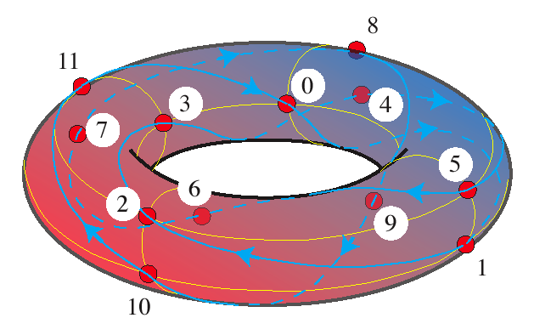
consonance-dissonance dichotomy
Ÿ₁₂ = K∪ D disjoint, #K = #D = 6 K = {0, 3, 4, 7, 8, 9}, D ={1, 2, 5, 6, 10, 11}
Κ_{ε} = {x ⊕ k | k ∈ Κ} = consonant intervals
D_{ε} = {x ⊕ d | d ∈ D} = dissonant intervals

Slide 26
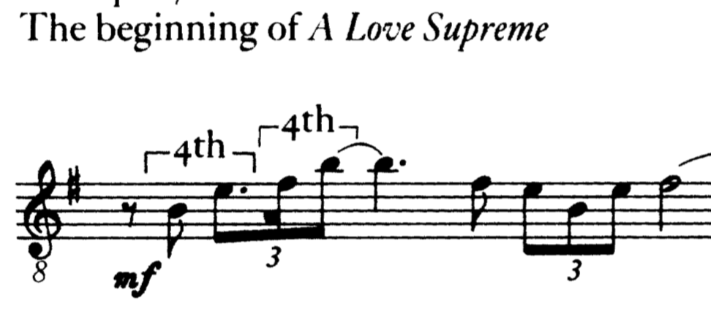
inversional scale symmetry
at e
inversional scale symmetry
at f
11
0
1
0
1
11
10
2
10
2
9
3
9
3
8
4
8
4
7
5
7
5
6
6
pentatonic with tonic f
pentatonic with tonic e

Slide 27
Recall that a major scale (or a pentatonic scale)
is a full sequence of fifths/fourths,
e.g. C major scale:
C
G
F
D
B♭
A
E♭
E
A♭
B
D♭
G♭

Slide 28
F min ~A♭
B♭ min ~ D♭
C
G
F
D
B♭
A
E♭
E
A♭
B
D♭
G♭
C min ~ E♭

Slide 29
Acknowledgment 7:43 prelude, free form, with song ending F minor
Resolution 7:18 increasing tension standard E♭ minor 24 measures = 3 x 8 measures
Pursuance 10:43 fastest section, drum intro B♭ minor 12 measures blues scheme
Psalm 7:03 postlude, free poetical form, bass intro C minor
C min.
?
B♭ min.
11
0
1
10
2
E♭ min.
9
3
8
4
7
5
basic motive!
6
F min.

Slide 30
13
27
22
24
2
23
7
14
3
1
8
C
4
G
F
21
D
B♭
12
A
E♭
9
20
E
A♭
17
5
25
B
D♭
10
G♭
16
6
15
18
26
11
28
19

Slide 31
G
D
A
E
B
G♭
D♭
A♭
E♭
B♭
F
C
1 2 3 4 5 6 7 8 9 10 11 12 13 14 15 16 17 18 19 20 21 22 23 24 25 26 27 28

Slide 32
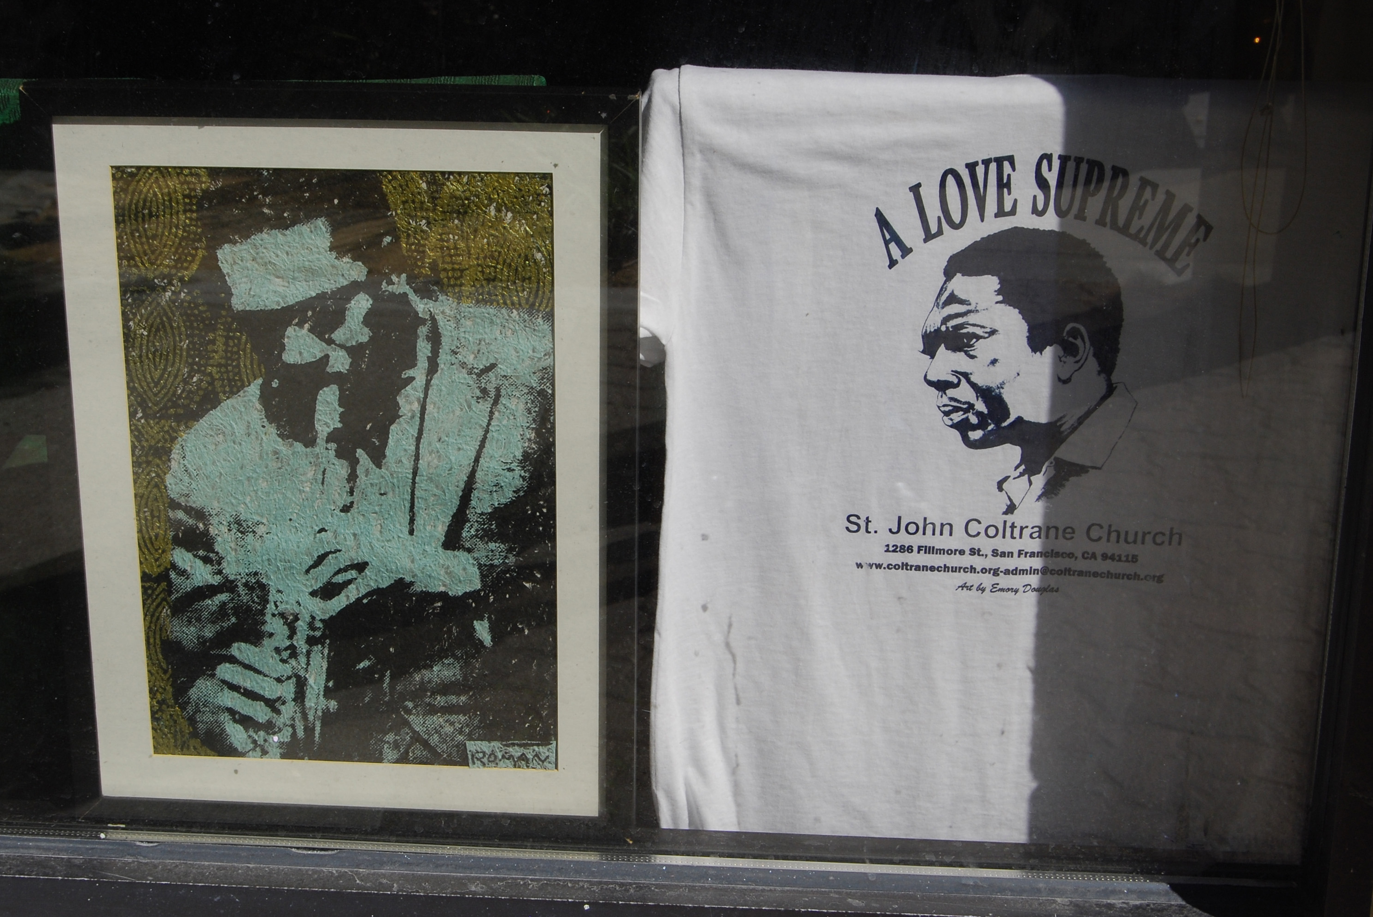
Coltrane Church

Slide 33
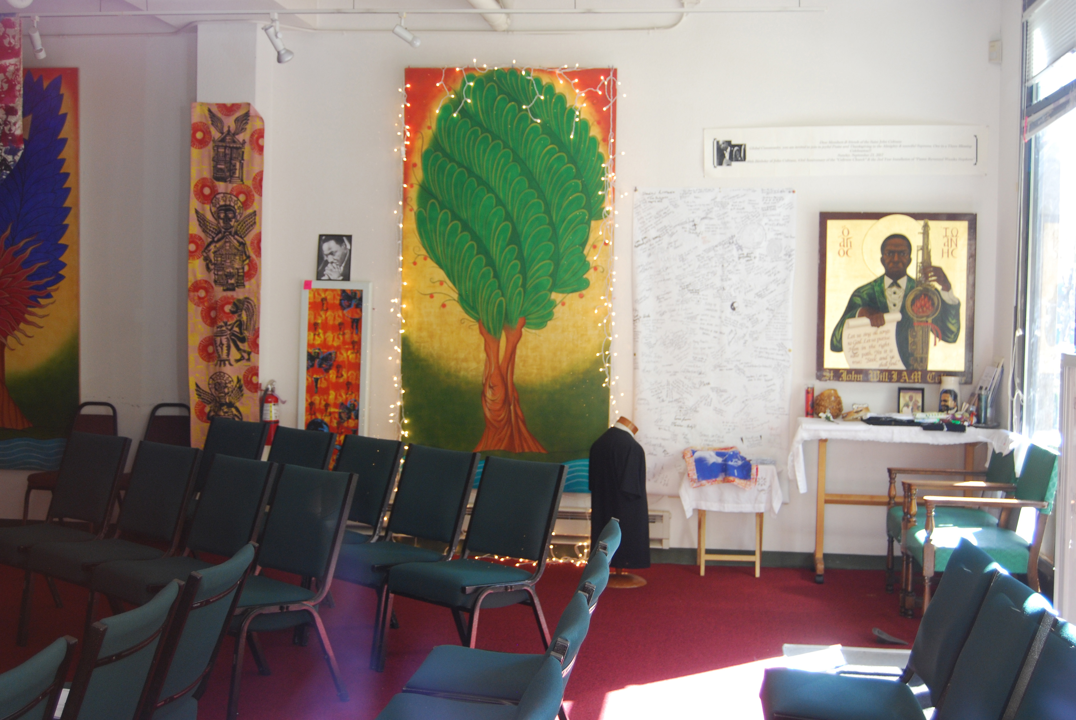
Coltrane Church

Slide 34
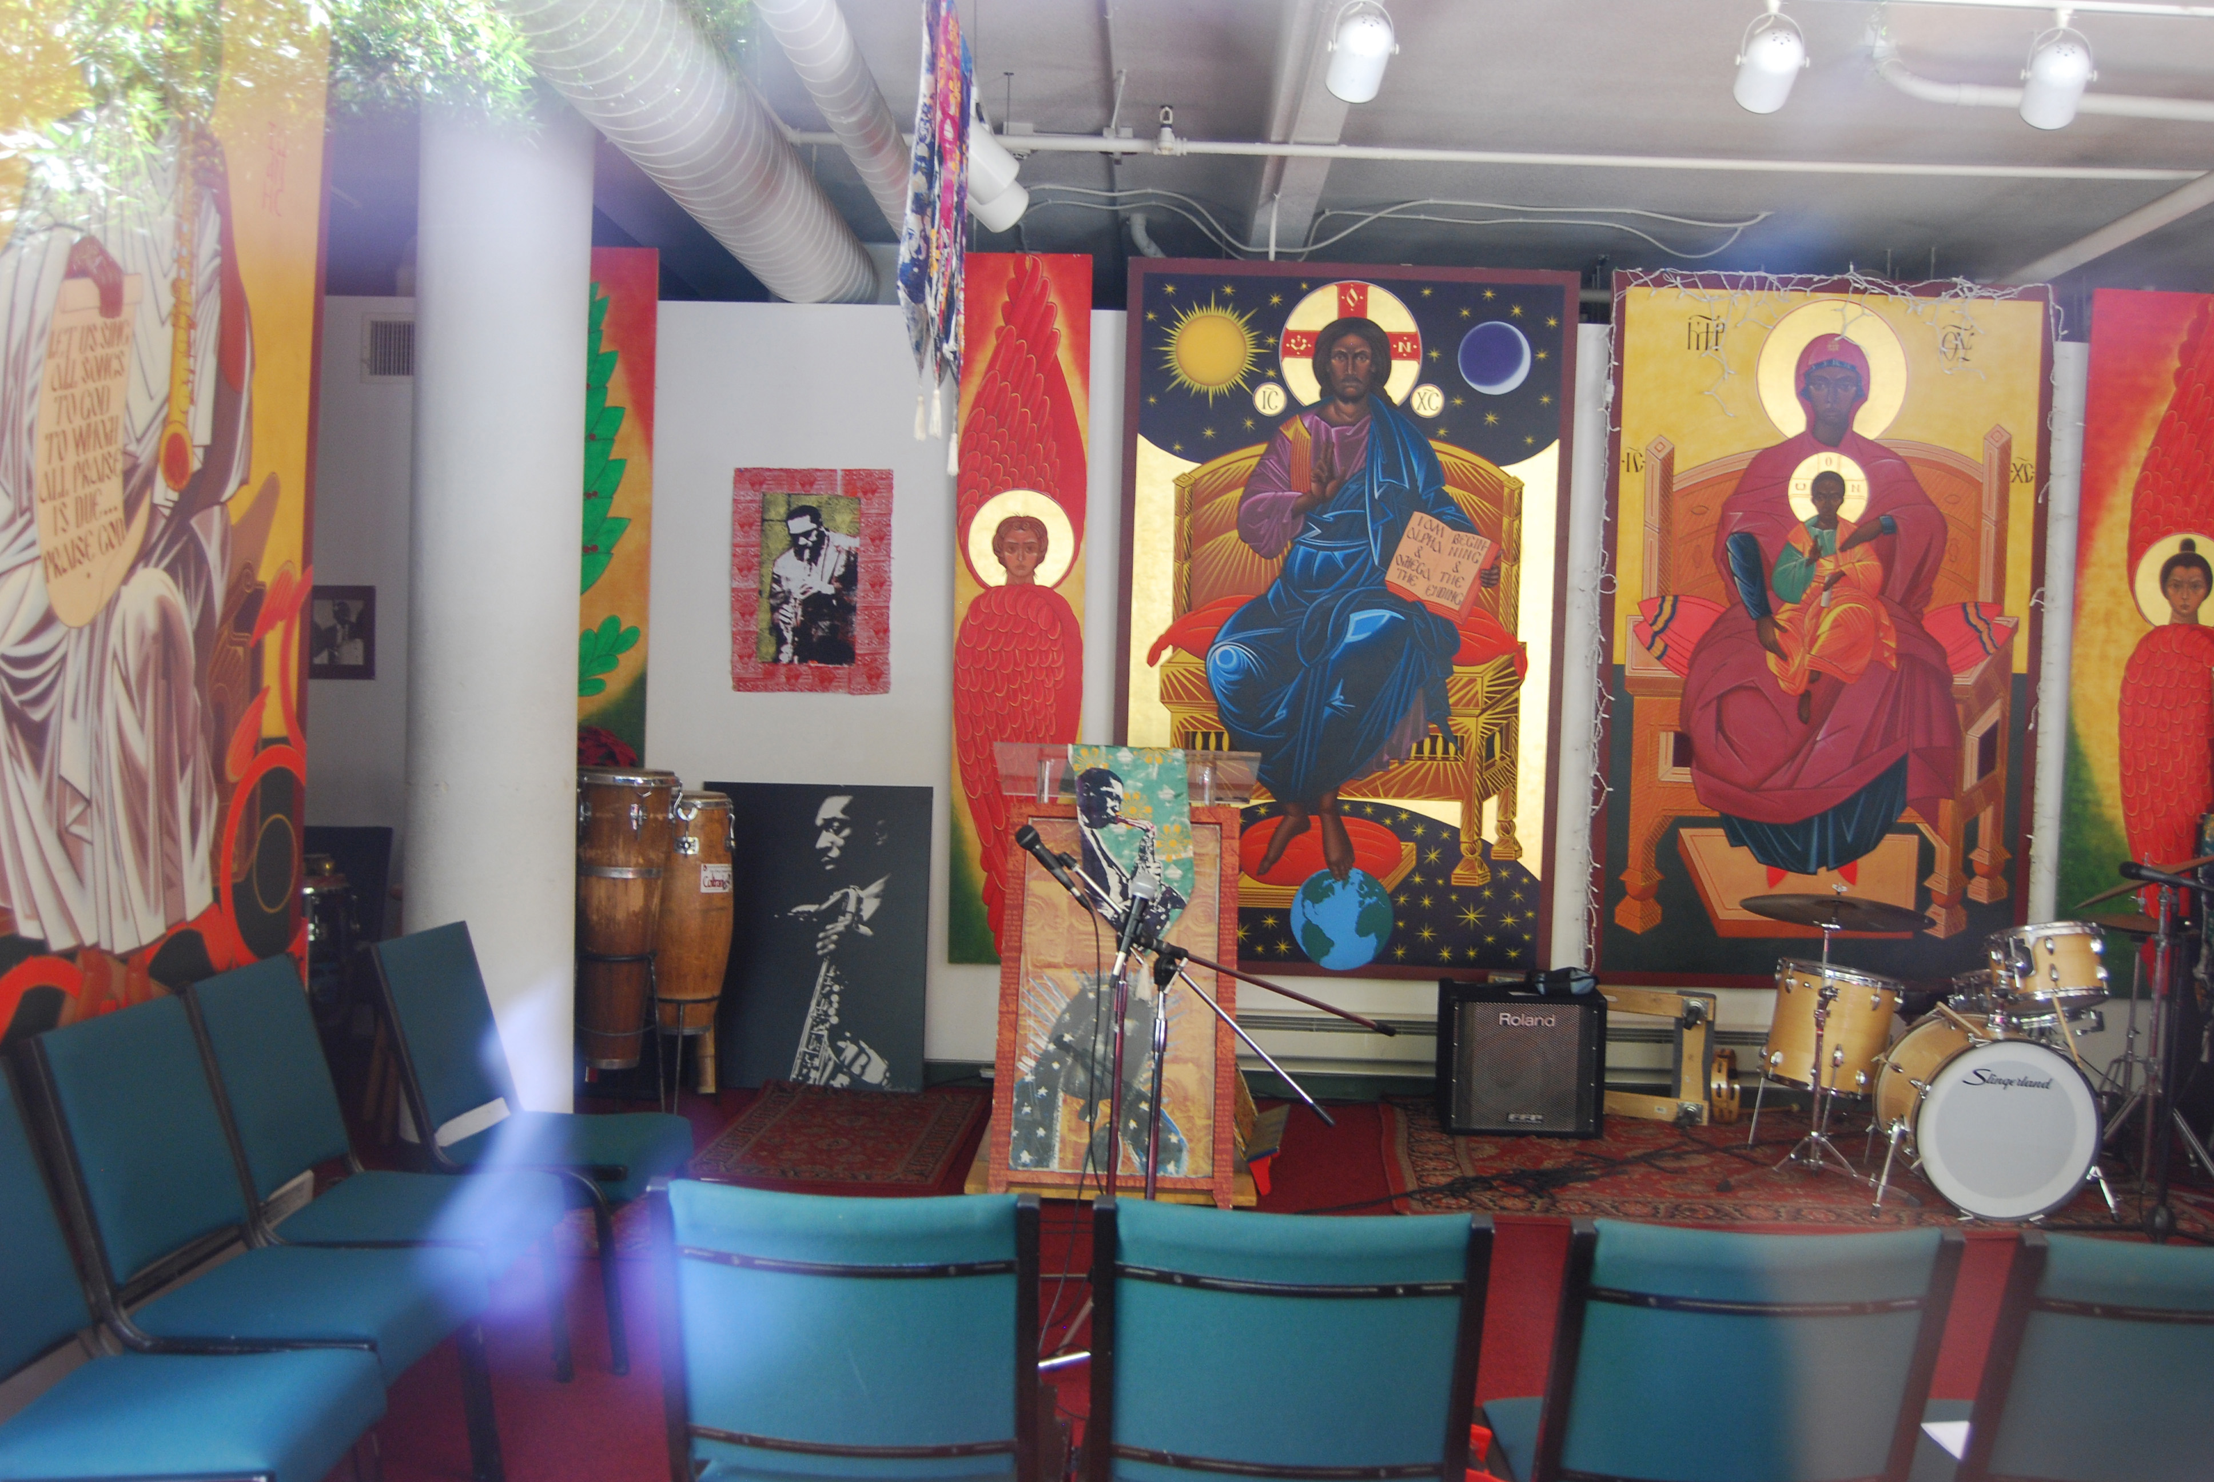
Coltrane Church

Slide 35
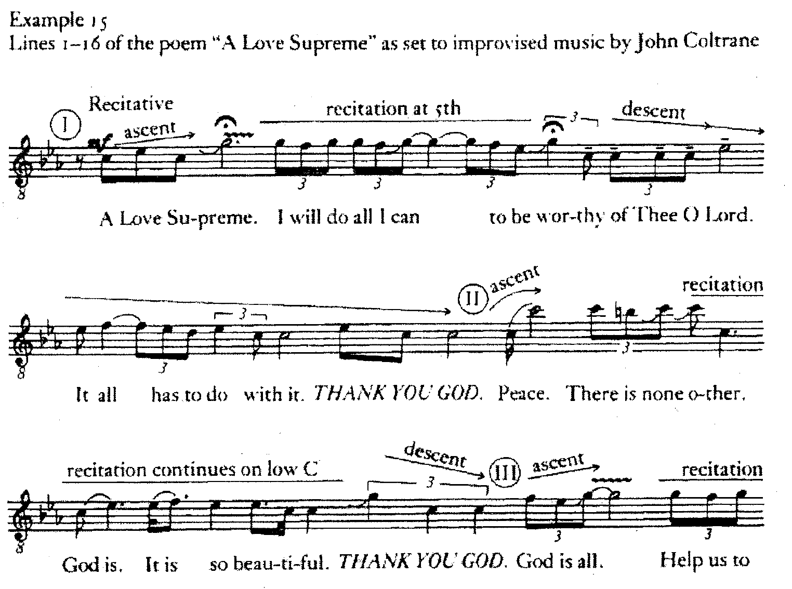

Slide 36
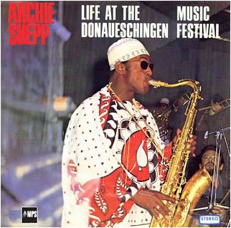
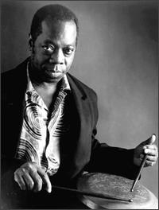
Archie Shepp ts
Roswell Rudd tb
Grachan Moncur tb
Jimmy Garrison b
Beaver Harris ds
One for the Trane I 22:00
One for the Trane II 21:45
Donaueschingen Musiktage October 21 1967
Comments by Joachim Ernst Behrendt
Rudd ✞17 Moncur Garrison ✞76 Harris✞91

Slide 37
