Slide 1
INTRODUCTION
I.3 (Mo Jan 22) What is free jazz? Imagine the Sound DVD: Our comments

Slide 2
DVD: Imagine the Sound. + discusssion!

Slide 3
Discussion:
A. General comments about the DVD
B. Questions about statements in the movie
B.1 Sociology
B.2 Politics
B.3 Collaboration
B.4 Esthetics
B.5 Music making
B.6 Music listening
B.7 The body

Slide 4
Discussion from 2024 course

Slide 5
A. General comments about the DVD
overwhelming at times
movement relating to music

Slide 6
B.1 Sociology
B.2 Politics
B.3 Collaboration
B.4 Esthetics
B.5 Music making
B.6 Music listening
B.7 The body
Discussion:
B. Questions about statements in the movie
B.1 Sociology

Slide 7
B.1 Sociology
B.2 Politics
B.3 Collaboration
B.4 Esthetics
B.5 Music making
B.6 Music listening
B.7 The body
Discussion:
B. Questions about statements in the movie
B.2 Politics

Slide 8
B.1 Sociology
B.2 Politics
B.3 Collaboration
B.4 Esthetics
B.5 Music making
B.6 Music listening
B.7 The body
Discussion:
B. Questions about statements in the movie
B.3 Collaboration

Slide 9
B.1 Sociology
B.2 Politics
B.3 Collaboration
B.4 Esthetics
B.5 Music making
B.6 Music listening
B.7 The body
Discussion:
B. Questions about statements in the movie
B.4 Esthetics

Slide 10
B.1 Sociology
B.2 Politics
B.3 Collaboration
B.4 Esthetics
B.5 Music making
B.6 Music listening
B.7 The body
Discussion:
B. Questions about statements in the movie
B.5 Music making

Slide 11
B.1 Sociology
B.2 Politics
B.3 Collaboration
B.4 Esthetics
B.5 Music making
B.6 Music listening
B.7 The body
Discussion:
B. Questions about statements in the movie
B.6 Music listening

Slide 12
B.1 Sociology
B.2 Politics
B.3 Collaboration
B.4 Esthetics
B.5 Music making
B.6 Music listening
B.7 The body
Discussion:
B. Questions about statements in the movie
B.7 The body

Slide 13
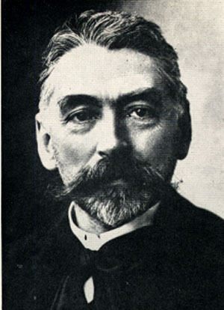
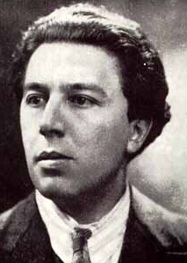
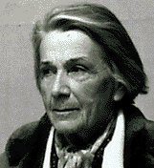
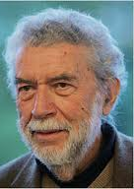
Stéphane Mallarmé (1842-1898): Le livre
André Breton (1896-1966):
Ecriture automatique surréaliste
Nathalie Sarraute (1900-1999), Alain Robbe-Grillet (1922-2008): Nouveau roman

