Slide 1
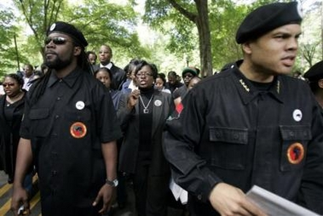
INTRODUCTION
I.2 (Fr Jan 19) What is free jazz? The musical, social, and political origins of the movement

Slide 2
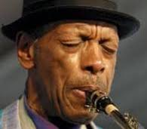
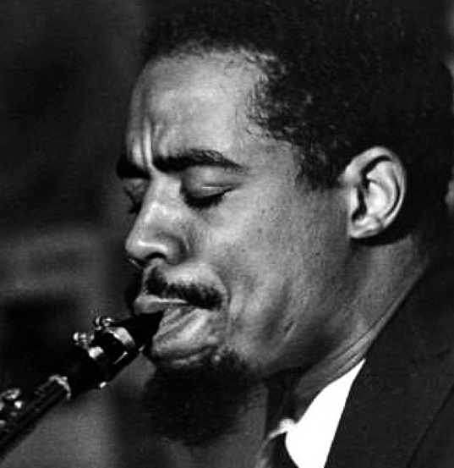
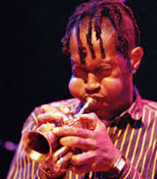
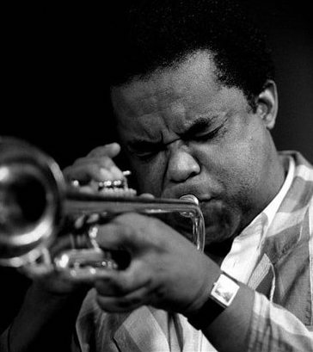
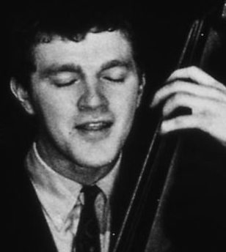
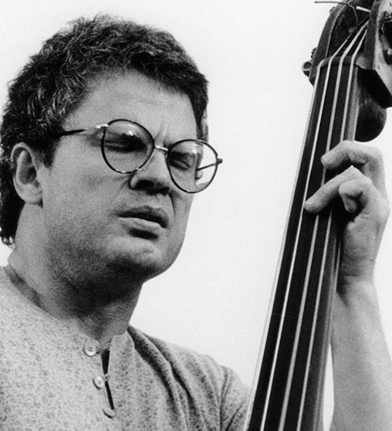
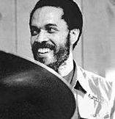
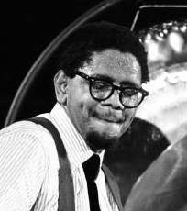
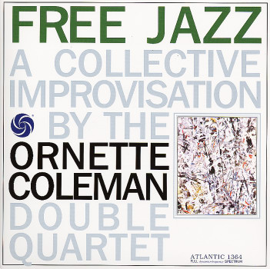
The name "free jazz" is the title of Ornette Coleman's LP recorded 1960 for Atlantis with a double quartet. Musicians:
Ornette Coleman Eric Dolphy Don Cherry Freddie Hubbard Scott La Faro Charlie Haden Billy Higgins Ed Blackwell
(as) (bcl) (pockettp) (tp) (b) (b) (ds) (ds)
L R L R L R L R
Other names such as „New Thing“ „Cosa Nova“, „Nouvelle Gauche“, „Out Music“, „Great Black Music“, „Energy Music“ etc. are known.
The famous citation of Coleman on „Free jazz“: „Let's try to play the music and not the background.“
PLAY beginning of „free jazz“.

Slide 3
Socio-political Background:
Single event for the free jazz as a socio-political movement = „October revolution“, early Oct. 1964, one week. At the small Cellar Café in NY's West Ninety-Sixth Street. Initiated by trumpeter and jazz pedagogue Bill Dixon.
First time to hear Archie Shepp, Alber Ayler, Sun Ra, Milford Graves, Giuseppe Logan. Dixon had founded the United Nations Jazz Society. He painted and taught art history. Worked with Shepp in NY Contemporary Five. After a discussion with CT he founded the Jazz Composers Guild, with Shepp, Taylor, Dixon, Paul and Carla Bley, Mike Mantler, John Tchikai, Sun Ra, Roswell Rudd, with a CG-Orchestra four concerts in Dec. 1964, on a weekly basis, at the Contemporary Center near Village Vanguard. Ideas of collective contracts and recording labeled, and institute.
Shepp negotiated with Impulse on an ego basis, in order to survive (4 children), and the Guild was furious, etc. The idea was soon buried. (Robert Levin „The Jazz Composers Guild—An Assertion of Dignity“. Down Beat 6 May 1965)

Slide 4
Political Dimensions:
cf. book Free Jazz Black Power by Philippe Carles & Jean-Louis Comolli (10/18 Paris 1971)
Free jazz was intolerable, did litteraly hurt. Critic had become irrelevant, out of use. Death of jazz, anti-jazz (see Down Beat discussion 1962 with John Coltrane and Eric Dolphy later).
Writer and poet LeRoi Jones started an intellectual shaping within the national political movement: Black Power, -> Black Studies at Universities, stressing the pride and beauty of the black, not without a racist accent, book: Blues People (NY 1963, Apollo).
Gives back to the black their music, the jazz, which was sold to the white commerce, esthetics, and culture.
Shepp in recent interview maintains that jazz has been degraded to a label like Coca Cola. Free jazz was (according to Shepp) a liberation from these constraints.

Slide 5
Shepp in Down Beat 1965:
„Jazz is one of the socially and esthetically most significant contributions of America. Some do accept it for what it is: A significant, deep contribution to America—it is against war; against Vietnam; for Cuba; for the liberation of the peoples of the world. This is the nature of jazz. Without having to search very far. Why? Because jazz is itself born from oppression, born from the subjugation of my people.“
And Ornette Coleman (A.B Spellman: Four Lives in the Bebop Business. pantheon, NY 1966): „I am black and a jazzman. As a black and as a jazzman I feel miserable.“
The black were politically organized and active, e.g. the Montgomery autobus strike 1965, the 1960 SNCC (Student Non Violent Coordination Committee) for black inscription in South States elections, Stokely Carmichael's 1966 Black Power movement, Malcom X: Black Muslims around Eliah Muhammed (since 1932), Actions 1965, 1966 against the black ghettos: Harlem, Detroit, Watts.

Slide 6
General socio-cultural position:
Jazz music had been usurped, stolen by white intelligenzia. Black musicians vs. white critics and theorists. White parasites.
The (typically II-V sequences) chord changes, the blues scheme (3 x 4 bars ) and song form (4 x 8 bars, AAB(ridge)A). Jazz theory and standard forms and instrumentation and role: rhythm section (piano, bass, drums) plus soloists (saxes, trumpets, singers).
Jazz was taken away from its creators, abused as bar music background and also tamed and casted by the jazz theory. Miles Davis: No more quarter notes, no more books, jazz (1972 to Joe Henderson). You are fired if you go on with jazz!
The factor of black beauty, the rewriting of history which had been „whitened“. Archie Shepp: „Jazz is singularly unique in that the people who control it are thoroughly ignorant of it, know nothing about it.“
Blacks who were tamed = n*, the „blacks of the white“.

Slide 7
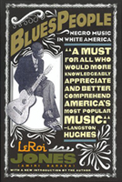
LeRoi Jones initiated an intellectual reshaping of the cultural theory of jazz within the framework of Black Studies at US universities, stressing the pride and beauty of the black, as described in his book „Blues People“ (1963).
Within the US socio-political movements, LeRoi Jones, now aka Amiri Baraka, and the Cultural Nationalism (United Brothers in Newark, lead by Stokely Carmichael et al.) is contradicted by the overtly political (socialist, communist, class struggle) movement of the Black Panther Party (BPP).
Carmichael: „What counts in our struggle is the culture.“
BPP: „The power is at the end of a sashiki.“ (swahili for long african shirt)

Slide 8
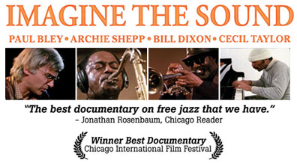
DVD: Imagine the Sound. + discusssion!

