Slide 1
INTRODUCTION
I.1 (We Jan 17)
Overview

Slide 2

General Remarks:
Administrative: two papers + participation; 1/3 each for grading,
This is not a course on improvisational performance.
Participation with instruments not as test for virtuosity, but advantageous; most important instrument: your ears!
Also, you may possibly meet with improvising musicians, see the improvisation course by Maja Radovanlija MUS 5440 (MUS 3440 for undergrads) .
And this is in particular not a course in music therapy or any similar psychotherapeutic vein, although we shall have to discuss the specific individual approaches to such music.
Course = traced in a book on creative collaboration in free jazz
Office hours by zoom appointment, or #164, mazzola@umn.edu
PPT for the lessons on www.encyclospace.org

Slide 3
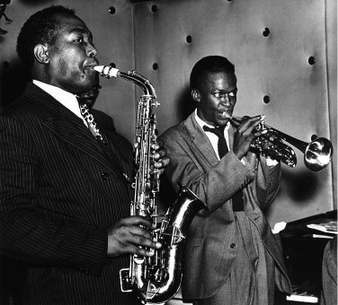
Bebop:
Charlie Parker - Dexterity 2:59 - 1945
(Charlie Parker as, Miles Davis tp, Max Roach ds, Ted Dameron p, Curly Russell b)
(The Genius of Charlie Parker, Savoy Jazz 2005)

Slide 4
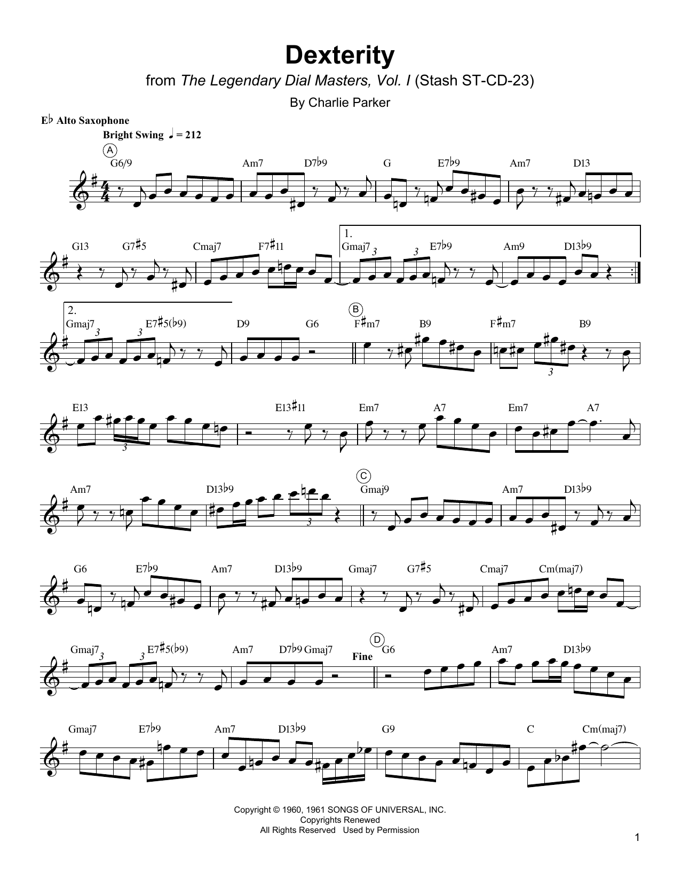


Slide 5
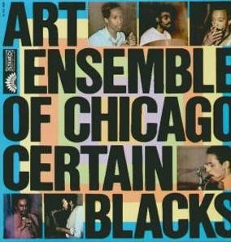
Free Jazz:
Art Ensemble of Chicago: Certain Blacks/
Chicago Beau - Certain blacks do what they wanna
00:00-08:30 (out of 24:00)
America/Paris 1970 verve 2005
Chicago Beau: ts/pc
Julio Finn: harmonica
Joseph Jarman: ts/ss/as/pc/vibes
Ed Mitchell Jr. (=Roscoe Mitchell): bass sax
William A. Howell: ds
Lester Bowle (= Lester Bowie): tp
Malachai Favors: pc/b

Slide 6
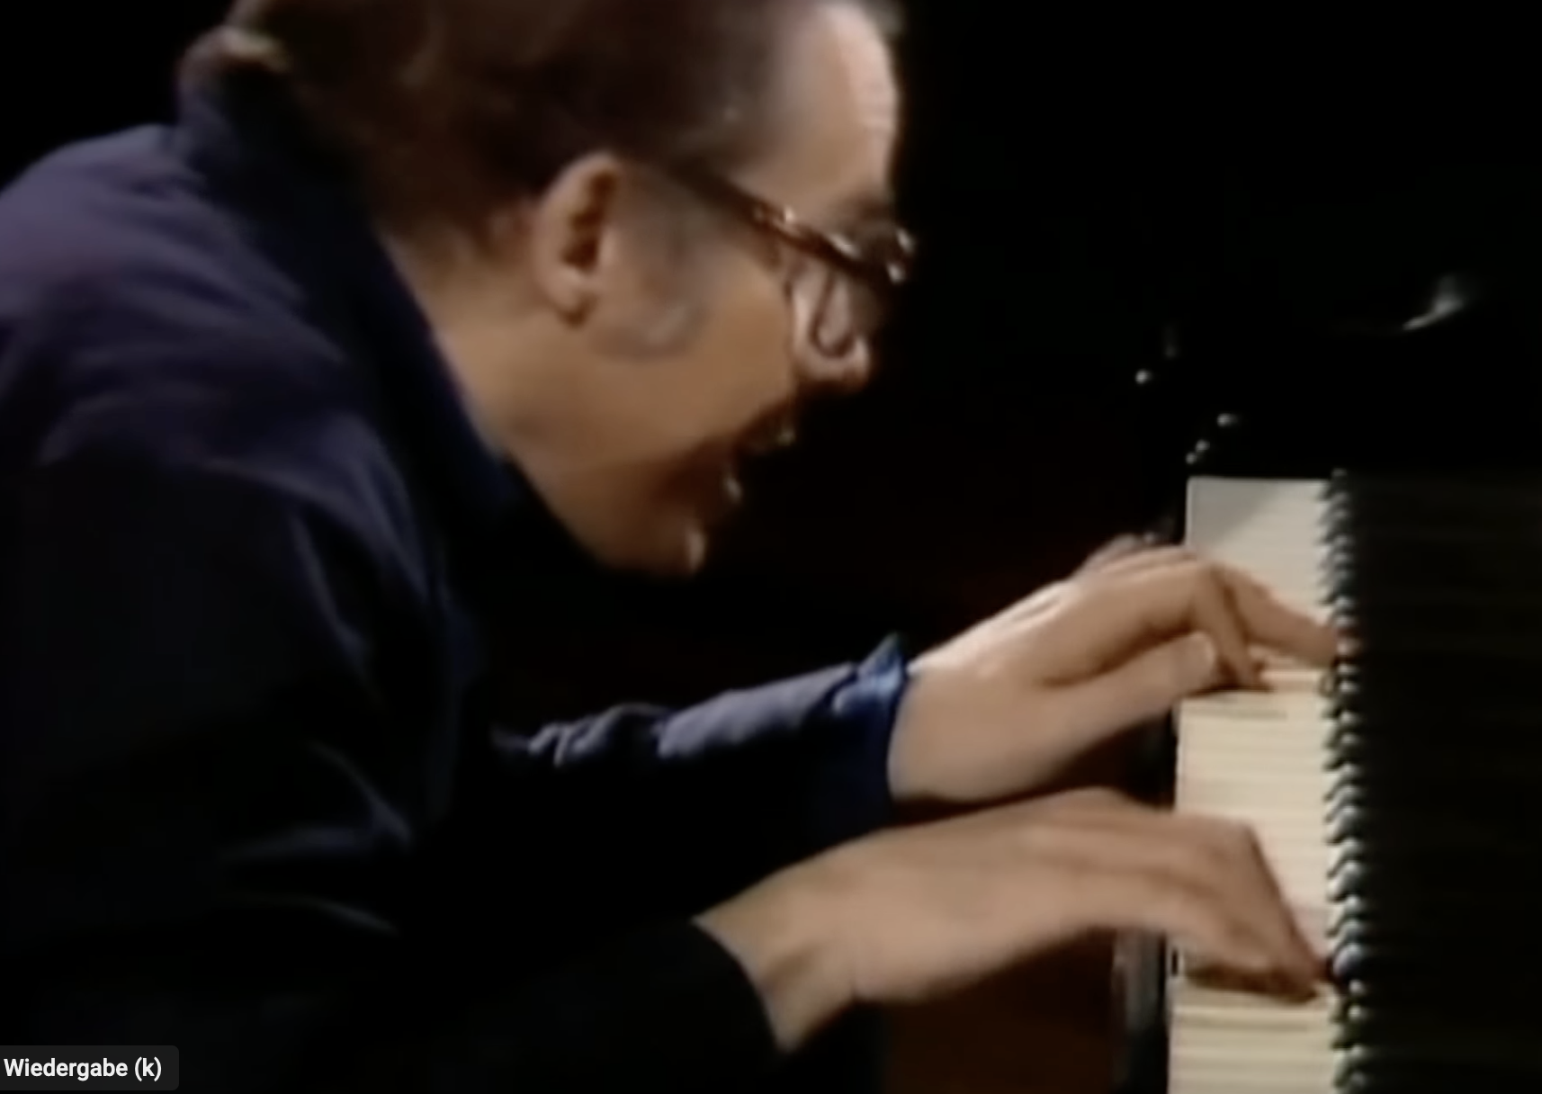
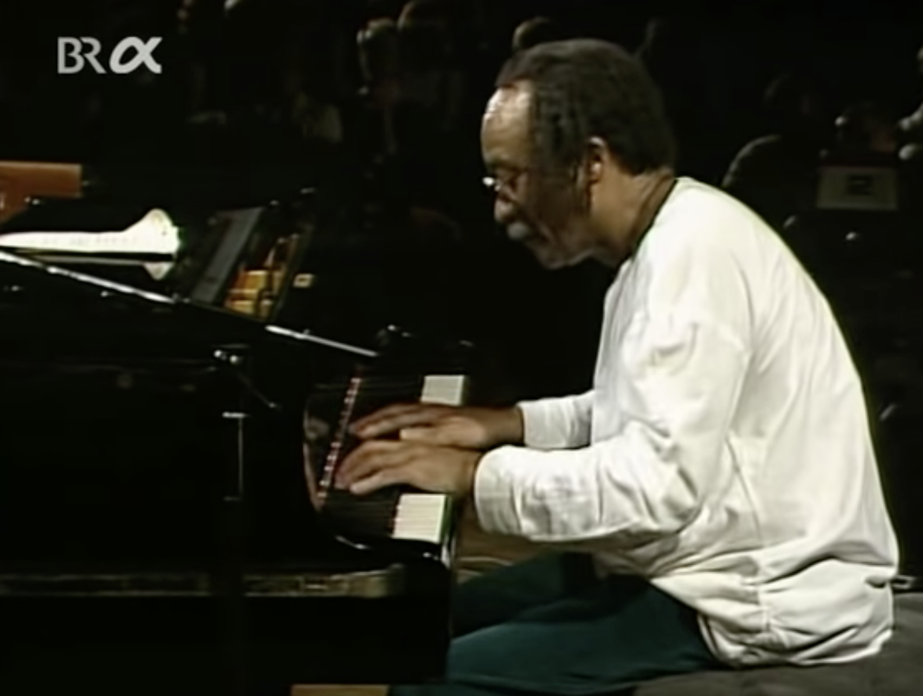
Free Jazz:
Glenn Gould (Goldberg)
vs. Cecil Taylor „CT“ (1984 Nurnberg Festival)

Slide 7
Teaching a course in free jazz is problematic in view of a number of arguments:
Free jazz is by definition breaking with rules, anti-academic, and conflict oriented
(Cecil Taylor could never accomplish his teaching...), how could one learn to „negate whatsoever“?
Free jazz is a profoundly anti-factual phenomenon, there are no facts and truths, such as theories, scores, schools. Asking CT, he responded: „Just Listen! That might be a good approach.“
I am myself a free jazz musician, so, why could I teach the unteachable?
Free jazz is a merely historical phenomenon that is intimately tied to past social and political situations around 1960 and cannot be revitalized. It can only be the subject of a historical reflection and not an art, which could be taught in academia.

Slide 8
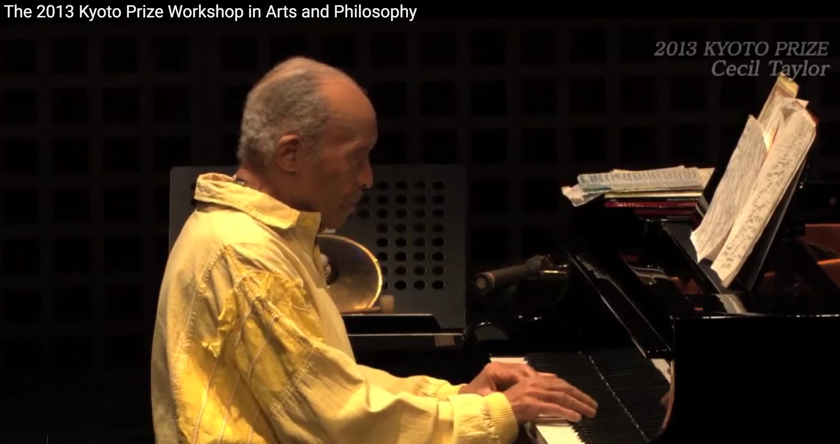
https://www.youtube.com/watch?v=Q8rqVi_ROSo

Slide 9
We shall see that despite some truth in most of these arguments, they miss the point, and in fact free jazz can be viewed under a completely different angle:
Free jazz is a unique example of collaborative behavior, leading to group creativity and collective flow, i.e., characteristics of a very modern direction of human performance, which is desperately needed in the arts, in management, in computer programming and software design communities, and in the research culture.

Slide 10

The latter is in particular important with regard to
(inter)disciplinary projects and organizations.
It is in fact not possible to perform innovative (inter)disciplinary research without changing also the fundamentals of scientific behavior from individual and isolated working style
to intense exchange of data, ideas, and engagements.
collaborative
interdisciplinary

Slide 11
We shall not only teach the intellectual aspects of free jazz, comprising examples from the piano, CDs, and Videos, but also
try to make experiments in performance with students, and to discuss collaborative behavior in such situations (We 7-9 PM, Ferg 225).
Optionally, we shall also offer a one-day workshop with students and free jazz musicians (Guerino Mazzola p, Alex Lubet b/gt, Scott Currie as) on Feb. 24 2019.
We however believe that our discussions will help approach improvisation from a more substantial angle than simple „spontaneity“.

