Slide 1
VIII.4 Symbolic Gesture as „Counterpoint“
to Wanderley and Tanaka
Mo March 18

Slide 2
Modulation B-flat major -> G major
in Beethoven‘s op. 106, Allegro
and the Escher Theorem

Slide 3
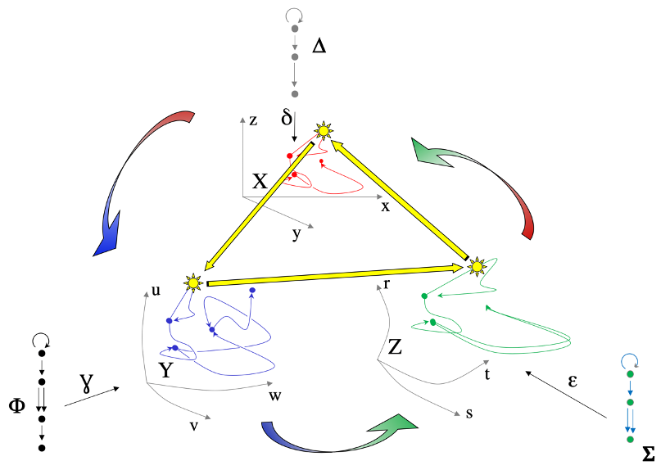
Recall Vertical Time

Slide 4
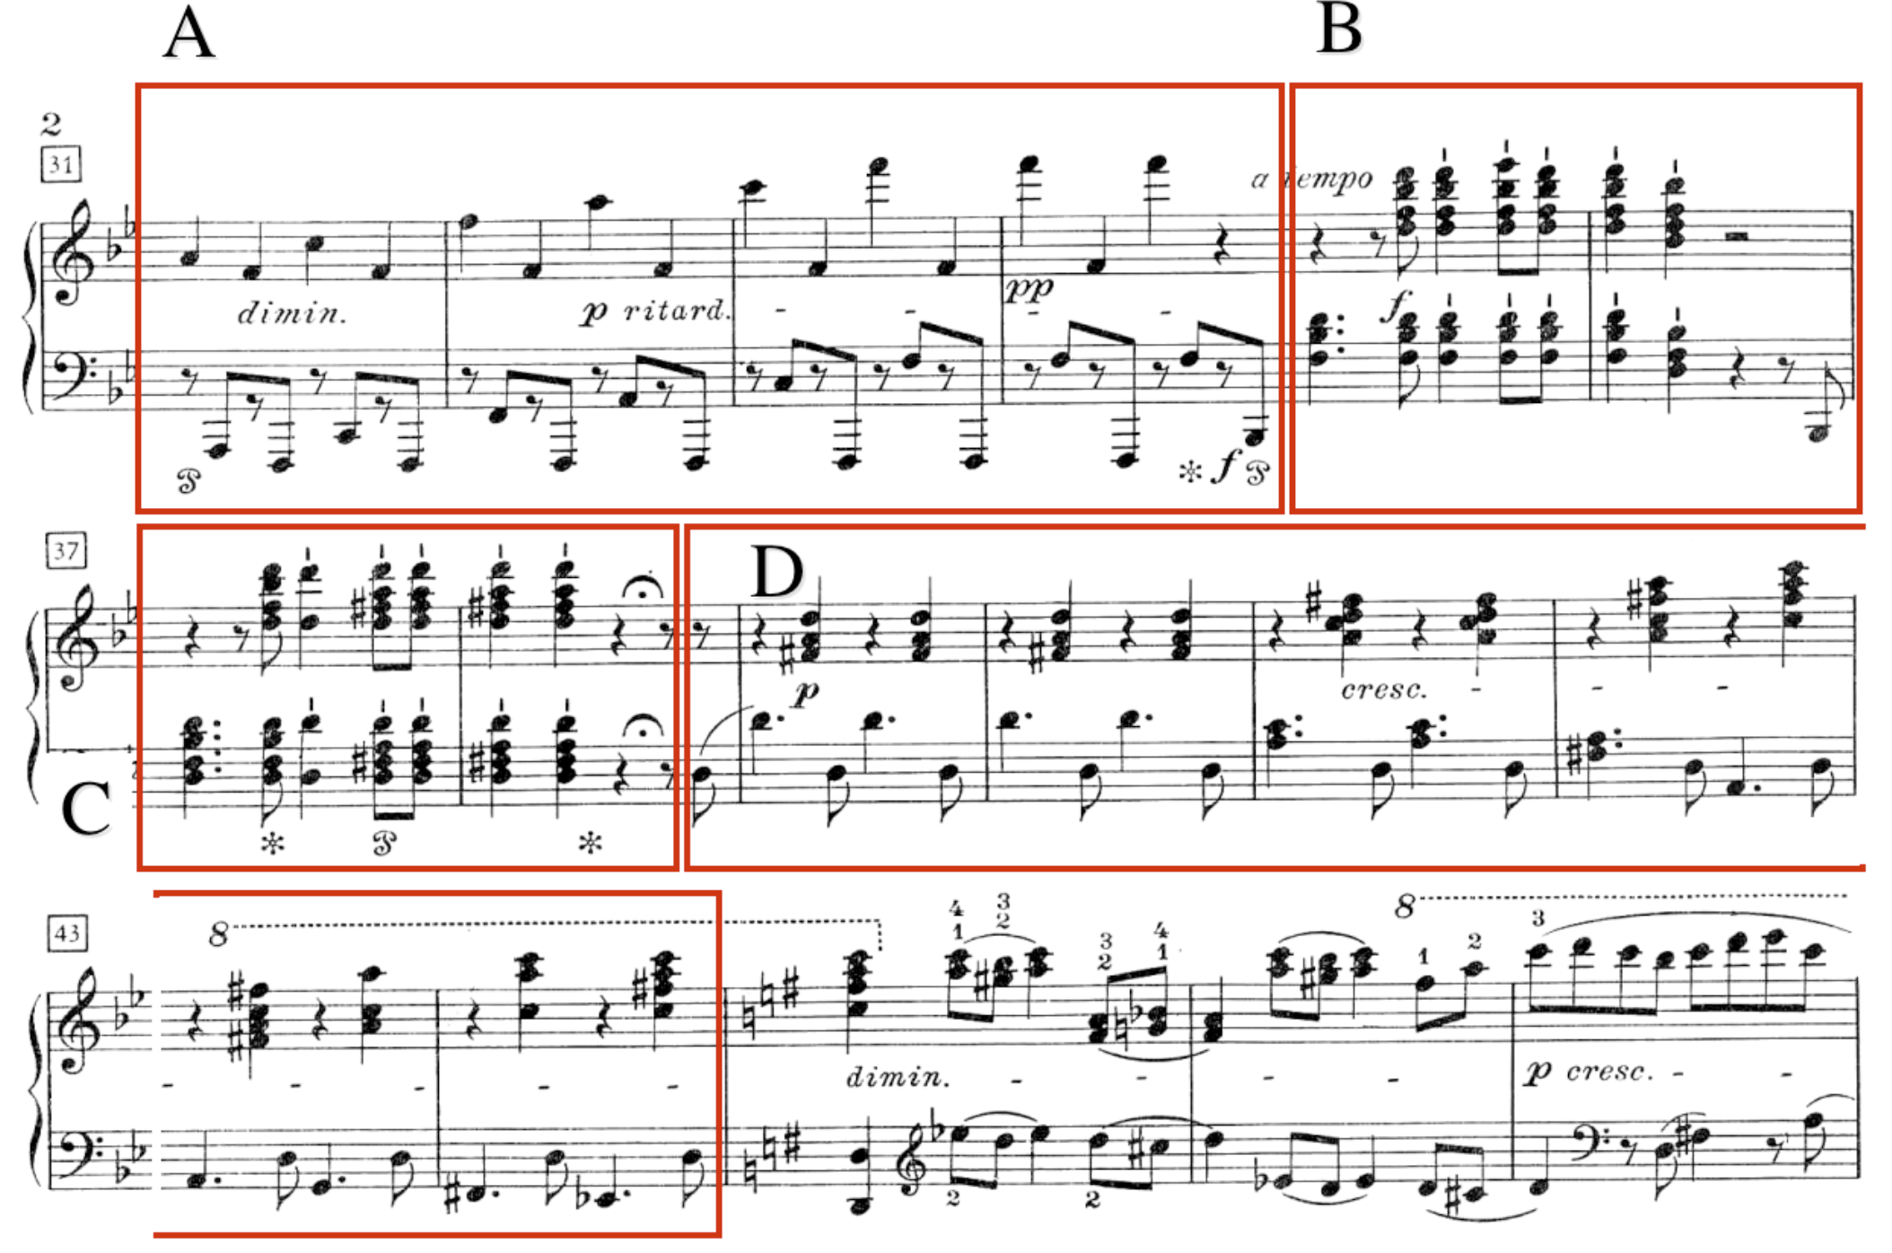

Slide 5
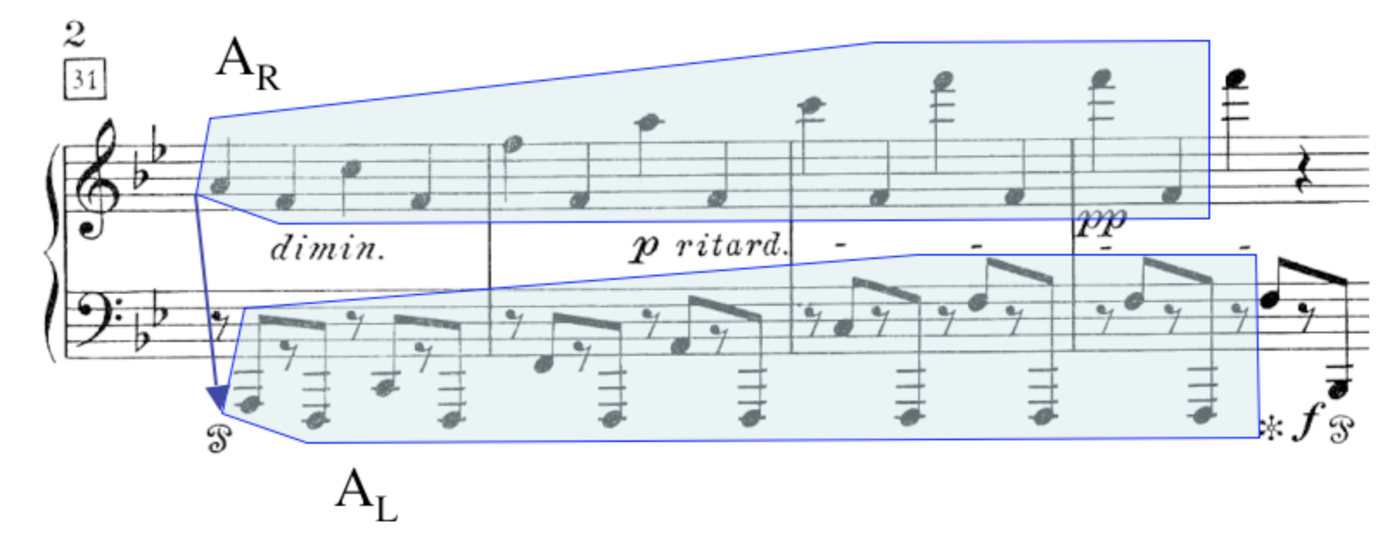

Slide 6
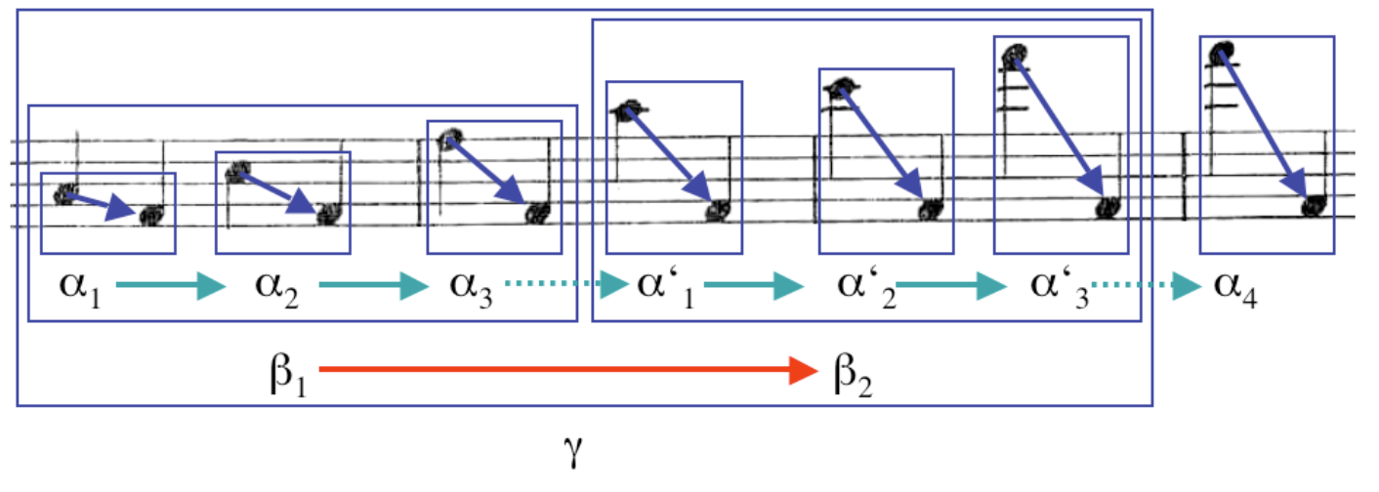
α₁, α₂, α₃, α₁’, α₂’, α₃’, α₄ ∈↑@ℝ²

Slide 7
α₁, α₂, α₃, α₁’, α₂’, α₃’, α₄ ∈↑@ℝ²
→
→
β₁, β₂ ∈↑² @↑@ℝ²

Slide 8
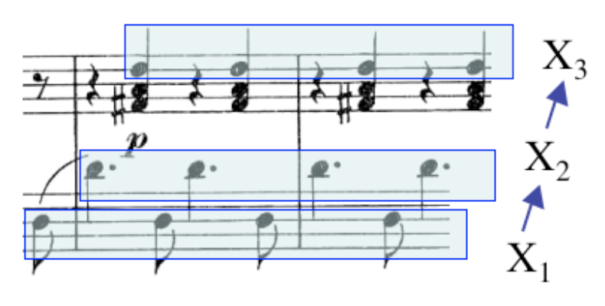

Slide 9
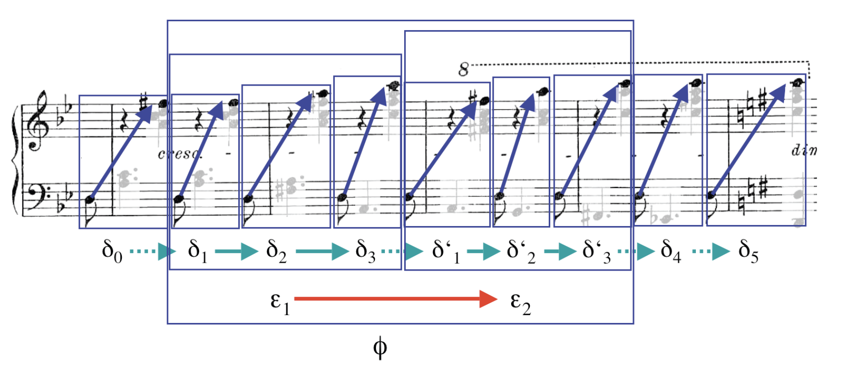
→
δ₀, δ₁, δ₂, δ₃, δ₁’, δ₂‘, δ₃’, δ₄, δ₅ ∈ ↑@ℝ²
→
→
→
→
→
→
↑⁶ @↑@ℝ² ⥱↑ @↑⁶@ℝ²
↑⁸@↑@ℝ² ⥱ ↑@↑⁸@ℝ²
ɸ ∈ ↑⁸@↑@ℝ²
→
→
→
→

Slide 10
↑⁸@↑@ℝ² ⥱ ↑@↑⁸@ℝ²
→
→
→
→

Slide 11
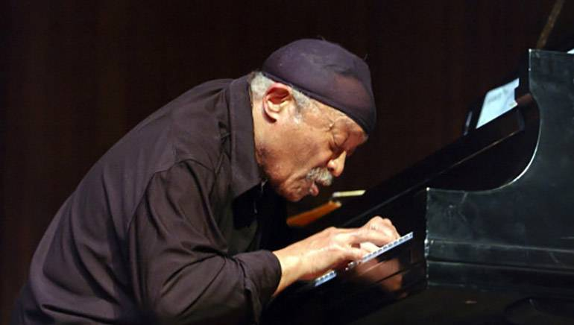
Cecil Taylor’s gestural technique

Slide 12
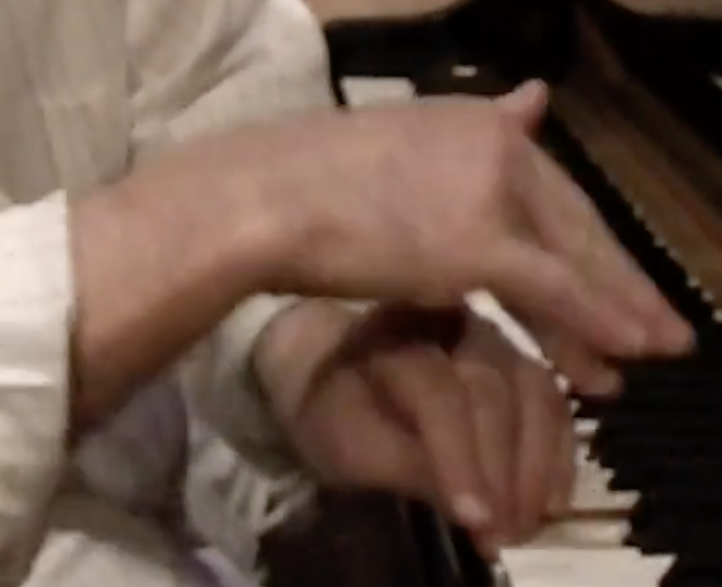
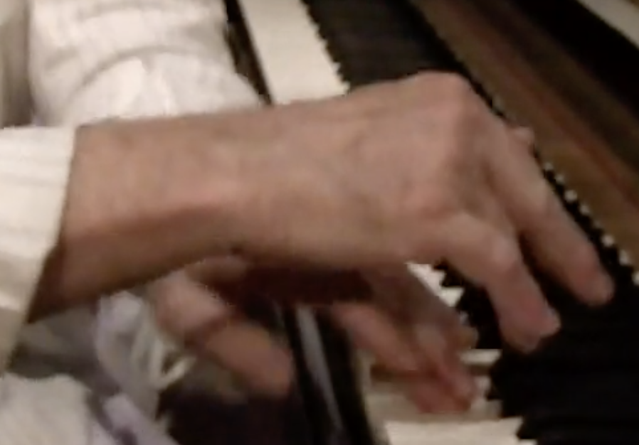
Imaginary Time movie, 12/24-25/2014, VIMEO 2016
Guerino Mazzola p., Heinz Geisser perc., Shiro Onuma perc.
Yokohama Airegin jazz club,
Right
Left

