Slide 1
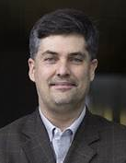
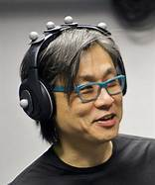
VIII.3 Two opinion leaders:
Marcelo Wanderley and Atau Tanaka

Slide 2
VIII.3.1 Marcelo Wanderley
PhD Wanderley started end of 20th century at IRCAM in Paris and later worked at McGill U in Montreal.
This includes
Publications
Research
Pedagogy
Dance
Discussion Groups

Slide 3
VIII.3.1 Marcelo Wanderley
Publications
Research
Pedagogy
Dance
Discussion Groups

Slide 4
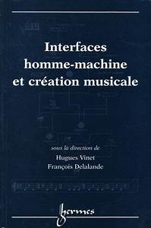
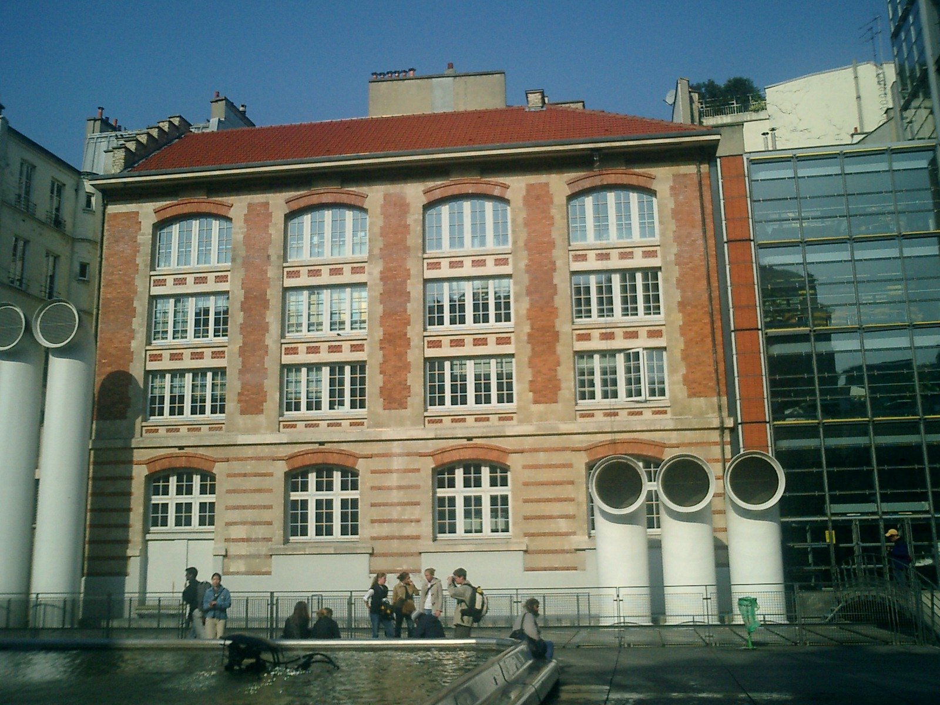
Interfaces Homme-Machine et Création Musicale
Hermès Science Publishing 1999, from workshop 1998 at IRCAM

Slide 5
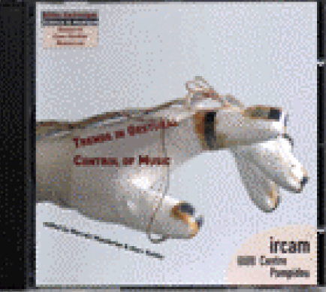
Trends in Gestural Control of Music, IRCAM 2000, CD
edited by M. Wanderley and M. Battier; papers, videos, music, and bibliography

Slide 6
VIII.3.1 Marcelo Wanderley
Publications
Research
Pedagogy
Dance
Discussion Groups

Slide 7
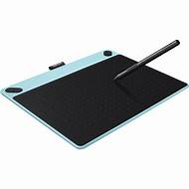
Alternate Controllers
Haptic Devices
Real-Time Additive Synthesis Control – ESCHER
Real-time Control of Physical Models
Inversion of Physical Models (how should the model be controlled in order to obtain a given sound)
Score Following
Modeling Performer Gestures
Mapping Strategies for Instrumental Performance
Wacom Tablet

Slide 8
VIII.3.1 Marcelo Wanderley
Publications
Research
Pedagogy
Dance
Discussion Groups

Slide 9
Compositions
Applied Studies
Courses
MSc Course on Multimedia at CNAM (Conservatoire National des Arts et Métiers)
Session and Workshop at ISEA 2000 (International Symposium on Electronic Art)
Hardware Developments

Slide 10
VIII.3.1 Marcelo Wanderley
Publications
Research
Pedagogy
Dance
Discussion Groups

Slide 11
IRCAM Choreography Department in collaboration with composers

Slide 12
VIII.3.1 Marcelo Wanderley
Publications
Research
Pedagogy
Dance
Discussion Groups

Slide 13
Discussion groups
Groupe de discussion sur le geste musical,
created by Wanderley and S. Dubnov

Slide 14
VIII.3.1 Marcelo Wanderley
paper 2008 with A R Jensenius, R I Godøy, and M Leman
Music and Dance Gestures
Definitions of Gesture
Concepts for Studying Musical Gestures
Methods or Studying Musical Gestures
Conclusions

Slide 15
Music and Dance Gestures
musical gesture = human body movement along with sounding music.
Producing sound vs. perceiving sound.
Dancers make gesture, because they make movements with meaning.
Gestures transcend Cartesian duality.

Slide 16
Definitions of Gesture
Three types: communicative, control, metaphor.
communicative Kendon and McNeill; gesture as coexisting with speech

Slide 17
Definitions of Gesture
2. control
HCI
„...we understand the intended meaning of the gesture based on its context and on our life-long experience of multimodal communication.“
Extract expressiveness of body movement.
Computer music technology, not linguistic as with Kendon and McNeill.
Wanderley and Miranda: „Gesture is used in a broad sense to mean any human action used to generate sound.“ „Naked gestures“ = gestures without haptic contact.

Slide 18
Definitions of Gesture
3. metaphoric
N. P. M. Todd: Musical movement is similar to, and imitates, movement in physical space.
R. Hatten: „Gesture is significant energetic shaping of time.“
F. Delalande: „Musical Gesture is the intersection of observable actions and mental images.“
Essential for the definitions of Gesture is that it transcends the Cartesian duality.

Slide 19
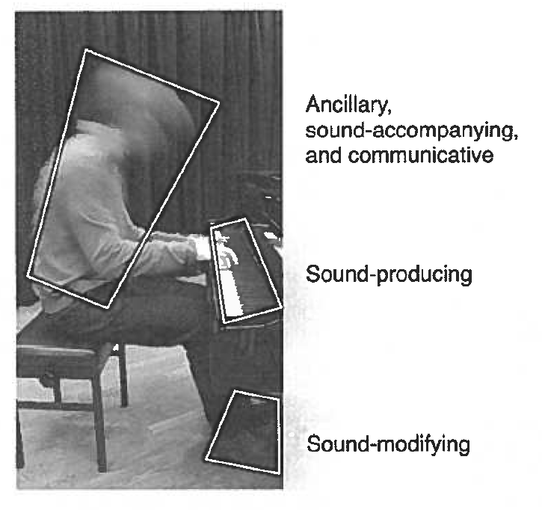
Concepts for Studying Musical Gestures
Spatial Aspects Scene, position, space
Gestures may be nested

Slide 20
Concepts for Studying Musical Gestures
2. Functional Aspects: - excitation vs. modification
- communication: performer-performer vs. performer-receiver
sound fascillitating gestures (support, phrasing, entrained)
sound-accompanying gestures, sound tracing.

Slide 21
Methods or Studying Musical Gestures
Need multidisciplinary approaches from natural sciences and humanities.
Different methodologies from qualitative to quantitative are required. Measuring, interpreting, simulating, etc.

Slide 22
Their Conclusions
Have no unequivocal definition, but a definition should refer to body and meaning.
Let us discuss this research at IRCAM!

Slide 23
VIII.3.1 Marcelo Wanderley
paper 2012 with R M Winters, A Savart, and V Verfaille
The Tool
Mapping Data
Video Integration
Goals of Sonification

Slide 24
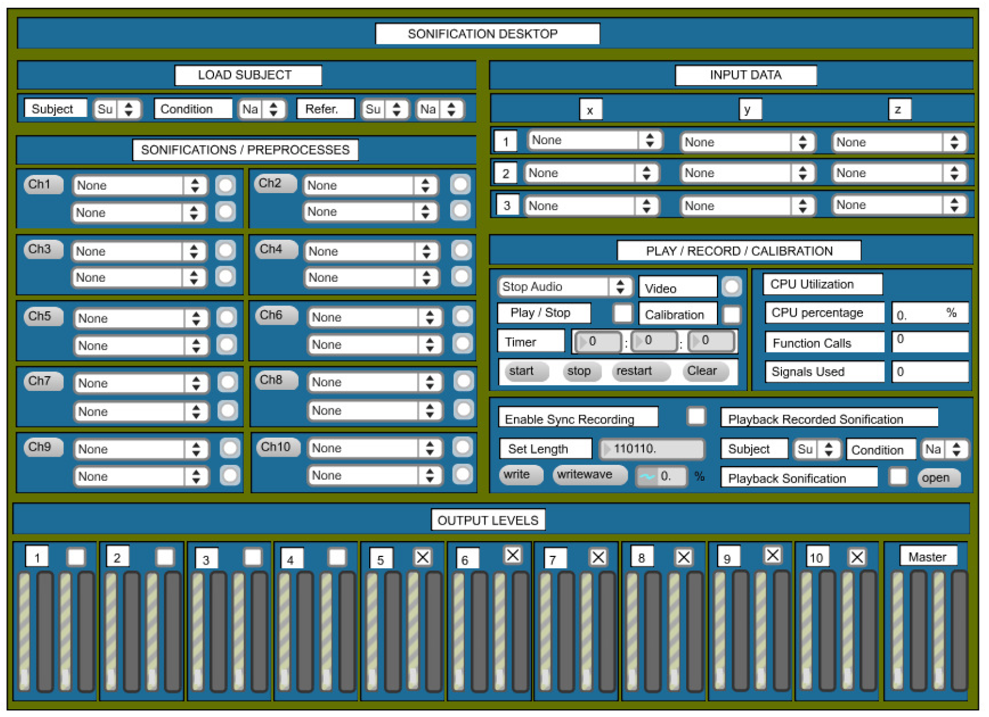
The Tool
It is a motion capture system.
The GUI:

Slide 25
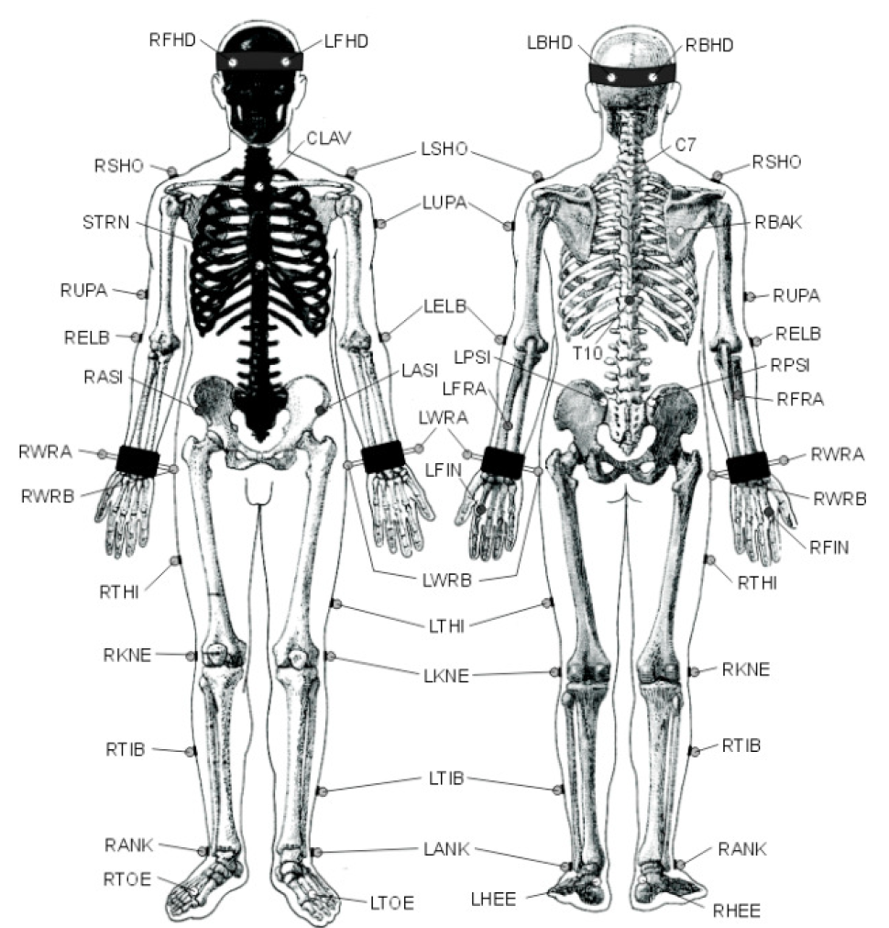
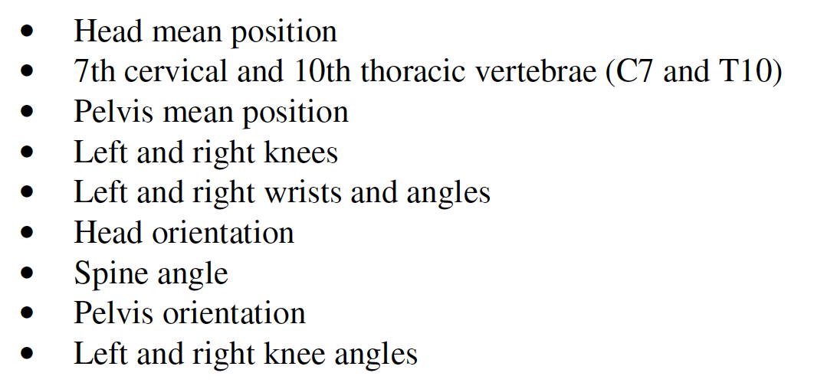
The marker placement:

Slide 26
Mapping Data
using MAX/MSP music software

Slide 27
Video Integration
it is possible to record video of movements and play back with the sonification.
See also IDMIL website (Input Devices and Music Interaction Laboratory)

Slide 28
Goals of Sonification

Slide 29
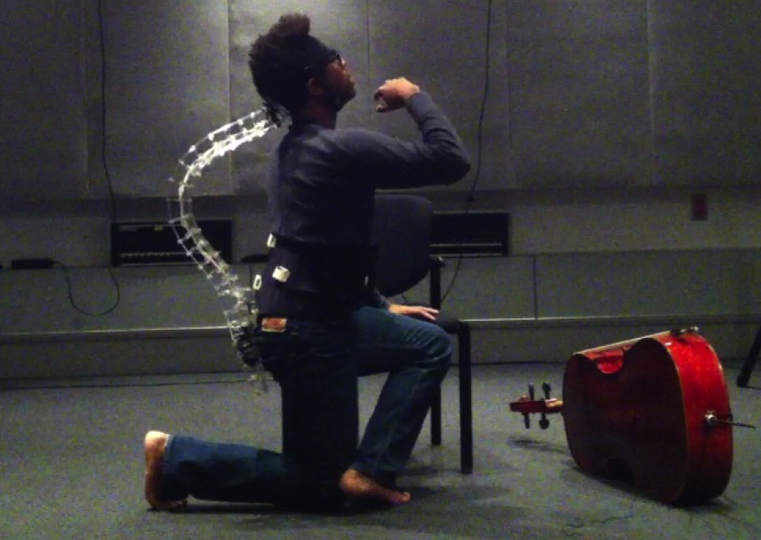
VIII.3.1 Marcelo Wanderley
paper 2014 with I Hattwick, and S Woods
The Spine tool with cello.
Train a
professional
cellist to per-
form on a new
electronic
instrument, the
spine.

Slide 30
VIII.3.2 Atau Tanaka, PhD, Goldsmith U, London
Atau Tanaka conducts research in embodied musical interaction. This work takes place at the intersection of human computer interaction and gestural computer music performance.
He studies our encounters with sound, be they in music or in the everyday, as a form of phenomenological experience. This includes the use of physiological sensing technologies, notably muscle tension in the electromyogram signal, and machine learning analysis of this complex, organic data.
At the other extreme, he studies user experience through ethnographic methods of participatory design where activities of workshopping, scenario building, and structured brainstorming lead an understanding of a mediums affordances in bottom-up, emergent ways.
He is a member of the EAVI (Embodied AudioVisual Interaction) research group, which focuses on embodied interaction with sound and image. EAVI is a small group of academics, researchers, and PhD students carrying out cutting-edge research across topics including motion capture, eye tracking, brain computer interfaces, physiological bio-interfaces, machine learning, and auditory culture.

Slide 31
Atau Tanaka
Musical Performance Practice on Sensor-based Instruments
2000, in Trends in Gestural Control of Music, Wanderley ed.
Definition of a computer-based instrument:
A reprogrammable system, with sensor input system, software, hardware and sound output devices.
Tanaka describes three instruments of electronic nature: BioMuse, SoundNet, and Global String
Here is an early 1994 youtube video of Edwin van der Heide, Zbigniew Karkowski, and Atau Tanaka, the Sensorband

Slide 32
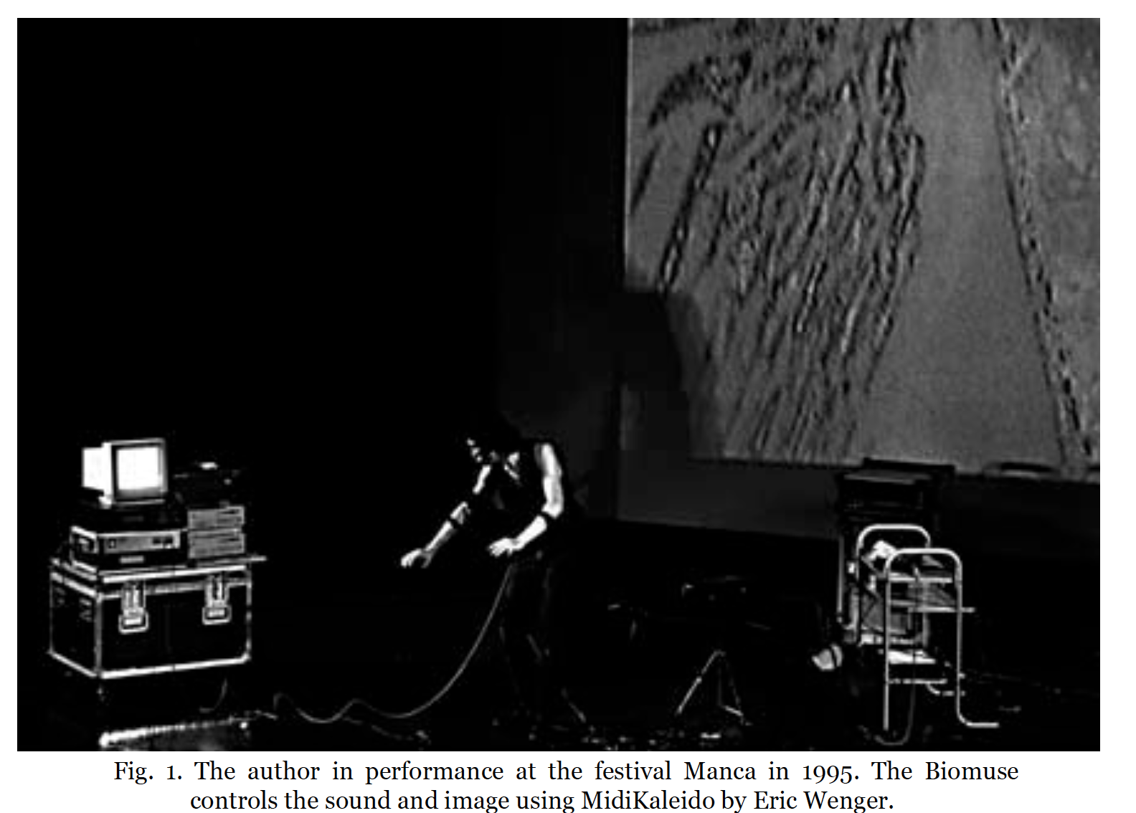
Atau Tanaka
Musical Performance Practice on Sensor-based Instruments
2000, in Trends in Gestural Control of Music, Wanderley ed.
BioMuse, since 1992. It messages 8 channels:
EEG, EMG, EOG
and hand/arm movements
to MIDI
and then to MAX/MSP
for sound.
Inaugural performance

Slide 33
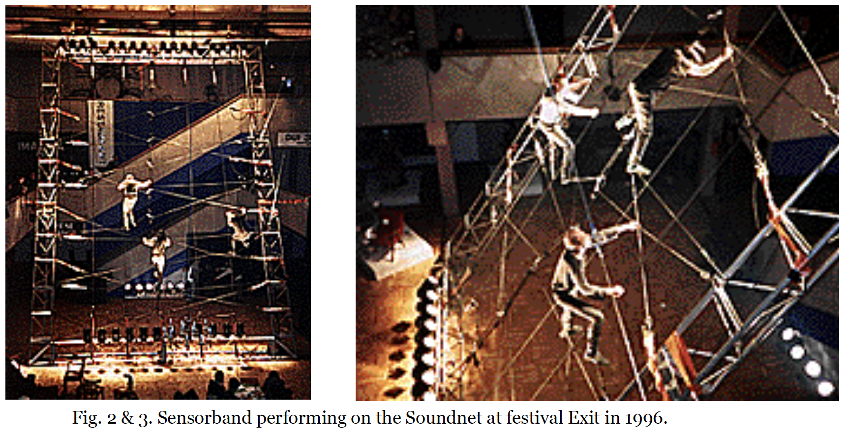
Atau Tanaka
Musical Performance Practice on Sensor-based Instruments
2000, in Trends in Gestural Control of Music, Wanderley ed.
SoundNet. A multisensor instrument created by Sensorband. 11 x 11 meters
11 sensors detect stretching and movement.

Slide 34
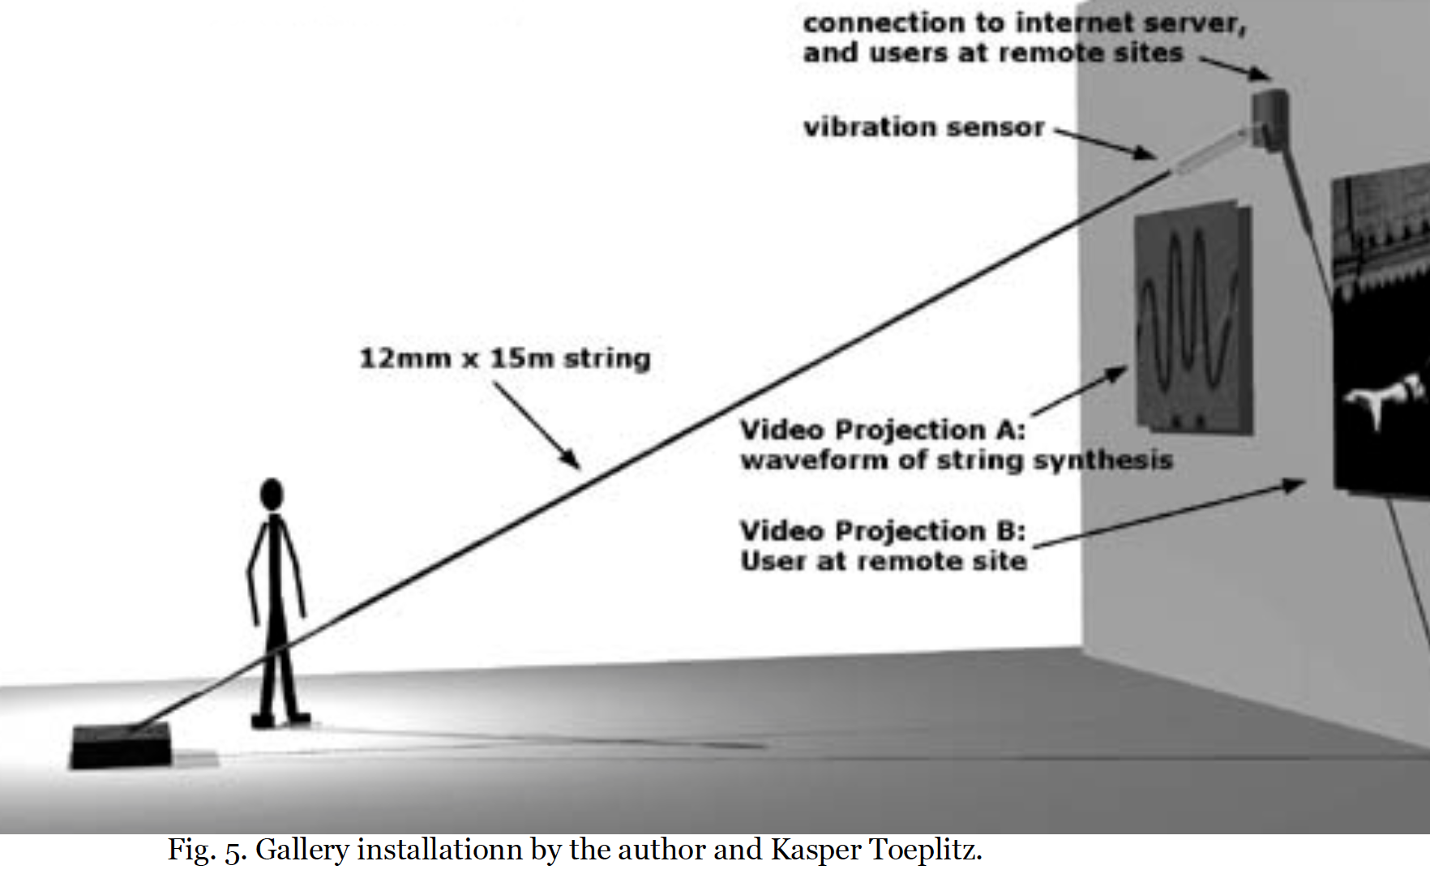
Atau Tanaka
Musical Performance Practice on Sensor-based Instruments
2000, in Trends in Gestural Control of Music, Wanderley ed.
Global String. Idea: Create a string that spans the world.

