Slide 1
IX.0 Gestural Experiments
Mar.20

Slide 2
Embodied AI
Stumpy: AI Lab, U Zurich
„Cheap design“

Slide 3
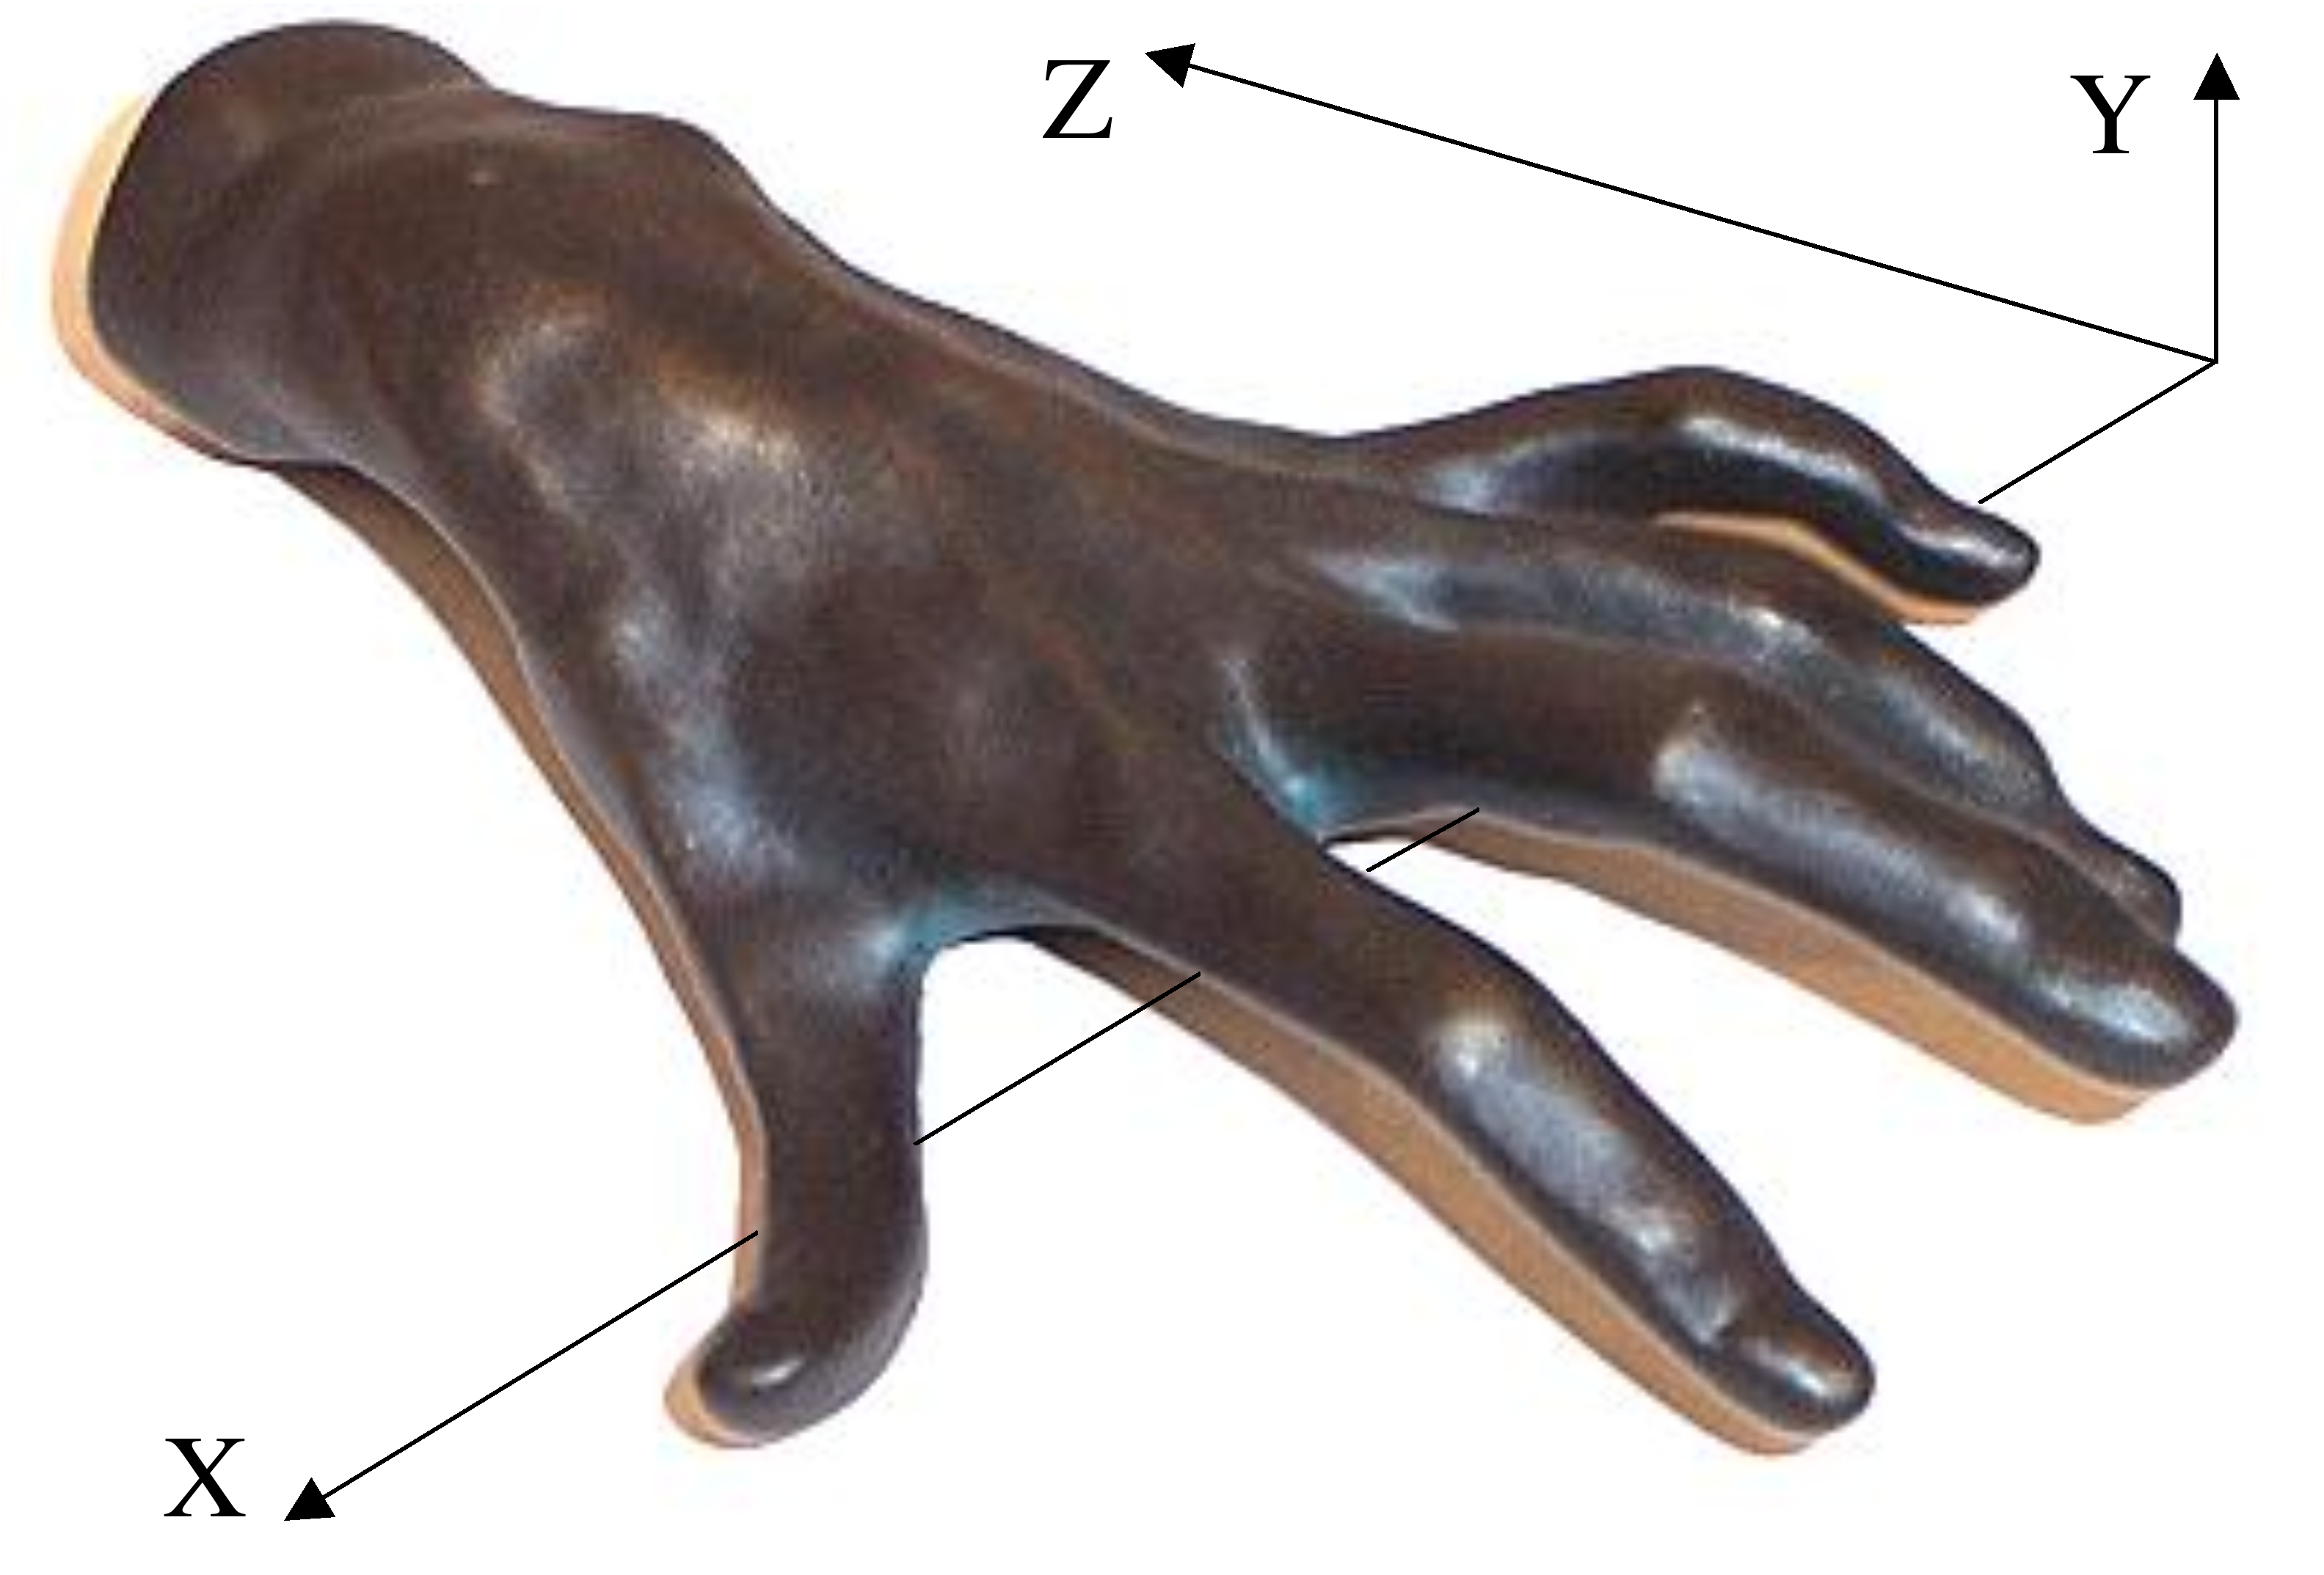
One hand ⇒ product γ = γ₁×γ₂×γ₃×γ₄×γ₅×γ₆ of 6 gestural curves in space-time (x,y,z;e) of piano
j = 1, 2, ... 5: tips of fingers
j = 6: the carpus
e = time
y
z
γ
γ
(t
)
6
(t
)
6
γ
γ
(t
)
5
(t
)
5
γ
γ
(t
)
4
(t
)
4
γ
γ
(t
)
3
(t
)
3
γ
γ
γ
γ
(t
)
(t
)
(t
)
x
(t
)
2
1
2
1

Slide 4
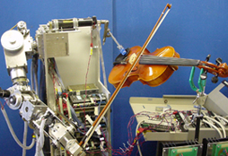
Koji Shibuya‘s Ryukoku
violin robot

Slide 6
Honda‘s Asimo

Slide 7
Compressorhead Ace

Slide 8
Sound anatomy
Classical Joseph Fourier (partials/overtones) ~ 1800
envelope H
+
=
wave w
shift and squeeze
w. H
support

Slide 9
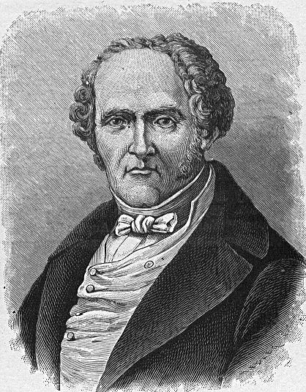
Sound anatomy
Classical Joseph Fourier (partials/overtones) ~ 1800
every periodic function!!!
2nd partial
= 2nd overtone
amplitude length of arrow
wave w
w(t) = A_{c} + A₁ sin(2π.ft+Ph₁) + A₂ sin(2π.2ft+Ph₂) + A₃ sin(2π.3ft+Ph₃) +...
time
fundamental = 1st partial
= 1st overtone
phase (angle)

Slide 10
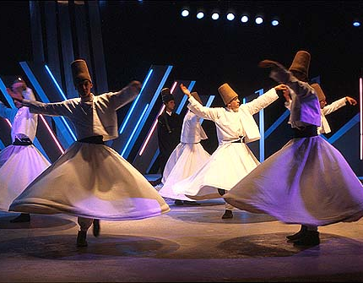
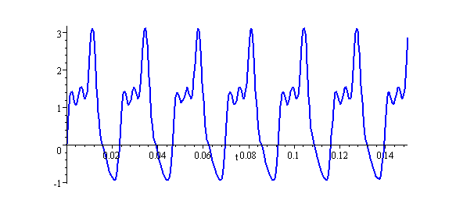
2009: Dancing the Violent Body of Sound
Schuyler Tsuda
dancing
Diyah Larasati
Bill Messing
f(t) = Σ _{n} a_{n} e^{i2πnt}

