Slide 1
IV Introduction to Gesture Theory of Performance
(We Feb 14)

Slide 2
IV.1 Summary of Classical Performance Theory

Slide 3
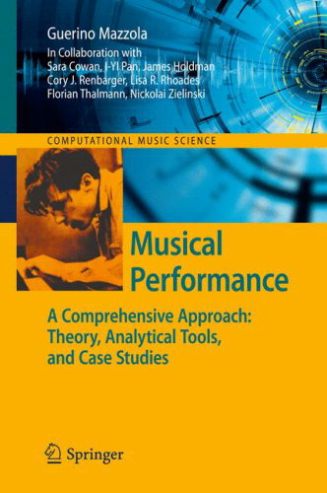
I INTRODUCTION
I.2 Short History
2011

Slide 4
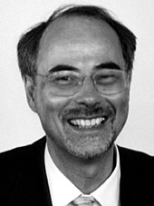
Two histories of performance and its theory:
musicological/philosophical
practical/empirical
Although they go back to 18th Century, they have had little if any points of contact until 2nd half of the 20th Century.
Danuser et al., p. 320 (1992):
At present, we have no comprehensive theory of performance.
Hermann Danuser

Slide 5
History 1: musicological/philosophical (Danuser et al.)
He discusses the transition from traditional rhetorically oriented performance rules (German "Vortragslehre" for "rendition") to a performance theory that also takes into account the specific structure and semantics of a given work and aims at its expression/communication via rhetorical means. It testifies the transition from the aesthetics of affect and effect to aesthetics of works around 1800 (Danuser p.272). Tosi, Agricola, Quantz, C. Ph. E. Bach, L. Mozart are all systematic pedagogical works, not theoretical ones.
Five rules of rhetorics:
inventio (the arguments)
dispositio (the articulation)
elocutio (the communicative wording of thoughts)
memoria (memory for performance)
pronuntiatio/actio (the actual physical performance)
Start: Nikolaus Listenius: Musica...(1537) science of right singing
Parallel to Vasari‘s invention of central perspective (Individual!)
Claudio Monteverdi, 1600: general categories of affect

Slide 6
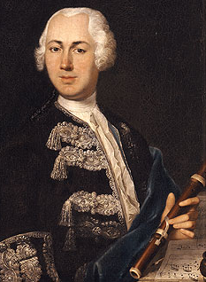
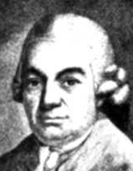
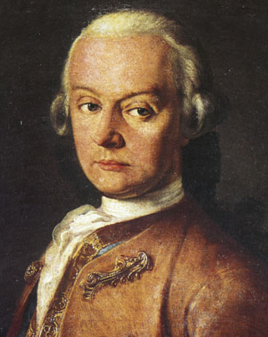
Johann Joachim Quantz (1697-1773) Versuch einer Anweisung die Flöte traversière zu spielen 1752
Carl Philipp Emanuel Bach (1714-1788) Versuch über die wahre Art das Clavier zu spielen 1753
pedagogical works
Leopold Mozart (1719-1787) Versuch einer gründlichen Violinschule 1756

Slide 7
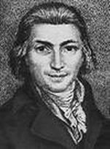
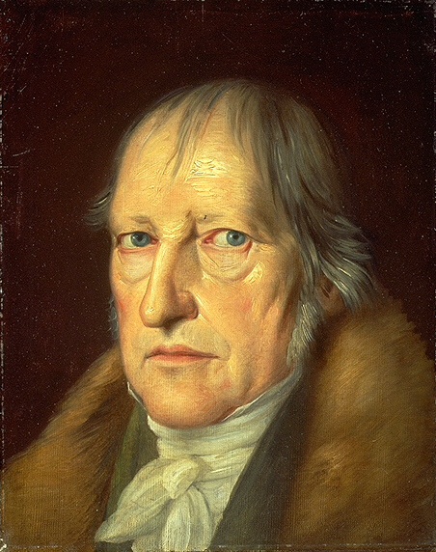
Daniel Gottlob Türk (1750-1813) Klavierschule 1789: Scientific remarks; the book is not only for students, but also for researchers.
August Leopold Crelle (1780-1855) Einiges über musicalischen Ausdruck und Vortrag 1823: Performance is the exact expression of a work‘s contents, as a whole and in parts. And as an expression of the individual „autonomous“ character of the work (Beethoven, autonomous music).
first theoretical directions
Georg Wilhelm Friedrich Hegel (1770-1831) Aesthetik 1835 (posthum): Reproduction vs. creative production. Performance as a recreation of the improvisational origin/root (cf. Adorno!). Transforming composer‘s inside to outside.

Slide 8
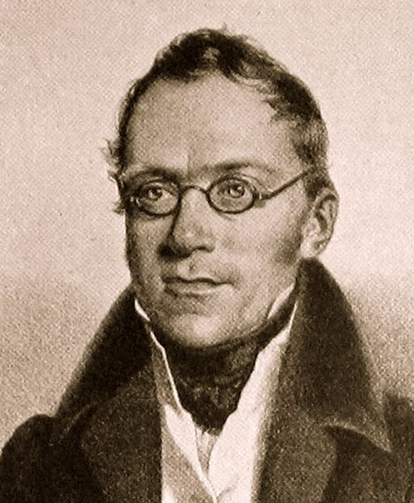
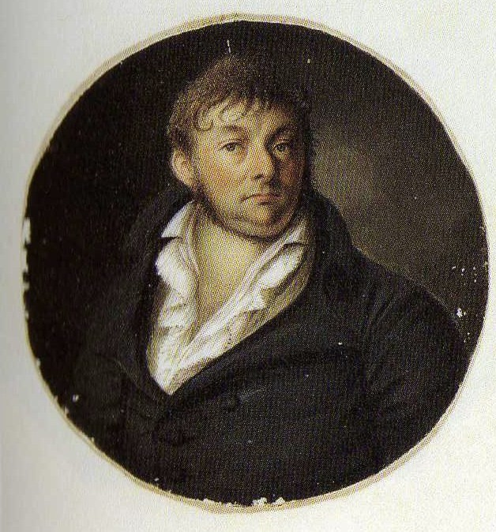
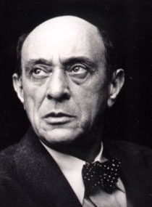
Carl Czerny (1791-1857) Klavierschule 1840: The interpreter creates the language character of music, adds meaning by his/her shaping.
Gustav Schilling (1805-1880) Musikalische Dynamik oder die Lehre vom Vortrage in der Musik 1843: From general to particular, follows Hegel's systematization principles. Performance has to follow the three principles of
• objectivity = reference to a completed composition when transforming it into „real life“
• ideality = role of performer in the identification with the composition's ideas/contents
• totality = capturing the totality of the ideas as expressed in the score's symbols.
more theoretical directions
Arnold Schoenberg (1874-1951) Theory of Performance 1923-31: „Is performance necessary? Not the author, but the audience only needs it. (...) Instead of examining what performance does to musical ideas, the problem should be ‚What notation does do to musical performances‘. Imperfection of notation causes problems of performances and causes the necessity of interpretation.“

Slide 9
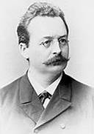
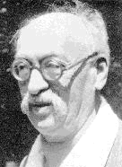
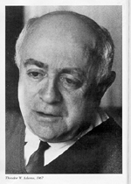
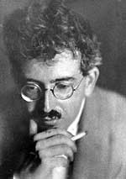
Hugo Riemann (1849-1919) Der Ausdruck in der Musik 1884: „The concept of musical expression is directly understandable as the clear expression of musical thoughts, the plastic emergence of motifs and themes, the clarity of the whole structure of the work of art.“ He declares explicit rules of dynamics to shape melodies and harmonic modulations.
Heinrich Schenker (1867-1935) Die Kunst des Vortrags (unpublished): Schenker argues for a performance as an expression of analytical facts (analytical performance in Adorno's language).
towards analytical performance
Theodor Wiesengrund Adorno (1905-1980) Der getreue Korrepetitor 1963: Discusses works of new music (Webern, Schoenberg, Berg). What does not descend, at least in models, to the single note and the single rest is non-binding as interpretive instruction. Adorno/Walter Benjamin: Micrological procedure.

Slide 10
Danuser (p. 301):
defines „Interpretationsanalyse“ (performance analysis) as the translation of structural and formal insights (on the conceptual level = semiotic) into performative shaping.
The rhetorical theory (Vortragslehre) just applied general rules of rhetorics, such as pronuntiatio, to special works, whereas performance analysis fully recognizes the specific work and expresses its contents in the shaping of performance This became a necessity by Beethoven's works.

Slide 11
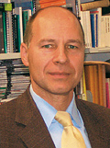
History 2: practical/empirical (Reinhard Kopiez in Helga de la Motte‘s Book)
He discusses historical aspects of empirical „performance research“. He refers to Nikolaus Listenius‘ treatise Musica (1537) as one of the first speaking of „music as the science of good and correct singing“.
This is parallel to the invention of central perspective in painting, defining the relevance of the (human) individual position as opposed to the Medieval idea of a world „sub specie aeternitatis“, following eternal/divine laws as set up in Pythagorean music philosophy (tetractys).
Kopiez stresses the increasing role of the performer as opposed to the composer, mentioning Quantz etc., Liszt‘s treatise Zur Stellung der Künstler (1835), where he equals composer, instrumental teacher, and performer as three variants of artistic personalities.
The performance research here described is a purely empirical topic, where machines are discussed to analyze and/or synthesize performances, mainly for keyboards.

Slide 12
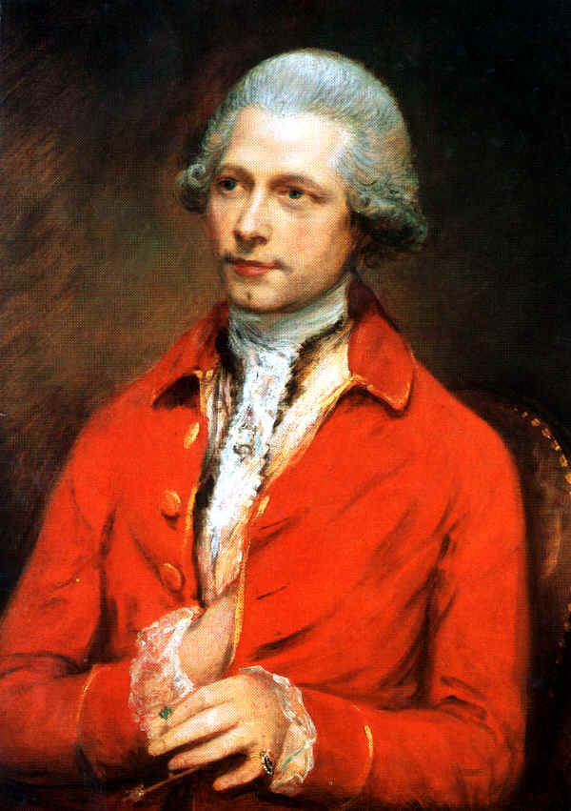
1745: Construction plans for measuring key movements in cembalo. Precursor of piano rolls, mainly for improvisation. J. Hohlfeld's Fantasiermaschine 1753 presented to Berlin Academy of Sciences. Uses pencils on paper, 3.45 m for 6.5 minutes. C. Ph. E. Bach tested and approved. The only sample was burnt in a fire at the Academy. We however have a sample built by Jean-Joseph Merlin (1735-1803) in London 1780. Called Klavier-Cembalo

Slide 13
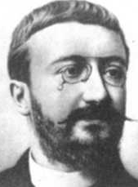
1895 Alfred Binet (1857-1911) and Jules Courtier built machine with rubber air tubes measuring loudness and onset (1msec resolution), not pitch.
From recording it results that faster performance makes more irregular and legato.

Slide 14
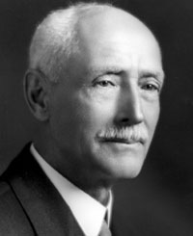
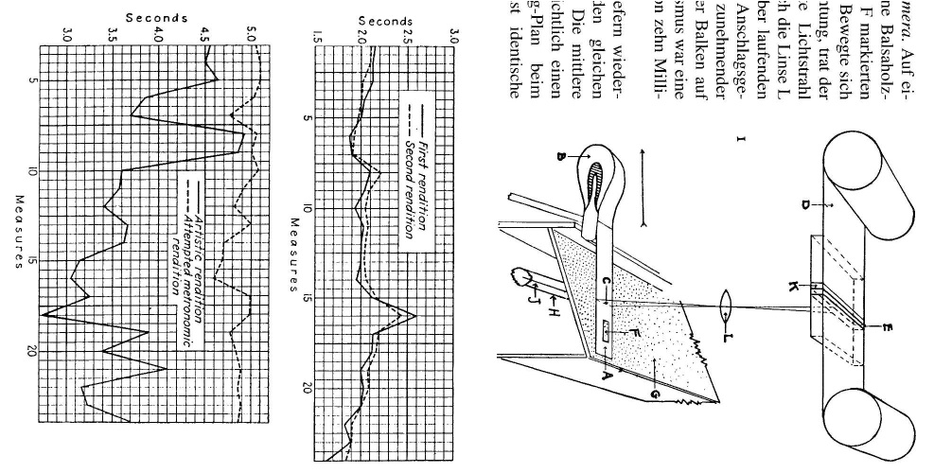
1932 Carl Seashore's (1866-1949, translation of the Swedish surname Sjöstrand) Iowa Piano Camera, records photo film of events.
First results on agogics (resolution 10msec) and relative note dynamics (measured black block lengths from velocity of passing light J through window F onto film D) in chords.
Graphics proves agogical consistency of renditions.

Slide 15
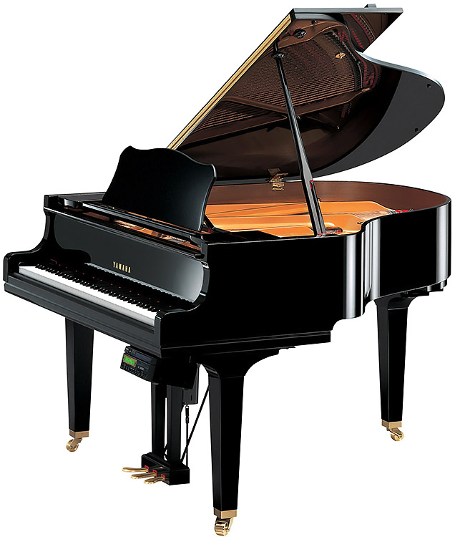
1974 SYVAR project of Erling Bløndal Bengtsson and Alf Gabrielsson (and Shaffer 1980). Shaffer constructed optoelectronic machine feeding a computer. Precursor of Disklavier.
In 1983 with MIDI, the recording of performance became general standard, although C. Wagner (1974) had already experimented with such divices with accurateness of 1msec.
Yamaha Disklavier

Slide 16
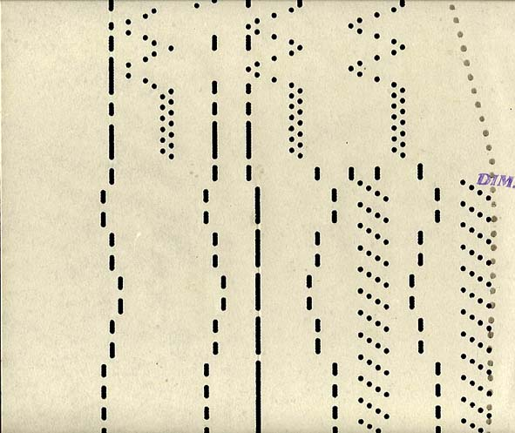
The analysis of piano rolls with prominent historical recordings between the late 19th and early 20th Century by nearly all important pianists. Piano rolls are not precise in dynamics and timing. More „simulation“ than „imitation“.
Based upon this data, R. Seipp (1988) could prove that agogics are systematic rather than random (A-flat major polonaise by Chopin).
H. Gottschewski (1992) has measured a great deal of piano rolls and found rules of agogics.
Presently, there are MIDI readers for piano rolls by H. Mohr, Z. Jánosy & J. Mácsai (1994). Dynamics is still an imprecise information from these piano rolls.
time
pitch

Slide 17
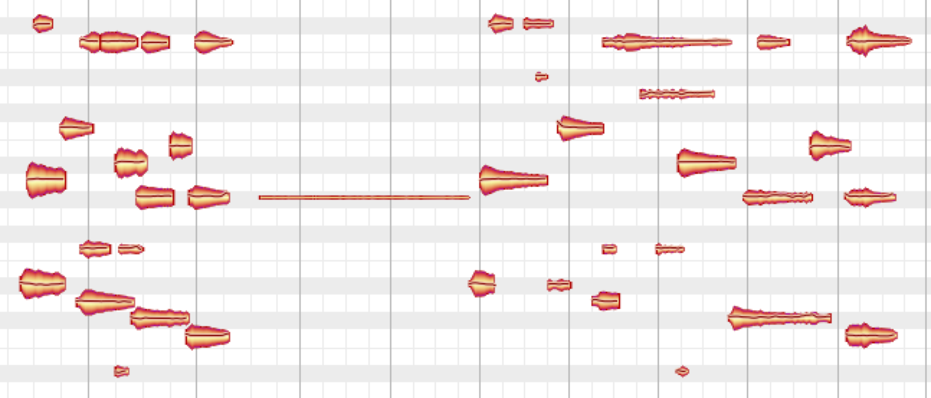
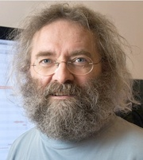
Analysis of LPs and CDs. The so-called „comparative interpretation/performance research“ has a long tradition.
W. Heinitz (1926) compared timings from Wagner's Meistersinger,
A. Kalix (1934) compared 10 recordings of Weber's Freischütz ouverture, comparing performance with score to find out about "musical romanticism".
Different compositions, e.g. op.106 Hammerklavier, have been analyzed from LPs.
Also Bruno Repp (1989, 1992,...) analyzed recordings using FFT for precise onset calculations.
In August 2008, Peter Neubäcker has published a software Melodyne capable of transforming polyphonic acoustical material into symbolic score format. The latter is a real revolution and will change empirical/comparative performance research dramatically.

Slide 18
Two histories of performance and its theory:
musicological/philosophical
practical/empirical
Although they go back to 18th Century, they have had little if any points of contact until 2nd half of the 20th Century.
In 1992, we had no comprehensive theory of performance.
musicological/philosophical
practical/empirical
2020 comprehensive?

Slide 19
IV.2 The Problem of Artistic Presence: Imaginary Time

Slide 21
Have three dimensions E, H, L with similar map structures to e, h, l:
℘_{E}
symbolic onset time E in q
—
—
physical onset time e in sec.
℘_{H}
—
—
symbolic pitch H in St.
physical pitch h in Ct.
℘_{L}
—
—
symbolic loudness L in Vl.
physical loudness l in dB.

Slide 22
Tempo: T(E) = 1/slope(E) = 1/(de/dE) [♩ /sec]
e₁ - e₀ = _{E0}∫ ^{E1} slope(E) dE = _{E0}∫ ^{E1} 1/T(E) dE [sec]
e
E
Intonation: S(H) = 1/slope(H) = 1/(dh/dH) [St/Ct]
h₁ - h₀ = _{H0}∫ ^{H1} slope(H) dH = _{H0}∫ ^{H1} 1/S(H) dH [Ct]
Dynamics: I(L) = 1/slope(L) = 1/(dl/dL) [Vl/dB]
l₁ - l₀ = _{L0}∫ ^{L1} slope(L) dL = _{L0}∫ ^{L1} 1/I(L) dL [dB]

Slide 23
Putting it all together?
℘_{H}
℘_{E} ×℘_{H} × ℘_{L}
symbolic pitch H
physical pitch h
(e,h,l)
(E,H,L)
℘_{L}
symbolic loudness L
physical loudness l
physical onset time e
symbolic onset time E
℘_{E}

Slide 24
Product field: tempo-intonation
EH
Z(E,H)=(T(E), S(H))
E
H
[1/2-tone/Ct]
H
generalize!!
S(H)
E
[♩ /sec]
T(E)
Notes:
Local Hierarchies
Consider first the default field generated as a product of a tempo and an intonation field.
Here bothe parameters, onset and pitch play the same role, and their fields are projections of the field on the onset-pitch plane.

Slide 25
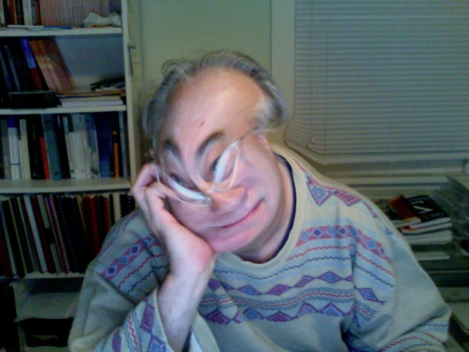
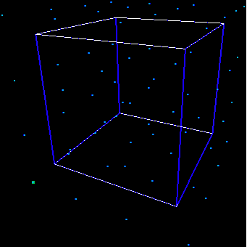
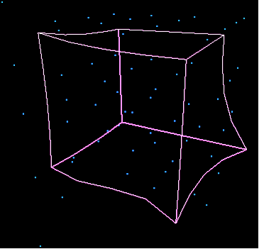
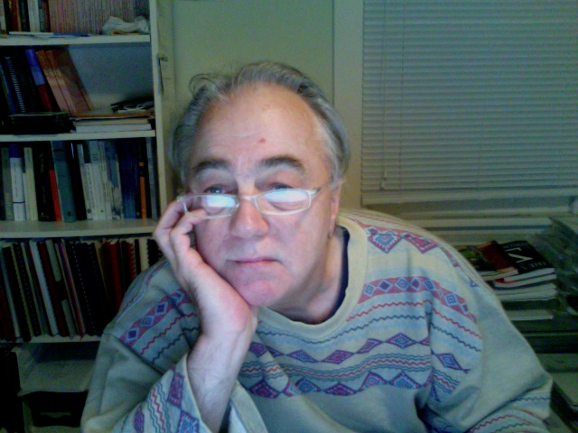
Necessary to look at the map as a whole, since this one is not a product of the three coordinate maps in general!
℘_{EH L} ≠℘_{E} ×℘_{H} × ℘_{L}
symbolic pitch H
physical pitch h
(e,h,l) = ℘_{EH L}(E,H,L)
(E,H,L)
symbolic loudness L
physical loudness l
physical onset time e
symbolic onset time E
Discuss examples!

Slide 26
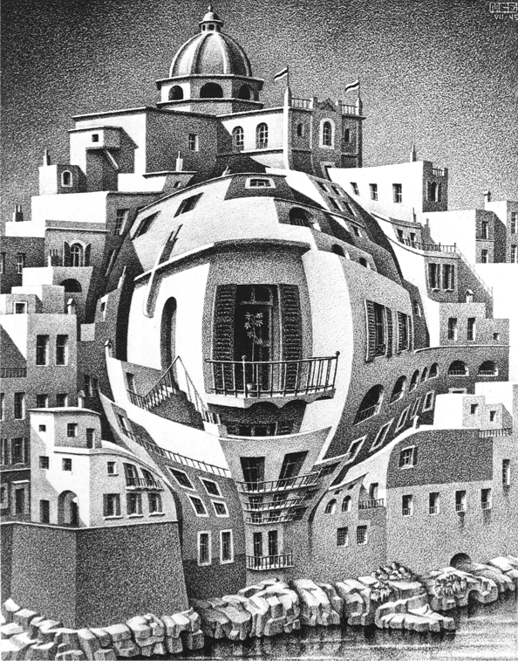
M.C. Escher:
Balcony

Slide 27
Reconsider the one-dimensional case, Tempo
slope(E) = de/dE [sec./♩], T(E) = 1/slope(E) = dE/de [♩/sec.]
[sec.]
T(E).x
T(E) = 1/slope
x
1
look backward!
slope
e = e(E)
linear approximation around E
[♩]
E
1
what about 2-dimensional linearization?

Slide 28
look backward!
℘_{EH}
(∂E/∂h, ∂H/∂h)
(e, h + y)
1
y
(∂E/∂e, ∂H/∂e)
H
h
1
(e + x, h)
x
E
e
vertical tangent arrow
horizontal tangent arrow
Notes:
Local Hierarchies
Consider first the default field generated as a product of a tempo and an intonation field.
Here bothe parameters, onset and pitch play the same role, and their fields are projections of the field on the onset-pitch plane.

Slide 29
Product field of tempo-intonation, special case: ℘_{E} ×℘_{H}
(0, S(H))
(T(E), S(H))
(e, h + y)
1
(1, 1)
y
H
h
1
(e + x, h)
(T(E), 0)
x
E
e
(T(E), S(H)) = (T(E), 0) + (0, S(H))
(1, 1) = (1,0) + (0, 1)
Notes:
Local Hierarchies
Consider first the default field generated as a product of a tempo and an intonation field.
Here bothe parameters, onset and pitch play the same role, and their fields are projections of the field on the onset-pitch plane.

Slide 30
(∂E/∂e + ∂E/∂h, (∂H/∂e + ∂H/∂h)
(∂E/∂h, ∂H/∂h)
(e, h + y)
1
(1, 1)
y
(∂E/∂e, ∂H/∂e)
H
h
1
(e + x, h)
x
E
e
(∂E/∂e, ∂H/∂e) + (∂E/∂h, ∂H/∂h)
(1, 1) = (1,0) + (0, 1)
Notes:
Local Hierarchies
Consider first the default field generated as a product of a tempo and an intonation field.
Here bothe parameters, onset and pitch play the same role, and their fields are projections of the field on the onset-pitch plane.

Slide 31
1
1
H
h
1
1
1
1
E
e
performance field
diagonal field
Notes:
Local Hierarchies
Consider first the default field generated as a product of a tempo and an intonation field.
Here bothe parameters, onset and pitch play the same role, and their fields are projections of the field on the onset-pitch plane.

Slide 32
Performance fields for onset time, pitch, and loudness
℘_{EH L}
H
h
(E,H,L)
(e,h,l) = ℘_{EH L}(E,H,L)
L
l
E
e
performance field
diagonal field

Slide 33
Infinitesimal character:
Theodor W. Adorno („Der getreue Korrepetitor“):
Walter Benjamin hat «das Vermögen der Phantasie» als «die Gabe, im unendlich Kleinen zu interpolieren» definiert. Das beleuchtet blitzhaft die wahre Interpretation. (...)
Im dicht gewobenen Zusammenhang des Notentextes sind die minimalen Hohlräume zu entdecken, in denen sinnverleihende Interpretation ihre Zuflucht findet. (...)
Das Medium künstlerischer Phantasie ist nicht ein Weniger an Genauigkeit, sondern das noch Genauere.
Theodor W. Adorno („Der getreue Korrepetitor“):
Walter Benjamin has defined «the power of phantasy» as being «the gift to interpolate in the infinitely small». This flashes at once the real performance. (...)
In the densely intervowen score texture we may discover minimal cavities, where the significative performance finds its refuge. (...)
The medium of artistic phantasy is not the decrease of precision, but the more precise.
Theodor W. Adorno
Walter Benjamin

Slide 34
Product field of tempo-intonation, special case: ℘_{E} ×℘_{H}
(0, S(H))
(T(E), S(H))
(e, h + y)
1
(1, 1)
y
H
h
1
(e + x, h)
(T(E), 0)
x
E
e
(T(E), S(H)) = (T(E), 0) + (0, S(H))
(1, 1) = (1,0) + (0, 1)
Notes:
Local Hierarchies
Consider first the default field generated as a product of a tempo and an intonation field.
Here bothe parameters, onset and pitch play the same role, and their fields are projections of the field on the onset-pitch plane.

Slide 35
Product field: tempo-intonation
EH
Z(E,H)=(T(E), S(H))
E
H
[1/2-tone/Ct]
H
S(H)
E
[♩ /sec]
T(E)
Notes:
Local Hierarchies
Consider first the default field generated as a product of a tempo and an intonation field.
Here bothe parameters, onset and pitch play the same role, and their fields are projections of the field on the onset-pitch plane.

Slide 36
Look at performance map for onset E and duration D
℘_{ED}(E, D) = (e, d) = (e(E), d(E,D) = e(E+D)-e(E))
OFF - ON in MIDI!
℘_{ED}
d
D
(E,D)
(e, d)
E
E+D
e
℘_{E}
Notes:
Local Hierarchies
Consider first the default field generated as a product of a tempo and an intonation field.
Here bothe parameters, onset and pitch play the same role, and their fields are projections of the field on the onset-pitch plane.

Slide 37
ED
Parallel fields: articulation
Z(E,D) = ∂T(E,D) = (T(E), 2T(E+D)−T(E))
E
pianola
D
glissando
HG
H
(e(E), d(E,D) = e(E+D)-e(E))
crescendo
LC
E
L
basis
T(E)
Notes:
But not all music parameters play the same role in performance. For example, performance of durations is determined by performance of onsets. In the default setup, the performed duration is the difference between the performed onset of the event's end and the performed onset of the event's beginning. This type of dependencies entails hierarchies of parameters, and therefore, hierarchies of performance fields. Rational performance deals with the calculation of such field hierarchies by use of analytical weight functions.

Slide 38
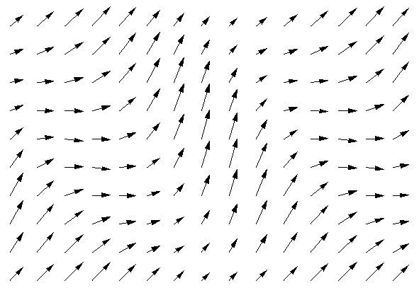
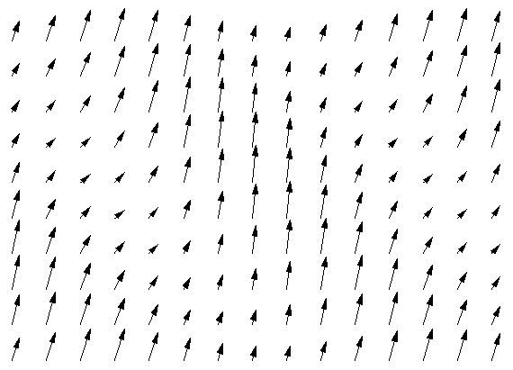
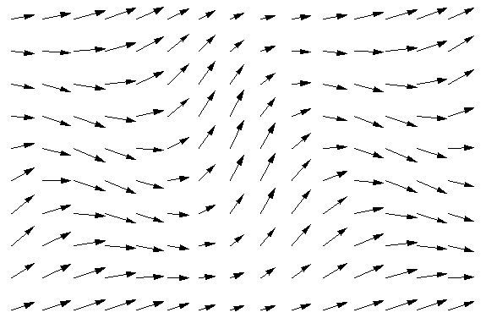
Three different articulation fields
above T(E) = 1 + 0.4 sin(E):
Z_{λ}(E,D) = (T(E), (1+ λ⁻¹)T(E+D)-T(E))
change nominal durations by factor λ
no articulation
molto staccato
molto legato
D
D
D
E
E
E
λ = 1
λ = 0.3
λ = 3
Notes:
Local Hierarchies
Consider first the default field generated as a product of a tempo and an intonation field.
Here bothe parameters, onset and pitch play the same role, and their fields are projections of the field on the onset-pitch plane.

Slide 39
Performance fields are gestures!
morphism of gestures!
H
h
L
l
performance field
E
diagonal field
e
skeleton of an integral curve!

Slide 40
Performance fields are gestures!
A performance of n notes:
∐_{n}→_{i} Symbolic Space
↓
Physical Space
→_{i} =
∐_{n}→_{i} =

Slide 41
Performance fields are gestures!
Performance hypergestures:
These are continuous deformations of performance gestures, i.e., connections between different performances
of a given piece.
In other words:
Performance (hyper)gestures are a very natural setup of performance analysis or synthesis!

Slide 42
Performance hypergestures
for a fixed composition
∐_{n}→_{i} Symbolic Space
∐_{n}c_{i} const.
c_{i} =

Slide 43
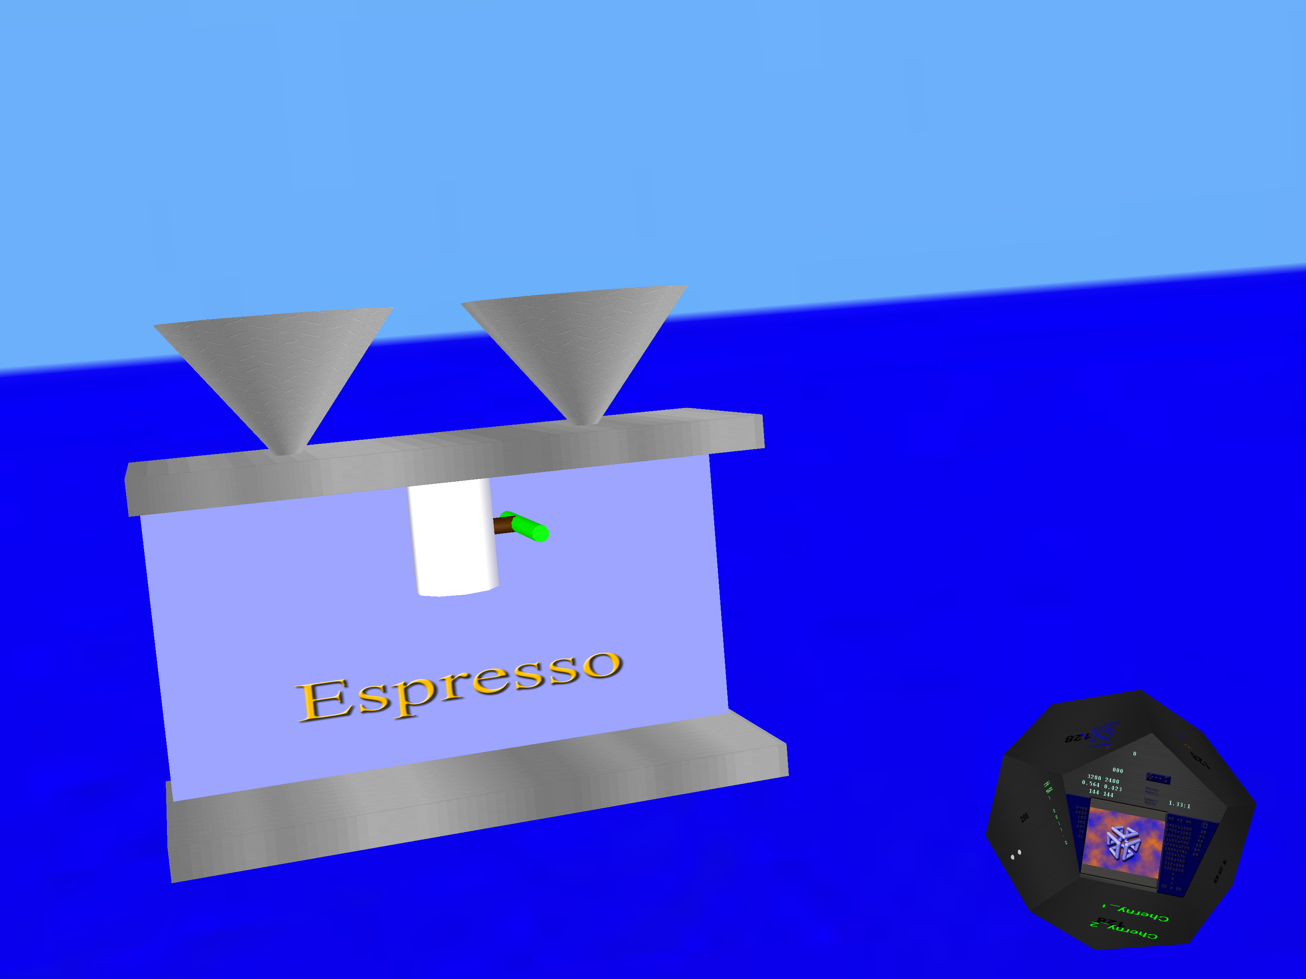
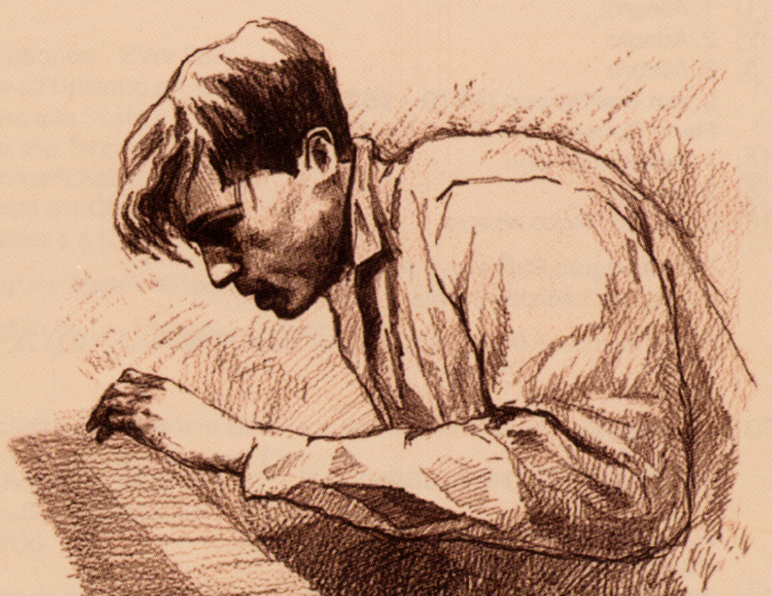
Stefan Göller, Stefan Müller

Slide 44
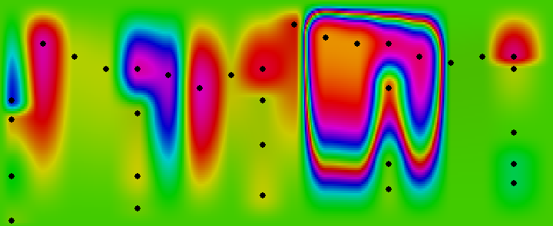

Slide 45
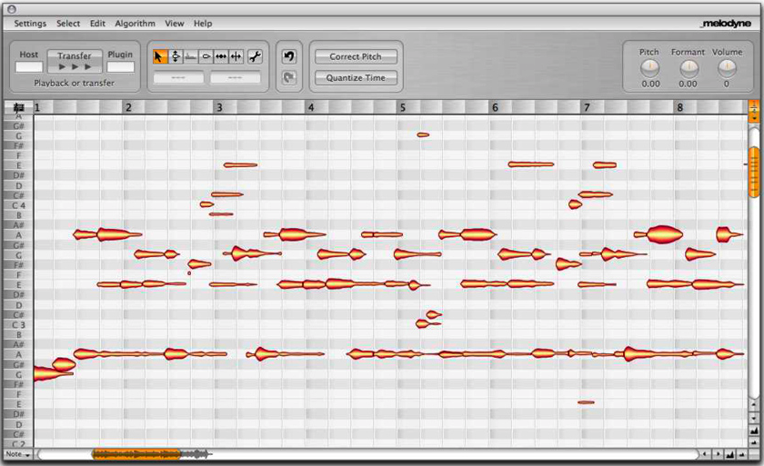
audio file
Melodyne editor
MIDI file

