Slide 1
III Gesture Theory in Composition
(Fr Feb 09)

Slide 2
III.1 A Gestural Model of Tonal Modulation

Slide 3
A
A
A*
A*
B
B
B*
B*
C
C
C*
C*

Slide 4
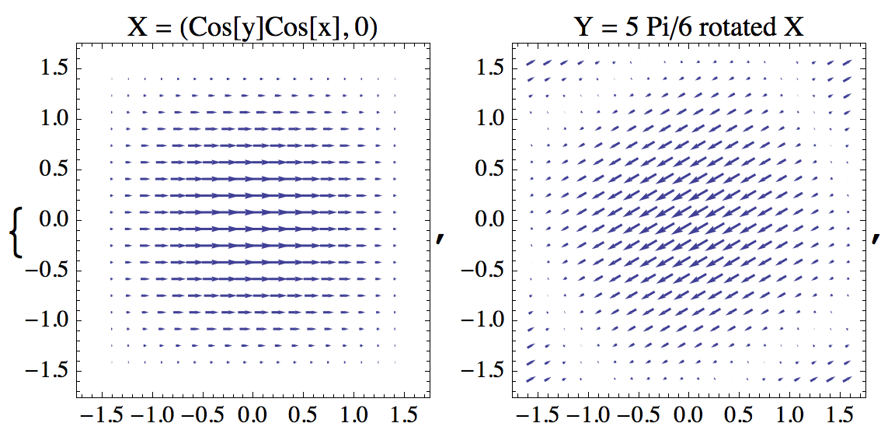
U_{g}
U_{d}

Slide 5
[X,Y]-integral curves (Lie bracket)
symmetry of C major
symmetry of F major

Slide 6
[X,Y]-integral curves (Lie bracket)

Slide 7
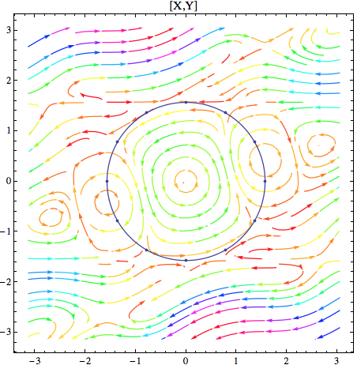
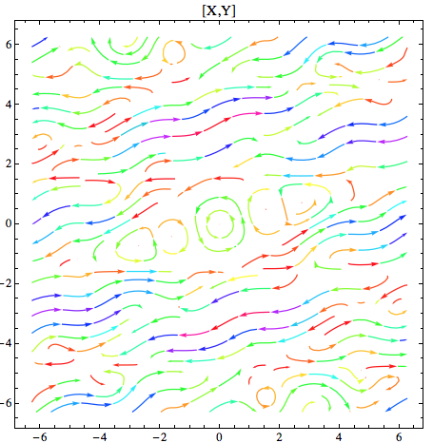
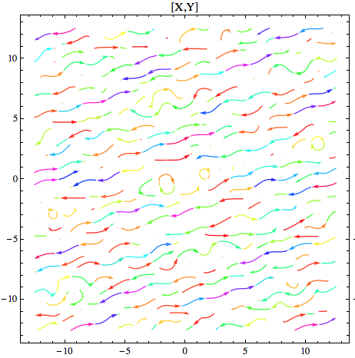
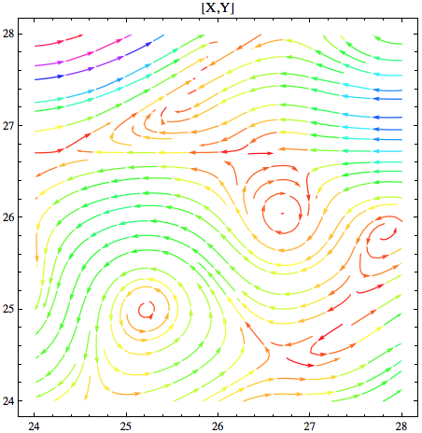
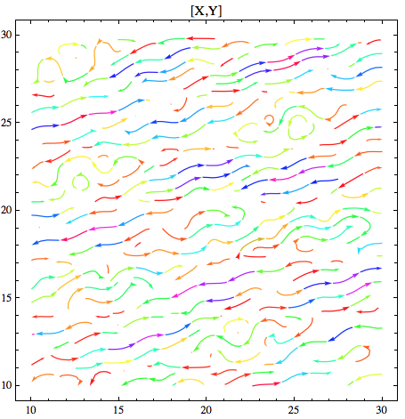
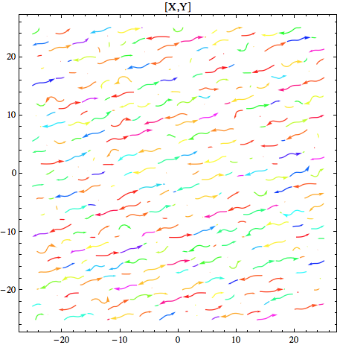

Slide 8
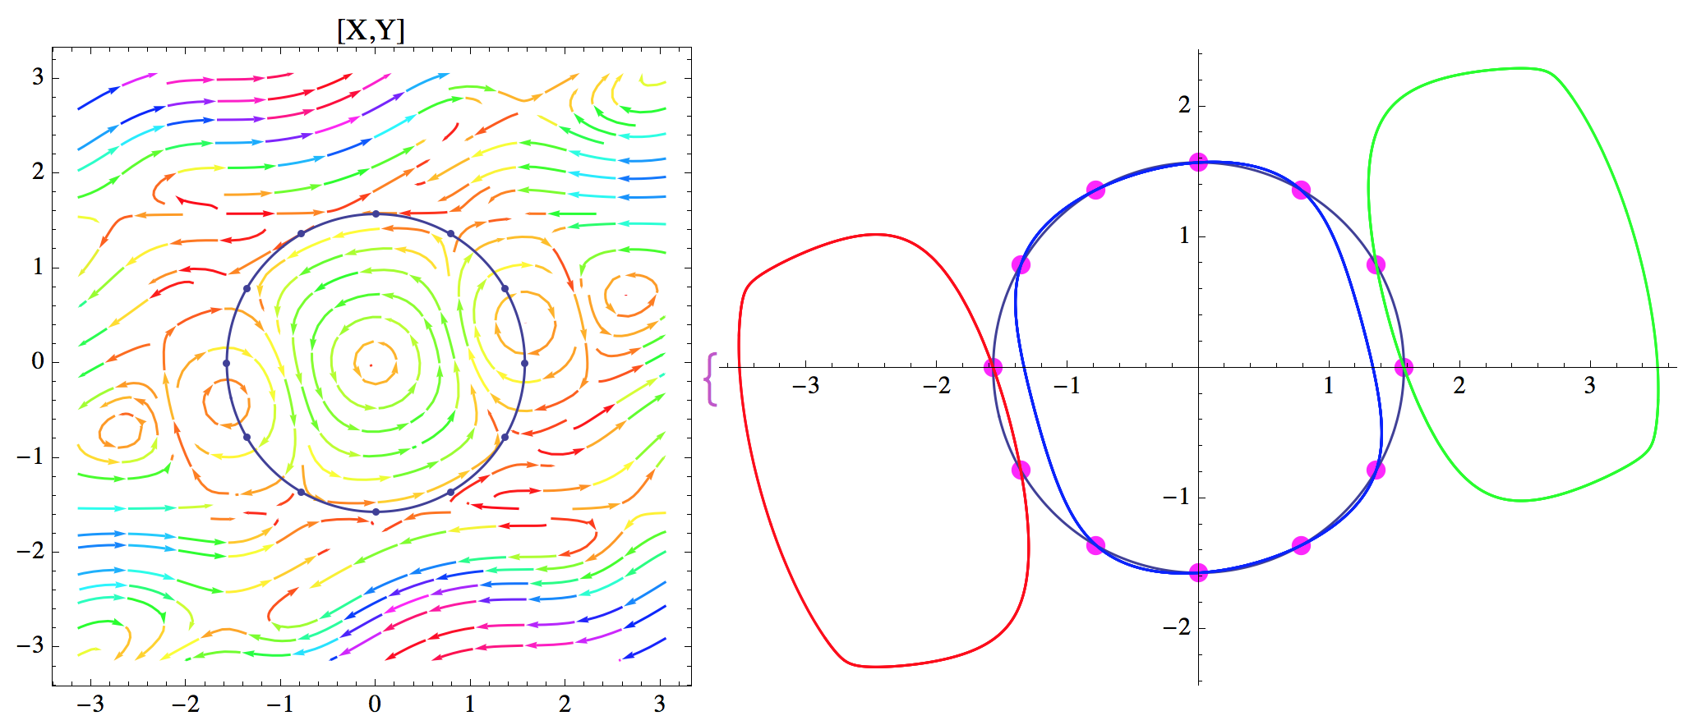
c♯
d
d♯
c
e
f
b
a♯
f♯
U_{e/f}
g
a
g♯

Slide 9
The twelve pitch class points are contained in three closed integral curves: C_{b} through {b, a#}, C_{c} through {c, c#, d, d#, f#, g, g#, a}, and C_{e} through {e, f}.
The curves C_{b}, C_{c}, C_{e} are symmetrical with respect to the modulator symmetry U_{e/f} that maps C to F in the sense that every pitch class p in its integral curve C_{b}, C_{c} or C_{e} is mapped to U_{e/f} (p) that is contained in the same integral curve.
If R is the 180⁰-rotation in —², we have [X_{C}^{R}, X_{F}^{R}] = [X_{C}, X_{F}]^{R} = [X_{C}, X_{F}].
If R = U_{e/f} then X_{F} = X_{C}^{R}, and we have –[X_{C}, X_{F}]^{R} = [X_{C}, X_{F}]. The latter is also true if R is the reflection orthogonal to U_{e/f} . These formulas mean intuitively that the two reflection axes transform the Lie bracket field into its negative.

Slide 10
Hypergestures that are Parallel to a Vector Field
c♯
d
d♯
c
e
f
b
h_{x,y}(λ)
a♯
f♯
a
g
g♯

Slide 11
[X,Y]-integral curves are “branes” of modulation theory
VII_{C}
VII_{F}

Slide 12
Hypergesture between VII_{C} and VII_{F} gestures
Cadence sets:
{II, III}
{II, V} (Jazz)
{III, IV}
{IV, V} (classical)
{VII}
VII_{C}
VII_{F}
look at union
of degrees
in a cadence set!
Theorem:
For every triadic degree Z_{C} in C, there is a nonsingular hypergesture Z_{C} ☞ U_{e/f}(Z_{C}).
But only for the cadence set {VII_{F}} such a nonsingular hypergesture exists. This yields the modulation quantum with II_{F}, IV_{F}, VII_{F}.

Slide 13
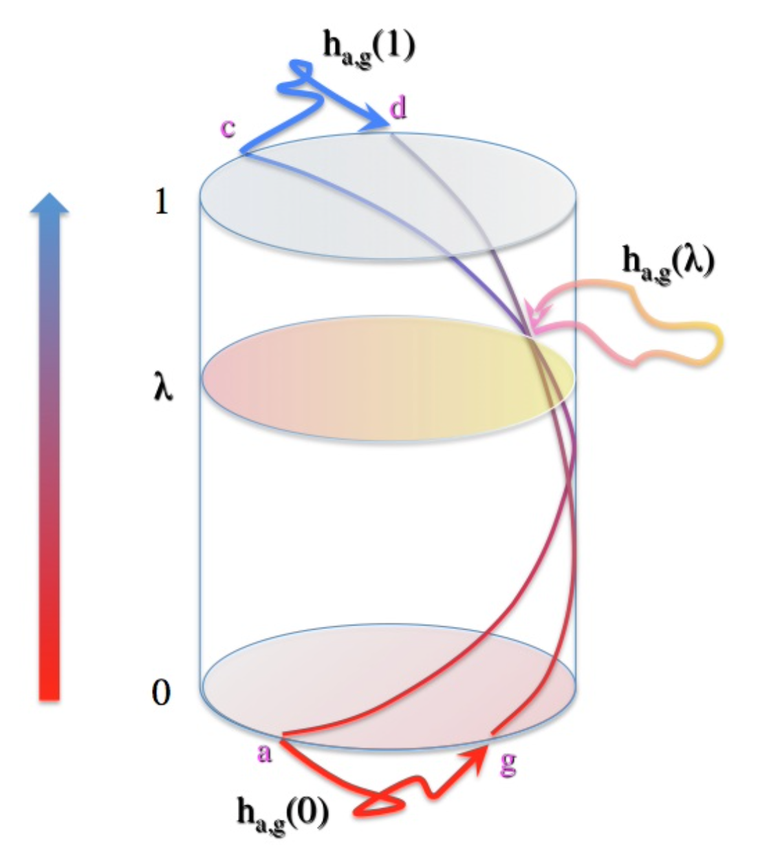
singular points

Slide 14
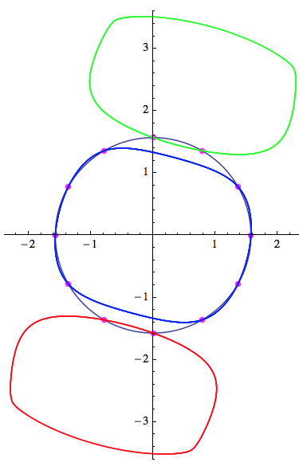
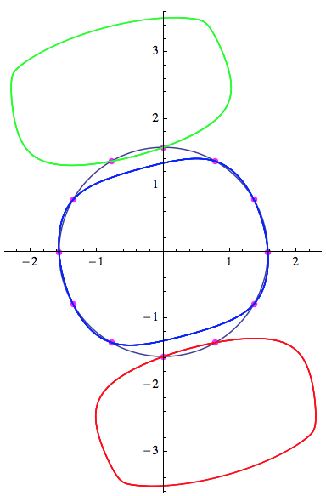
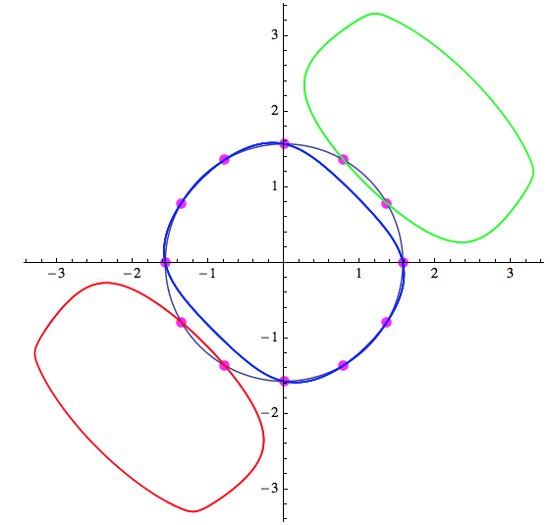
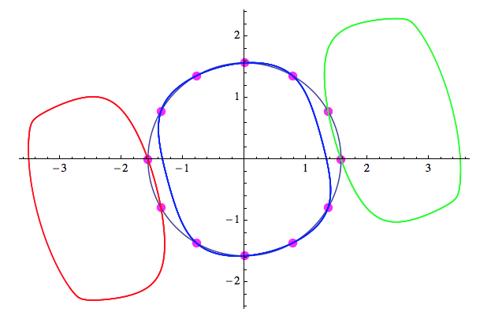
Idea: Seek a sequence of nonsingular hypergestures
in fourth relations
C
F
F
B♭
B♭
E♭
E♭
A♭

Slide 15
movement from e to d via two stages
C
F
F
B♭
d
e
f
f

Slide 16
c
f♯
hypergesture V_{C} ☞ II_{E♭}
d
g
c
d
c
c
b
f
f
f♯
a♯
a♯
f♯
g
a
a
g♯
g → c
b → a♯
d → f♯
c → c
a♯ → a
f♯ → f
c → c
a → g♯
f → f
h_{C}
h_{F}
h_{B♭}

Slide 17
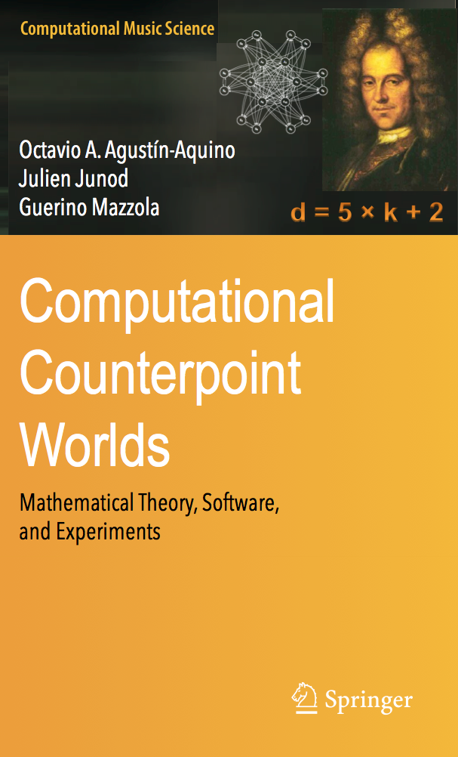
Theorem:
With the above procedure, when applied to all fourth and fifth circle modulations for up to four circles, the resulting modulation steps coincide with the steps calculated in the classical model (coinciding with Schoenberg’s steps).
Remark:
The counterpoint theory that has been developed in collaboration with Julien Junod and Octavio Agustín-Aquino also enables a hypergestural interpretation of some core methods. Published in our counterpoint book

Slide 18
III.2 Singular Homology of Gestures for Species Counterpoint
We cannot go into this theory, it is mathematically too advanced. But we may recall the condition in counterpoint theory, namely that the set T(ξ) of possible target consonances when starting from a fixed consonance
ξ in counterpoint theory should be maximal possible.
But this set may infinite if we work in a context of an infinity of consonant and dissonant intervals.
But singular gesture homology allows us to consider maximal dimensions of vector spaces of intervals instead of set cardinality, even for infinite interval sets. This solves our problem!

Slide 19
III.4 Gestural collaboration across civilizations

Slide 20
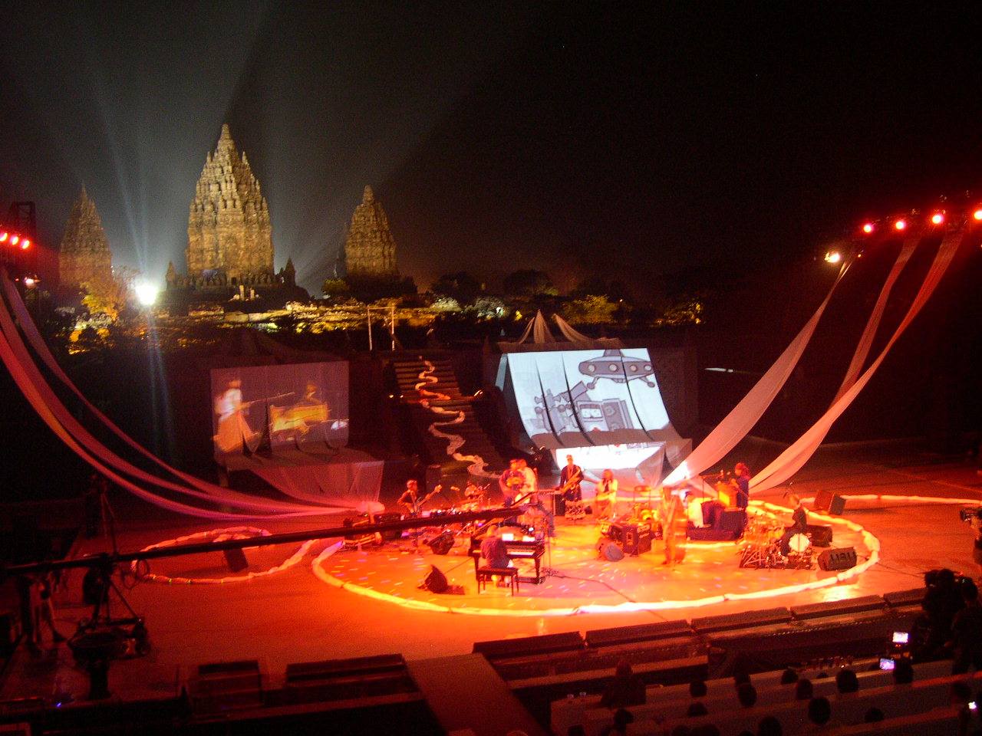
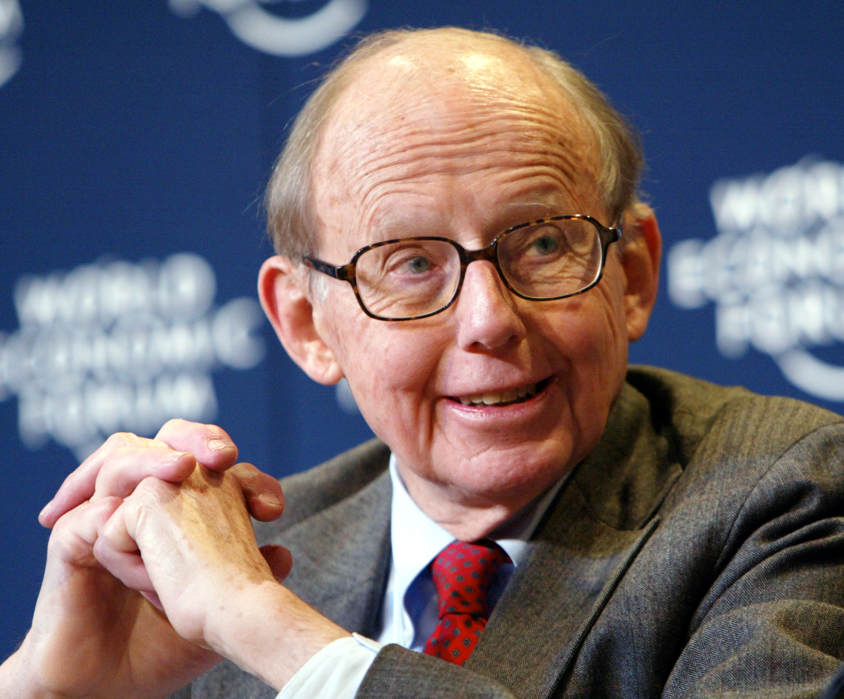
Teak Leaves at the Temples
Clash of Civilizations (Samuel P. Hungtingon 1996)

