Slide 1
III. 0 A Classical Model of Tonal Modulation
Wed Feb.07

Slide 2
Schoenberg (Harmonielehre 1911):
There is, for example, a very popular harmony treatise, in which modulations are nearly exclusively made using the dominant seventh or diminished seventh chord. And the author only demonstrates that after each major or minor trriad any of those two chords can be played, and thereby go to any tonality. If I wanted that, I could have finished even earlier. In fact I am capable to show (using „gauged“ examples from literature) that you may use any triad after any other triad. So if that reaches every tonality and thereby modulation has been realized, the procedure would even be simpler. But if somebody, to tell a story, makes a journey, he would not choose the air line. The shortest path is the worst. The bird‘s perspective is the perspective of a bird‘s brain. If everything is blurred, everything is possible. Differences disappear. And it is then irrelevant if I have made a modulation with a dominant or diminished seventh chord. The essential of a modulation is not the target, but the trajectory.

Slide 3
Arnold Schönberg: Harmonielehre (1911)
old tonality
neutral/pivot
degrees
(I_{C}, VI_{C})
fundamental
degrees
(II_{F}, IV_{F}, VII_{F})
new tonality
cadence
degrees
(II_{F} & V_{F})
What is the set of tonalities?
What is a degree?
What is a cadence?
Which is the modulation mechanism?
How do these structures determine the fundamental degrees?

Slide 4
pitch class space Ÿ₁₂
for 12-tempered tuning
11
0
1
10
2
C
scale = part of Ÿ₁₂
9
3
8
4
7
5
6
twelve diatonic scales: C, F, B♭ , E♭ , A♭ , D♭ , G♭ , B, E, A, D, G

Slide 5
I
II
III
IV
V
VI
VII

Slide 6
Harmonic band of major scale C⁽³⁾
II
VI
V
IV
I
VII
III

Slide 7
C⁽³⁾
G⁽³⁾
F⁽³⁾
B♭⁽³⁾
D⁽³⁾
Dia⁽³⁾
triadic interpretations
E ♭⁽³⁾
A⁽³⁾
A♭⁽³⁾
E⁽³⁾
D♭⁽³⁾
B⁽³⁾
G♭⁽³⁾

Slide 8
f
S⁽³⁾
b
k₁(S⁽³⁾) = {II_{S}, V_{S}}
k₂(S⁽³⁾) = {II_{S}, III_{S}}
k₃(S⁽³⁾) = {III_{S}, IV_{S}}
k₄(S⁽³⁾) = {IV_{S}, V_{S}}
k₅(S⁽³⁾) = {VII_{S}}
k
k(S⁽³⁾)
space of cadence parameters

Slide 9
gluon
W⁺
γ
graviton
strong force
weak force
electromagnetic force
gravitation
quantum = set of
pitch classes = M
S⁽³⁾
T⁽³⁾
force = symmetry between
S⁽³⁾ and T⁽³⁾
k
k

Slide 10
A
e^{t}
e^{t}.A
S⁽³⁾
T⁽³⁾
e^{t}
k
k
modulation S⁽³⁾ → T⁽³⁾ = „cadence + symmetry “

Slide 11
Given a modulation k, g:S⁽³⁾ → Τ⁽³⁾
a quantum for the modulation (k,g) is a set M of pitch classes such that:
the symmetry g is a symmery of M, g(M) = M
the degrees in k(Τ⁽³⁾) are contained in M
M ∩ T is rigid, i.e., has no non-trivial symmetries
M is minimal with the first two conditions
M
S⁽³⁾
T⁽³⁾
g
k
k

Slide 12
Modulation theorem for 12-tempered tuning
For two different tonalities S⁽³⁾, Τ⁽³⁾ there exist
a modulation (k,g) and
a quantum M for (k,g)
(= quantized modulation)
Moreover:
M is the union of the degrees in S⁽³⁾, Τ⁽³⁾ contained in M which thereby define the triadic interpretation M⁽³⁾ of M
the common degrees of Τ⁽³⁾ and M⁽³⁾ are called the modulation degrees of (k,g)
the modulation (k,g) is uniquely determined by the modulation degrees.

Slide 13
IV_{C}
II_{E♭}
VII_{E♭}
M⁽³⁾
II_{C}
V_{E♭}
VII_{C}
V_{C}
III_{E♭}
E♭ ⁽³⁾
C⁽³⁾

Slide 14
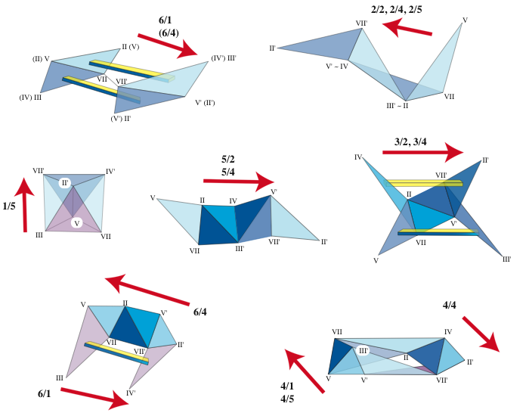
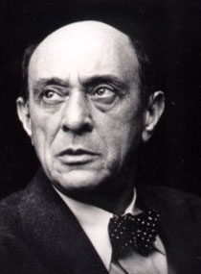
# fourths
Arnold Schoenberg
(1874-1951)

Slide 16
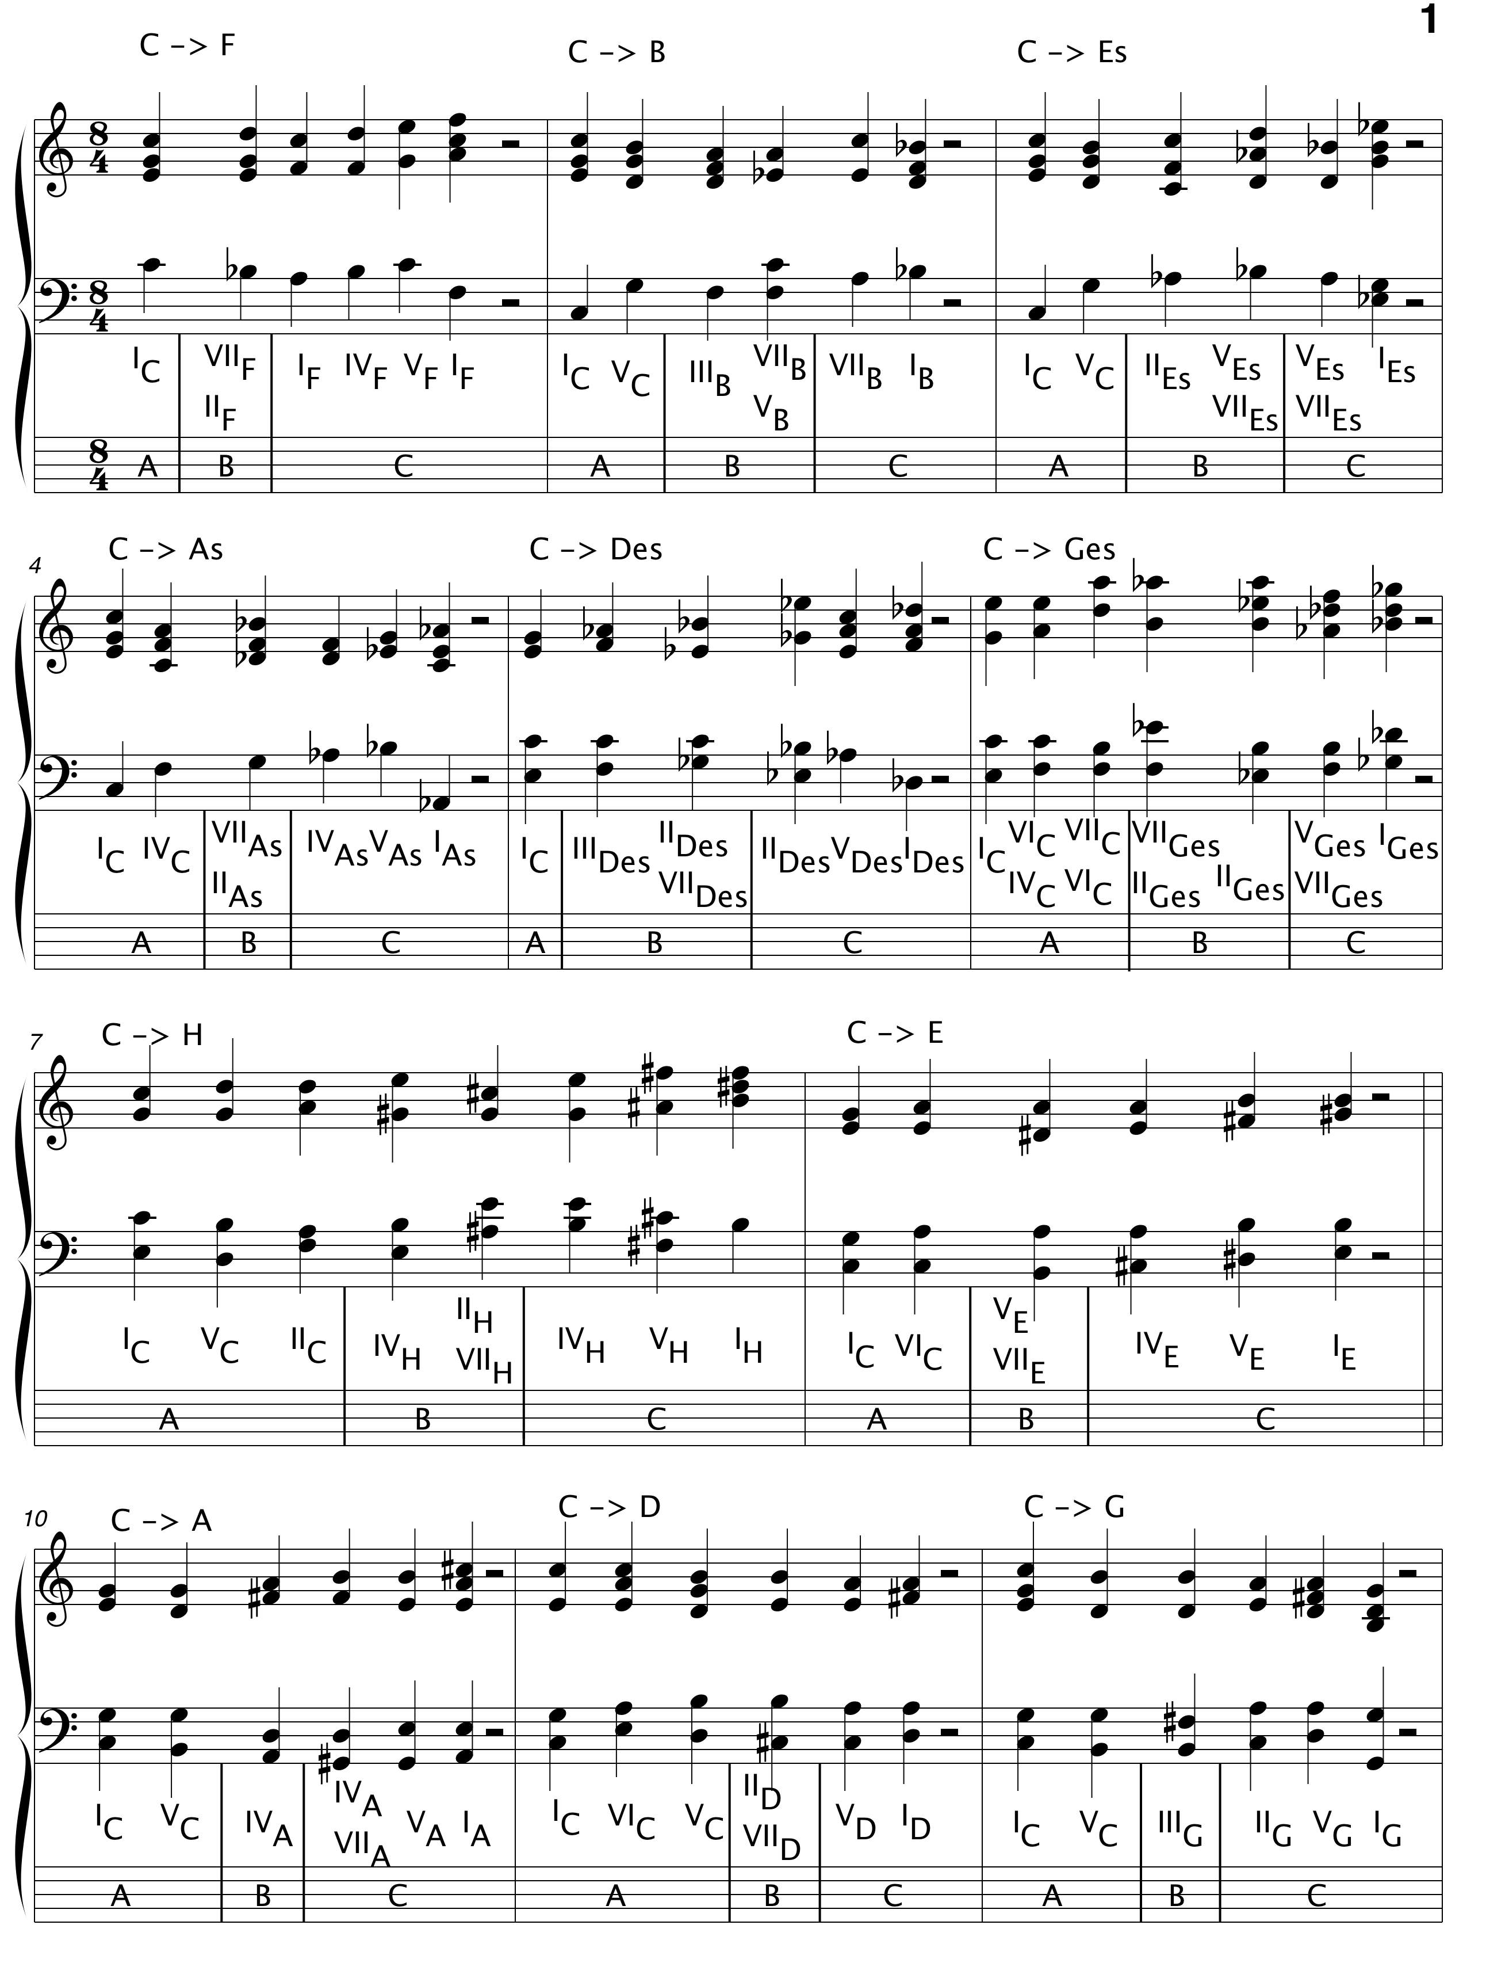

Slide 17
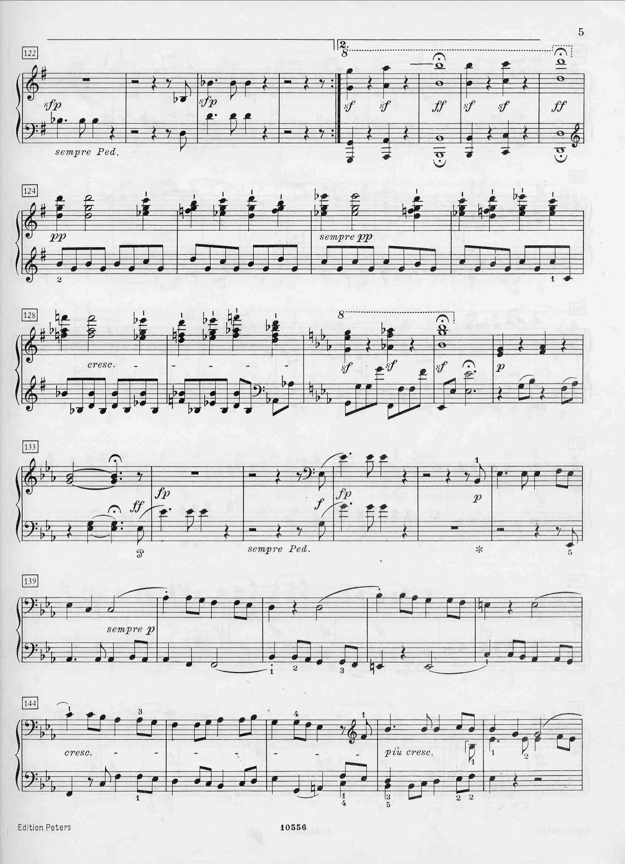
G
?
VII_{E♭}
E♭
V_{E♭}
4:50

Slide 18
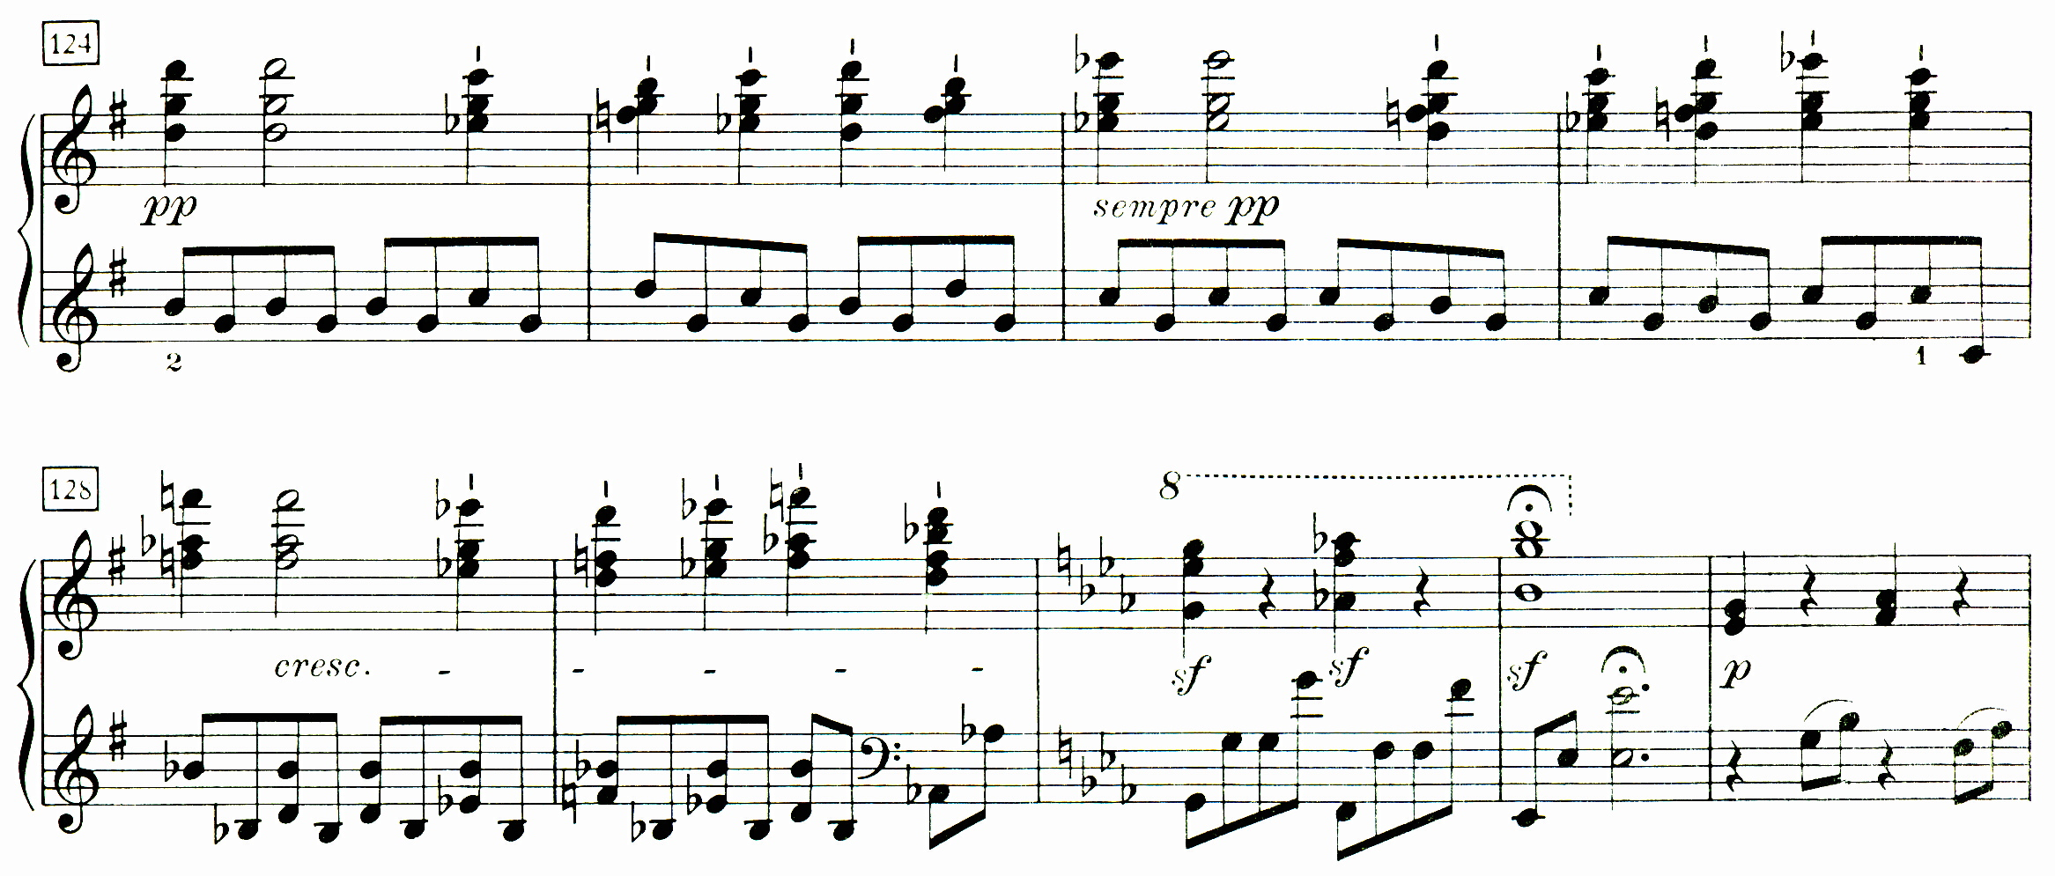
Inversion_{d♭} : G⁽³⁾ → E♭⁽³⁾
#124 - 125
#126 - 127
g
d♭
g

Slide 19
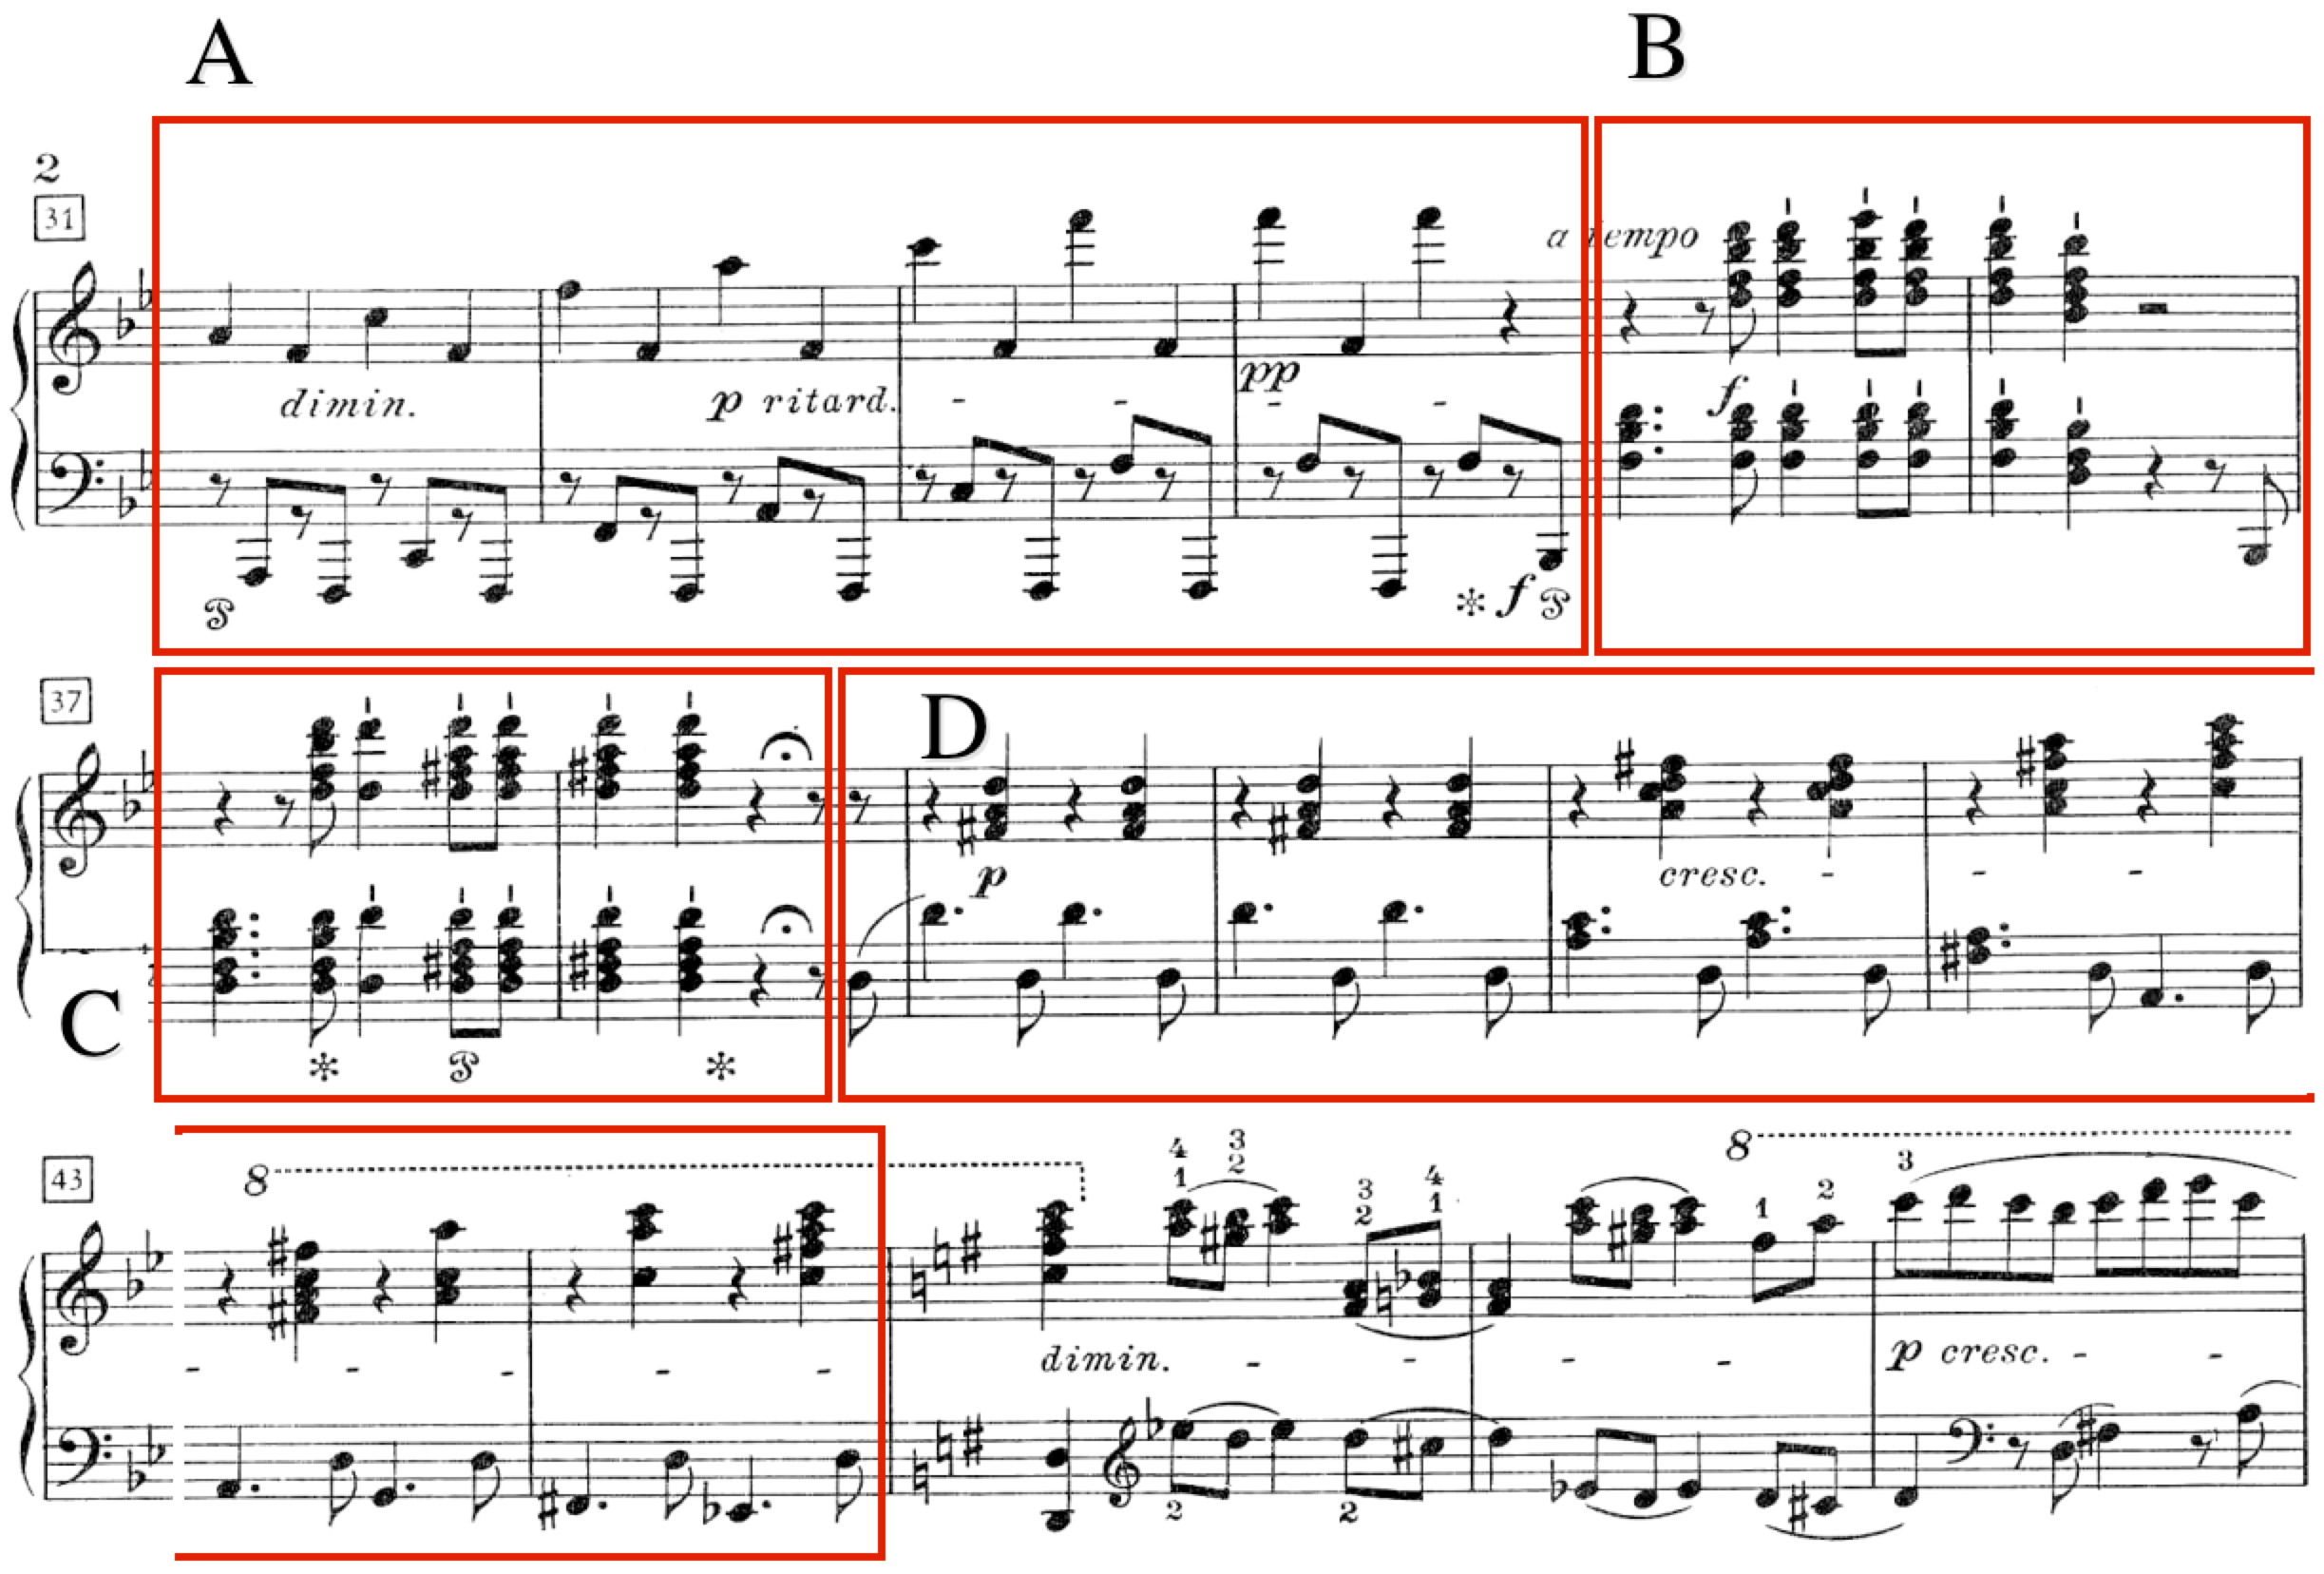
Example: „Hammerklavier“ Sonata, Allegro
modulation B♭ -> G, p. 2, (Topos 62.4.2)
0:38

Slide 20
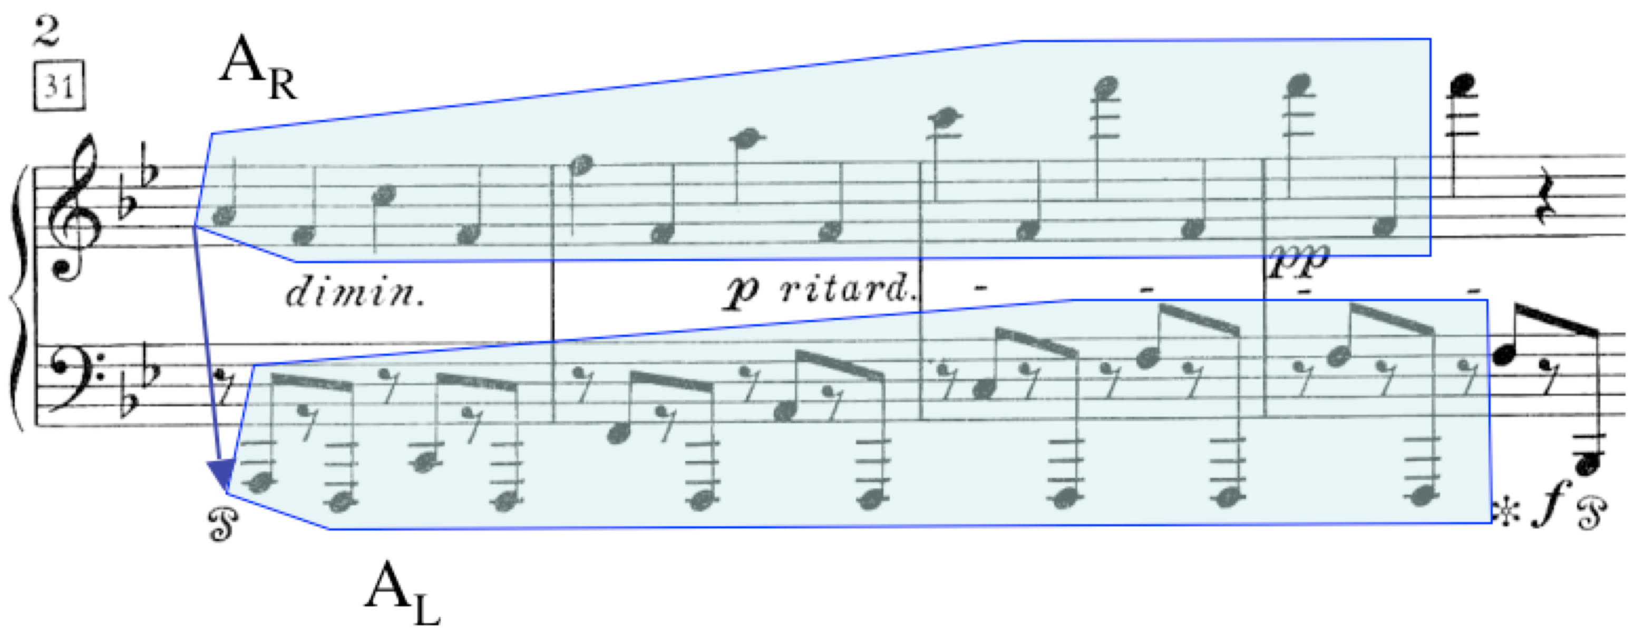
Example: „Hammerklavier“ Sonata, Allegro
part A: hypergesture

Slide 21
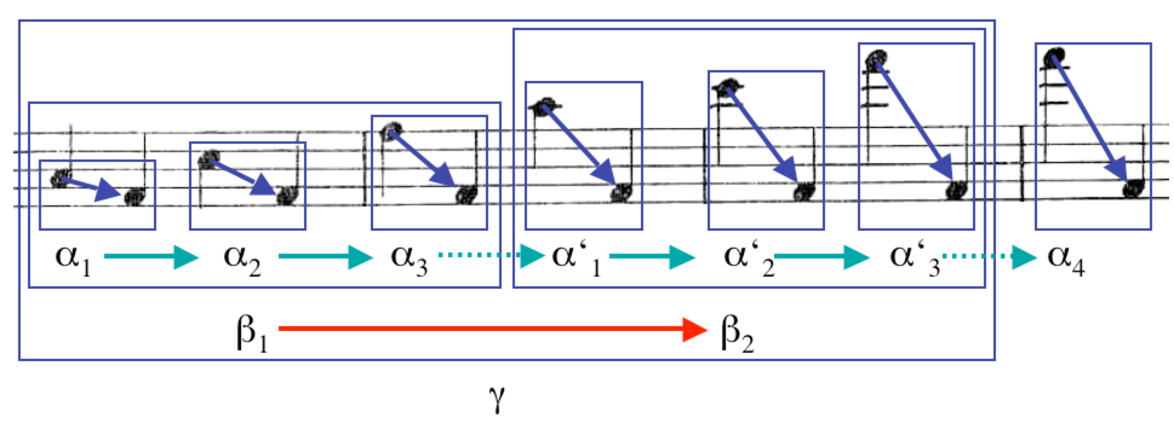
Example: „Hammerklavier“ Sonata, Allegro
part A: hypergesture

Slide 22
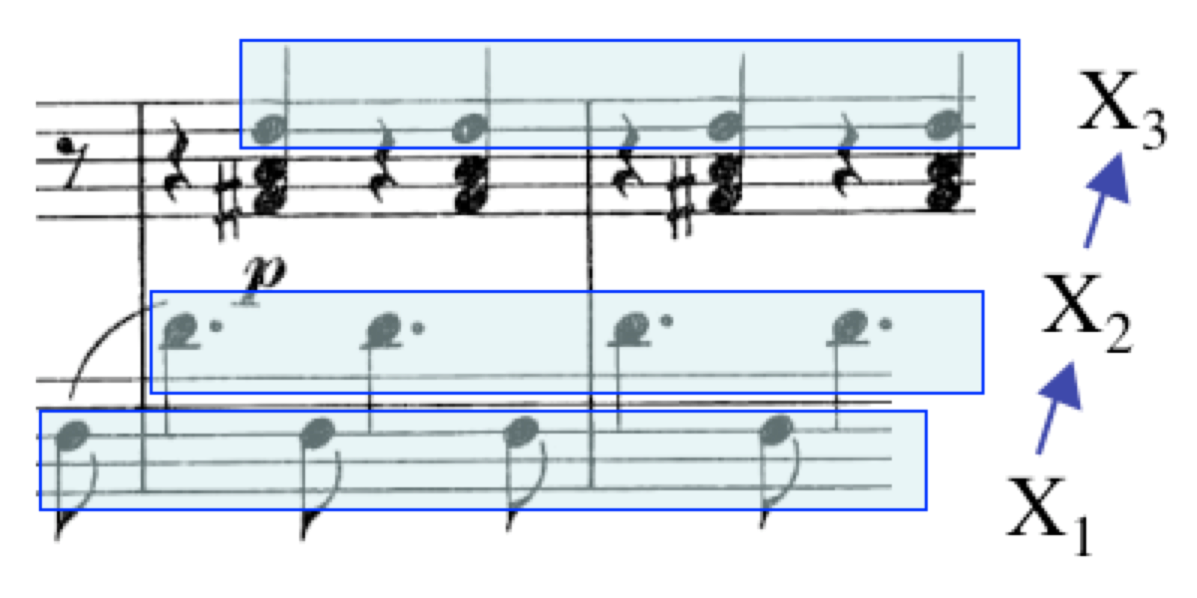
Example: „Hammerklavier“ Sonata, Allegro
part D: beginning of modulation hypergesture

Slide 23
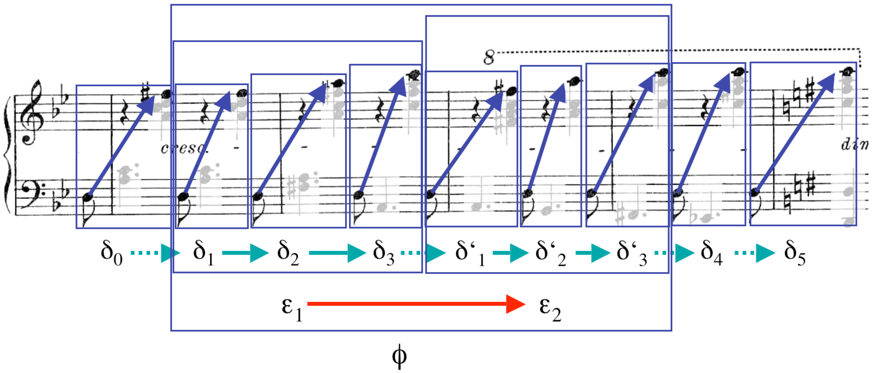
Example: „Hammerklavier“ Sonata, Allegro
part D: modulated hypergesture

Slide 24
C-minor melodic
a
g
f
d
e-flat
c
b-flat
replaces tone of a higher octave
instead of tone of double duration
fundamental
Gruppen und Kategorien
in der Musik, p.107

Slide 25
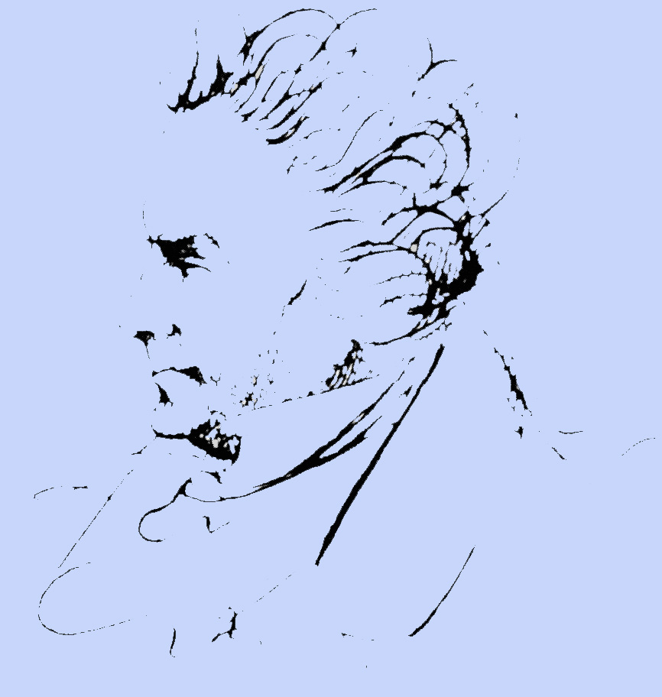
Thesis: The modulation structure of op. 106 is governed by the symmetries of the diminished seventh chord C# ⁻⁷ = {c#, e, g, b♭} carrying the admitted modulation forces.
C⁽³⁾
G⁽³⁾
F⁽³⁾
Exposition
B♭ ⁽³⁾
D^{(3) ~} b⁽³⁾
Development
E♭ ⁽³⁾
Recapitulation
A⁽³⁾
Coda
A♭ ⁽³⁾
E⁽³⁾
D♭ ⁽³⁾
B⁽³⁾
G♭ ⁽³⁾

