Slide 1
I General Introduction
I.4 Gestures in Music and Performance Theories
(Adorno, Wieland/Uhde, Sessions, Hatten, Lewin, Klumpenhouwer, Ungvary, Taylor)
(Fr Jan 26)

Slide 2
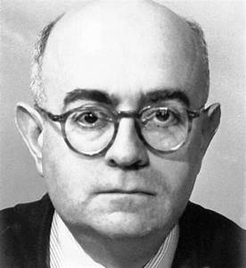
Theodor Wiesengrund Adorno, philosopher, music theorist (1903-1969)
In his book “Zu einer Theorie der musikalischen Reproduktion”, he unfolds a very critical perspective upon the character and impact of musical notation. This is interesting as it stresses the distructive relationship of this method to musical time.

Slide 3
He says that notation wants “music to be forgotten”, while fixing it in an objectification of the gesture. This action produces a deadly eternalization of music. Notation spatializes music and wants to create a total control, but fails as the time of music is irrevocably lost: All making music is a recherche du temps perdu, that famous title of Marcel Proust’s epochal novel.

Slide 4
For Adorno, notation is an expression of a christianization of music: It beams it to eternity, it kills music as a natural phenomenon and embalms it as a spiritual entity, similar to a Platonic idea, which is an atemporal entity (Plato‘s ideas). This form of survival of music presupposes killing its here and now, and detaches music from its mimetic representation.
Mimesis for Adorno is the expression of expression, the gestural representation of expressive categories.

Slide 5
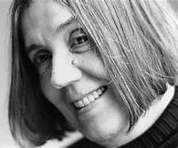
Renate Wieland (1935-2017) and Jürgen Uhde (1913-1991) Performance theorists
Die Klangberührung ist das Ziel der zusammenfassenden Geste, der Anschlag ist sozusagen die Geste in der Geste.
(The touch of sound is the target of the embracing gesture, the keystroke is so to speak the gesture within the gesture. )

Slide 6
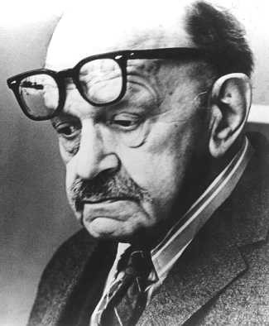
Roger Sessions, performance theorist (1896-1985)
Sessions in his book “Questions About Time” stresses that awareness of movement in performance is essentially “awareness of time as a process”. He claims that we experience music, and especially its time, as a gestural movement. The performer therefore is an essential contributor to the musical reality. Each performance is a renewed realization of this full existence of music. In particular, there is no “definitive” performance, it is a semiotic shifter: every performance is a new realization.

Slide 7
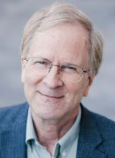
Robert Hatten, performance theorist (?)
Musical gesture is biologically and culturally grounded in communicative human movement. Gesture draws upon the close interaction (and intermodality) of a range of human perceptual and motor systems to synthesize the energetic shaping of motion through time into significant events with unique expressive force. The biological and cultural motivations of musical gesture are further negotiated within the conventions of a musical style, whose elements include both the discrete (pitch, rhythm, meter) and the analog (dynamics, articulation, temporal pacing). Musical gestures are emergent gestalts that convey affective motion, emotion, and agency by fusing otherwise separate elements into continuities of shape and force.

Slide 8
Given the importance of gesture to interpretation, why do we not have a comprehensive theory of gesture in music?

Slide 9
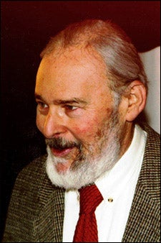
David Lewin, music theorist (1933-2003)
The dichotomy between performance practice, where embodiment and gesturality are well-known perspectives, and theoretical understanding appears condensed in David Lewin’s celebrated book on musical transformation theory, where he asks: “If I am at s and wish to get to t, what characteristic gesture should I perform in order to arrive there?” He thinks about a dancer, about the embodied musical subject, and the metaphor is quite strong.

Slide 10
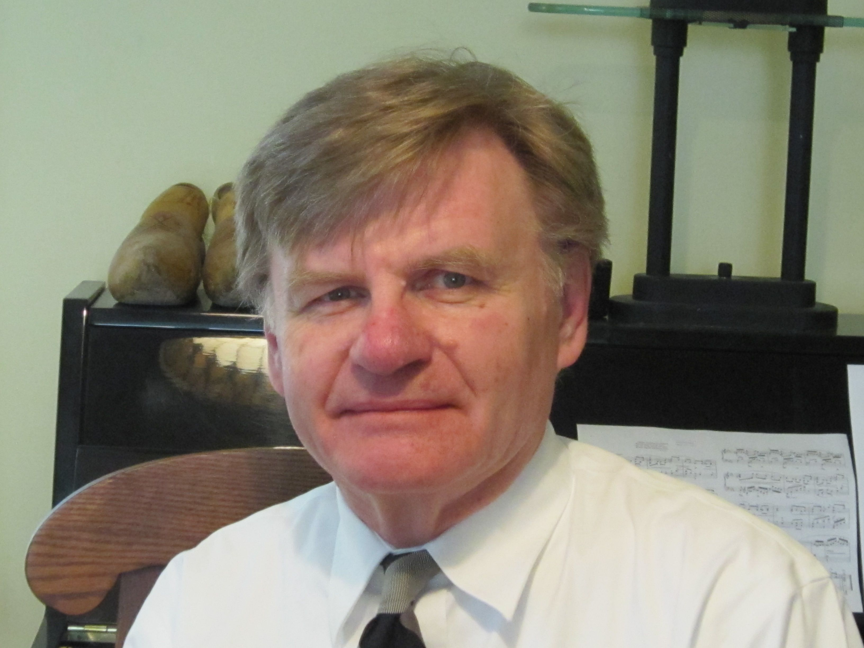
Henry Klumpenhouwer, music theorist (?)
Lewin’s theory uses classical transformations and then, in Klumpenhouwer’s networks, diagrams of transformations.
So the diagrams play the role of industrial plants, producing facts (factum, what is made), namely Klumpenhouwer’s K-nets. So the Lewinian digression from Cartesian facticity (or extensionality) is the step to processes, but not to gestures.

Slide 11
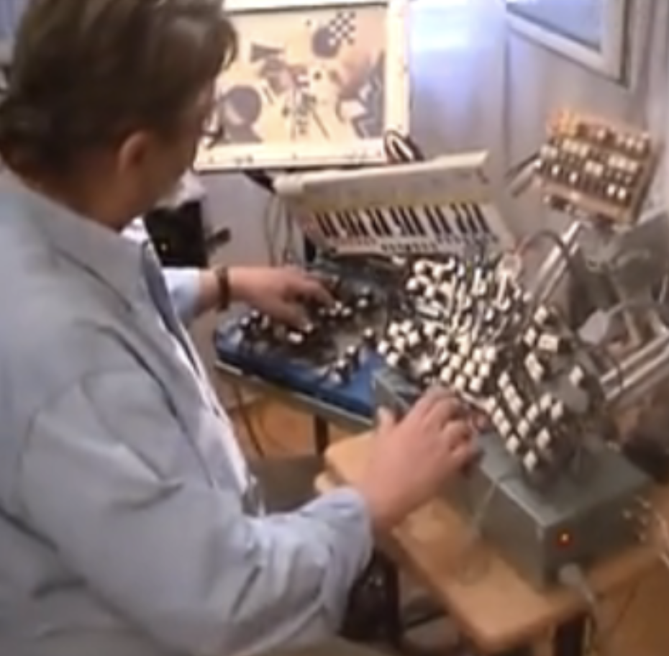
Tamas Ungvary, Hungarian composer (1930-2019)
Ungvary has constructed a sentograph that can be used by improvising composers in order to play/create music by gestural input. Ungvary replaces the usual encoding of sound events in discrete points in a parameter space by an intrinsically gestural input that is given by variable pressure and angle on a joystick.

Slide 12
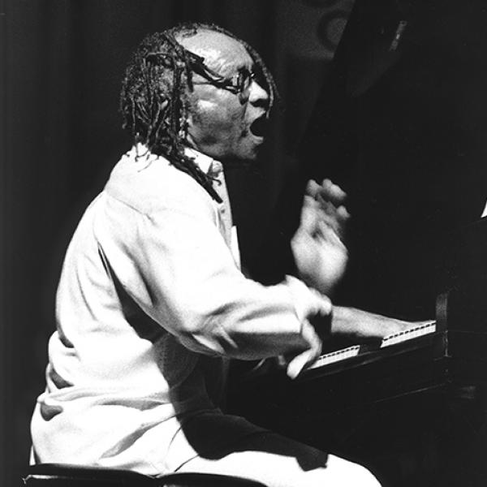
Cecil Taylor, pianist (1929-2018)
Taylor, the monstre sacré of improvised piano music, states that:
I try to imitate on the piano the leaps in space a dancer makes.
Taylor quite radically opposes to a representative type of Western music culture:
David Tudor is supposed to be the great pianist of the modern Western music because he’s so detached. You’re damned right he’s detached. He’s so detached he ain’t even there.

